Slide 1



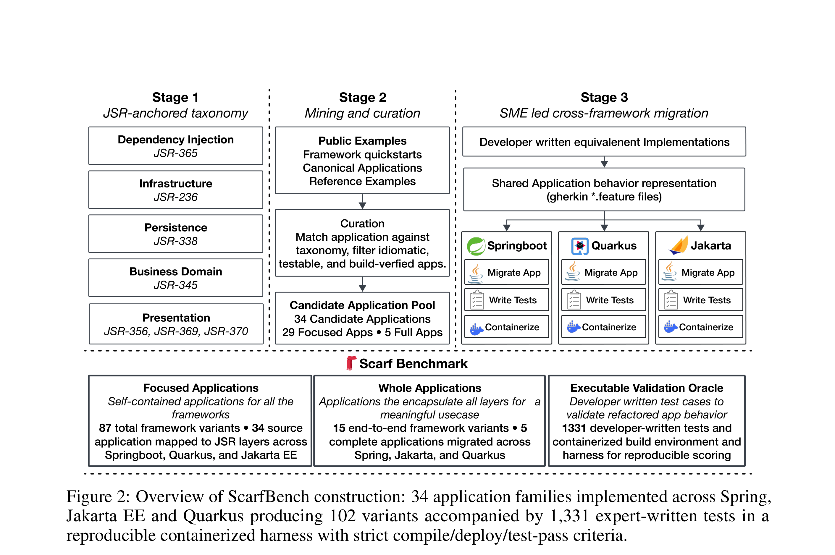
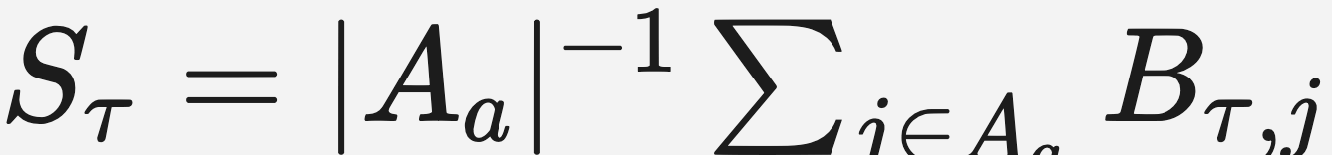


SCARFBench: A Benchmark for Cross-Framework Application
Migration in Enterprise Java
2026
Advait Pavuluri¹, Bridget McGinn², Ashita Saxena², George Safta², Srikanth Tamilselvam², Raju Pavuluri², Michele Merler², Baishakhi Ray³, Rahul
Krishna²
¹Rensselaer Polytechnic Institute ²IBM Software Innovation Labs ³Columbia University
Problem
Method
3
Task scale & layers
five JSR-anchored layers
Key Results
Enterprise Java applications are
long-lived, and migrating them across
frameworks (Spring, Jakarta EE,
Quarkus) is behavior-preserving
refactoring that spans build
configuration, dependency injection,
persistence, request handling, and
deployment — coordinated multi-file
rewiring, not a local API swap.
29 focused single-layer apps span
dependency injection, persistence,
presentation, infrastructure, and business-
domain logic; 5 whole multi-layer apps
combine them. Median task = 11 files, 370
changed lines (up to >200 files, >14K lines).
SETTING
TEST
PASS
Strongest agent · focused-
layer
15.3%
Strongest agent · whole-
app
12.2%
Only 1 of 204 tasks fully
behaviorally equivalent ·
Jakarta EE hardest (2% pass)
Overview of ScarfBench construction:
34 application families across Spring,
Jakarta EE and Quarkus produce 102
variants and 1,331 expert-written tests
in a containerized compile/deploy/test harness.
4
Agents evaluated
five frontier coding agents
Existing benchmarks cover bug
fixing and version upgrades —
cross-framework application
refactoring is left largely
unmeasured.
SO WHAT → Cross-framework migration is beyond current agents: the strongest reaches 15.3% aggregate test pass on focused migrations and 12.2% whole-app, with only one task yielding a fully behaviorally equivalent target.
5
Headline Numbers
1
Benchmark construction
expert-built variants
frontier coding agents, each run once at
temperature 0
Motivation
1/204
tasks fully
behaviorally
equivalent
Deprecation pressure pushes
enterprises toward lower memory
overhead, faster startup, and cloud
elasticity — yet no reproducible
benchmark measures whether
agents can migrate correctly.
C_{τ}=1 ⇒ D_{τ} evaluated · D_{τ}=1 ⇒ S_{τ} evaluated
15.3%
34 app families — expert Java developers
implement all three framework variants per
family
AGENT
MODEL
2%
Jakarta EE
pass (vs 12%
Spring, 14%
Quarkus)
Claude Code
Opus-4.6
strongest
focused-layer
test pass
102 variants — runnable source + validated
human-written target for every directed
migration
Gemini CLI
Gemini-3.1 Pro
12.2% whole-app ·
frontier agents still fail
1,331
expert-
written
tests
Codex
GPT-5.4
Takeaway
Qwen CLI
Qwen3.5-397B
Agents reliably translate framework
APIs at the source level, yet rarely
re-express application behavior through
target framework’s runtime model
— behavior-preserving cross-
framework migration remains an
open, asymmetric challenge.
Compiles ≠ works: strong agents
ship code that compiles & deploys
but fails the original test suite —
build-only oracles substantially
overstate migration quality.
2
Gated scoring oracle
compile → deploy → test
OpenCode
GLM-5.1
1
Compile (C_{τ}) — the candidate must build
cleanly
2
Deploy (D_{τ}) — run in a containerized
runtime
Temperature 0 — each agent run once, with
either a monolithic prompt or a modular skills
directory
WHY NOW
Scan to Read
Judging migration quality by build
success alone is dangerously
optimistic — agents ship code
that compiles and deploys yet still
fails the original tests.
3
Test (S_{τ}) — behavioral tests over the
observable interface
Paper
Project
Six framework pairs — 204 directed
migration tasks across Spring, Jakarta EE,
Quarkus
If an earlier stage fails, later scores are zero —
a single honest signal of whether behavior was
preserved.

