Slide 1

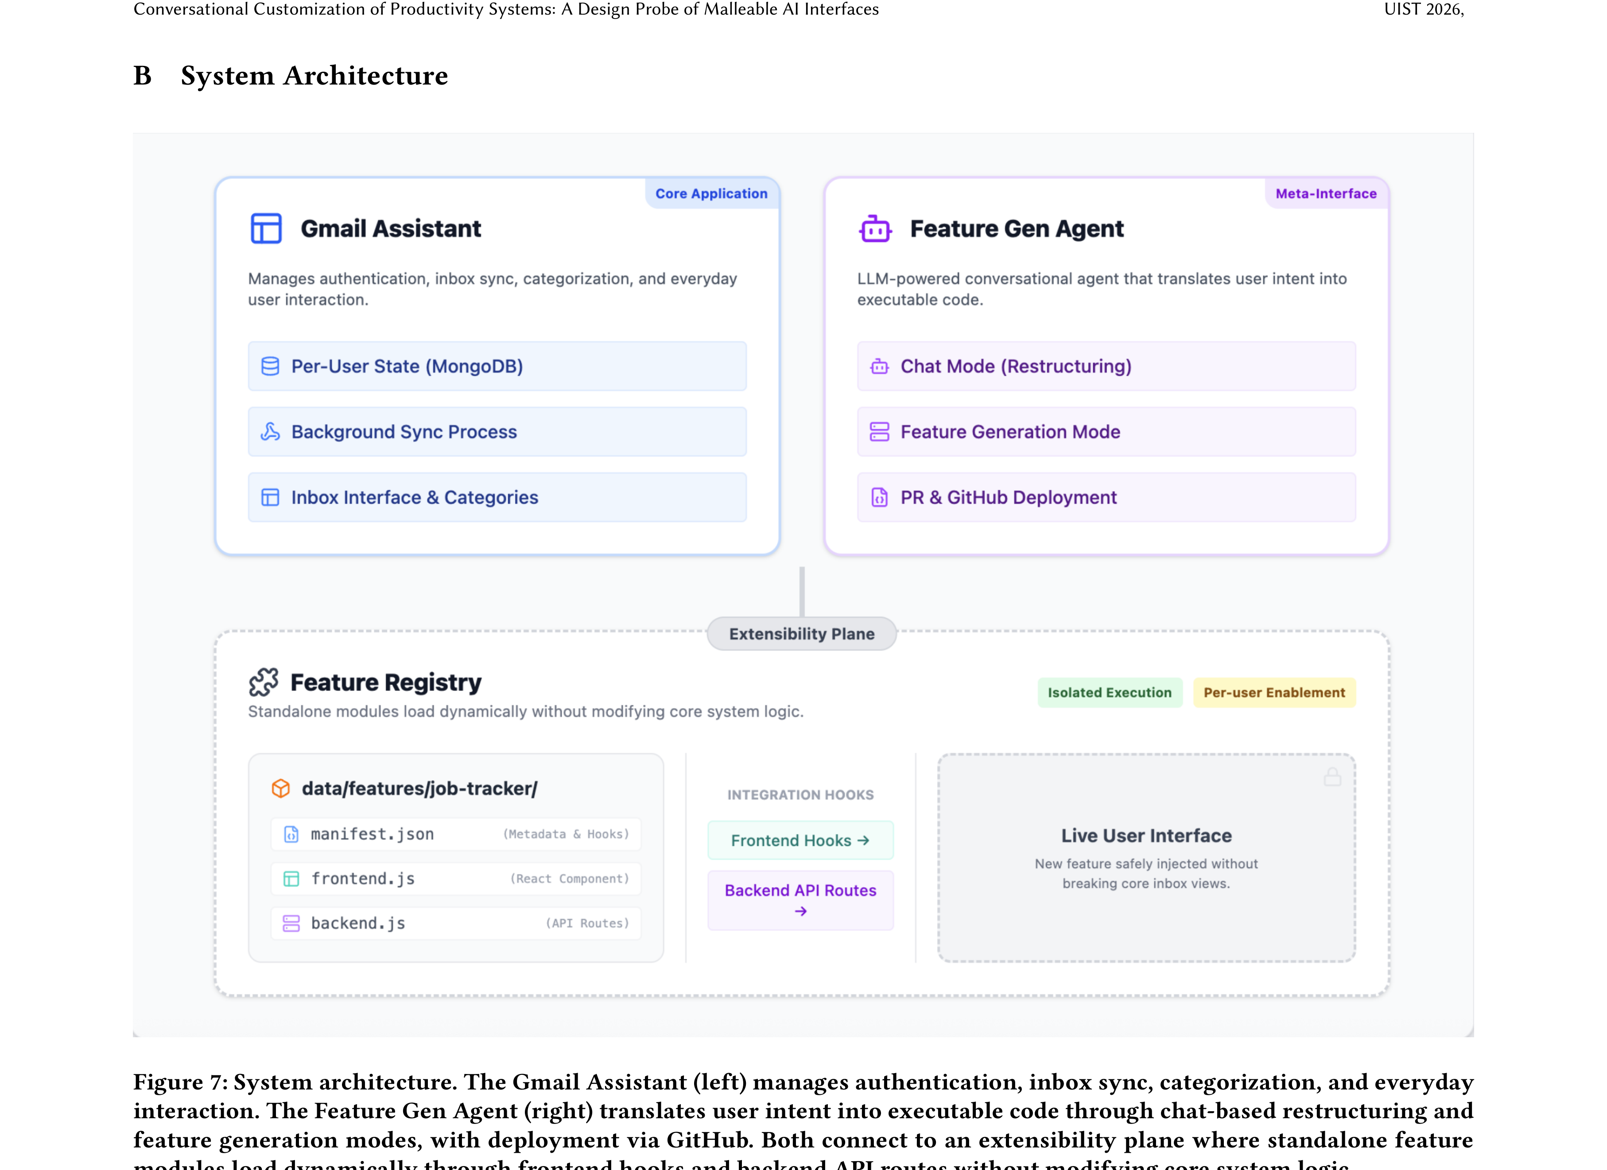
Conversational Customization of Productivity Systems: A Design Probe
of Malleable AI Interfaces
UIST
2026
Karthik Sreedhar¹, Aryan Kaul¹, Lydia B. Chilton¹
¹Columbia University
Paper
PROBLEM
METHOD
3
Design probe
8 users · 3 days
KEY RESULTS
End-user customization is a long-standing goal, yet users rarely tailor their tools. Generative AI makes malleable systems — tools modified by natural language — feasible, but how people actually use such malleability remains unclear.
A three-day probe with eight participants (5 men, 3 women) spanning technical and non-technical roles, using their own real email accounts so ideas emerge from live workflows.
METHOD
METRIC
From-scratch ideas
0/8
Demo-grounded (ours)
8/8
Day 1
Day 2
Day 3
8/8 features ≈ a shown example · none invented from scratch
ideate + build
use + refine
reflect + survey
The open question is not capability — it is whether systems adapt to how each user actually works.
4
SO WHAT → Malleability turns the inbox into a flexible data layer; user-authored features surface new risks — managed through oversight, iteration, and selective trust, not vendor patches.
System architecture: the Gmail Assistant (triage + categorization) and Feature Gen Agent (chat-based restructuring) connect through an extensibility plane.
Three patterns
findings
8/8
features grounded in shown examples
MOTIVATION
1
Two interaction levels
base + meta
PATTERN
WHAT USERS DID
Productivity work is high-frequency and idiosyncratic — small workflow-fit gains compound into real time and attention.
natural language ⇒ self-modified systemtwo levels — base triage + meta-level modification
Grounded
adapted & specialized demos
HEADLINE NUMBERS
natural language ⇒ self-modified system
Base level — triage email into categories
Data layer
reshaped the inbox
8/8
8
participants
Meta level — the agent modifies the system itself
Risks
oversight + iteration + trust
features demo-grounded
3
research questions
Prior customization lived outside real work — scripting and settings menus demand planning users never invest; generative AI lets people change tools in the moment.
Grounded in examples — every one of the 8 features resembled a shown demo, adapted to each workflow
none invented from scratch — all demo-grounded
3-day
design probe
2
Feature lifecycle
request → deploy
1
Request → refine — draft a feature bundle, refine it in conversation
Flexible data layer — the inbox shifts from a fixed interface to a layer users actively shape
TAKEAWAY
New risks, managed — mis-specified behavior, hidden info, over-reliance; tamed via oversight, iteration, selective trust
When customization becomes conversational and in-situ, users reshape their own tools — turning software from a fixed product into a malleable system they iteratively make their own.
WHY NOW
2
Deploy → registry — a GitHub pull request redeploys into a removable registry
Generative AI makes conversational, in-situ modification feasible for the first time.
Standalone feature modules keep every change auditable, persistent, and safely removable.
examples-grounded
data layer
oversight
iteration
selective trust

