Slide 1



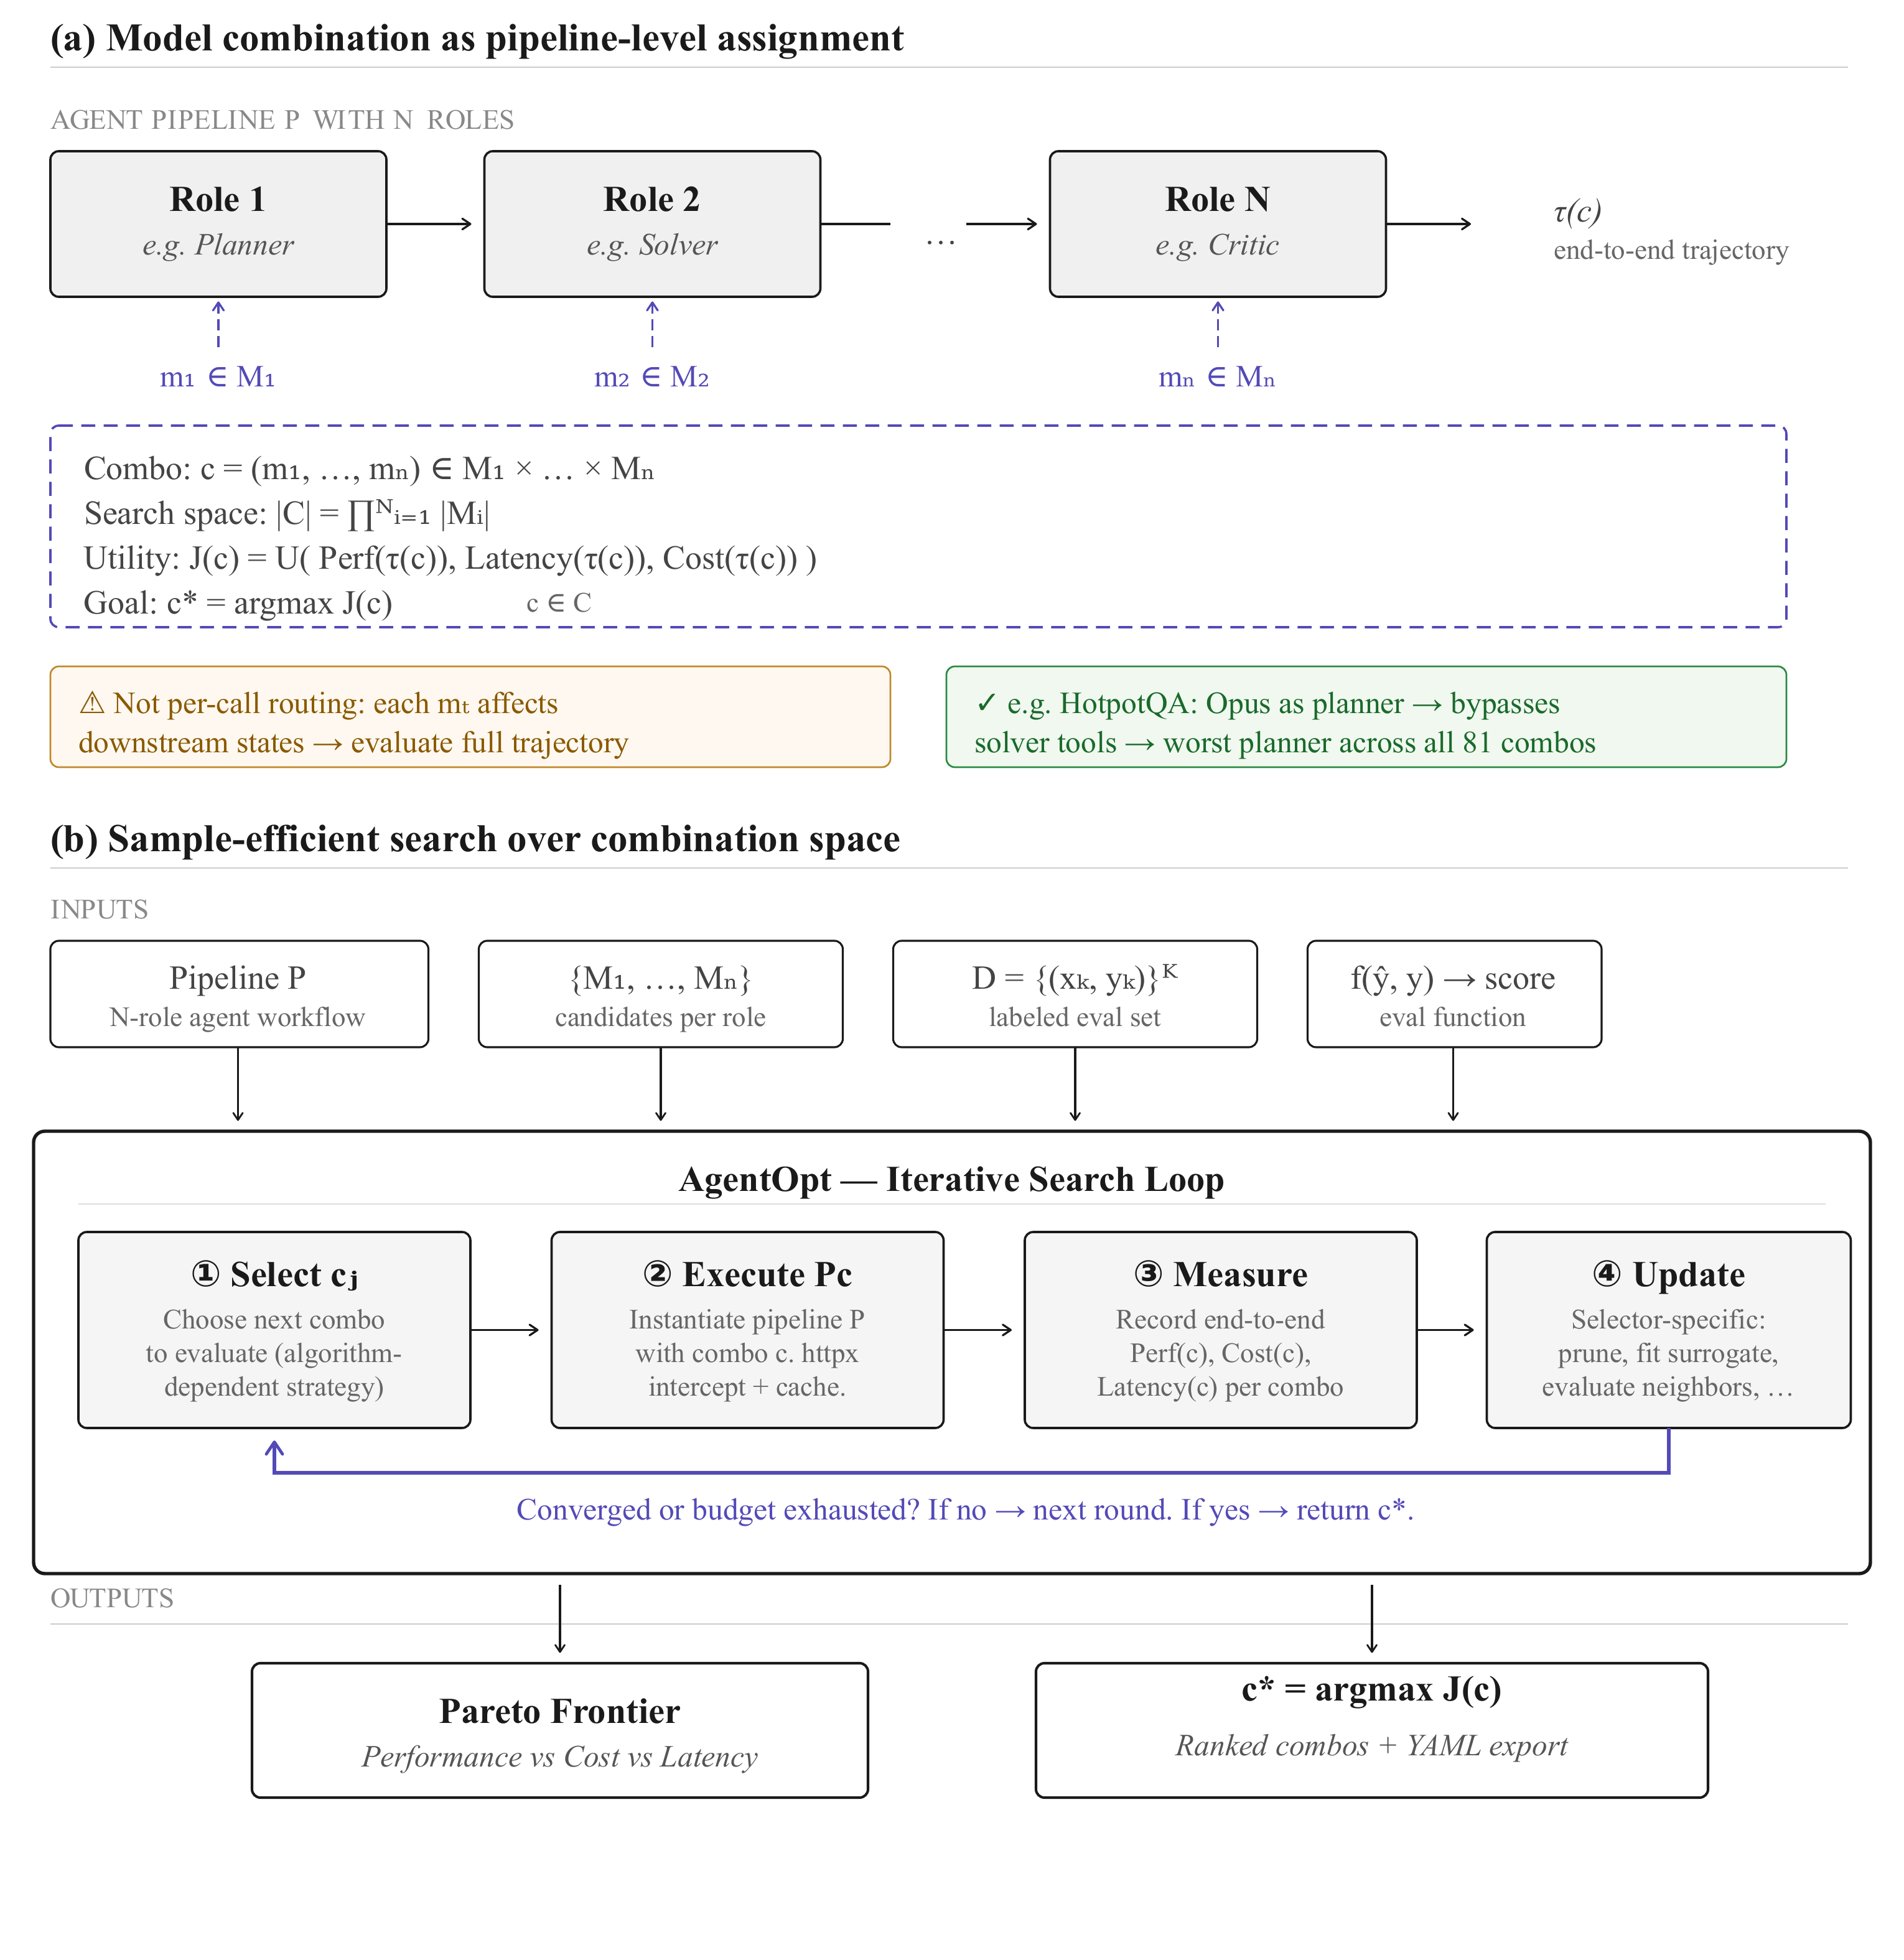


AgentOpt: Client-Side Optimization for LLM-Based
Agents
Preprint 2026
Wenyue Hua^{1*}, Sripad Karne³, Qian Xie², Armaan Agrawal³, Nikos Pagonas³, Kostis Kaffes³, Tianyi Peng^{3†}
¹Microsoft Research, AI Frontiers ²Cornell University ³Columbia University
Problem
Method
3
Framework-agnostic interception
no rewrites
Key Results
Efficiency research for AI agents has optimized the server — caching, scheduling, speculative execution, load balancing — but developers now compose agents from heterogeneous models and tools, so the highest-impact decisions (which model per role, how to split the API budget) sit on the client side, where a provider cannot optimize them.
AgentOpt patches httpx.Client.send / AsyncClient.send and tags each call with its datapoint + combination via Python contextvars, so any agent framework is covered with zero code changes.
HOTPOTQA COMBO
ACC.
ROLE LESSON
Opus + Opus
31.71%
strong planner bypasses solver
Ministral 8B + Opus
74.27%
cheap planner delegates
HTTP-level caching (in-memory + SQLite) reuses identical calls across combinations, and two-level concurrency bounds in-flight requests across combinations and datapoints.
+42.6 pts over the naive all-strongest combo
FIRST
Any framework that issues LLM requests through httpx is covered automatically.
SO WHAT → Best combo: cheapest planner + strongest solver.
First framework-agnostic Python package for client-side optimization of agentic workflows.
Overview of AgentOpt: combination-level model selection via an iterative search loop.
4
Ten search algorithms
one substrate
Headline Numbers
1
Combination as unit
c = (m₁, …, mₙ)
62–76%
13–32×
best–worst cost gap
Motivation
One model per pipeline role; the full trajectory τ(c) is evaluated end-to-end.
74.27%
best HotpotQA combo
Search space |C| = ∏ᵢ |Mᵢ| — exponential in the number of roles.
eval-budget savings
Bandits: Arm Elimination, Epsilon-LUCB, Threshold Successive Elimination.
Matrix UCB-E vs brute force
Utility J(c) = U(PERF, LATENCY, COST); optimize the Pareto frontier.
Matrix UCB-E / UCB-E-LRF explore the combination × datapoint grid.
Takeaway
Model selection is structurally upstream of every other optimization — caching, routing, and scheduling only pay off once a model assignment is fixed.
Agent efficiency is no longer a server-only problem — the leverage has shifted to the client, where model selection optimizes full combinations under the developer's own utility.
c* = argmax_{c} U( PERF, LATENCY, COST )over combinations c = (m₁, …, mₙ) — one model per pipeline role
c* = argmax
U( PERF, LATENCY, COST )
Local & surrogate: Hill Climbing, Bayesian Optimization, LM Proposal.
Standalone capability does not transfer across roles: Claude Opus 4.6 is the strongest model yet the worst planner on HotpotQA.
2
Sample-efficient search
5-step loop
Winner: Matrix UCB-E recovers near-optimal accuracy at a 0.2 budget (62–76% savings).
1
Select the next combination (algorithm-dependent).
Optimize the combination, not the model.
2
Execute the pipeline end-to-end, intercepting httpx calls.
Scan to Read
3
Measure Perf, Cost, and Latency per combo.
Paper
Code
Arm Elimination
Epsilon-LUCB
Threshold SE
Model quality must be judged in context, at the level of the full workflow.
4
Update — prune, fit, or return c*.
Matrix UCB-E
UCB-E-LRF
Hill Climbing
All selectors share one execution substrate; they differ only in how they choose the next combination.
Bayesian Opt
LM Proposal

