Slide 1

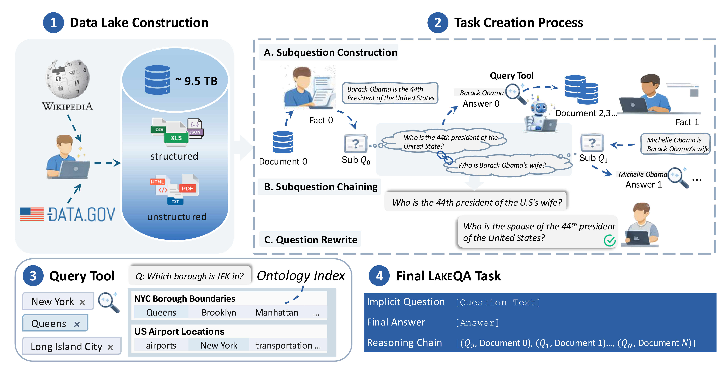
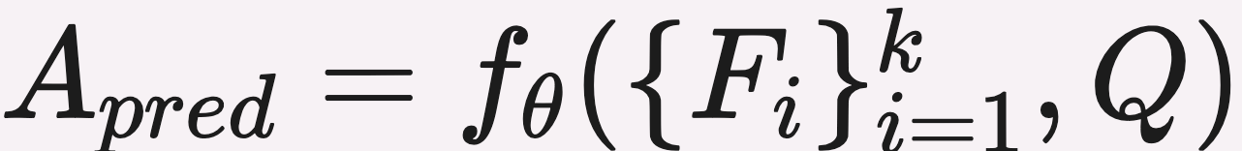
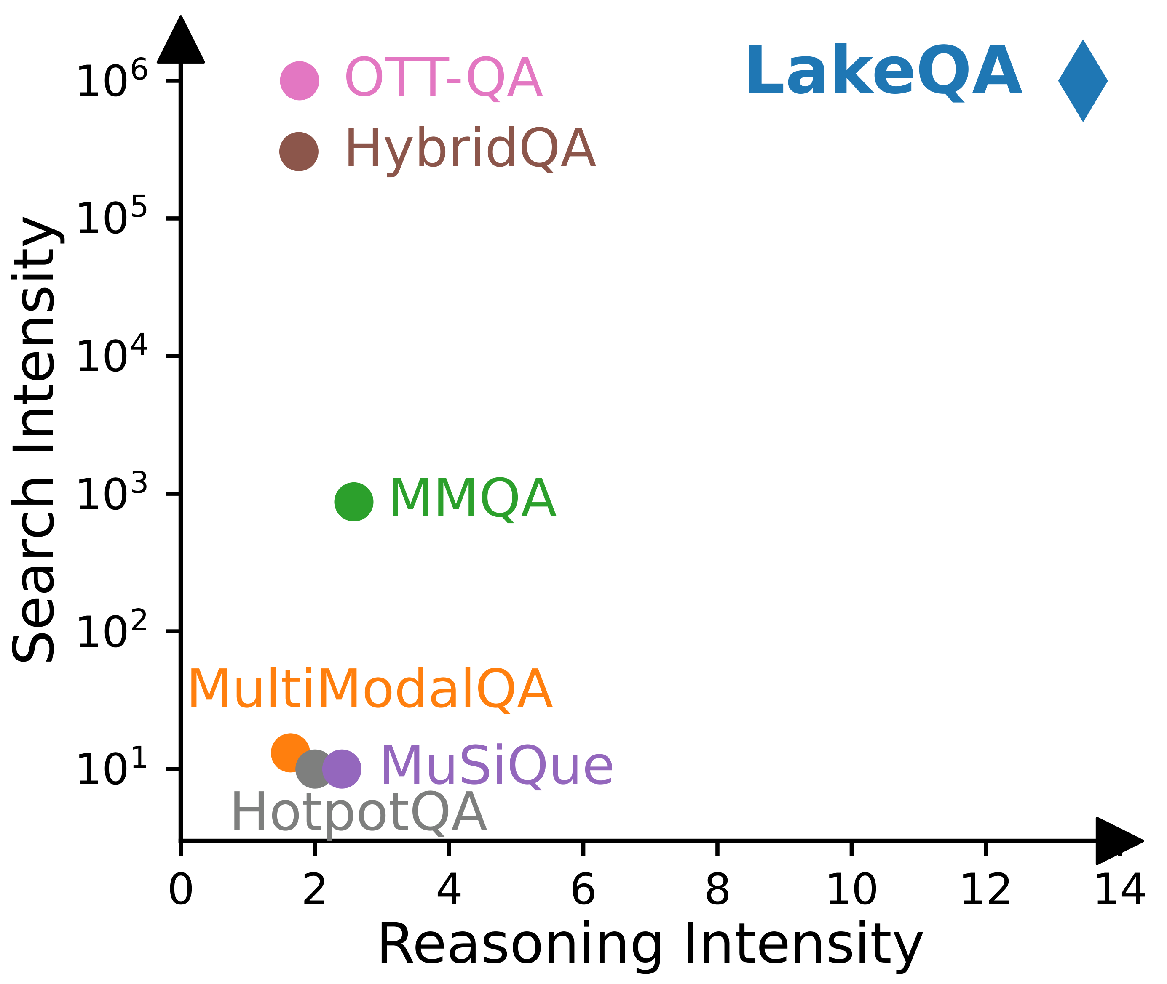
LAKEQA: An Exploratory QA Benchmark over a Million-Scale Data Lake
Haonan Wang¹*, Jiaxiang Liu¹*, Yurong Liu², Austin Senna Wijaya¹, Tianle Zhou¹, Eden Wu², Yijia Chen¹, Wanting You³, Reya Vir¹, Daniela Pinto², Grace Fan², Yusen Zhang¹, Juliana Freire², Eugene Wu¹
¹Columbia University ²New York University ³Barnard College
Paper
PROBLEM
METHOD
3
Annotation protocol
quality control
KEY RESULTS
Real-world questions are rarely paired with their evidence — useful evidence sits scattered across massive data lakes, so an agent must search before answering. Existing benchmarks hand over evidence; none jointly scales search and reasoning.
Nine annotators (5 CS Ph.D. students + 4 screened seniors) build tasks; every task is reviewed by ≥4 annotators, including ≥1 Ph.D., across construction and rewrite stages, ensuring expert verification of answers.
MODEL
EM · FULL
GPT-5.2
18.37%
Claude-sonnet-4.5
32.87%
Best 32.87% vs GPT-5.2 18.37% · all 7 frontier LLMs < 35%
4
Benchmark statistics
at a glance
Search is a prerequisite — evidence is never handed over.
LAKEQA pipeline.
1007
SO WHAT → Failures are dominated by missing evidence: Claude-sonnet-4.5 retrieves 42.36% of gold docs but accesses only 13.04%.
1
Exploratory QA task
formal definition
full tasks · 135 mini (stratified)
DOMAIN
SHARE
MOTIVATION
Government & Admin
27.5%
facts F_{i} from retrieved docs · D_{acc} / D_{ret} ground evidence vs gold D*
Health & Social
20.8%
Benchmarks scale one axis only — OTT-QA (huge search) vs MuSiQue / HotpotQA (deep reasoning).
Search axis N ≈ 40M documents — evidence never handed over
Environment
17.5%
HEADLINE NUMBERS
Reasoning axis K = 13.12 hops — answers chain across many files
Education
11.5%
13.12
avg reasoning hops
Economy & Infra
9.6%
32.87%
Industry is racing toward data-lake agents — yet no realistic testbed exists.
13.12 hops avg · 2.06 wiki + 11.06 data.gov docs per task
best end-to-end EM
45.93%
best EM on mini
2
Four-stage pipeline
how it is built
7 LLMs · none above 35%
40M
1
Build the lake — Wikipedia + data.gov → ~40M files, ~9.5 TB
101 tokens avg question (max 255) · 45.9% numeric, 24.4% temporal answers
docs · ~9.5 TB
2
Annotate tasks — chain subquestions; each answer instantiates the next
Evaluation harness — Exact Match + LLM-judge + evidence grounding via D_{acc} / D_{ret}
TAKEAWAY
RAG baselines — BM25 vs hybrid BM25+HNSW over 10K/25K/50K; gains unstable
Exploratory QA over a million-scale data lake is far from solved: document discovery is the bottleneck, and accuracy degrades steeply as reasoning intensity grows. LAKEQA gives the community a realistic testbed to close that gap.
3
Search — ontology-indexed query tool locates facts
4
Format — implicit question + gold answer + hidden reasoning chain
Mini split — 135 stratified tasks
Trajectory failures: search-dataset-missing (GPT-5-mini 112/135); retrieved-but-not-selected (GPT-5.2 56/135).
No benchmark scales both axes — LAKEQA fills that corner.
Structured and unstructured data coexist; evidence often spans many files.

