Slide 1

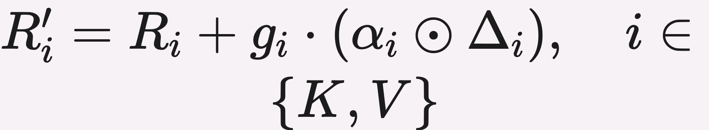
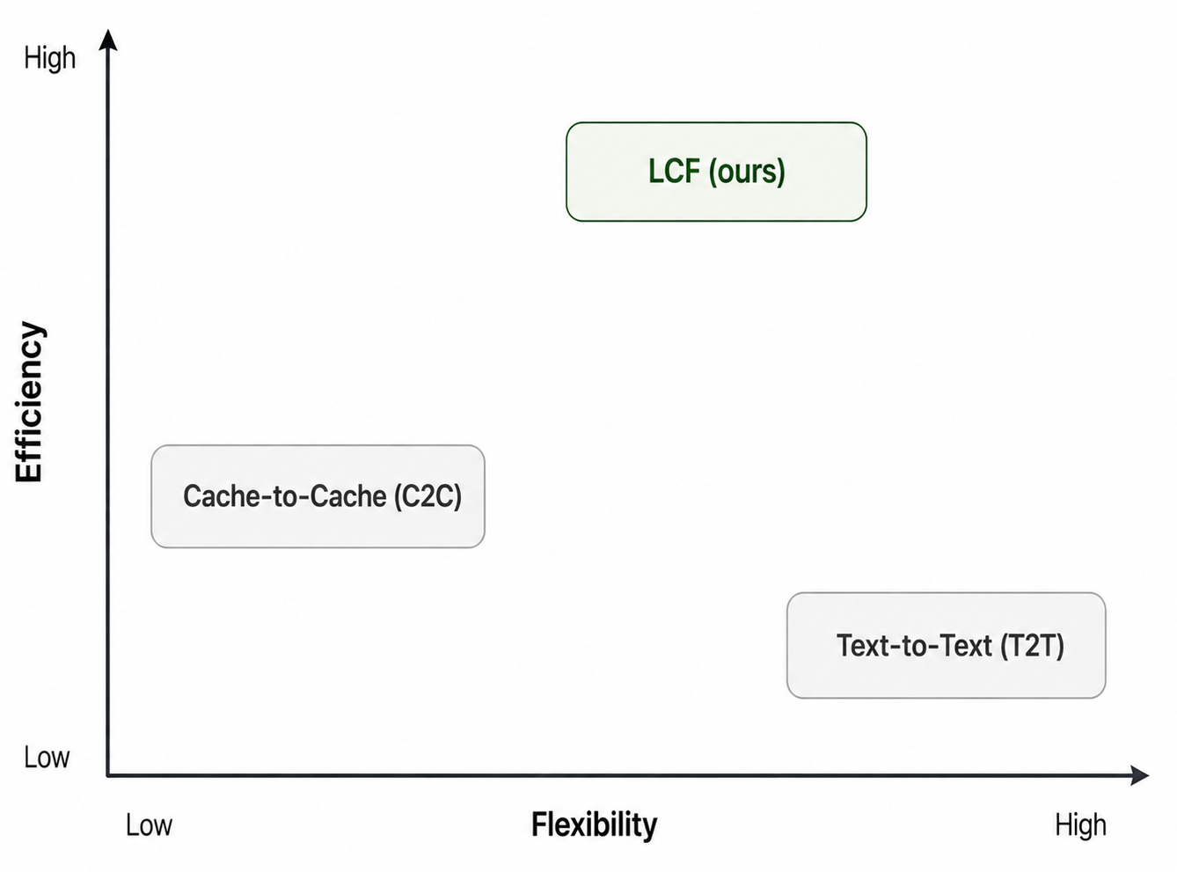
ICML
Latent Cache Flow: Model-to-Model Communication Without Text
2026
Maximillian Rossi, Prajwal Raghunath, Eugene Wu
¹Columbia University
Paper
PROBLEM
METHOD
3
LCF-X: cross-context
summarize, don't align
KEY RESULTS
LLM agents talk through text: the sender autoregressively decodes and the receiver re-encodes, so every exchange is slow and lossy. Multi-model workflows need a non-text channel for agents with different tools and contexts.
LCF treats cache transfer as compressed communication: a shared low-dim channel between sharer and receiver KV.
A sharer-side hierarchical attention pool condenses the full KV cache into P position-free span summaries — the receiver conditions on what the sharer learned, not token-aligned positions; LCF-X adds +2.47 F1 / +4.75 EM on HotpotQA-bridge.
METHOD
METRIC
C2C (cache fuser)
29.13
LCF-128 (ours)
31.94
1
Latent communication
channel
one projector
+2.81 wtd acc · 24.6× smaller adapter
Every model-to-model exchange is slow to decode and lossy to re-encode.
4
Efficiency: prune & scale
ablation
SO WHAT → A pruned 13 MB LCF still beats C2C's 956 MB adapter on every benchmark; LCF-X adds +2.47 F1 and +4.75 EM over the strongest text baseline.
76×
z = W_{down}x · Δ_{i} = W^{i}_{up} z_{i} — gated residual update
fewer parameters · 9-layer critical subset still beats C2C
One pipeline, not two fusers — C2C learns separate K and V fusers per position, a 956 MB adapter for a 1.1B pair.
MOTIVATION
BOTTLENECK
WTD ACC
LCF-64
underperforms
Cache-to-Cache (C2C) drops text via KV exchange — but its adapter is 956 MB for a 1.1B pair and expensive to train.
LCF shares one projector: concat & flatten the KV, down-project into a low-dim latent z, up-project gated residuals back — ~4% the adapter size.
LCF-256
32.88
HEADLINE NUMBERS
LCF-512
overshoots
Layer pruning — the signal concentrates in a 9-layer critical subset (13 MB, 76× fewer params) that beats C2C on every benchmark.
8.5×
31.94%
LCF-128 weighted accuracy
C2C is token-by-token and demands identical, aligned context — unusable for agents with different tools or sub-tasks.
2
Compressed transfer
faster time-to-first-token
13 MB
adapter vs C2C's 956 MB
the LCF projector
1
Compress — concat & flatten the sharer/receiver KV, down-project to z = W_{down}x, split into z_{K}, z_{V}.
Bottleneck scaling — LCF-256 peaks at 32.88 wtd acc; LCF-64 underperforms and LCF-512 overshoots, so the channel both compresses and regularizes.
+23% exact match over text communication
4.5 h
training on one A100
2
Inject — per-head gates α_{K}, α_{V} scale up-projected residuals, added back as R′_{i} = R_{i} + g_{i}(α_{i} ⊙ Δ_{i}).
TAKEAWAY
Span invariance — LCF-X F1 stays within a 0.32-point band across a 4.7× span-count change; trains in ≈4.5 h on one A100.
Inter-model communication doesn't need full-width cache transfer: a compressed latent channel moves a model's state to another model faster, lighter, and across differing contexts than text — opening a new Pareto frontier for multi-model agents.
3
Prune — drop receiver layers that contribute little, yielding the 13 MB 9-layer critical subset.
Transferable — one trained LCF-128 serves all four MCQ benchmarks without per-task retraining.
One W_{down}/W_{up} pair replaces C2C's duplicated fusers; the low-dim latent bottleneck compresses and regularizes communication.
13 MB pruned
76× fewer params
32.88 peak
Efficiency–flexibility trade-off: LCF sits between T2T and C2C.
4.5 h / A100

