Slide 1

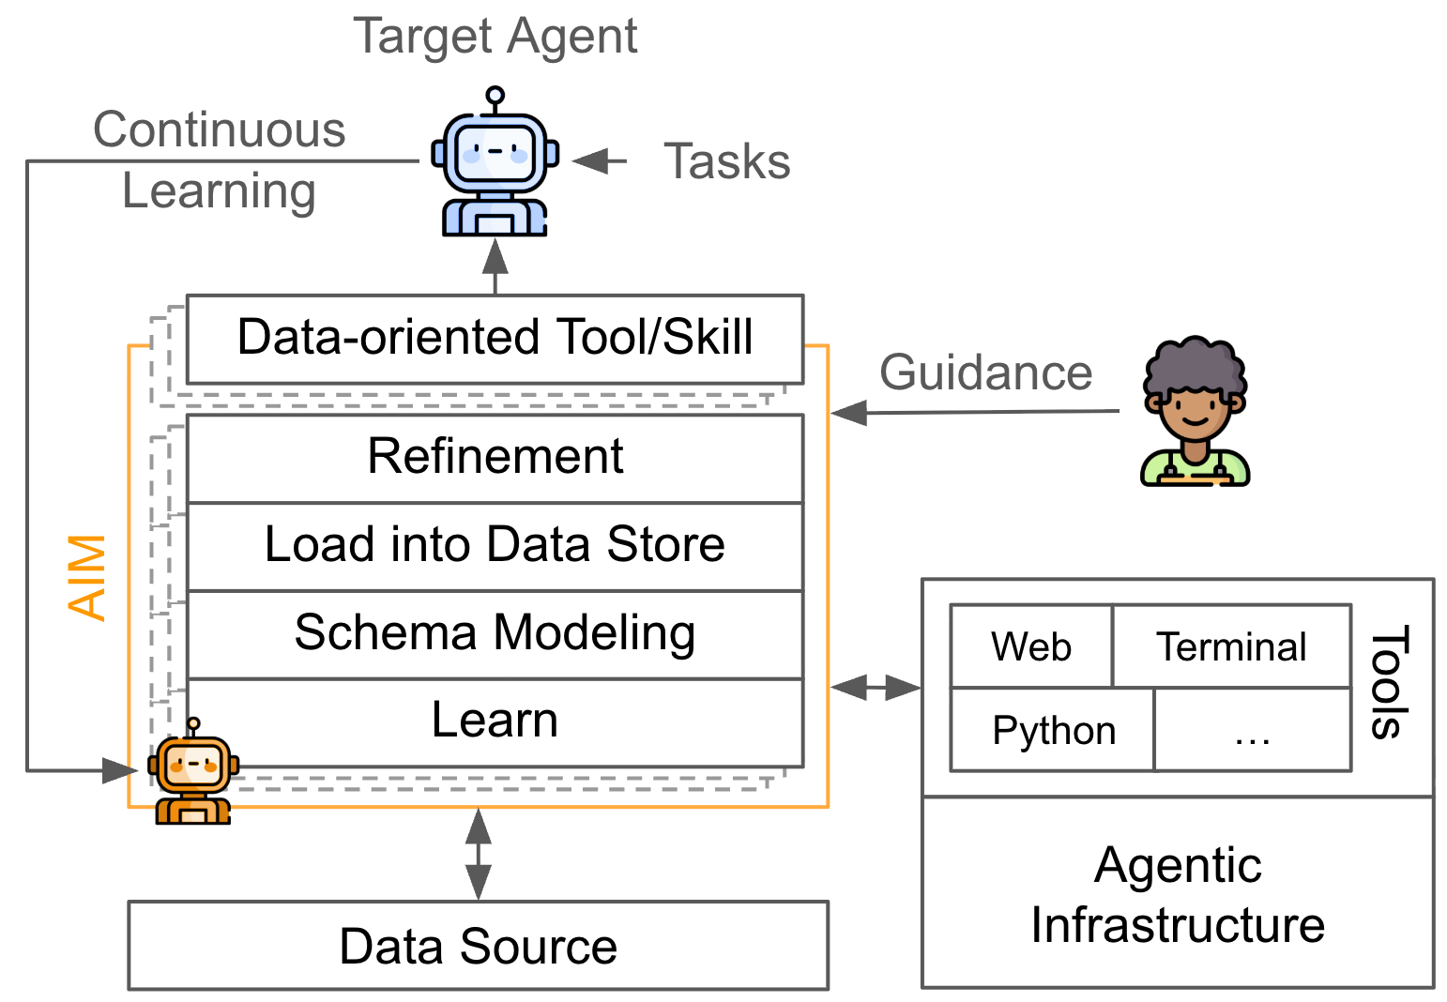

Agentic Data Environments
IEEE Data Engineering Bulletin 2026
Elaine Ang¹, Chenxi Huang¹, Georgios Liargkovas¹, Jerry Liu¹, Jinhui Liu¹, Nikos
Pagonas¹, Charlie Summers¹, Haonan Wang¹, Jiakai Xu¹, Tianle Zhou¹, Yusen Zhang¹,
Zhou Yu¹, Zhuo Zhang¹, Tianyi Peng¹, Kostis Kaffes¹, Eugene Wu¹
¹ Columbia University
Problem
Method
Key Results
Today's data agents are
read-only copilots.
Agentic automation mutates
the environment — each
step is both a data write
and a legal act, so errors
become regulatory
penalties, not merely
wrong answers.
3
ADE
03 / Amplify
SO WHAT → AIM +49.8% over Mem0 / +15.82% over Octen on LoCoMo (4.18× faster than GAM). LakeQA: &x2264;23% accuracy; discovery is the failure. BranchBench: no branchable DBMS supports agentic loads. DFC: ~0 overhead on TPC-H. Chkpt: 66 ms for 2 GB FS.
Materialize latent signals —
schema structure, workload
regimes, knob sensitivity, tribal
knowledge — into reusable objects
via observation + controlled
experimentation.
Headline Numbers
AIM: Learn → Schema → Load → Refine
→ Skill.
+49.8%
&x2264;23%
LakeQA
accuracy
4
Branching + DFC
04 / Bound
~0
DFC TPC-H
overhead
Motivation
1
AIM
01 / Amplify
Chkpt: BranchBench shows no
branchable DBMS supports
agentic loads (read latency 5–
4000×, Neon 3% of a 1000-step
MCTS). Chkpt: 66 ms for 2 GB
FS vs 11.21 s containers.
AIM vs Mem0 on
LoCoMo
A single salient failure
suppresses adoption out
of proportion to its
likelihood — prospect
theory weights losses far
more than gains (Replit
DB deletion, AWS
outages, prompt-injection
leaks).
Learn: hypothesize data models
for target tasks.
+15.82% vs Octen RAG
66 ms
Chkpt FS
checkpoint
Takeaway
Schema: instantiate in a chosen
store.
Agentic automation is a systems problem
about the data environment — not an agent
design problem. Amplify (AIM/AIR/ADE) +
Bound (Branching + DFC), or worst-case
outcomes pin adoption. Each task then
produces reusable artifacts (schemas, indexes,
policies) that make future tasks faster — a
virtuous flywheel.
Load + Refine: ETL →
views/indexes → Skill.
Data Flow Control:
source→sink provenance
policies; ~0 overhead on TPC-H
(5 engines).
2
AIR
02 / Amplify
“Best-effort” safety is
not enough. Value =
Benefits − Costs; we
need both higher benefits
and bounded failure
consequences.
Exploratory QA over a 9.5 TB /
~40M-doc data lake. LakeQA
pushes search + reasoning
intensity (mean 7.67 sources/task).
End-to-end accuracy &x2264;23%
across 7 frontier models; dominant
failure is dataset discovery.
Representation invariance:
track info across
SQL/Python/files/prompts.
Scan to Read
Paper

