Slide 1

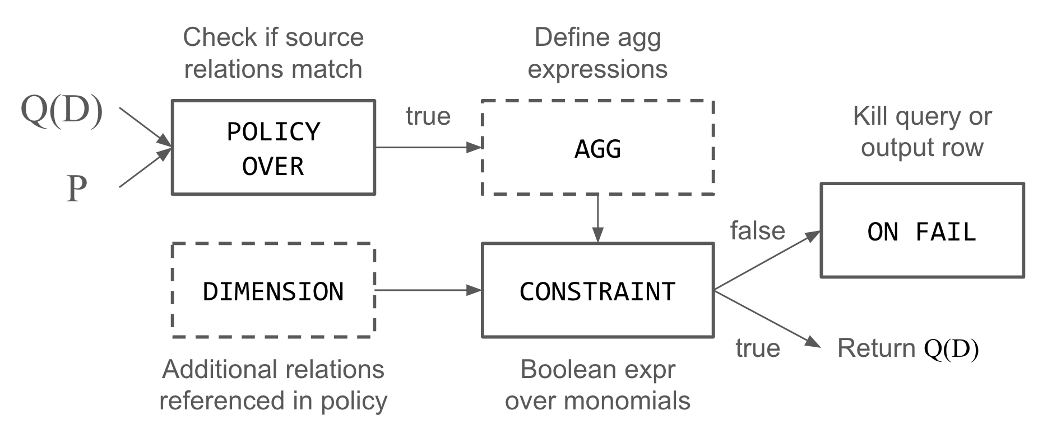
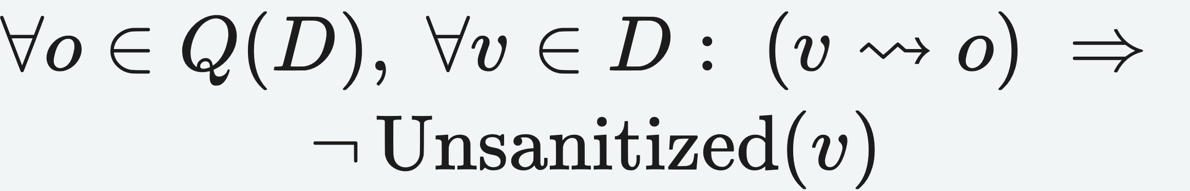
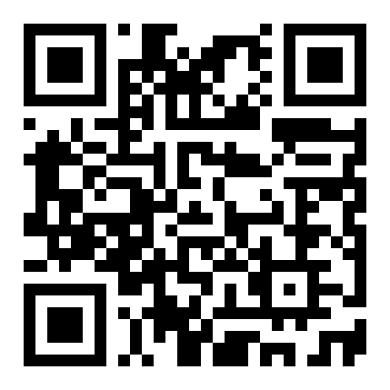
CIDR 2026
Please Don't Kill My Vibe: Empowering Agents with
Data Flow Control
Charlie Summers · Haneen Mohammed · Eugene Wu
Columbia University, New York, NY, USA
Problem
Method
3
Prompt injection
a data-flow problem
Key Results
The tension between giving agents powerful tools and limiting them for safety is "Killing Our Vibes."
Model the prompt as a template over query results, then forbid unsanitized values from flowing in:
Method
Metric
GProM / SmokedDuck (capture)
orders-of-magnitude overhead
LLM agents risk policy violations, process corruption, and prompt injection — no system tracks the data flows an agent's actions produce.
FlowGuard (rewrite)
≈0 overhead, sometimes faster
no unsanitized value may reach the prompt
≥10× less overhead than provenance capture
The FlowGuard policy evaluation pipeline.
4
Four policy classes
one language
Motivation
Disaggregation — split aggregate outputs along protected attributes so the released result never hides a too-small group.
The dominant safety approach is model-centric — data curation, fine-tuning, RL — and it will never be perfect.
1
Policy over provenance
the data-flow model
Headline Numbers
Each output tuple o carries a polynomial: + = aggregation, × = join.
K-anonymity — require ≥ k constituent rows in every public output; drop the result when the threshold is not met.
≈0%
4
policy classes in one language
Data flow control should be enforced natively by the system, just as validation and access control moved into the DBMS.
Standard form (expanded monomials) keeps the policy's meaning optimizer-independent.
overhead on most queries
≥10×
less overhead vs capture
Business process — model valid update sequences as an acyclic FSM (Created → Verified → Settled); kill any disallowed transition.
sometimes faster than no policy
Errors become visible once you track the data flow an action produces: policy violations, process corruption, prompt injection — three risks no agent system can fully eliminate.
join, then aggregate
Takeaway
Prompt injection (card 3) — bind the LLM prompt to the policy; unsanitized values are forbidden from flowing in.
Safe agents need safe systems — enforce data flow policies natively, and the vibes will flow.
2
Enforce by rewriting
no provenance capture
Parse policy
→
Rewrite query
→
Inline AGG
→
Check constraint
→
KILL on fail
Provenance-free — FlowGuard enforces via query rewrite, no runtime lineage capture, so it adds ~0 overhead on TPC-H.
Data Flow Control decouples policy from agents, mitigating violations, corruption, and injection.
The gap is not a better model but a missing layer: data-flow control as a systems primitive.
FlowGuard rewrites the query rather than capturing provenance: it inlines the AGG clause into the aggregation, then appends a final projection that KILLs the query or the violating rows. The rewrite is optimizer-agnostic — the policy is enforced by the standard form, not by a custom operator, so it composes with any existing query engine.
Disaggregation
K-anonymity
Business process
A better model is never a guarantee — the missing layer is system-level enforcement.
Prompt injection
3
Scan to Read
risk types any agent system can leak
Paper

