Slide 1





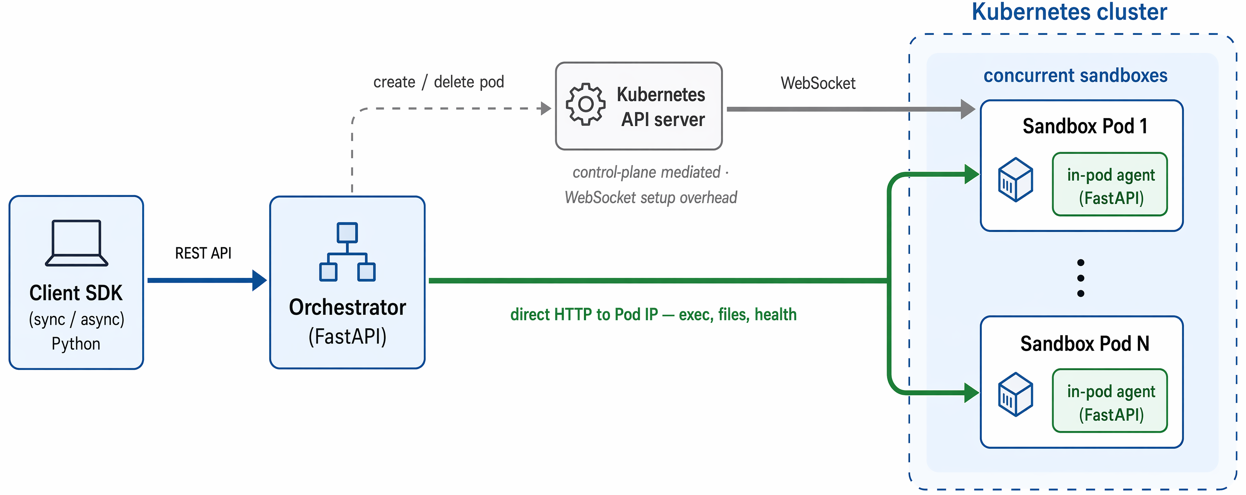
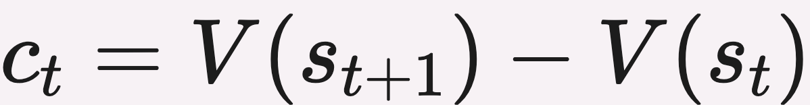
Orchard: An Open-Source Agentic Modeling Framework
Baolin Peng¹, Wenlin Yao¹, Qianhui Wu¹, Hao Cheng¹, Xiao Yu², Rui Yang³, Tao Ge¹, Alessandro Sordoni¹, Xingdi Yuan¹, Yelong Shen¹, Pengcheng He¹, Tong Zhang³, Zhou Yu², Jianfeng Gao¹
¹Microsoft Research ²Columbia University ³University of Illinois Urbana-Champaign
Paper
Code
PROBLEM
METHOD
3
Orchard-SWE recipe
SFT + RL
KEY RESULTS
Training LLM agents needs huge rollout trajectories, each running dozens of sequential calls to a sandboxed environment — yet the environment layer is usually closed (E2B, Daytona, Modal) or coupled to one stack (ProRL Agent, MegaFlow).
BAR assembles reward-balanced rollouts online per prompt; OPD adds token-level teacher distillation; RPR scores self-verification across 7 rubrics (0.85 on verification); historical rollouts distill into a 4B value model for best-of-N reranking.
METHOD
METRIC
Orchard-SWE (RPR-RL)
69.7%
Orchard-SWE + value model
73.0%
+3.3 pts · open-source SOTA
Orchard Env — SDK → orchestrator → in-pod agent.
4
Ablation
what helps
SO WHAT → Orchard-GUI (4B) reaches 68.4% avg GUI — the strongest open-source agent.
Trajectories, recipes, and evals can't be reused across domains, harnesses, or stages.
1
Credit-assignment SFT
core idea
73.0%
SWE-bench Verified — open-source SOTA
per-step credit = TD shift in the teacher's success probability; rise segments have c_{t} ≥ ε
HEADLINE NUMBERS
MOTIVATION
Teacher as value function — mines productive rise segments from failed trajectories
ABLATION
Δ PTS
Data scale 512→2048
+8.2
73.0%
68.4%
avg GUI (4B)
The environment layer is the foundational bottleneck — close it, and everything above locks in.
Dense token-level credit — turns sparse rewards into per-step signal
Credit-assignment SFT
+1.9
SWE-bench Verified
0.28 s
env latency
BAR (RL)
+7.7
open-source SOTA
107K
Value model (BoN)
+3.3
trajectories
A thin, standalone service frees data, recipes, and evals to transfer across domains, harnesses, and stages.
2
Orchard Env
thin env service
Data scale dominates — doubling trajectories 512→2048 gains +8.2 pts
TAKEAWAY
1
3-layer design — Python SDK → FastAPI orchestrator → in-pod agent
SFT init — moderate init helps out-of-distribution (+6.7 multilingual); heavy init regresses
A thin, open, harness-agnostic environment layer makes agentic data, training recipes, and eval protocols reusable — so open-source agentic modeling scales without coupling the environment to any single stack.
2
2 scaling choices — runtime agent injection + direct Pod-IP routing
WHY NOW
Cross-harness lock-in — mismatched eval collapses to 19–28%
Frontier agents now span software, browsers, and assistants — open infrastructure lets research reproduce them.
Sandbox lifecycle, command execution, file I/O, network policy — 0.28 s latency, 1,000-sandbox stress success.
Oracle best-of-N selector reaches 82.4% — 12.7 pts of inference-time headroom remain.

