Slide 1
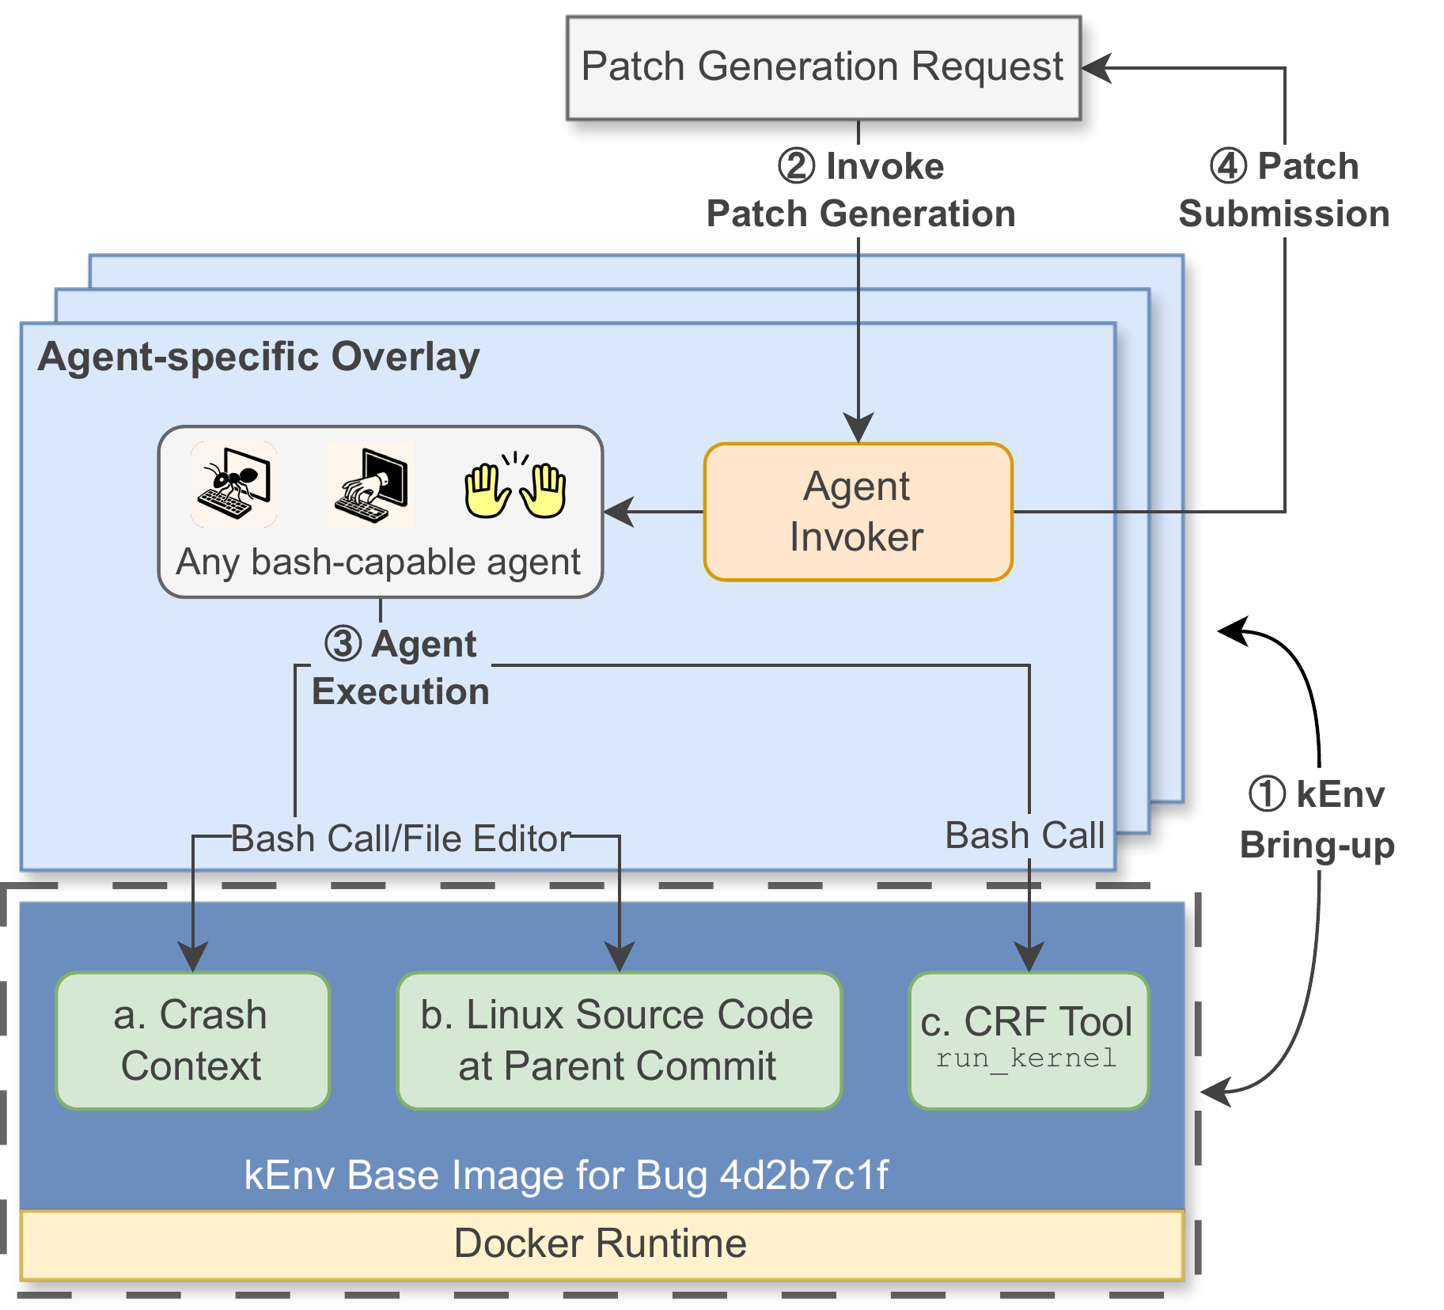
ICML 2026
Outrunning LLM Cutoffs: A Live Kernel Crash
Resolution Benchmark for All
Chenxi Huang¹, Alex Mathai¹, Feiyang Yu², Aleksandr Nogikh³, Petros Maniatis⁴, Franjo Ivančić³, Eugene Wu¹, Kostis Kaffes¹, Junfeng Yang¹, Baishakhi Ray¹
¹ Columbia University ² New York University ³ Google ⁴ Google DeepMind
PROBLEM
METHOD
2
CRF: run_kernel Interface
Uniform feedback
KEY RESULTS
STALE
Bring-up
→
Invoke
→
Execute
→
Test
→
Submit
SETTING
CRR (FIRST-TRY)
EPR (PATCH MATCH)
Static data overstates kernel-crash repair by up to
run_kernel submits the agent’s git diff and returns crash resolved, crash reproduced (new stack trace), or compilation error.
Claude Opus 4.5
74.2%
19.9%
+ test-time scaling
~90%
~30%
.
~$0.28 per job; ~7× the wall-clock of LLM inference.
Existing LLM-agent benchmarks for Linux kernel crash resolution are static and manually curated — they miss the kernel’s constant evolution and are vulnerable to data contamination from LLM knowledge cutoffs — old fixes get memorized.
−25 pts EPR: static benchmarks overstate patch equivalence by up to 25 pts (pre vs post knowledge-cutoff bugs).
3
LIVE-KBENCH: Self-Evolving
Curation
Weekly Syzbot crawl
534 bugs · 70 subsystems · 10 bug types (Jan 2025 cutoff).
SO WHAT → Only ~20% of patches truly match the developer’s fix.
1
Crawl — weekly Syzbot bug harvest.
2
Filter — drop reliably-triggered crashes.
HEADLINE NUMBERS
MOTIVATION
3
Execute — agents run on live bugs.
6,000+ crashes
CVE-assigned
KENV × LIVE-KBENCH interaction.
74%
~20%
EPR (patch match)
30 min / build
data contamination
4
Dashboard — metrics & leaderboard.
−25 pts
Syzkaller has surfaced over six thousand kernel crashes — many assigned CVE identifiers — yet automated repair of system-level failures lags far behind user-space coding agents for such crashes.
1
KENV: Agent-Agnostic
Environment
Base image + overlay
First-Try Crash Resolution
EPR cutoff gap
4
Patch Equivalence via LLM
Judge
9-vote Gemini 3 Flash
vs ~20% true patch equivalence
+29%
CRR with CRF feedback
crash context
Linux source
run_kernel CRF
agent Dockerfile
~90%
83%
9
An agent-specific Dockerfile overlays the base — any bash-capable agent drops in.
judge accuracy
judge F1
judge votes
TAKEAWAY
Crash Resolution Rate (CRR) and Localization IoU are scored on every run.
Kernel crashes are underspecified and a single build/test cycle takes at least 30 minutes; a static benchmark silently overestimates generalization as the kernel drifts.
Static benchmarks overestimate kernel-crash repair by up to 25%; a live, time-aware benchmark is required to measure — and drive — real progress. The 74%-vs-~20% gap is the field’s open problem.
Identical conditions for every agent: same crash context, same parent commit, same feedback tool.
Equivalent Patch Rate (EPR): how closely a patch matches the developer’s fix.
Compilation and testing run on the KGymSuite backend; the agent only edits files.
Rigid: apart from variable names, structure and logic must match.

