Slide 1




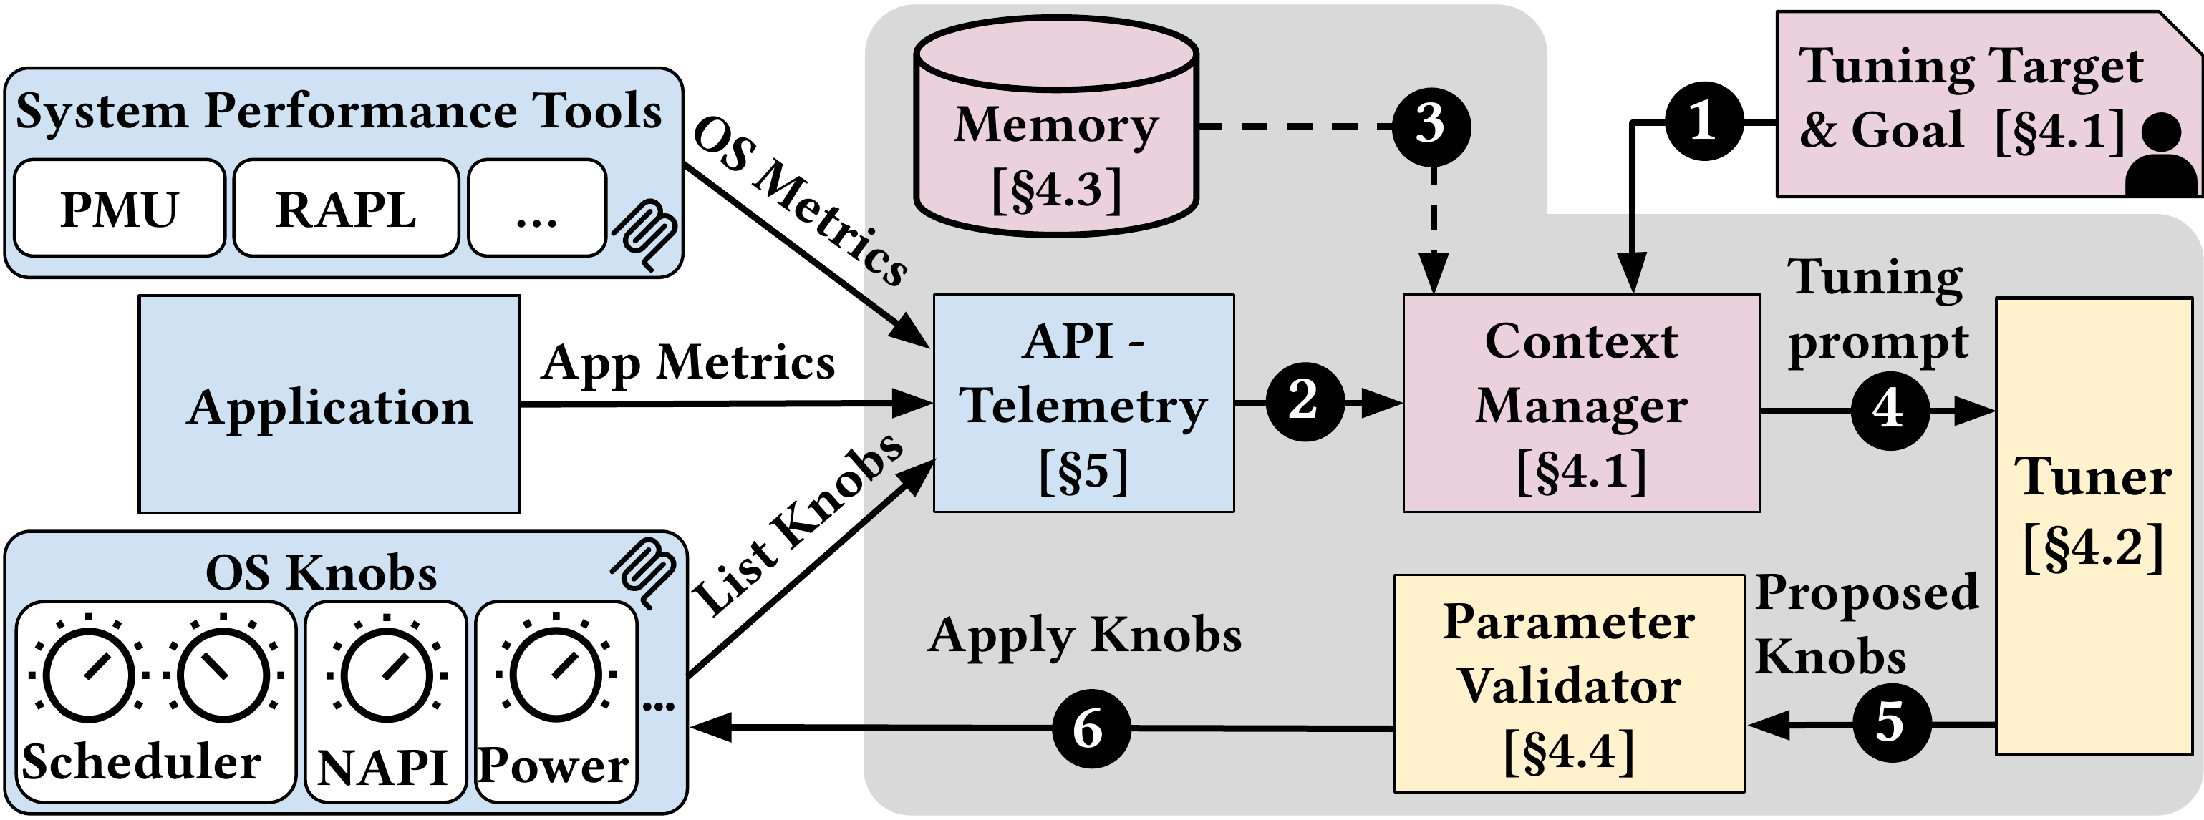
TuxBot: Semantic-Aware Online OS Tuning with Large
Language Models
arXiv
2026
CS.OS
Georgios Liargkovas¹, Mihir Nitin Joshi¹, Hubertus Franke², Kostis Kaffes¹
¹Columbia University ²IBM Research
Paper
Code
Problem
Method
3
Explicit Cross-Session
Memory
warm
start
Key Results
Bayesian & RL tuners treat
hundreds of coupled Linux
knobs as isolated
numbers, blindly pushing
live hosts into unsound
regions.
TuxBot records summaries from
prior runs and retrieves them to
warm-start new sessions, so tuning
reuses workload-specific experience
instead of restarting from scratch
each time.
METHOD
PERF.
METRICS
MLOS (best
baseline)
baseline
app-level
TuxBot
+153.3%
system-
only
TuxBot: telemetry → semantic view →
dual-loop LLM control → typed knob
updates.
1,200+
No re-learning — experience
carries across runs.
tunable Linux
knobs, often
semantically coupled
Headline Numbers
1
Semantic
Reasoning
knobs as
policy
+153%
~$0.20
LLM cost
/ session
Motivation
Treats knobs as one joint policy,
rejecting unsound configs up front:
4
Typed, Validated
Actuation
safe
execution
+93.7
pts,
system-
only
avg. gain over
MLOS (13
workloads)
Numerically valid configs
turn semantically
unsound once scheduler,
power, memory & I/O
interact on a live host.
scheduler
power
memory
I/O
Every LLM proposal passes a
typed, validated interface before
reaching the host.
41
Linux knobs
co-tuned
2
Cost-Aware Dual-Loop
Control
fast +
deep
A knob metadata store covers 41
Linux knobs with domains and
constraints.
Takeaway
Hidden app metrics force
misleading proxies (IPC,
cache misses) that don't
track real performance.
1
Observe telemetry
Treating OS knobs as a coupled
semantic system — not isolated
numbers — lets an LLM tuner deliver
large, safe, cheap gains where classic
tuners cannot.
2
Instant fast fix
Keeps semantic reasoning paired
with safe execution on live
services.
3
Reason deeply
2×
50%
4
Validate & Actuate
SAFE
Semantic reasoning + typed
actuation = safe, effective live
tuning.
>47×
worse
p99 on
proxies
p99 loss,
1→32
knobs
Fast Instant + deep Reasoning
loops — cost near $0.20/session.
LLM proposals are type-checked before reaching the host.
tail-latency
spike

