Slide 1

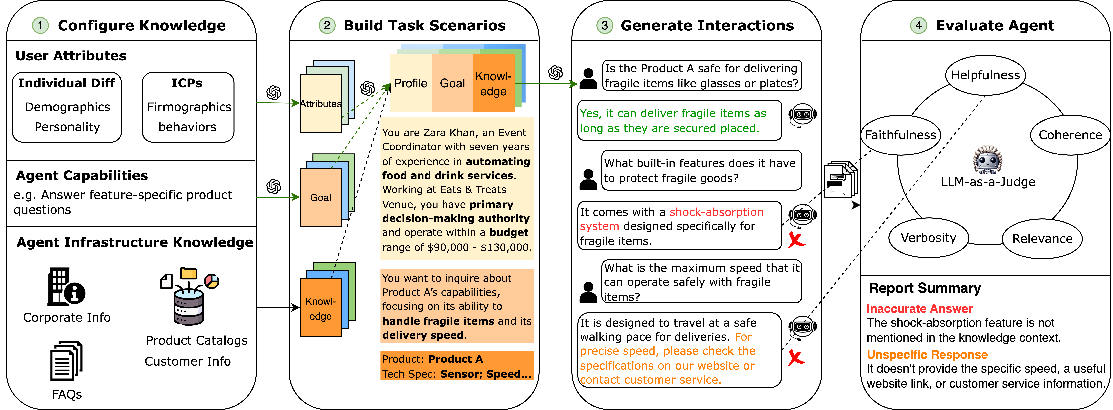
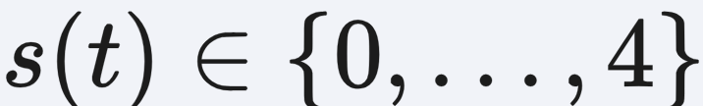

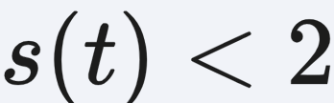
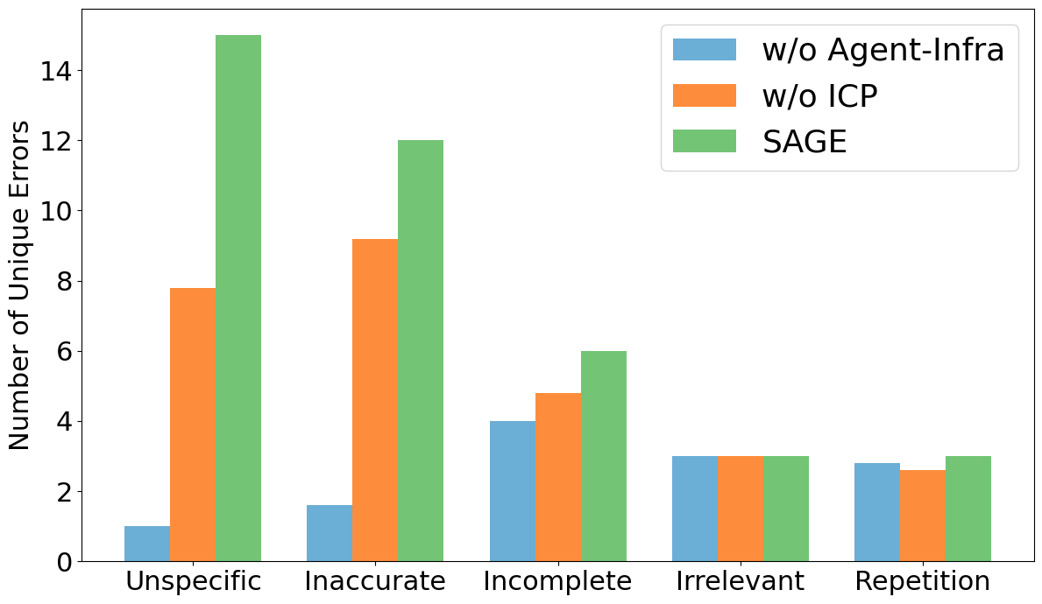
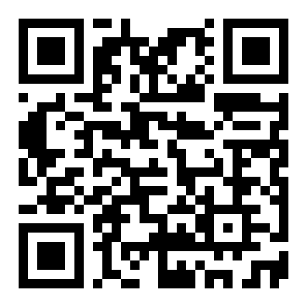

arXiv 2026
SAGE: A Top-Down Bottom-Up
Knowledge-Grounded User
Simulator for Multi-turn Agent
Evaluation
Ryan Shea¹, Yunan Lu^{1,2}, Liang Qiu, Zhou Yu^{1,2}
¹Columbia University ²Arklex.ai
Problem
Method
3
Generate Interactions
shared environment
Key Results
Simulator and agent converse in a shared
environment over the interaction history and
infrastructure knowledge, ending on a
###STOP### sentinel or turn budget. An LLM-
as-a-Judge scores each reply on five
dimensions:
Evaluating multi-turn interactive
agents demands costly human
assessment. Existing user
simulators model generic users
and overlook the domain-specific
business knowledge needed to
reproduce realistic behavior —
yielding interactions of limited
evaluation utility.
METHOD
RAG BUGS
SHOP BUGS
w/o Agent-Infra
13.6
13.0
w/o ICP
29.0
14.4
SAGE
38.6
18.0
keep as a bug iff scored on helpfulness, coherence, verbosity, relevance, faithfulness
keep
as a bug iff
Headline Numbers
SAGE overview: configure knowledge → build
scenarios → generate interactions → evaluate
agent.
Evaluation is the bottleneck —
human testing does not scale.
4
Evaluate & Identify Bugs
+33%
38.6
bugs
(RAG)
LLM-as-a-Judge
Low-scoring turns are summarized into
fine-grained, unique bug statements
with linked turns.
more agent
bugs identified
2.58
human-
like
1
Configure Knowledge
top-down & bottom-up
vs. existing user-
simulation methods
0.73
Motivation
User attributes: Big-Five personality &
demographics (individual differences).
LLM bug lists match human experts at F1
0.73 (Fleiss' κ 0.85).
bug-ID
F1
Real agents are deployed in
specialized business settings
where behavior is shaped by who
the user is (role, demographics,
budget) and what company-
specific information they seek.
ICPs: firmographics, decision authority,
budget — the most valuable customers.
94%
of flagged low-scoring turns were real
bugs (human-verified)
Takeaway
Agent infrastructure: the company's own
knowledge, given to the simulator.
Grounding a user simulator in real
business knowledge — customer profiles
plus agent infrastructure — makes
interactions more realistic and finds
more agent bugs than generic simulators
or even human testers.
Catalogs
FAQs
Personality
Budget
Simulators that ignore business
design principles — ideal
customer profiles, product
knowledge — produce
interactions that are less
realistic and hard to use for
rigorous evaluation.
2
Build Task
Scenarios
goal → knowledge →
profile
1
Pick a user goal from agent capabilities.
Business-grounded simulation >
generic simulation for bug-finding
evaluation.
2
Select the most relevant infrastructure
knowledge (hierarchical, clustering-based,
diverse-yet-relevant).
Scan to Read
Key idea: inject top-down
customer profiles and bottom-
up agent infrastructure so the
simulated user behaves like a
real customer of this business.
Paper
Code
3
Build a coherent user profile, then
compose a natural-language scenario
prompt.
Unique errors by category (RAG sales agent).
2.58
86.0
150
human-likeness
(vs 2.90)
MTLD
(human 86.8)
interactions
/ condition

