Slide 1



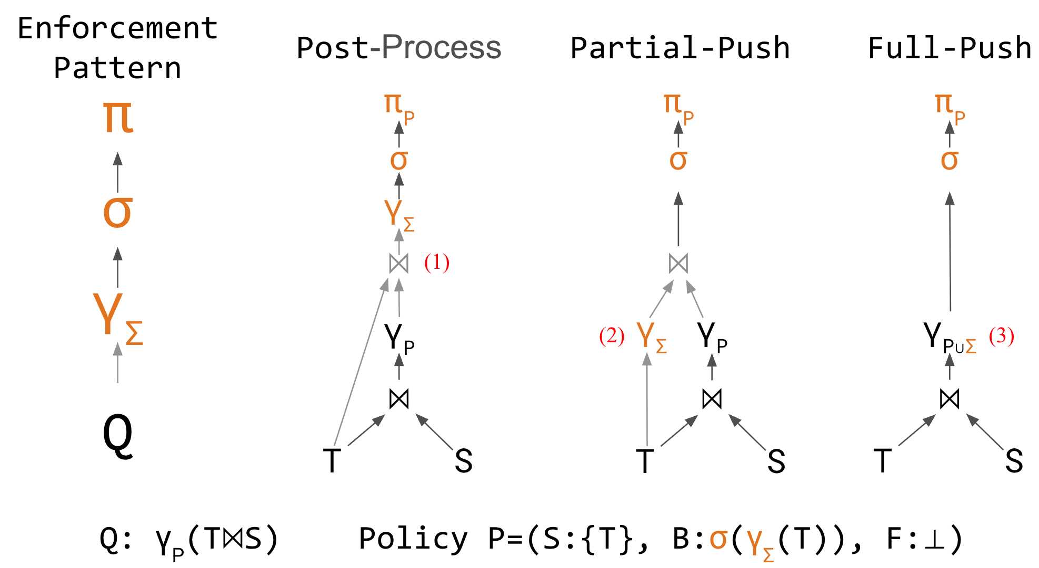
Data Flow Control: Data Safety Policies for AI Agents
Charlie Summers, Eugene Wu
¹Columbia University
Paper
Code
PROBLEM
METHOD
3
PGN policy language
declarative clauses
KEY RESULTS
AI agents increasingly generate SQL, but query correctness is not safety: a semantically valid query can still violate privacy, regulatory, and business rules. No existing DBMS mechanism enforces these rules at the tuple level during execution.
PGN clauses — SOURCE, SINK, DIMENSION, CONSTRAINT, ON FAIL — map one-to-one to the formal policy, then compile to a query rewrite. Violations resolve to REMOVE (drop), KILL (abort), or UDF.
METHOD
METRIC
Provenance (Logical)
2,000–75,000%
Passant Full-Push
≈0%
≈0% overhead · beats provenance baselines by orders of magnitude
4
Sub-linear scaling
theoretical speedups
Correctness ≠ safety — access control, integrity constraints, and provenance audits govern permissions, not disallowed derivations.
20%–10,000×
Full-Push inlines enforcement — compute, filter, project.
provenance tax avoided
SO WHAT → Full-Push achieves ≈0% overhead on all five engines — often faster than the unenforced base query.
1
Provenance monomials
optimizer-invariant
METHOD
OVERHEAD
MOTIVATION
a policy over provenance monomials, invariant to the query optimizer
Provenance (Logical)
2,000–75,000%
HEADLINE NUMBERS
M(o) — the bag of provenance monomials recording which input tuples produced output o
Provenance (Physical)
300–700%
Agents are judged on correctness, but a query can reflect intent perfectly yet produce a result that should never have been computed.
Passant Full-Push
≈0%
≈0%
5
DBMS engines
B(M(o)) — an aggregate boolean constraint over monomials, invariant to the query optimizer
Templated policies collapse to one dominant check — cost stays flat as policy count explodes
Full-Push enforcement overhead
20%–10,000×
provenance tax avoided
across DuckDB, Umbra, PostgreSQL, DataFusion, SQL Server
2,000%–75,000%
Logical slowdown vs Passant
TaxAgent needs three guarantees at once: non-leakage across users, grounding in real receipts, and a 50% meal-deduction cap.
Symmetric self-joins reduce enforcement from factorial to linear in join count
2
Passant rewrite layer
two push-down algorithms
Wide intermediates degrade cache locality — Partial-Push wins there
1
Partial-Push — pushes policy aggregates down through the join
TAKEAWAY
State-machine compliance — ~2 orders faster than a correct GPT-5.2 baseline
Data safety belongs in the database, not in prompts or after-the-fact audits — Data Flow Control makes declarative, optimizer-invariant policy enforcement a near-zero-cost, first-class operation.
WHY NOW
2
Full-Push — inlines everything, zero provenance materialization
Data safety must move out of prompts and post-hoc LLM checks into the data infrastructure itself.
Passant rewrites Q so constraint aggregates are computed inline during execution — on any relational DBMS, no provenance-enabled engine required.
Source scaling — n sources apply when join count ≥ n (Fig. 10)
TPC-H Q1 confirms sub-linear scaling (Fig. 10–11).

