Slide 1


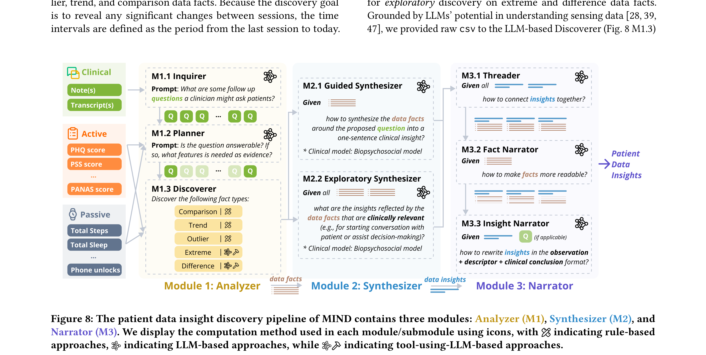

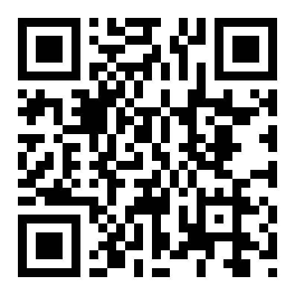
MIND: Empowering Mental Health Clinicians with Multimodal Data Insights
through a Narrative Dashboard
CHI 2026
Ruishi Zou¹, Shiyu Xu¹, Margaret E. Morris², Jihan Ryu³, Timothy D. Becker⁴, Nicholas Allen⁵, Anne Marie Albano¹, Randy Auerbach¹, Dan Adler⁶, Varun Mishra⁷, Lace
Padilla⁷, Dakuo Wang⁷, Ryan Sultan¹, Xuhai “Orson” Xu¹
¹Columbia University ²University of Washington ³Hamilton-Madison House ⁴Weill Cornell Medicine ⁵University of Oregon ⁶Cornell University ⁷Northeastern University
Problem
Method
3
Synthesizer (M2)
facts → insights
Key Results
Patient-generated and clinical data are
rich but scattered across four source
types with different formats and
cadences; existing dashboards dump
raw streams with minimal curation,
forcing clinicians to forage and
synthesize insights themselves under
time pressure.
Distills structured facts into one-sentence
clinical insights guided by the
Biopsychosocial model.
METHOD
METRIC
FACT (data-collection)
3.93
MIND
5.75
+1.82 pts · p<.001 · all 16 clinicians preferred
MIND
4
Narrator (M3) & structure
insights → story
SO WHAT → In a within-subject study (N=16 licensed clinicians), MIND significantly outperformed FACT at revealing hidden, clinically relevant insights (M=5.75 vs 3.93, p<.001) and supporting decision-making (M=5.68 vs 4.62, p=.004).
Raw multimodal data is not a
dashboard — curation is the
missing link between data and in-
session decisions.
MIND’s three-module insight pipeline: Analyzer
(M1) turns raw data into facts, Synthesizer (M2)
distills facts into one-sentence insights, Narrator
(M3) threads them into a coherent story.
Headline Numbers
4
1
Analyzer (M1)
multimodal source types fused
5.75
hidden-
insight score
(FACT 3.93)
Motivation
raw data → facts
16/16
5.68
decision-
support
score (FACT
4.62)
a typed, timestamped, verifiable datum
clinicians
preferred MIND
Multimodal patient data is rich —
passive sensing, active self-reports,
clinical notes, and transcripts — but
their formats and frequencies clash.
Rule-based agents — Mann-Whitney U,
Mann-Kendall, STL/LOESS + MAD for
comparison / trend / outlier facts
SOURCE
FORMAT
CADENCE
N=16 licensed clinicians ·
within-subject vs FACT
p<.001
significance,
largest
effect
(r=.85)
LLM agents — extreme-value and difference
facts, stitched with drill-down panels for
verifiability
Passive sensing
numerical
daily
Existing tools fall short:
detect/predict models barely
generalize across datasets, and data-
collection dashboards (e.g., CardioAI)
expose everything but curate nothing.
Active self-report
numerical
weekly
Takeaway
Clinical notes
text
monthly
Curating multimodal patient data into a
clinician-centered narrative — via a hybrid
rule + LLM pipeline — lets mental-health
clinicians see hidden insights at a glance and
act on them, turning raw data into a decision-
support story.
Session transcripts
text
monthly
2
The MIND pipeline
three modules
1
Analyzer (M1) — data → facts
WHY NOW
2
Synthesizer (M2) — facts → insights
Scan
to
Read
ML predictors barely generalize and
raw-data dashboards curate nothing
— clinicians need text-first narrative
insights they can absorb at a
glance.
3
Narrator (M3) — insights → story
Insight cards carry drill-down panels so
clinicians can verify every claim
A hybrid rule-based + LLM pipeline, co-
designed with five mental-health experts to
surface clinically meaningful insights.
Project
https://gi
thub.com/sea
-lab-s
pace/MIND
Linear + parallel organization: chronological
order inside a Biopsychosocial frame
Paper
Code

