Slide 1



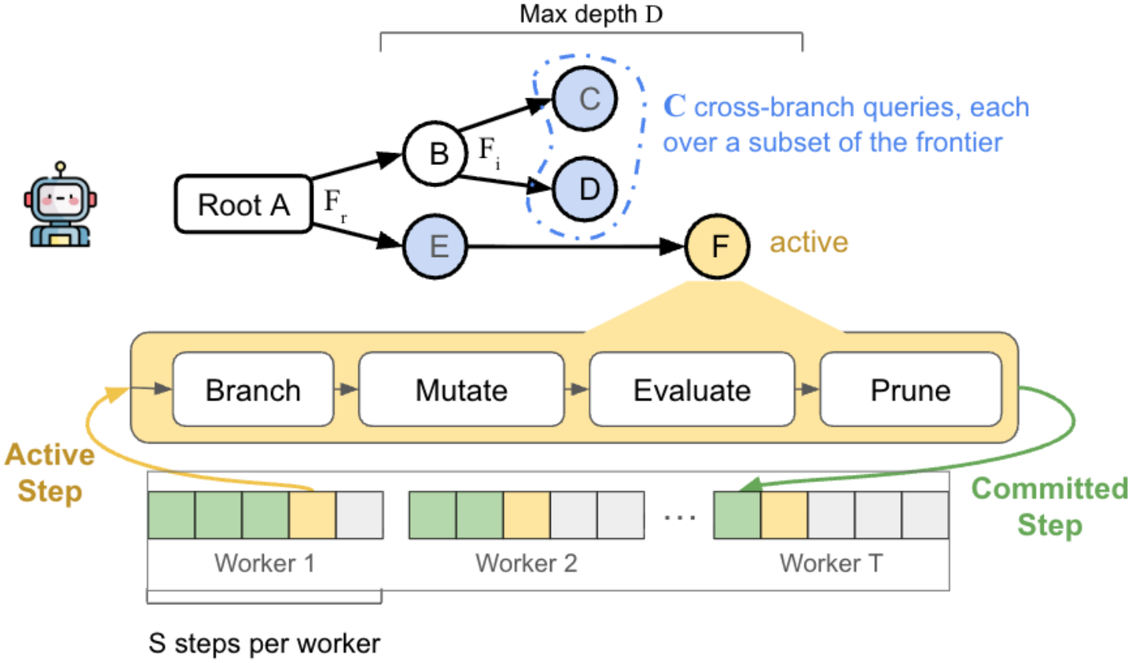

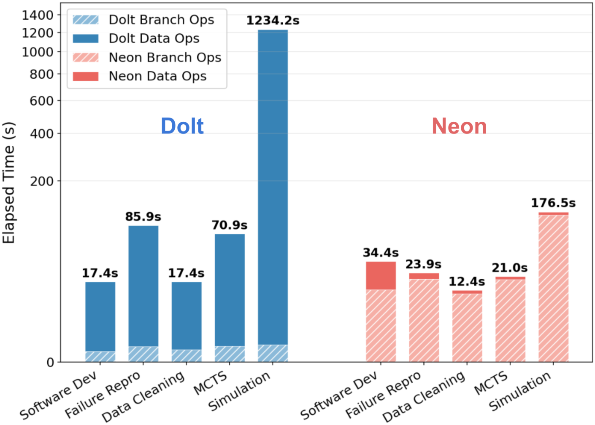
BranchBench: Aligning Database Branching
with Agentic Demands
Preprint
2026
CS.DB
Elaine Ang, In Keun Kim, Sam Weldon, Kevin Durand, Kostis Kaffes, Eugene Wu
Columbia University
Paper
Code
Problem
Method
3
Parameterized Workloads
5 workflows
Key Results
Branchable databases are
becoming infrastructure
for agentic workloads —
speculative mutations and
non-linear exploration.
Traditional RDBMS
mechanisms cannot give
agents persistent isolation or
concurrent branch
management at this
frequency.
Fanout, max depth D, and per-step operation
mix are tunable, so the loop expresses tree
shapes from flat wide simulations to deep
narrow MCTS under a UCT selection policy.
SYSTEM
BRANCH
COST
READ COST
Dolt (fast-data)
low
2–4000× slower
Neon (fast-
branch)
25–1500×
degrades w/
depth
A fundamental tension: no system
handles all 5 workloads at scale.
exploit reward vs. explore under-visited branches
4
SO WHAT → Fast-branching systems pay with reads up to 4000× slower at depth; fast-data systems pay with 25–1500× higher branch creation latency.
End-to-End Workflow Cost
Dolt vs Neon
1st
Architecture of the BranchBench macrobenchmark:
the branch–mutate–evaluate–prune loop executed by
parallel workers over a database state tree.
systematic benchmark
for branchable
relational DBMSes under
agentic loads
Headline Numbers
1
Four Core Operations
branch lifecycle
1500×
Motivation
Branch — fork a writable branch below
fanout and depth limits.
4000×
higher
branch
cost
Agentic exploration needs
high-frequency
speculative state
management —
checkpoint, fork, restore,
evaluate, discard.
Mutate — apply data and schema ops on the
active branch.
43×
Evaluate & Prune — score outcomes,
backpropagate reward, cut weak paths.
slower reads at
depth
Neon
storage
overhead
Neon
DoltgreSQL
Tiger Data
Xata
for fast-branching
systems
5
workloads
benchmarked
PostgreSQL
End-to-end latency per workflow (mini config):
branch vs data operations across five representative
agentic workloads.
Agents create structurally
separate branches at
scale, stressing
instantiation, metadata
scale, and reclamation.
Dolt’s fast branch ops are dominated by slow
reads; Neon stays low on data ops but pays on
branch creation.
2
Branch–Mutate–Evaluate Loop
per worker
Takeaway
Branch
→
Mutate
→
Evaluate
→
Prune
→
Commit
Today’s branchable databases force a choice
between fast branching and fast reads, and
none supports agentic workloads at scale —
motivating branch-native DBMSes built for
the high-frequency exploration autonomous
agents demand.
An MCTS agent forks
thousands of database
branches to explore
speculative actions — a
regime existing
branchable systems were
never designed to serve.
Each of T parallel workers runs S steps of the
loop, integrating branching overhead, mutation
throughput, and evaluation cost into one end-to-
end score.
1234s
176s
85.9s
12.4s
Dolt simulation
Neon
simulation
Dolt failure
repro
Neon data
cleaning
Read cost, not branch cost, dominates
Dolt’s slowest workflows (up to 1234s on
simulation) — the branch-vs-read tension is
structural, not incidental.
Microbenchmarks additionally isolate
branch creation, deletion, and
persistence costs.
Fast branching or fast reads — pick one.
No system does both at agentic scale.

