Slide 1


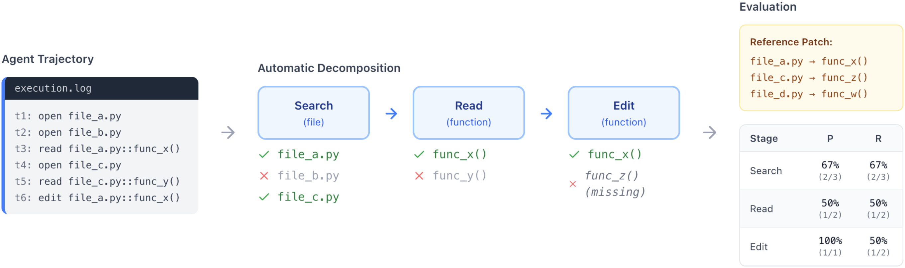



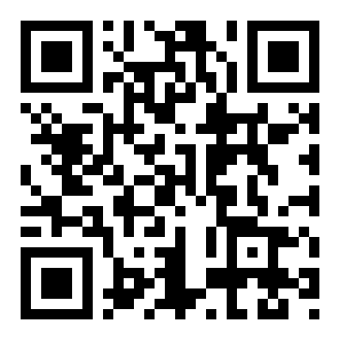
Coherence Collapse: Diagnosing Why Code Agents Fail After
Reaching the Right Code
Myeongsoo Kim¹, Dingmin Wang¹, Siwei Cui¹, Farima Farmahinifarahani¹, Terry Yue Zhuo², Shweta Garg¹, Baishakhi Ray¹, Rajdeep Mukherjee¹, Varun Kumar¹
¹AWS AI Labs ²Monash University
PROBLEM
METHOD
3
Isolating the Edit-Quality Residual
the culprit
KEY RESULTS
Code agents resolve 65–70% of SWE-bench issues, but Pass@1 cannot tell us why the rest fail — and capable-model failures are misdiagnosed without trajectory data.
The Edit-Quality bucket — 56.9% of all SWE-Agent failures — is the dominant residual for every capable model, yet stage-level precision and recall alone cannot decompose it into the actionable, mutually-exclusive failure types below.
FAILURE LOCUS
SHARE
Localization (Search + Read)
minority
GAP
Right location, wrong code: the failure lives inside the edit itself, not the search.
Edit-Quality (right code, wrong patch)
60–69%
Outcome-only metrics collapse a trajectory into one bit — hiding the real cause of failure.
TrajEval decomposes each agent execution trace into reference-patch-aligned Search (file), Read (function), and Edit (function) stages, then scores stage-wise precision and recall against the gold patch.
Coherence Collapse = 39.7% of Edit-Quality failures — the largest theme.
4
Failure Taxonomy
5 themes / 9 sub-types
SO WHAT → Most failures reach and edit the correct functions yet emit a wrong patch — replicating on PolyBench (32.3%).
MOTIVATION
1
Three-Stage Decomposition
All 914 Edit-Quality failures are classified by a cascading-precedence rule over three trajectory signals into these themes:
training-free
Every task ships a reference patch — the exact files & functions that must change.
Each trace is split into Search (file-level), Read (function-level inspection), and Edit (function-level modification), each compared against the gold reference set of files and functions.
Coherence Collapse
Confused Thrashing
It turns messy tool-use logs into checkable localization, comprehension, and modification signals at every stage.
Near-Correct Corrupted
Semantic Error
HEADLINE NUMBERS
Wrong Branch Point
Mis-localization
Scope / Completeness
Execution Gap
60–69%
16,758
trajectories analyzed
Without trajectory data, a failure that reached the right code looks identical to one that never found it.
precision & recall per stage ; = agent set, = gold set
EDIT-QUALITY THEME
N
%
Coherence Collapse
363
39.7
2
Stage-Wise Precision & Recall
per trace
Semantic Error
302
33.0
Intra-File Mis-loc.
161
17.6
of capable-model failures reach & edit the right code — yet ship a wrong patch
39.7%
Coherence Collapse share
TAKEAWAY
Trace
→
Search
→
Read
→
Edit
→
P / R
Scope / Completeness
72
7.9
Execution Gap
16
1.8
For capable code agents the frontier bottleneck is no longer finding the right code — it is not destroying the fix once found. In 5 EXACT cases the agent produced a patch bit-identical to the gold reference mid-trajectory, then overwrote it — an edit-commit checkpoint recovers all 5. A reference-free consensus variant even lifts GPT-5 Pass@1 by a directional +3.0 points without any reference patch.
Each stage yields precision and recall vs. the reference patch — turning one binary Pass@1 into a six-number profile that pinpoints which stage broke. Applied across 3 architectures (SWE-Agent, OpenHands, bash-only LiveSWEAgent) and 7 models from GPT-5 to the Qwen3 family. High recall with low precision flags an agent that found the target but thrashed around it; the reverse flags an agent that never reached it.
Second-author agreement on the 3-class split is substantial (κ=0.80, 90% raw).
5/5
gold patches recovered
Failure comes after localization, not before
SCAN TO READ
Coherence Collapse is a distinct, recoverable failure mode — trajectory-level analysis is what makes it visible.
16,758
agent trajectories scored end-to-end
Paper

