Slide 1
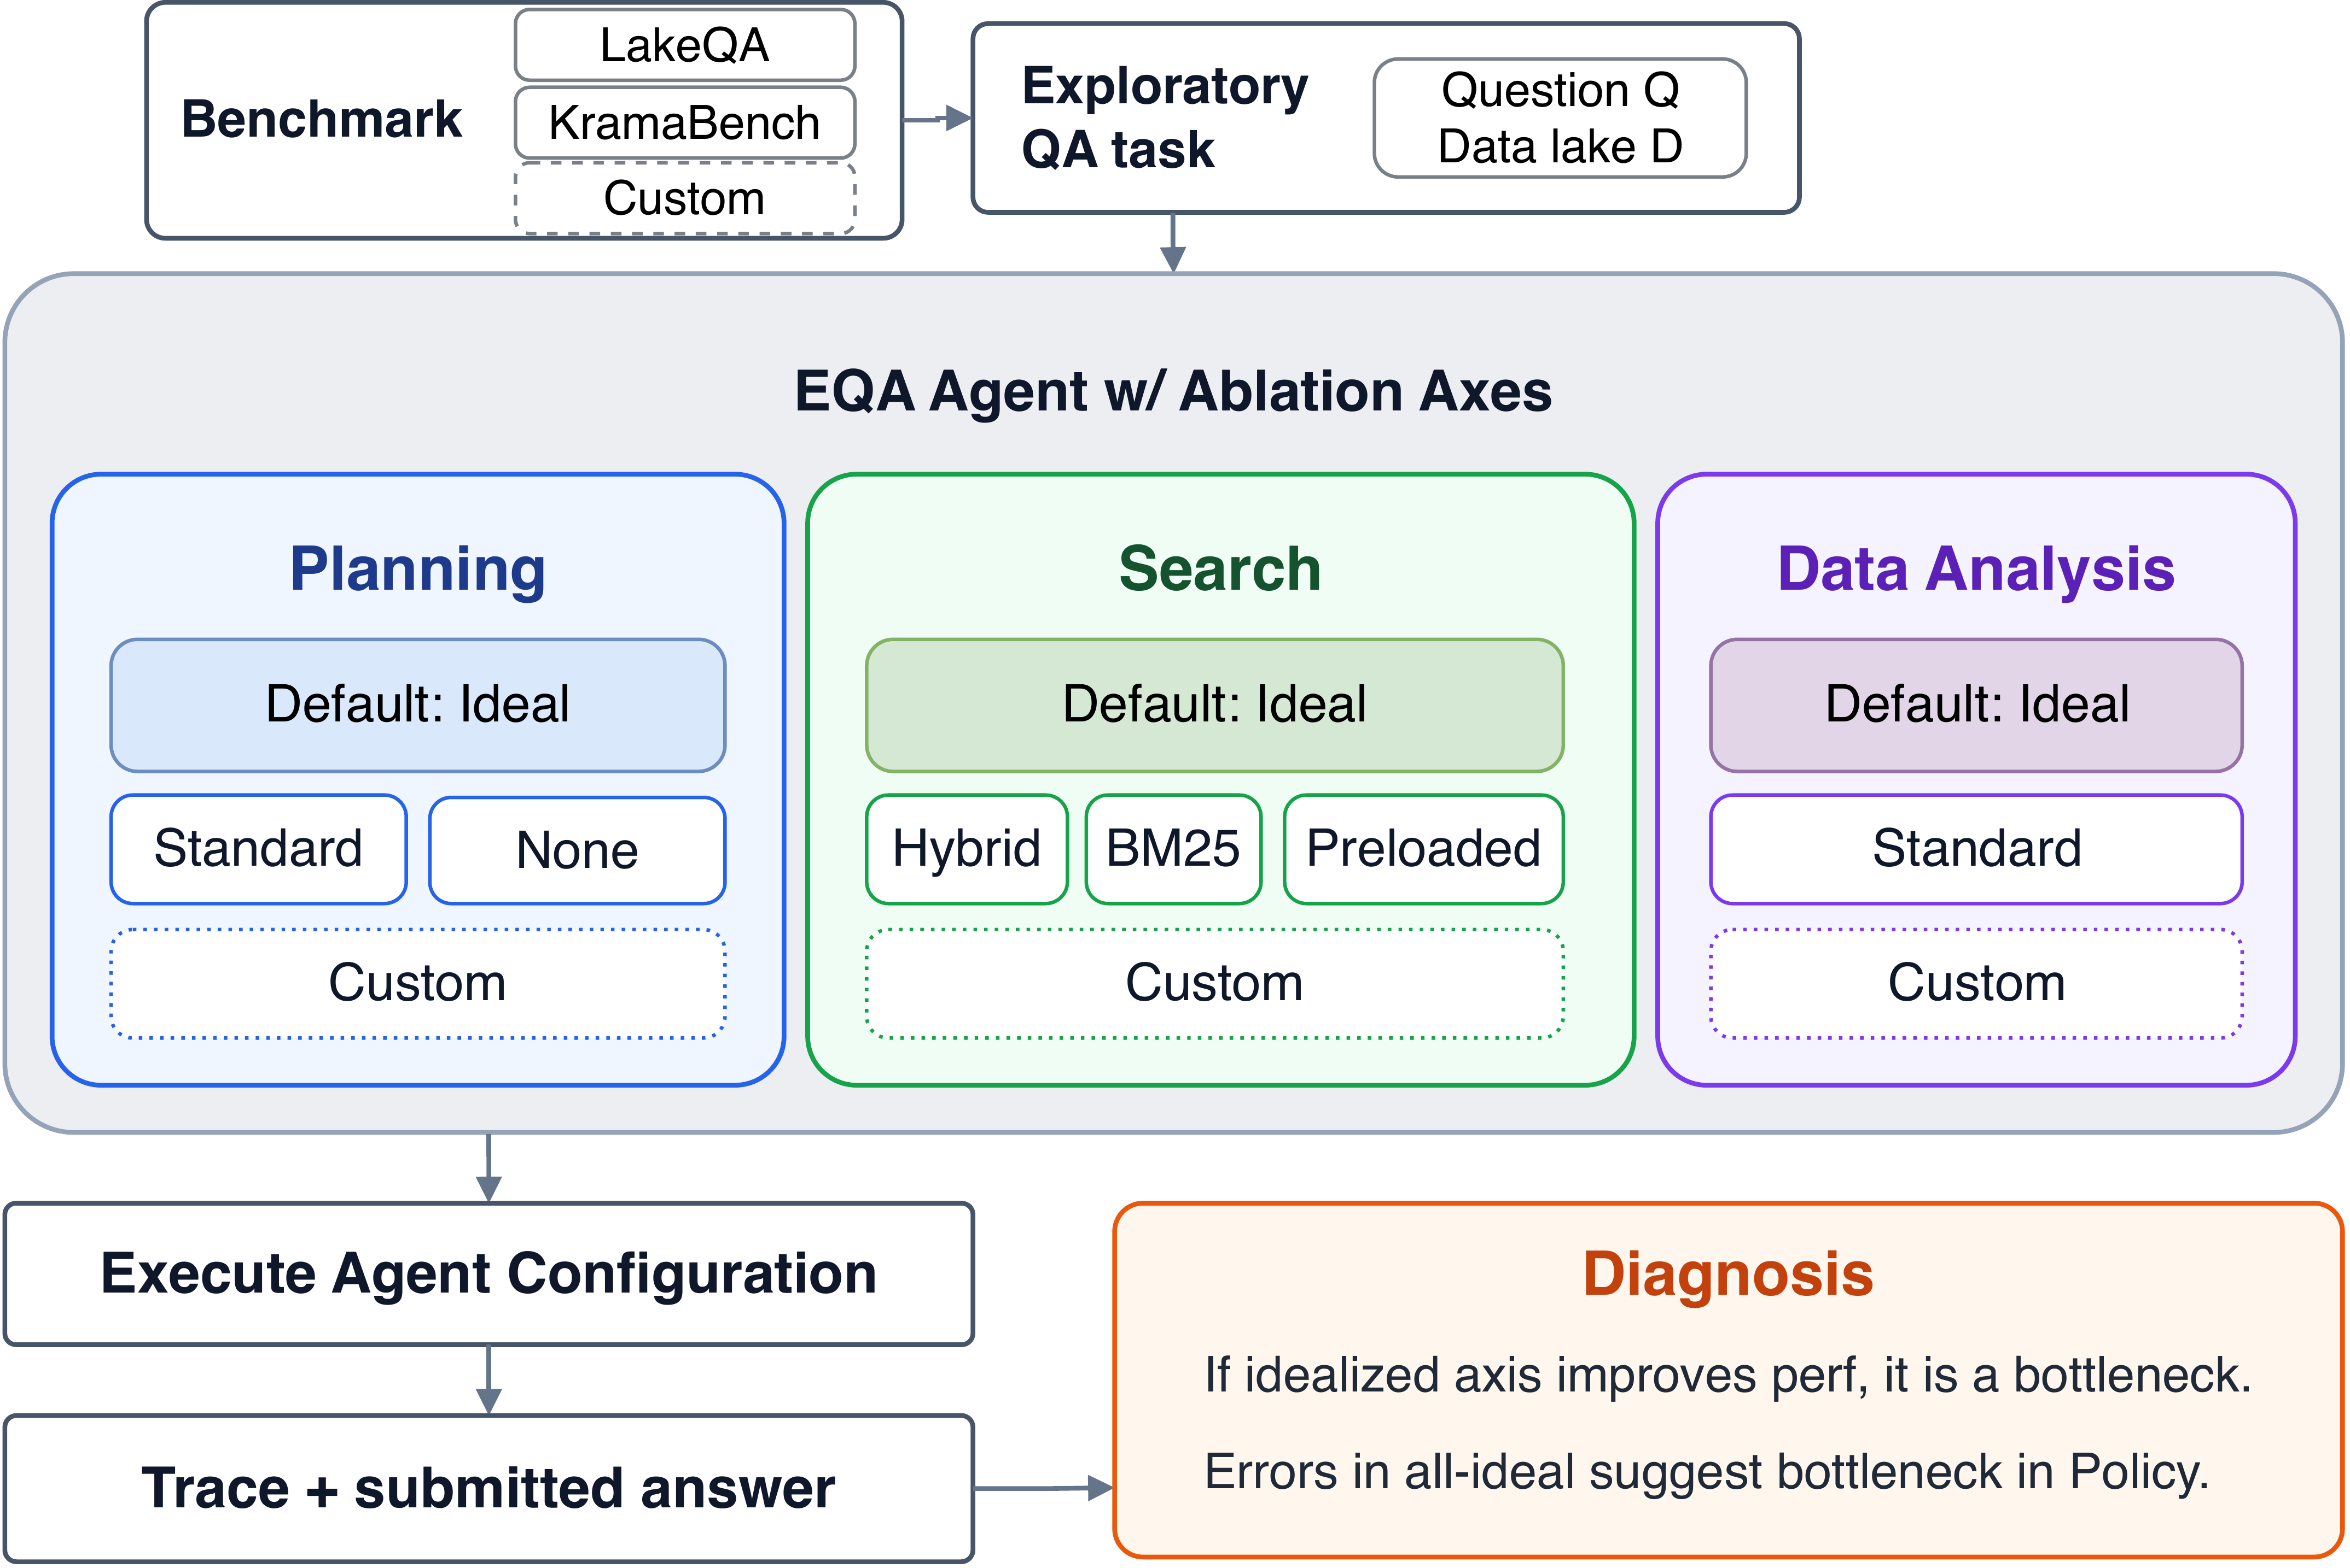
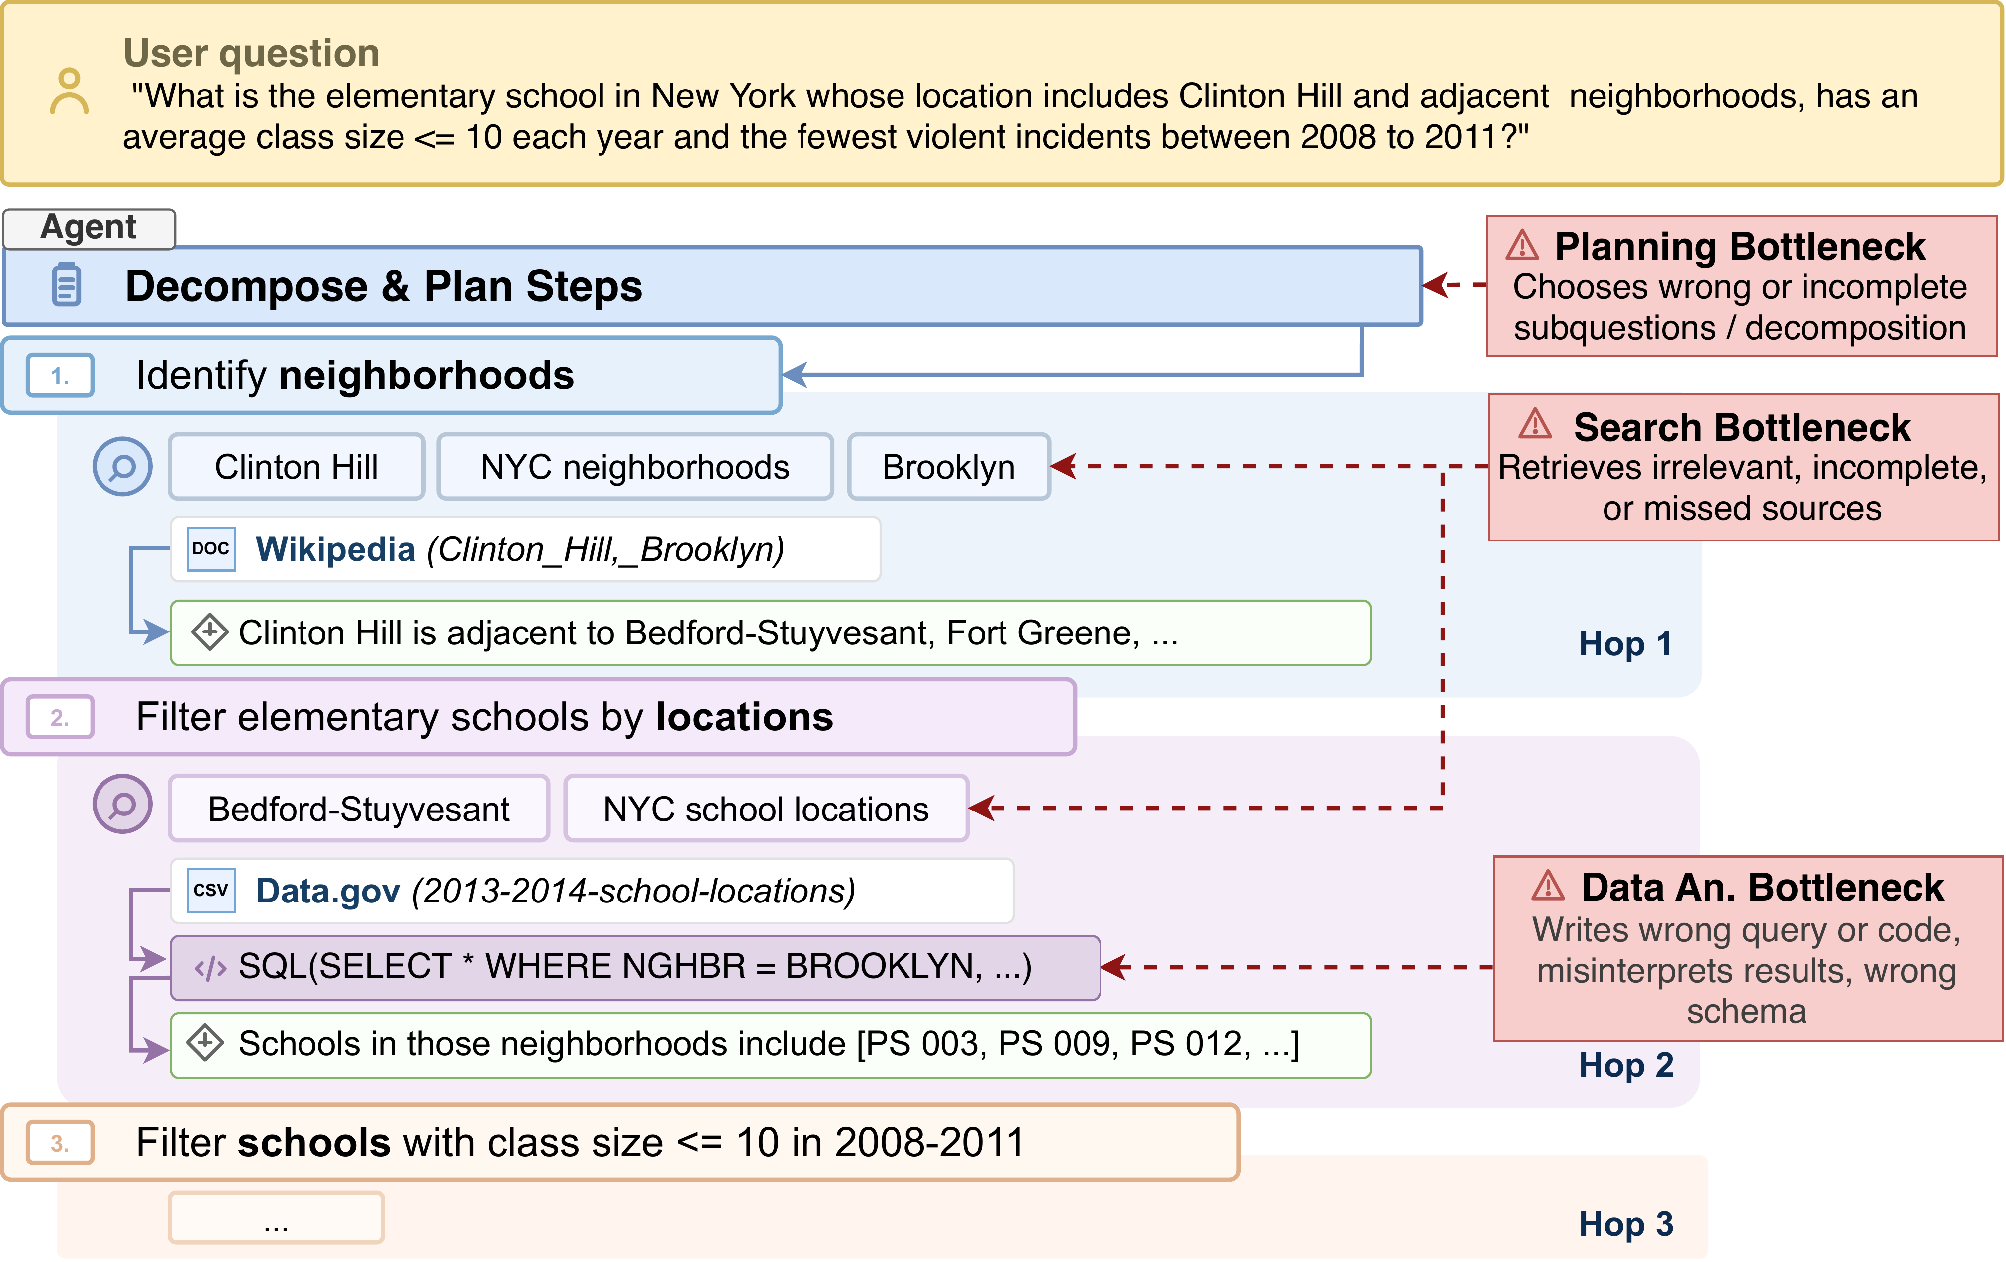


SANA: What Matters for QA Agents over Massive Data Lakes?
arXiv 2026
Austin Senna Wijaya, Jiaxiang Liu, Haonan Wang, Eugene Wu
Columbia University · New York, USA
Problem
Method
3
Idealized ablation tools
three axes
Key Results
End-to-end EQA accuracy can’t tell where an agent fails: search, planning, data-analysis execution, and the Action Policy are conflated into one number.
S
›
P
›
A
MODEL · LAKEQA
NAIVE
IDEAL
Ideal search
Ideal planning
Ideal analysis
gpt-5.4-nano
20.7%
37.0%
f_{ideal}(q,k) ⊆ D_{gold}
sanitized subquestions
intent-verified answer
gpt-5-mini
56.3%
76.3%
One score can’t separate missing sources, ignored evidence, wrong decomposition, and brittle SQL.
Each idealized tool is built from the profile, then ablated one axis at a time.
+20pt
end-to-end SM gain (all-ideal)
Ideal search routes the query, gold set, and intent to a selector subagent; each dataset carries an LLM description plus a schema/row preview. Ideal analysis returns the gold answer on an intent match — otherwise a stronger model (gpt-5.4) regenerates the code and self-repairs up to twice.
SO WHAT → Data analysis is the consistent bottleneck; search dominates LakeQA’s large-scale discovery; planning is least limiting — agents write near-gold plans but don’t follow them.
Motivation
agentic retrieval
plan decomposition
SANA’s three runtime components — planning, search, and data analysis.
tool use
code/SQL gen
DCI
Headline Numbers
Metadata Reasoner
1
Anatomy of an EQA task
+20.0pt
39.6%
execution/computation failures (gpt-5-mini)
Prior work advances each capability in isolation — retrieval, decomposition, tool use, SQL — so scores say little about a real long-horizon agent.
4
Diagnosis rule
read the gap
81.5%
plans judged similar to gold (nano)
each intermediate answer is entailed by its subquestion, gold dataset, and prior answers
Idealize one axis at a time; hold the others ideal so no bottlenecks conflict.
LakeQA end-to-end SM gain (gpt-5-mini)
The agent decomposes Q into subquestions, discovers each subquestion’s gold dataset, and derives intermediate answers within budget B.
56.3% → 76.3% semantic match — the residual gap is the Action Policy.
19.0%
baseline plan-follow rate (nano)
An idealized axis that improves accuracy is a bottleneck.
DCI gives direct corpus access; Metadata Reasoner scores dataset selection. Neither isolates search vs planning vs execution vs policy.
Search → planning → analysis feed one another inside a single long-horizon loop.
Errors under all-ideal reveal the residual Action-Policy gap.
Takeaway
All-ideal residual errors = the policy (plan-following, source commitment, finalization), not the tools.
DIAGNOSIS
Without a diagnosis of where an agent fails, builders optimize the wrong thing — a better retriever won’t help if the real gap is plan-following or finalization.
2
Runtime profiling
task → profile
One accuracy number becomes a per-component diagnosis: data analysis is the bottleneck, search dominates discovery, and the hardest gap is the Action Policy — not better retrievers or code.
1
Collect the gold source sequence.
Failed LakeQA traces are audited into seven failure families; the dominant family shifts with model scale and agent capability.
2
Sanitize the subquestion decomposition.
3
Record execution traces (query, code, intent).
Future EQA agents need policies that commit to validated sources and verify the final answer.
4
Build idealized tools from the profile.
39.6%
21.0%
17.7%
12.2%
5
Ablate one axis, hold the rest ideal.
execution / computation
finalization
tool blockers
incomplete evidence
Three end-to-end modes — Naive, Standard, Ideal — bound the gap: Standard barely beats Naive (+1.5% / −1.5%), while Ideal lifts both agents sharply. The Standard→Ideal distance is the diagnosis; the all-ideal residual is the policy.
Scan to Read
Each task becomes a runtime profile — gold source sequence, sanitized subquestions, and execution records — the ground truth that every idealized tool is built from.
EQA runtime loop and its three bottlenecks.
Paper
Code

