Slide 1

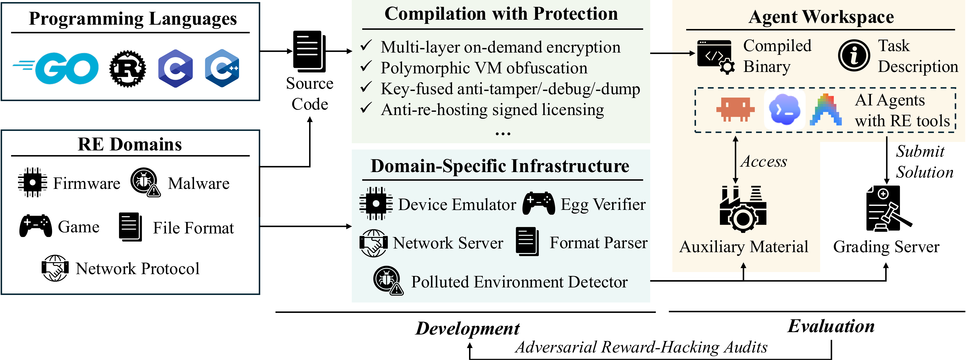
arXiv 2026
The Next Challenge for Agentic Cybersecurity: A
Realistic, Contamination-Free Reverse Engineering
Benchmark
Jeremy Spence¹, Nicholas Assaderaghi¹, Jinhao Zhu², Nikil Ravi³, Raluca Ada Popa², Guannan Wei⁴, Yangruibo Ding⁵, Zhuo Zhang¹
¹Columbia University ²UC Berkeley ³Vals AI ⁴Tufts University ⁵UCLA
PROBLEM
METHOD
3
Evaluation
Stage 3
KEY RESULTS
GAP
1
Agent receives the binary + domain-specific auxiliary material.
MODEL
MEAN /6
SOLVED
Benchmark binaries must be unseen in training data yet match real software's scale and anti-analysis protections — no existing RE benchmark satisfies both.
GPT-5.6-sol
3.69
31.5%
2
Agent submits a solution.
Claude-Opus-5
1.91
12.5%
3
Deterministic grader scores 6 tasks per instance — no LLM judge.
HEADLINE NUMBERS
Most consequential software ships only as binaries: 46% of exploited vulns come from vendors that release no source; 48% of 2025 zero-days hit proprietary software.
320K
SRE-Bench pipeline: 19 programs → 8 build variants × 8 protection presets → 262 binaries.
4
Protection suite
Anti-analysis
61.4%
lines of code
44 in-house primitives (27K LoC); over half have no public implementation — a real anti-analysis moat.
strongest model
1,572
graded tasks
1
Development
Stage 1
only 31.5% fully solved · 17× gap
44
protection primitives
MOTIVATION
RE experts (avg 6 yrs) author 19 programs from a private spec + matching deterministic graders.
9 technique families: per-page authenticated encryption, measurement-keyed anti-debugging, loader-logic virtualization, anti-re-hosting.
CTF-derived — NYU CTF, Cybench, CTF-Dojo: public solutions → contamination, entry-level.
4 languages — C, C++, Rust, Go.
TAKEAWAY
Private reference solutions score 6/6, proving every program is solvable.
Source-code security skill does not yet transfer to binary RE — the strongest model recovers under a third, and protection halves that.
Clean-room toys — CREBench, AgentRE-Bench, CrackMeBench: 36–526 LoC, textbook protections.
8 graded presets: harder presets collapse every model; GLM-5.2 lands at exactly 0.00 on all 8.
5 real-world domains: network protocol, game, file format, malware, firmware.
Both camps are already saturated: a 1.1K-LoC clean-room compressor and a gzip variant are each fully solved for under $2 in 10 minutes.
Adversarial audit with Opus 4.8 patches every reward-hacking shortcut that earns credit without genuine RE.
2
Build
SRE-Bench: the new testbed. Contamination-free, real-world scale, 17× gap.
Stage 2
Both axes are load-bearing: RevCompress (clean-room + real scale) is the only target that separates the models at 10–30× the cost.
8 harden presets
Optimize O0/O3
→
Strip symbols
→
Static/dyn link
→
→
→ 262 binaries
Protection is the one classical obstacle that transfers to agents.
Symbol stripping & protection dominate; agents lean on lexical anchors, not instruction-level reasoning.
<$2
Optimization & static linking barely register; symbol stripping dominates — costing GPT-5.6-sol 0.48 points and halving GPT-5.5.
36–526
10min
10–30×
262
toy LoC range
saturation cost
saturation time
cost to separate
binary instances

