Slide 1




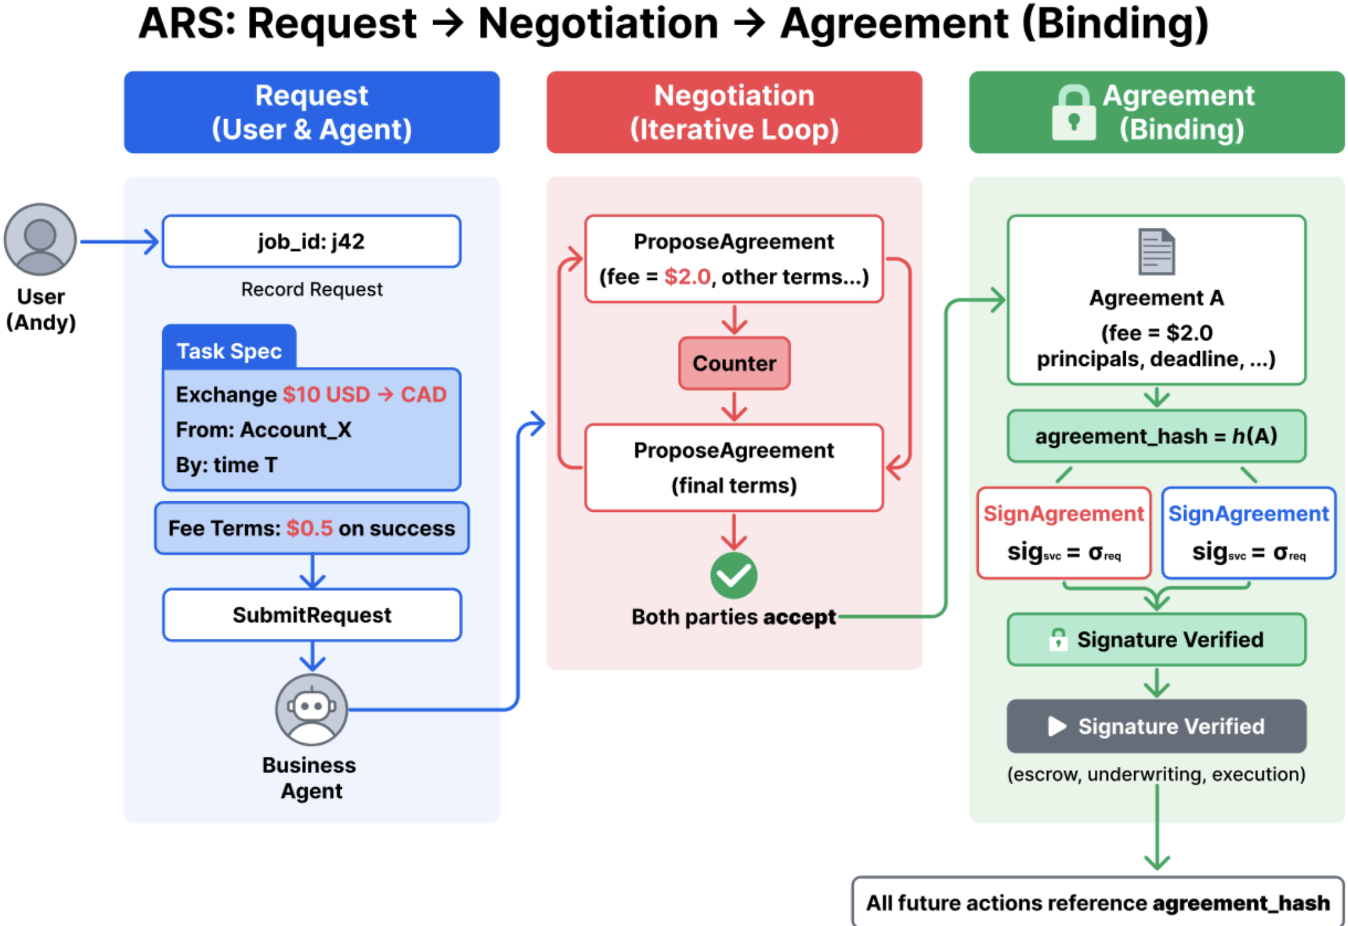
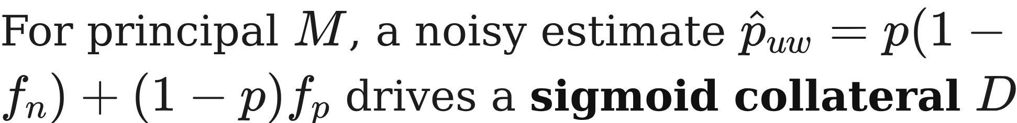

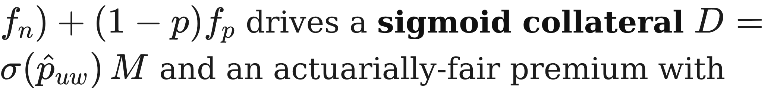


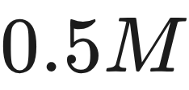

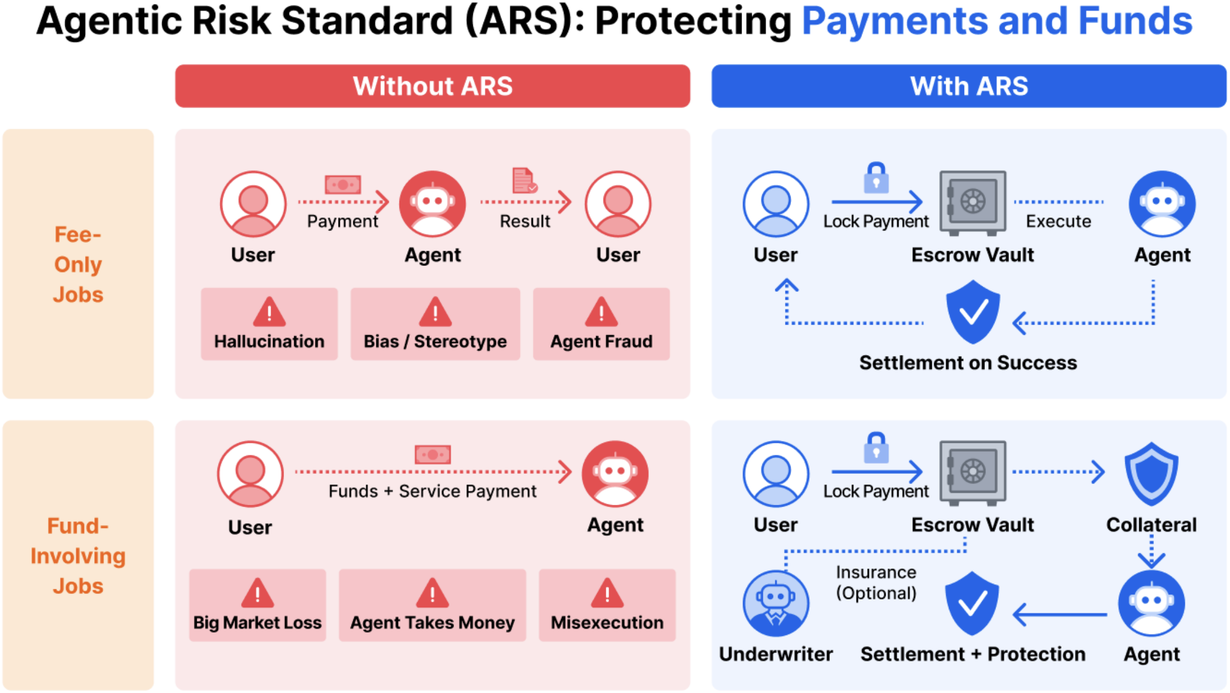


Preprint 2026
Quantifying Trust: Financial Risk
Management for Trustworthy AI
Agents
Wenyue Hua¹, Tianyi Peng², Chi Wang³, Jiaxin Pei⁴, Ian Kaufman⁵, Bryan Lim⁶, Chandler Fang⁵
¹Microsoft Research ²Columbia University ³Google DeepMind ⁴Stanford University ⁵t54.ai ⁶Virtuals ACP
PROBLEM
METHOD
3
Underwriting: Collateral &
Premium
actuarial pricing
KEY RESULTS
Agent behavior is inherently stochastic, so product-level harms — execution failure, misalignment, unintended outcomes — cannot be eliminated by model-internal safeguards like robustness or interpretability alone.
For principal , a noisy estimate drives a sigmoid collateral and an actuarially-fair premium with loading :
LOADING Λ
LOSS REDUCTION
ADOPTION
0.0
61%
0.446
0.5
~42%
0.30
1.0
24%
0.126
SO WHAT → Loss reduction stays positive across the whole sweep; collateral deters risky jobs before execution.
The operational meaning of trust shifts to end-to-end outcomes that technical safeguards cannot guarantee.
residual exposure after collateral, scaled by the loading factor
Midpoint sets where collateral reaches ; steepness controls how sharply low- and high-risk jobs separate.
HEADLINE NUMBERS
MOTIVATION
15–20%
failure events deterred
High-stakes industries never rely on trust alone — they use insurance and underwriting to price and absorb risk.
ARS job lifecycle: Request → Negotiation → binding Agreement anchored by a signed agreement_hash.
4
Three-Stage Friction
Gate
protection vs. participation
61%
Sigmoid sizing sharply separates low- vs. high-risk jobs while staying continuous — near-zero collateral for safe jobs, approaching full principal as risk rises.
Peak reduction in mean user loss
5,000
simulation episodes
Prior trustworthy-AI work treats safety as a model property; none give users predefined, contractually enforceable recourse when a transaction fails.
Standard-Mediated Job
Lifecycle
transaction layer
vs. no underwriting (zero loading)
$9.4K
peak underwriter wallet
1
A transaction-layer settlement standard uniting risk assessment, underwriting, escrow, and compensation.
Merchant posting: willingness to post collateral falls linearly from 0.90 at zero collateral to 0.10 at full collateral, capturing real participation friction.
ARS borrows financial underwriting to make agentic-transaction risk bearable and priced.
TAKEAWAY
A requestor, business agent, and underwriter interact through a typed action vocabulary, each one bound to a signed agreement_hash for audit.
Human override proceeds without coverage (probability 0.50) — no premium is collected and the buyer bears the full loss on failure, so the gate balances protection against participation.
Treating agent reliability as an underwritable financial risk — not a model property — gives enforceable, priced protection
3
standard roles, one auditable transaction interface
Two complementary protections: contingent reimbursement for covered failures plus an ex-ante collateral buffer that shifts downside to the business agent.
SO WHAT
Trust becomes a priced, enforceable guarantee.
2
End-to-End Transaction Flow
5 stages
The premium is actuarially consistent with collateral: as collateral nears full principal, residual exposure and premium both vanish, while risky uncollateralized jobs pay more. On resolution, collateral is returned when no failure occurs; on failure it is forfeited up to realized loss and the underwriter reimburses the rest.
Request
→
Assess
→
Collateral
→
Execute
→
Settle
SCAN TO
READ
Without ARS, users prepay agents and absorb every downstream harm; with ARS, fees lock in escrow and release only on verified success, with optional underwriting for fund-moving jobs.
ARS targets pre-verification fund exposure, where principal releases before verification, so fee escrow alone cannot protect the buyer.
wenyuehua@microsoft.com github.com/t54-labs/AgenticRiskStandard
Every action stays attributable to a standard role and bound to the signed agreement.
Paper
Code

