Slide 1


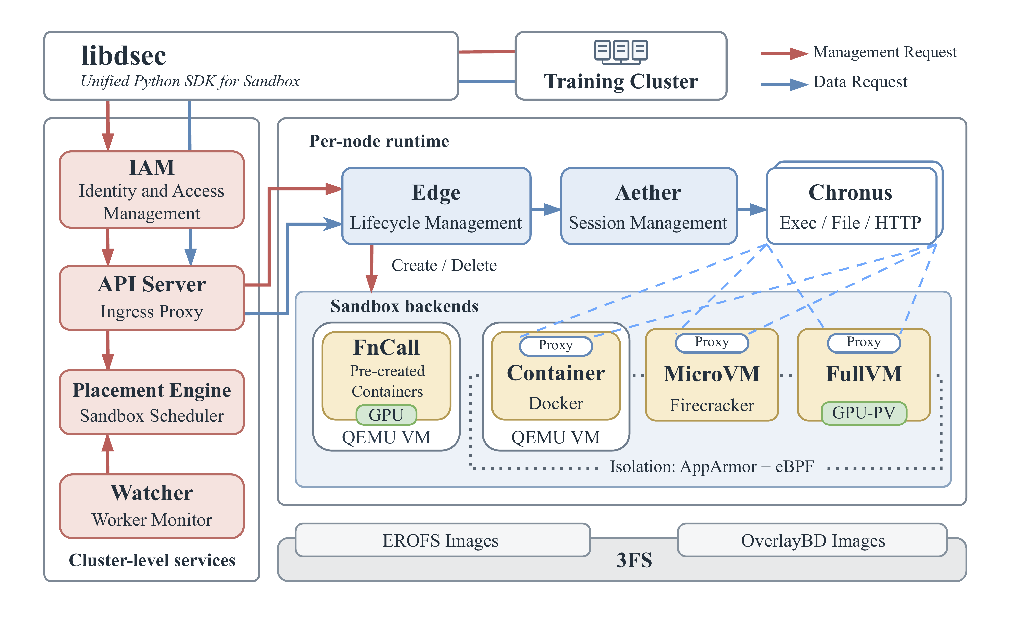

DeepSeek Elastic Compute (DSec): A Sandbox
Infrastructure for Effective Agentic Training at
Scale
PREPRINT 2026
Jialiang Huang^{1,2}, Hongxuan Tang¹, Jingchang Chen¹, Yuxuan Liu¹, Yixiao Chen¹, et al.
¹ DeepSeek-AI ² Tsinghua University
Problem
Method
C
Composable Environments
load only what runs
Key Results
Agentic training creates bursty, stateful
sandboxes; persistent memory, huge
image corpora, and mixed isolation
exceed any single runtime.
Immutable EROFS layers keep metadata local while 3FS
serves file data lazily, avoiding full-image download and
repeated extraction.
IMAGE PATH
COMPLETION
WRITES / NODE
Docker · cached
≈35 min
≈600 GB
Docker · eager
>60 min
>1,600 GB
1
Compose
›
2
Mount
›
3
Fetch on
demand
DSec · EROFS
≈35 min
≈700 GB
SCALE GAP
≈57% fewer disk writes than eager image
pulling
One job may request up to 32,000
stateful sandboxes.
D
Dense Execution
share · reclaim · protect
SO WHAT → Lazy data access approaches fully-local speed while avoiding eager distribution and extraction.
virtio-pmem shares read-only mappings across
microVMs.
Motivation
DAMON plus balloon FPR reclaims idle guest
memory at scale.
Headline Numbers
DSec architecture: one SDK, four sandbox backends, and 3FS-backed
images.
Eager pulls and monolithic
environments delay creation bursts.
SCHED_IDLE plus core scheduling protects
latency-sensitive work.
380K+
5K+/s
sandbox
creations
A
Runtime Portfolio
match isolation to work
concurrent
sandboxes
3M/day
sandboxes
served
Uncontrolled overcommit duplicates
memory and harms latency-sensitive
agent steps.
FnCall serves short, pre-created execution.
21.2%
17.3%
≈160
Containers cover broad Linux workloads efficiently.
40.2%
production peak
nodes per
unit
lower peak memory
lower integrated
memory
latency inflation
at 50% load
MicroVMs and full VMs add stronger isolation and
compatibility.
MECHANISM
PRESSURE
CONTROLLED
MEASURED
OUTCOME
Takeaway
EAGER +
MONOLITHIC
vs.
DSEC
Pull and unpack
every image
before work.
Compose
layers; fetch
only the
working set.
FnCall
Container
MicroVM
Full VM
virtio-pmem
Duplicate page
cache
−40.2% peak
memory
DSec scales agentic RL by co-designing
isolation, data access, lifecycle, memory, and
CPU control while preserving rollout state
across preemption.
Production proof: 380K+ concurrent sandboxes.
DSec scales agentic RL by co-designing isolation, data access, lifecycle, memory, and CPU control while preserving rollout state across preemption.
B
Elastic Control
one request path
DAMON + FPR
Idle guest pages
−21.2%
integrated
memory
SDK
→
API
→
Place
→
Edge
→
Run
CPU demand is intermittent, but
memory and accumulated state
persist between agent actions.
The control plane separates global placement from
node-local lifecycle management, allowing large
bursts to scale horizontally.
SCHED_IDLE +
core
SMT
interference
17.3% vs 45.2%
Low reuse and long sessions make
elasticity a system-wide requirement.
These controls are complementary: sharing removes
duplicate read-only state, reclamation recovers idle
pages, and CPU QoS protects interactive steps.
Scan to Read
Global scheduling, local lifecycle control, one
unified SDK.
Paper

