Slide 1


SYSTEMS RESEARCH · AGENTIC TRAINING
DeepSeek Elastic Compute
Elastic execution, not faster containers.
380K+
ONE SDK
FnCall
Containers
microVMs
concurrent sandboxes
VMs
Production infrastructure for training and evaluation
DeepSeek-AI · Tsinghua University
Notes:
## [Group 6] SYSTEMS RESEARCH · AGENTIC TRAINING
DeepSeek Elastic Compute, or DSec, is a production sandbox
## [Group 11] 380K+
infrastructure built for large-scale agentic training and evaluation.
## [Group 19] ONE SDK
It unifies several isolation backends while scaling stateful
## [Group 23] DeepSeek-AI · Tsinghua University
execution to hundreds of thousands of concurrent sandboxes.

Slide 2
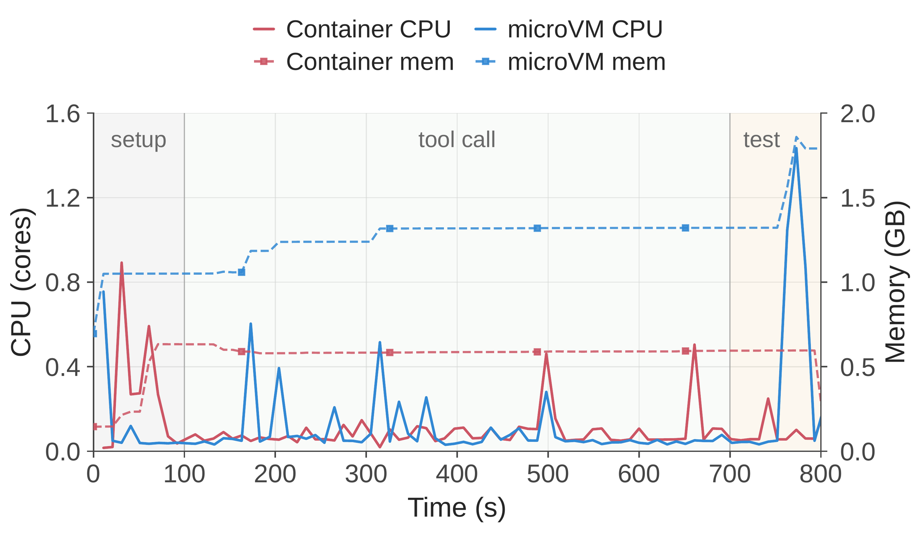
01 · WORKLOAD TENSION
The CPU goes idle. The state does not.
Bursty creation
Up to 32,000 sandboxes per task
Intermittent compute
Tool calls spike, then wait
Persistent state
Memory and filesystem remain resident
Representative sandbox execution: setup → tool calls → test
State retention constrains density even when CPU demand falls.
Notes:
## [Group 12] Bursty creation
Agentic models repeatedly inspect repositories, run tools, and preserve state across long interactions. This creates bursty demand, heterogeneous isolation requirements, and
## [Group 16] Representative sandbox execution: setup → tool calls → test
resource footprints that persist even while CPUs are idle. A scalable platform must therefore coordinate much more than one sandbox runtime.

Slide 3
02 · WHY THE OLD MODEL BREAKS
Four pressures collide at production scale
Isolation varies
Images fan out sparsely
Functions → containers → microVMs → full VMs
Eager pulls duplicate work and disk traffic
Idle state stays resident
Neighbors interfere
Long lifetimes keep memory and state alive
Best-effort load inflates agent-step latency
THE REQUIREMENT
One elastic substrate must solve all four together.
Notes:
## [Group 11] Isolation varies
Traditional container assumptions break under agentic workloads. Images
## [Group 18] Images fan out sparsely
are large and reused sparsely, setup arrives in
## [Group 26] Idle state stays resident
bursts, and long-lived state keeps memory resident. At
## [Group 41] Neighbors interfere
the same time, best-effort tasks can interfere with
## [Group 45] THE REQUIREMENT
latency-sensitive agents unless the platform controls co-location explicitly.

Slide 4
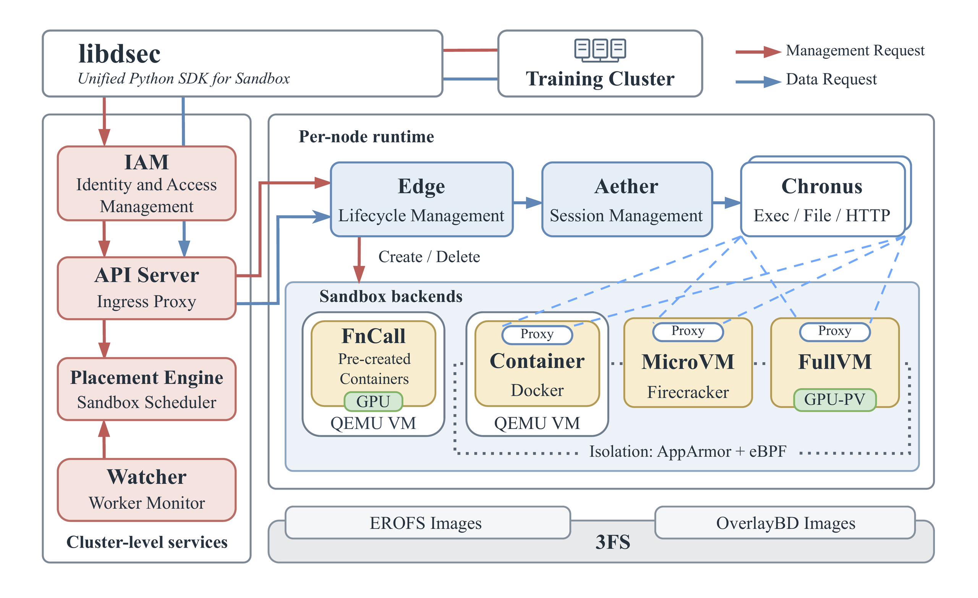
03 · THE UNIFIED INTERFACE
One SDK, four isolation backends
Route each job
to the lightest
suitable backend.
CONTROL PLANE
Cluster placement
EDGE PROXY
Lifecycle + mediation
EXECUTORS
Backend specialization
Unified training API above runtime-specific executors and shared cluster services.
Notes:
## [Group 15] Route each job
DSec combines multiple isolation backends behind one interface. It coordinates scheduling and lifecycle management across the cluster, composes immutable environment layers, and
## [Group 18] Group 18
uses memory reclamation plus CPU quality-of-service controls. It also integrates with the reinforcement-learning framework so long-running rollouts can survive preemption safely.

Slide 5
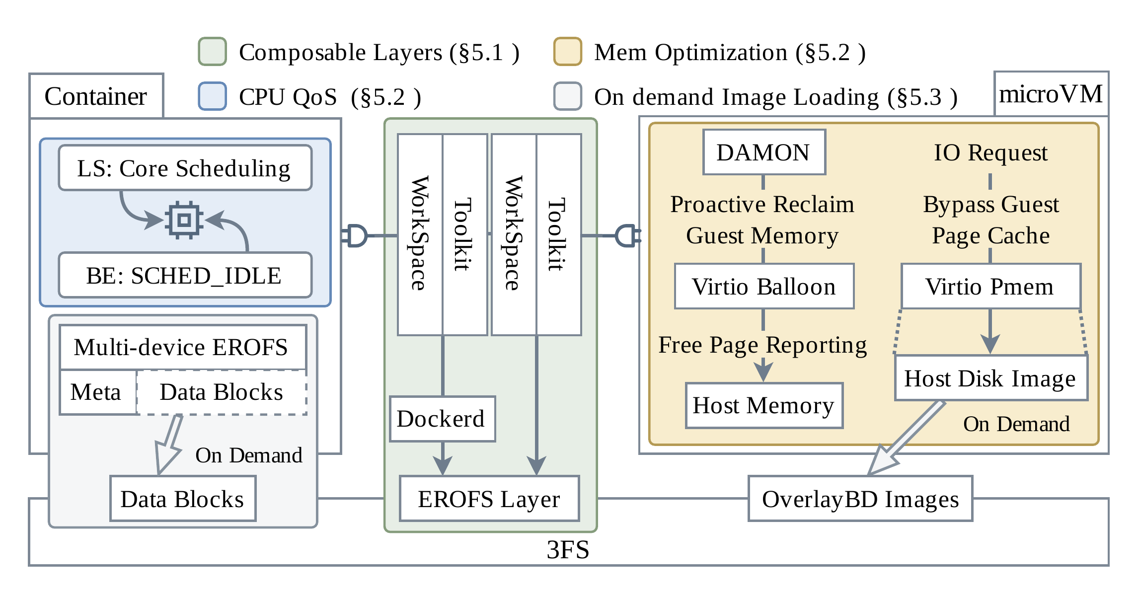
04 · CORE MECHANISMS
The mechanisms reinforce one another
01 · STORAGE
EROFS + 3FS
Load data on demand
02 · MEMORY
Share + reclaim
virtio-pmem + DAMON
03 · CPU QOS
Protect latency
SCHED_IDLE + cores
Density comes from coordinated controls across the full execution stack.
Notes:
## [Group 8] 01 · STORAGE
The architecture separates a cluster-level control plane from node-local edge proxies and
## [Group 12] 02 · MEMORY
runtime-specific executors. Environments are assembled from independently versioned EROFS layers, with
## [Group 16] 03 · CPU QOS
data loaded on demand from 3FS. For dense microVM hosting, DSec
## [Group 19] Group 19
combines shared read-only mappings, active memory reclamation, and two-level CPU scheduling.

Slide 6
05 · EVALUATION DESIGN
Test the production failure modes
Can setup absorb a burst?
Layers instead of extraction?
8,192 containers · 10 nodes
Tar workspace vs EROFS mount
Cold eager pull vs cached local
vs on-demand EROFS
Measure setup CPU and disk-write throughput.
Can hosts overcommit memory?
Can sharing preserve latency?
Four Firecracker configurations
10–50% best-effort CPU load
Track host memory under agentic RL.
Baseline vs SCHED_IDLE vs core scheduling.
Workloads: production traces · SWE-bench · Terminal-Bench
Internal software engineering · security tasks
Notes:
## [Group 10] Can setup absorb a burst?
The evaluation is grounded in production traces and real
## [Group 18] Layers instead of extraction?
agentic workloads. It measures image distribution, environment provisioning, memory
## [Group 27] Can hosts overcommit memory?
under overcommit, and CPU interference. Public workloads include SWE-bench
## [Group 43] Can sharing preserve latency?
and Terminal-Bench alongside internal software-engineering and security tasks.

Slide 7
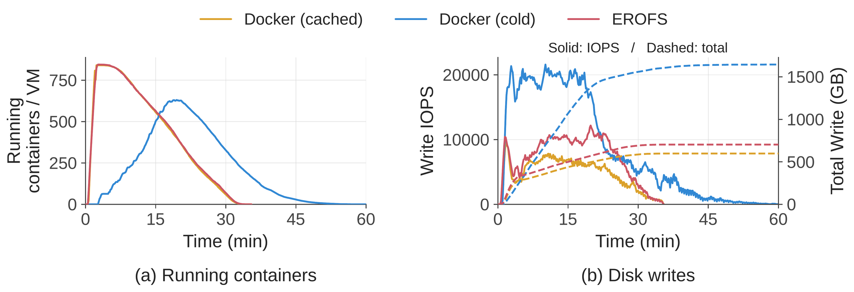
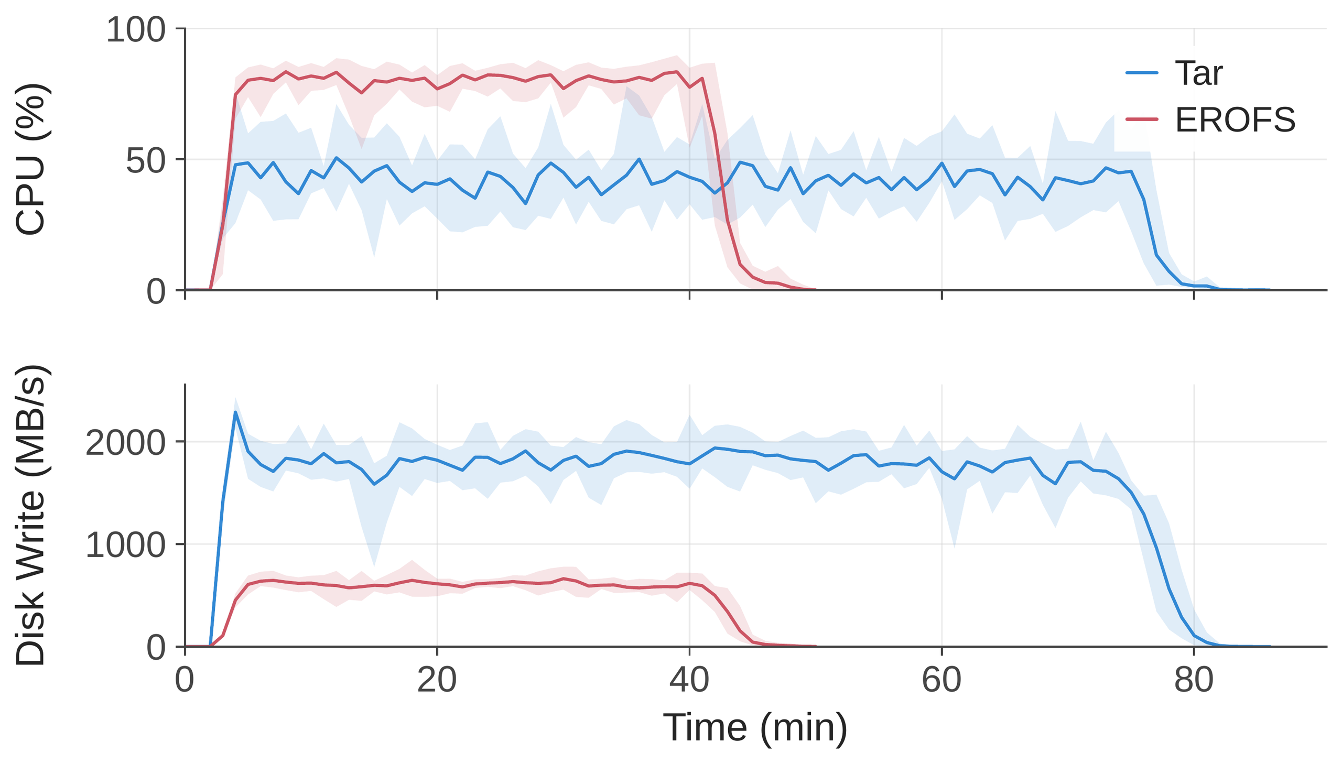
06 · DATA ON DEMAND
Load data when the agent needs it
BURST SETUP
≈35 min
on-demand ≈ cached local
>60 min
eager pull
8,192-container burst across 10 nodes
PROVISIONING
79 → 45 min
MOUNT, DON’T EXTRACT
Composable EROFS layers
5.5× less writes
3.4× lower peak throughput
reduce CPU pressure and disk-write traffic
Useful work begins without downloading and unpacking entire images first.
Notes:
## [Group 16] BURST SETUP
On-demand EROFS avoids downloading and unpacking entire images before work begins. In the 8,192-container burst, it
## [Group 20] 8,192-container burst across 10 nodes
finishes in about thirty-five minutes, matching the fully local baseline, while eager pulling needs more
## [Group 26] MOUNT, DON’T EXTRACT
than sixty minutes. Composable mounted layers also reduce provisioning time from seventy-nine to forty-five minutes.

Slide 8
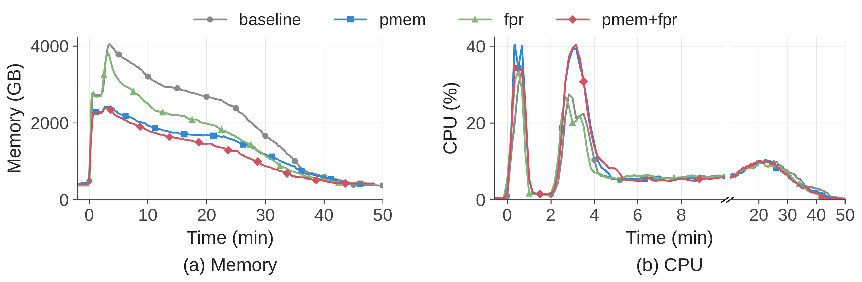
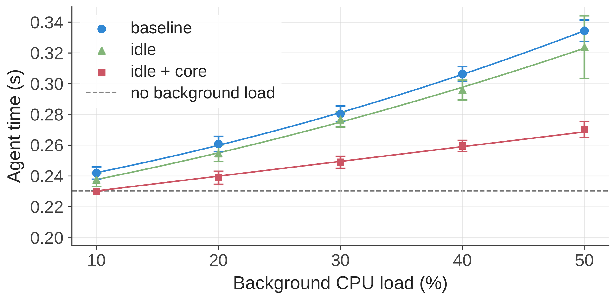
07 · COMPLEMENTARY CONTROLS
Density needs more than one mechanism
MEMORY
40.2%
lower peak host memory
21.2%
less memory-time
CPU INTERFERENCE · 50% BE LOAD
45.2 → 17.3%
latency inflation: unprotected
→ combined controls
SCHED_IDLE alone: ≤3.4% improvement
Shared mappings cut peaks; reclamation recovers idle memory; two-level scheduling protects latency.
Notes:
## [Group 11] MEMORY
The component comparisons show complementary effects. Shared virtio-pmem mappings reduce
## [Group 14] Group 14
peak host memory, while free-page reporting recovers idle guest memory
## [Group 20] CPU INTERFERENCE · 50% BE LOAD
over time. For CPU isolation, SCHED_IDLE alone is insufficient, but
## [Group 23] Group 23
combining it with core scheduling substantially limits latency inflation.

Slide 9
08 · PRODUCTION OPERATING POINT
Scale is a systems outcome
380K+
5K+
≈3M
≈160
concurrent
creations
sandboxes
nodes
sandboxes
per second
per day
per unit
across production
burst throughput
per production unit
dense cluster scale
FROM NODE DENSITY TO FLEET ELASTICITY
Thousands of containers—or hundreds of microVMs—per node.
The platform converts complementary mechanism wins into one stable operating point.
Notes:
## [Group 10] 380K+
At production scale, DSec supports more than three hundred eighty
## [Group 16] 5K+
thousand concurrent sandboxes and over five thousand creations per second.
## [Group 22] ≈3M
One production unit spans roughly one hundred sixty nodes and
## [Group 28] ≈160
serves about three million sandboxes each day. Individual nodes
## [Group 32] FROM NODE DENSITY TO FLEET ELASTICITY
can host thousands of containers or hundreds of microVMs.

Slide 10

09 · TAKEAWAY
The platform is the training primitive
Elastic execution, not merely faster containers.
Match isolation to workload, then coordinate the whole stack.
Match isolation
Compose layers
Load on demand
Coordinate resources
FnCall → full VM
Immutable · reusable
Local metadata · lazy I/O
Memory + CPU controls
DeepSeek Elastic Compute · arXiv:2609.22978
Read the paper
Notes:
## [Group 8] Elastic execution, not merely faster containers.
The central lesson is that agentic training needs
## [Group 14] Match isolation
an elastic execution platform, not merely faster containers.
## [Group 20] Compose layers
DSec scales by matching isolation to each
## [Group 27] Load on demand
workload, loading data only when needed, preserving
## [Group 41] Coordinate resources
state across the training lifecycle, and coordinating
## [Group 47] DeepSeek Elastic Compute · arXiv:2609.22978
memory and CPU controls across dense clusters.

