Slide 1



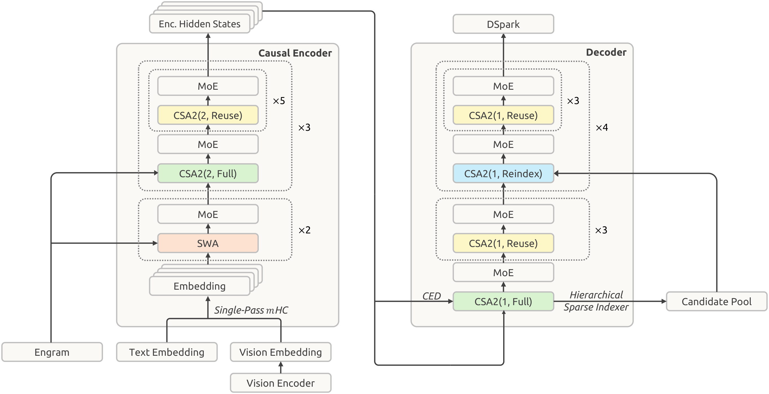
DeepSeek-V4.1-Flash: Pushing the Limits of KV Cache Compression
DeepSeek-AI
Paper
Code
Problem
Method
C
Bound the search
INDEXING
Key Results
Long-context agents are increasingly
input-heavy.
1
The first decoder Full layer scores the global
context and ranks blocks.
BENCHMARK
V4-FLASH
V4.1-FLASH
DeepSWE
54.4
74.2
Expensive prefill and large KV caches
strain accelerator memory, persistent
storage, and transfer bandwidth, limiting
economical deployment of million-token
contexts.
2
Collect a shared candidate pool for later indexers.
TB 2.1
82.7
90.6
3
Reindex layers select fresh Top-512 entries within
this pool.
Automation
37.7
54.8
Agents’ Last Exam
25.2
31.8
The first indexer still scans the full context. Up to
2,048 blocks × 8 positions form a 16,384-position
candidate pool. Training and inference use the same
restriction.
Table 3 · Max reasoning effort. Scores are
percentages; DeepSWE uses mini-SWE,
and TB 2.1 uses DeepSeek Harness
Minimal.
Motivation
DESIGN PRINCIPLE
Architecture: 20 encoder + 20 decoder layers.
Share global context. Rebuild local
state.
A
Causal encoder–decoder
PREFILL
D
Store less, replay locally
CACHE
Headline Numbers
Project decoder global KV from the final encoder
states, enabling most long-prompt prefill to stop
halfway through the network.
FP4 main KV
128-token replay
890
4×
Treat global KV and sliding-window state
differently: share and quantize the former;
reconstruct the latter when needed.
smaller global
KV
Store main KV at four-bit precision. Reconstruct
sliding-window attention from a short replay of the
most recent 128 tokens.
bytes / token ·
global KV
8×
smaller
persistent KV
Co-designing architecture and
deployment reduces both serving and
prefix-cache costs for repeated, million-
token inputs.
About ¼ of V4-Flash global KV
FP4 E2M1 stores main KV with one E4M3 scale per 16
channels. Quantization follows RoPE; values are
dequantized before attention. Quantization-aware
training is introduced during post-training.
Takeaway
C: KV entries · Z: compression weights
+
B
Share KV and indices
Smaller caches, stronger agents.
GLOBAL CONTEXT
LOCAL STATE
CSA2
Long-lived KV
dominates
memory as the
prompt grows.
Recent tokens
can recover short
attention
windows.
MODE
GLOBAL KV
TOP-K
Joint model and serving design makes
million-token agents more efficient while
improving reported agent performance.
Full
New
New
SWA KV stays FP8 because local attention is more
sensitive to quantization.
Reindex
Shared
New
Reuse
Shared
Shared
Persist global KV and omit SWA KV from persistent
storage. Replay is approximate and depends on the
cache-hit position; the authors report negligible
response-quality degradation.
Benchmark gains depend on reasoning
effort and scaffold. The memory ratios do
not measure an end-to-end serving-cost
reduction.
Exact local replay may span layers ×
window size. Smaller effective receptive
fields make bounded replay practical.
Layer-specific: every mode computes its own query
and local sliding-window KV.

