Slide 1


DEEPSEEK-AI / TECHNICAL REPORT
DeepSeek-V4.1-Flash
890
Pushing the Limits of
KV Cache Compression
bytes / token
GLOBAL KV CACHE
1M-token context. Smaller state.
Architecture → serving → evidence
An instructional walkthrough for researchers and inference engineers
Read paper
Notes:
## [Group 7] DEEPSEEK-AI / TECHNICAL REPORT
DeepSeek V4.1 Flash asks how far we can compress the memory of a long-running agent without giving up its capabilities. The headline is eight hundred
## [Group 12] 890
ninety bytes of global key-value cache per token, with support for one million context tokens. In this walkthrough, we will separate the architecture changes
## [Group 17] 1M-token context.
from the serving changes, then examine the evidence and its limits. The key idea is to share global context and reconstruct short-lived local state.

Slide 2
01 / THE SERVING PROBLEM
Long context creates three costs
Compute
Keep
Move
Process the prefix
Fit state in HBM
Load cached state
Prefill work grows
Global KV occupies
Host memory and SSD
with input length.
accelerator memory.
add a transfer bill.
Sparse attention reduces compute. State still has a cost.
Source: DeepSeek-V4.1-Flash report, Introduction and §3.2
02
Notes:
## [Group 4] 01 / THE SERVING PROBLEM
Long-horizon agents repeatedly consume tool outputs and revisit large prefixes. That creates three related costs.
## [Group 21] Compute
First, prefill must process the input. Second, global key-value state occupies accelerator memory. Third, cached
## [Group 31] Keep
prefixes must be stored and transferred through host memory or storage. Sparse attention mainly attacks
## [Group 40] Move
computation. It does not automatically eliminate the memory or transfer bill. This report treats those
## [Group 42] Sparse attention reduces compute.
costs together, which is why several model and serving changes appear in the same design.

Slide 3
02 / THE CORE DISTINCTION
Global and local state
need different policies
GLOBAL CONTEXT
LOCAL STATE
Share across layers.
Regenerate when needed.
Quantize long-lived history.
Replay a recent segment.
Fewer copies of expensive state
Approximation must preserve quality
State lifetime determines the serving policy.
Source: report §2.3–2.4 and §3.2.2
03
Notes:
## [Group 5] 02 / THE CORE DISTINCTION
The useful distinction is between global context and local state. A global cache carries information from a long history,
## [Group 11] GLOBAL CONTEXT
so reducing repeated copies and lowering precision have large benefits. Sliding-window attention has a short local horizon, making reconstruction
## [Group 16] LOCAL STATE
a plausible alternative to persistent storage. Exact reconstruction can still require replay across the layered receptive field. Bounded
## [Group 19] State lifetime determines the serving policy.
replay deliberately uses a shorter recent segment. Keep that approximation in mind as we work through the architecture.

Slide 4
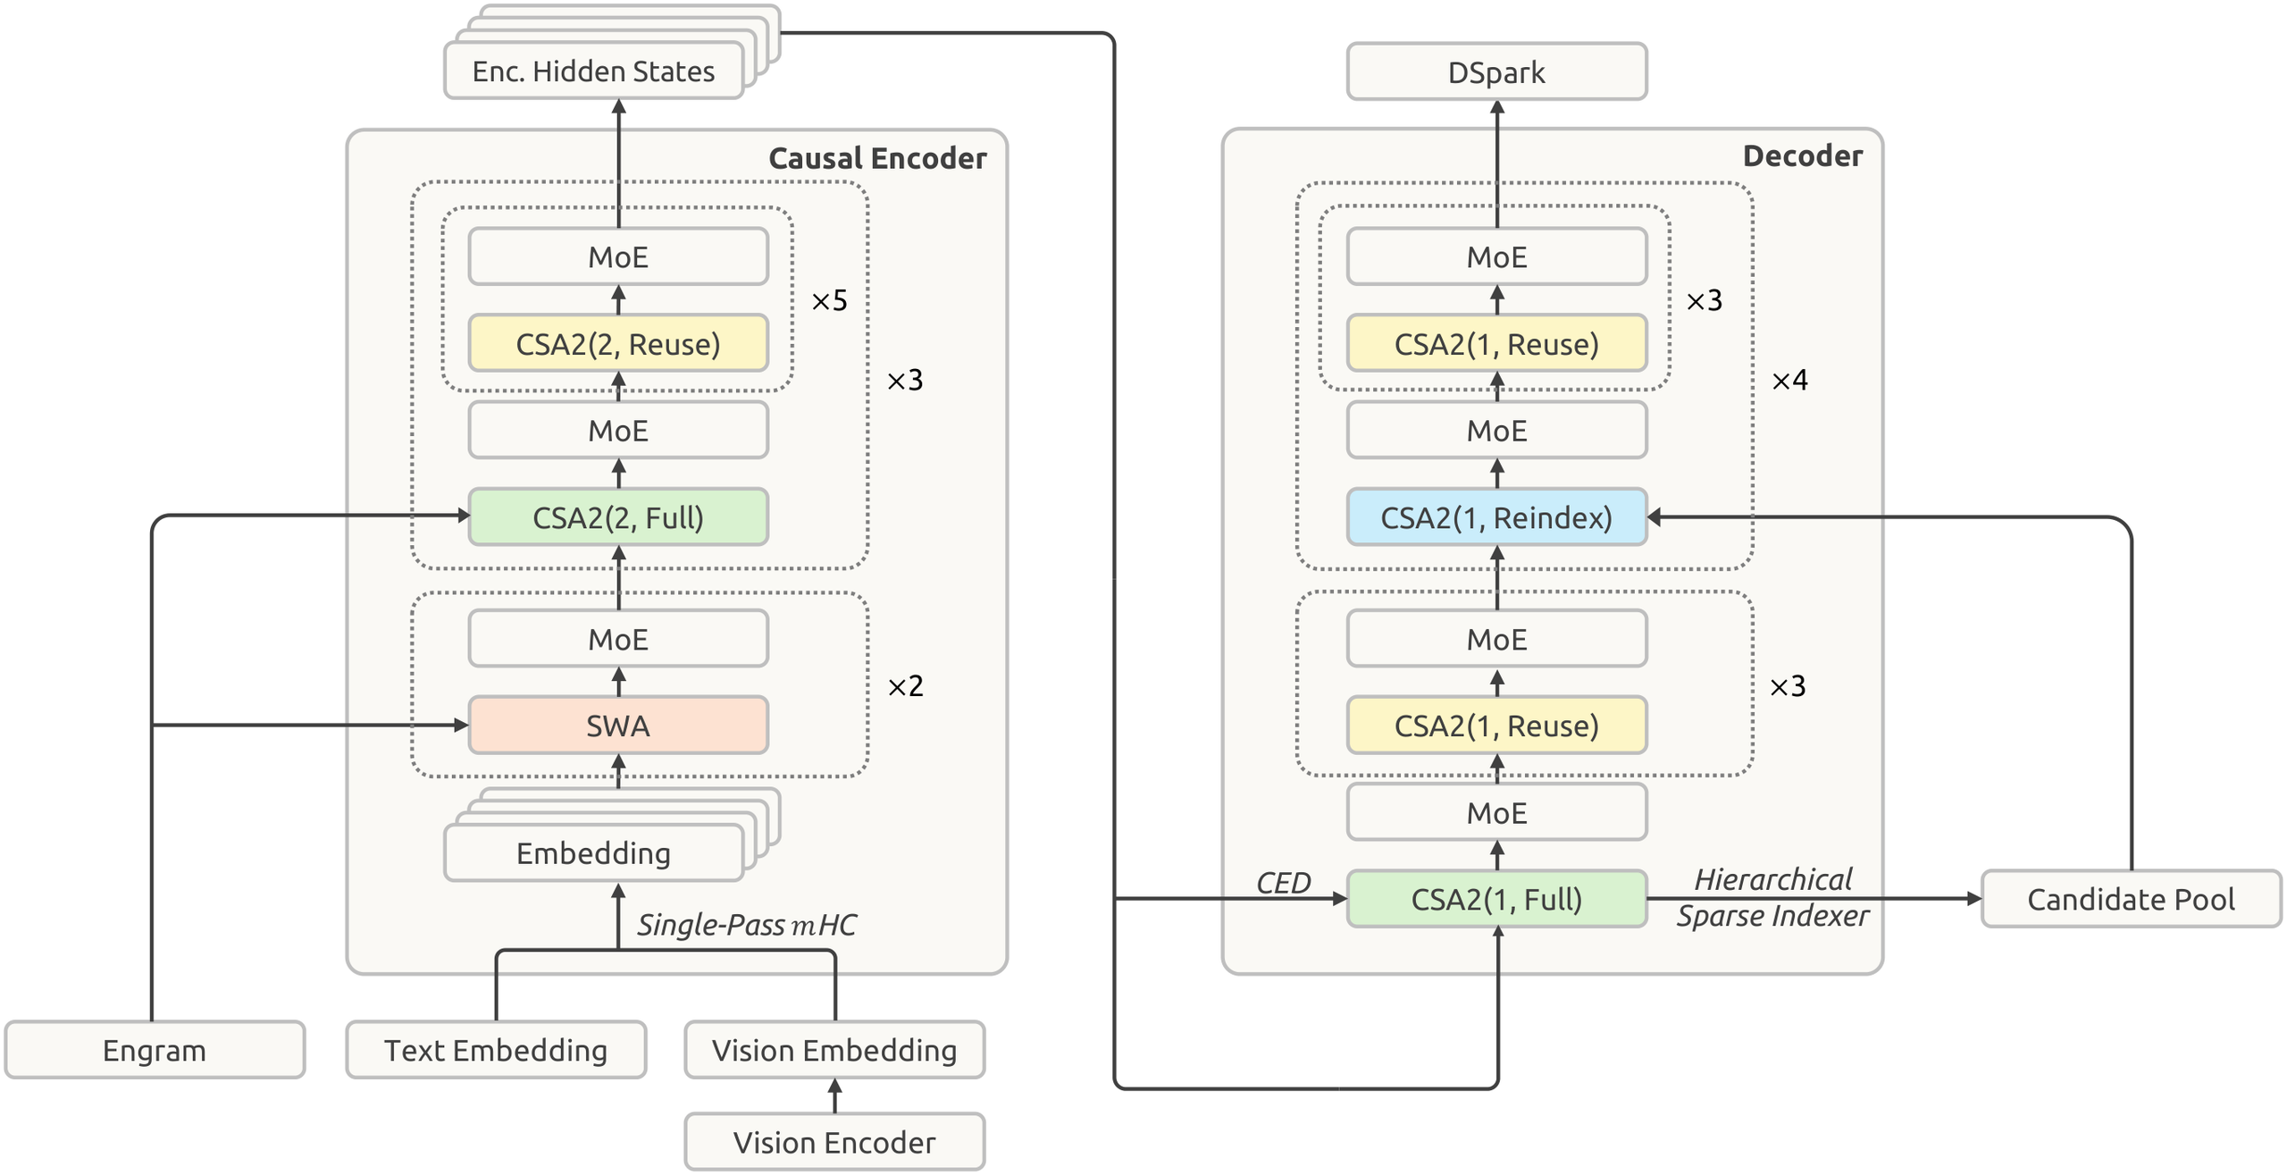
03 / THE CONTRIBUTION
One design connects model and serving
552B
backbone parameters
20 + 20 layers
Encoder + decoder
Up to 1M
context tokens
Source: report Figure 3 and §2.1. Architecture figure preserved in full.
04
Notes:
## [Group 4] 03 / THE CONTRIBUTION
The model has five hundred fifty-two billion backbone parameters and forty Transformer layers, split evenly between encoder and decoder.
## [Group 7] 552B
Its core efficiency mechanisms are the causal encoder-decoder, Compressed Sparse Attention Two, hierarchical indexing, four-bit main caching, and bounded
## [Group 13] 20 + 20 layers
replay. The architecture figure also includes Single-Pass mHC, Engram conditional memory, and the DSpark speculative decoder. We will
## [Group 15] Group 15
concentrate on the mechanisms that change long-context compute and cache behavior, while treating the remaining components as context.

Slide 5
04 / CAUSAL ENCODER–DECODER
Decoder global KV comes from the encoder
Encoder output
Decoder global KV
Final hidden states, after layer 20
Built directly from encoder states
Project
$$C_{l}=H_{L/2}W_{l}^{KV}, l>L/2$$
Each layer still has its own query and local SWA state.
Source: report §2.2, Eq. 1. C denotes global KV; L = 40 layers.
05
Notes:
## [Group 4] 04 / CAUSAL ENCODER–DECODER
Start with the causal encoder-decoder. In an ordinary decoder stack, producing a later layer’s
## [Group 8] Encoder output
cache requires running the prefix through earlier layers. Here, the decoder’s global keys
## [Group 11] Project
and values are projected directly from the final encoder hidden states. The equation
## [Group 15] Decoder global KV
expresses that dependency: each decoder layer’s global cache is a learned projection of
## [Group 17] Group 17
the encoder output. This changes what long-prefix prefill must compute. It does not
## [Group 20] Each layer still has
remove the decoder, and each layer still maintains its own local sliding-window state.

Slide 6
05 / WHY INPUT-HEAVY WORKLOADS BENEFIT
Prefill and decode activate different work
PREFILL
DECODE
8B
16B
activated parameters / token
activated parameters / token
Long-prefix work largely stops at the encoder.
Applies when context ≫ local window; activation counts are not measured latency.
Source: report §2.2 and §4.2.1
06
Notes:
## [Group 4] 05 / WHY INPUT-HEAVY WORKLOADS BENEFIT
The consequence is asymmetric work. Prefill activates eight billion parameters per token, while decoding activates sixteen billion. For a long
## [Group 9] PREFILL
input, most full-prefix processing stops at the encoder, with only short local-state work needed in the decoder. The report
## [Group 14] DECODE
approximates prefill complexity by the encoder half when sequence length is much larger than the local window. This is
## [Group 17] Long-prefix work largely stops at the encoder.
especially relevant to input-heavy agents. Activated-parameter counts describe computational structure; they are not a direct measurement of end-to-end latency.

Slide 7
06 / COMPRESSED SPARSE ATTENTION 2
Reuse caches, then selection work
Full
Reindex
Reuse
Build global KV.
Reuse global KV.
Reuse global KV.
Build indexer K.
Reuse indexer K.
Reuse indexer K.
Select Top-K.
Select fresh Top-K.
Reuse Top-K.
Every mode computes current-layer Q and SWA KV.
Source: report §2.3.1 and Figure 4. Reuse refers to preceding cache/index-producing layers.
07
Notes:
## [Group 4] 06 / COMPRESSED SPARSE ATTENTION 2
Compressed Sparse Attention Two has three modes. Full computes the main key-value cache, indexer keys, and selected
## [Group 10] Full
indices. Reindex reuses the cache and indexer keys from the most recent Full layer, but selects
## [Group 16] Reindex
fresh indices. Reuse also shares the selected Top-K set from the most recent index-producing layer. These
## [Group 22] Reuse
are distinct savings: one avoids storing or producing another cache, and the other avoids another selection
## [Group 29] Every mode computes current-layer Q and SWA KV.
pass. All three modes still compute the current layer’s main query and sliding-window keys and values.

Slide 8
07 / HIERARCHICAL SPARSE INDEXER
Bound later searches to a shared pool
FIRST FULL LAYER
UP TO
REINDEX
512
Full scan
16,384
candidates
Rank context blocks
selected entries
by maximum score.
2,048 blocks × 8 positions
The first scan still sees the full context.
The same candidate restriction is used during training and inference.
Source: report §2.3.2, Figure 5, and §4.2.1
08
Notes:
## [Group 4] 07 / HIERARCHICAL SPARSE INDEXER
Cache reuse does not by itself make indexing independent of context length.
## [Group 9] FIRST FULL LAYER
The hierarchical indexer narrows the work of later decoder layers. The first
## [Freeform 10] Freeform 10
Full decoder layer scans the context and ranks blocks using their maximum
## [Group 16] UP TO
index score. Up to two thousand forty-eight blocks, with eight positions each,
## [Freeform 17] Freeform 17
create a pool of sixteen thousand three hundred eighty-four candidates. Later Reindex
## [Group 21] REINDEX
layers select five hundred twelve entries from that pool. Training uses the
## [Group 25] The first scan still sees the full context.
same restriction. The first scan still depends on full context length.

Slide 9
08 / SELECTIVE CACHE PRECISION
Quantize the global cache selectively
MAIN KV CACHE
SLIDING-WINDOW KV
FP4
FP8
E2M1 values
Retained for state that is
One E4M3 scale per 16 channels
sensitive to quantization.
Quantize after RoPE; dequantize before attention.
Quantization-aware training begins during post-training.
Source: report §2.4.4
09
Notes:
## [Group 4] 08 / SELECTIVE CACHE PRECISION
The next saving comes from precision. Main cache values use the E2M1 four-bit format, with one E4M3 scale per sixteen
## [Group 10] MAIN KV CACHE
channels. Values are quantized after rotary position encoding and dequantized before attention. Quantization-aware training is introduced during post-training to reduce
## [Group 16] SLIDING-WINDOW KV
the quality impact. The choice is selective: sliding-window keys and values stay in FP8 because that state is sensitive to
## [Group 19] Quantize
quantization. The lesson is to compress according to a component’s tolerance, rather than force one format onto every cache.

Slide 10
09 / SWA BOUNDED REPLAY
Persist global KV;
replay the recent 128 tokens
REPLAY
128
Global KV
Local SWA
Load the persistent
Rebuild state.
prefix cache.
most recent tokens
Resume decoding.
Approximate replay. Quality depends on cache-hit position.
SWA KV is omitted from persistent storage; authors report negligible quality loss.
Source: report §3.2.2
10
Notes:
## [Group 5] 09 / SWA BOUNDED REPLAY
Bounded replay targets persistent prefix storage. Instead of saving every layer’s sliding-window
## [Group 13] Global KV
state, the system persists global key-value information and reconstructs local state
## [Freeform 14] Freeform 14
from the most recent one hundred twenty-eight tokens. This is shorter
## [Group 19] REPLAY
than exact reconstruction of the layered receptive field, so it is
## [Freeform 20] Freeform 20
approximate. Its behavior also depends on where the cache hit occurs.
## [Group 27] Local SWA
The authors report negligible response-quality degradation. This mechanism helps explain why
## [Group 31] Approximate replay.
persistent-cache savings are larger than the reduction in global cache alone.

Slide 11
10 / BEFORE READING THE RESULTS
Read capability scores with their settings
Context: 64K to 1M
45T
Extension to 1M begins at 34T training tokens.
multimodal tokens
Featured results: Max reasoning effort
Pretraining followed by
SFT, RL, and distillation.
DeepSWE v1.1: mini-SWE
Terminal-Bench 2.1: DeepSeek Harness Minimal
Terminal-Bench context: 1M tokens
Source: report §4–6 and Table 3 evaluation settings
11
Notes:
## [Group 4] 10 / BEFORE READING THE RESULTS
Before interpreting results, establish the settings. Pretraining uses forty-five trillion multimodal tokens. Context starts at
## [Group 10] 45T
sixty-four thousand and extends to one million at thirty-four trillion training tokens. The model then
## [Group 13] Context: 64K to 1M
receives supervised fine-tuning, reinforcement learning, and final on-policy distillation. The featured agent scores use maximum
## [Group 16] Featured results: Max reasoning effort
reasoning effort. DeepSWE uses mini-SWE, while Terminal Bench uses DeepSeek Harness Minimal with a
## [Group 21] DeepSWE v1.1: mini-SWE
one-million-token context. Harness and effort are part of the comparison, not incidental implementation details.

Slide 12
11 / CAPABILITY EVIDENCE
Agent scores rise despite smaller caches
DeepSWE v1.1 · Resolved
54.4%
74.2%
V4-Flash
V4.1-Flash
Terminal-Bench 2.1 · Pass@1
82.7%
90.6%
V4-Flash
V4.1-Flash
Max effort, report-specific harnesses; complete-model comparison.
Source: report Table 3. Scores are percentages.
12
Notes:
## [Group 4] 11 / CAPABILITY EVIDENCE
At maximum effort, DeepSWE version one point one improves from fifty-four point four to seventy-four point two percent resolved compared with
## [Group 11] DeepSWE v1.1 · Resolved
V4 Flash. Terminal Bench two point one improves from eighty-two point seven to ninety point six percent Pass at One. Those
## [Group 19] Terminal-Bench 2.1 · Pass@1
gains coexist with substantially smaller caches. They show that this complete trained model improves on the prior Flash model in
## [Group 21] Max effort, report-specific harnesses; complete-model comparison.
the reported setups. They do not isolate the causal contribution of cache compression from training, model changes, or evaluation scaffolds.

Slide 13
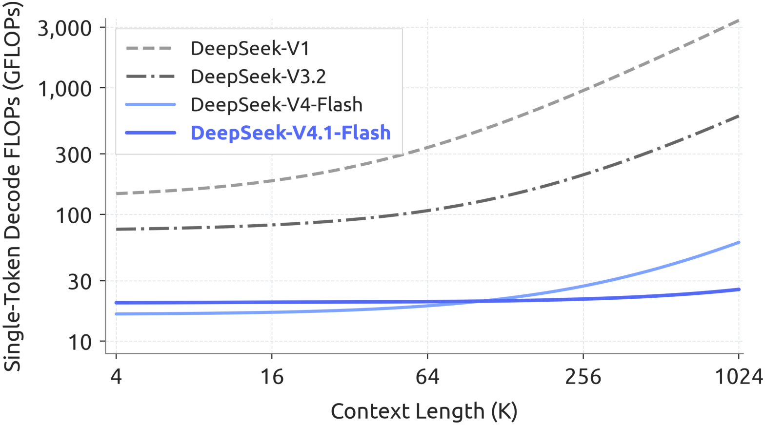
12 / LONG-CONTEXT COMPUTE SCALING
256× more context.
About 25% more decode FLOPs.
4K TO 1M CONTEXT
~25%
more weighted
decode FLOPs
FLOP weights:
BF16 / FP8 / FP4
1 / 0.5 / 0.25
Compute, not latency.
Source: report Figure 2 and Introduction. Single-token decode; precision-weighted accounting.
13
Notes:
## [Group 5] 12 / LONG-CONTEXT COMPUTE SCALING
Figure Two examines single-token decode computation as context grows. Moving from four thousand to one million context tokens is a
## [Group 7] Group 7
two-hundred-fifty-six-fold increase in length, yet the report describes only about twenty-five percent more decode FLOPs. These are precision-weighted operations: BF16
## [Group 12] 4K TO 1M CONTEXT
counts as one, FP8 as one half, and FP4 as one quarter. The result supports favorable compute scaling. It should
## [Group 18] FLOP weights:
not be read as a latency benchmark, a throughput guarantee, or a measured reduction in the complete serving bill.

Slide 14
13 / COST–QUALITY CONTROL SWEEP
More reasoning buys quality
with more output tokens
REASONING EFFORT: 25 TO 100
DeepSWE v1.1
~2.5×
66.0% to 74.2%
Terminal-Bench 2.1
as many output tokens
82.4% to 90.6%
This sweep does not isolate the architecture’s contribution.
FP4 and replay quality effects are described qualitatively in the architecture sections.
Source: report §6 reasoning-effort sweep; §2.4.4 and §3.2.2
14
Notes:
## [Group 5] 13 / COST–QUALITY CONTROL SWEEP
The reasoning-effort sweep exposes another deployment trade-off. Raising effort from twenty-five to one hundred increases DeepSWE
## [Group 9] REASONING EFFORT: 25 TO 100
from sixty-six to seventy-four point two percent, and Terminal Bench from eighty-two point four to ninety
## [Group 13] DeepSWE v1.1
point six percent. Output length grows by roughly two and a half times. The highest setting
## [Group 16] Terminal-Bench 2.1
gives diminishing gains. This is a useful control sweep, but not an isolated architectural ablation. The
## [Group 20] This sweep does not isolate the architecture’s contribution.
relevant architecture sections describe FP4 and replay degradation qualitatively rather than supplying a numerical component-attribution table.

Slide 15
14 / HEADLINE NUMBERS, CORRECT SCOPE
Keep the cache denominators explicit
~4× smaller
890
global KV cache
bytes per token
~8× smaller
GLOBAL KV / ALWAYS IN HBM
persistent cache
890 bytes excludes weights, activations, and other runtime state.
Source: report Abstract and §3.2. Ratios versus V4-Flash at the same sequence length.
15
Notes:
## [Group 4] 14 / HEADLINE NUMBERS, CORRECT SCOPE
The headline numbers refer to different boundaries. Eight hundred ninety bytes per token
## [Group 8] 890
measures global key-value cache, not model weights, activations, or every piece of runtime
## [Freeform 9] Freeform 9
state. At the same sequence length, the report gives approximately four times smaller
## [Group 12] ~4× smaller
global cache and eight times smaller persistent cache than V4 Flash. The persistent
## [Group 15] ~8× smaller
result additionally benefits from omitting sliding-window state. When estimating capacity, begin with the
## [Group 18] 890 bytes excludes weights, activations, and other runtime state.
right denominator and add the memory categories that this global-cache statistic excludes.

Slide 16
Share the history.
Rebuild the local state.
Quality
Replay
Total cost
Test your tasks.
Measure cache-hit behavior.
Account for memory,
Fix effort and harness.
Validate bounded replay
transfers, prefill, and decode
Check visual-task gaps.
on realistic prefixes.
in the same workload.
The model and the serving system are one design problem.
Notes:
## [Group 5] Share the history.
The reusable engineering principle is to share expensive global history and rebuild cheap local state. The model
## [Group 11] Quality
combines architectural reuse, sparse selection, selective precision, and a serving policy that takes advantage of local attention.
## [Group 17] Replay
For deployment, evaluate quality on your own tasks, measure cache-hit and replay behavior, and account for memory,
## [Group 23] Total cost
transfer, prefill, and decode together. Keep reasoning effort and harness settings explicit. The report also acknowledges remaining
## [Group 25] The model and the serving system are one design problem.
visual-task gaps. Its strongest lesson is the value of designing the model and serving system together.

