Slide 1
Color Temperature Curve( CTC )

Slide 2
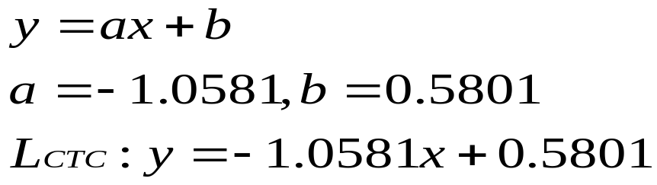
Linear Equation in log domain
y: log₁₀( G / B )
0.5801
0.5482
x: log₁₀( G / R )
L_{CTC}

Slide 3
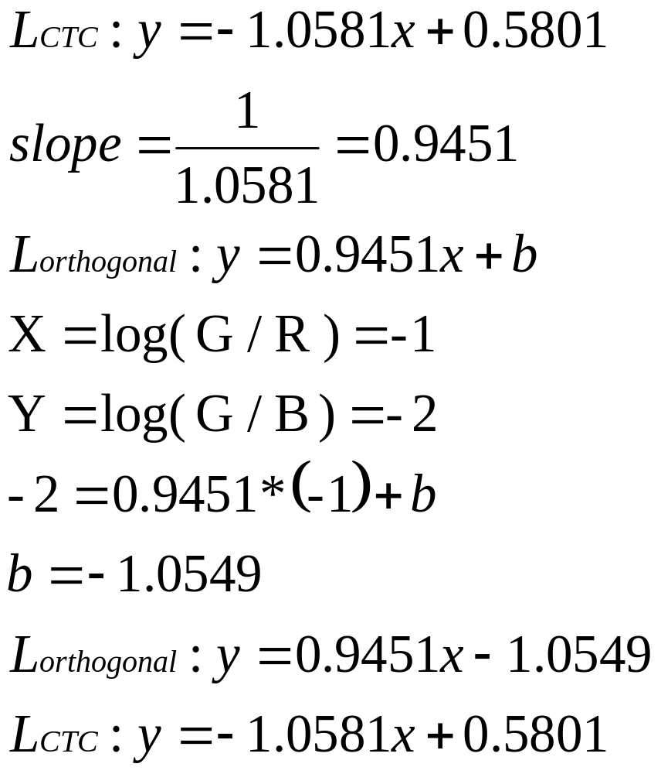
Example: log( G / R ) = -1,log( G / B ) = -2

Slide 4


Example: log( G / R ) = -1,log( G / B ) = -2
y: log₁₀( G / B )
0.5801
0.5482
x: log₁₀( G / R )
0.8162,-0.2831
-1,-2

