Slide 1
Gamma Correction

Slide 2
Actual Gamma Equation
For each R, G and B value:
if RGB <= 0.03928
RGB’ = RGB / 12.92;
else
RGB’ = ( ( 0.055 + RGB ) / 1.055 ) ^ 2.4;
end
(Note: RGB normalized to 0.0 to 1.0)
Standard Gamma Equation
For each R, G and B value:
RGB’ = c * RGB^{r} c = 1, r = 0.45
(Note: RGB normalized to 0.0 to 1.0)

Slide 3
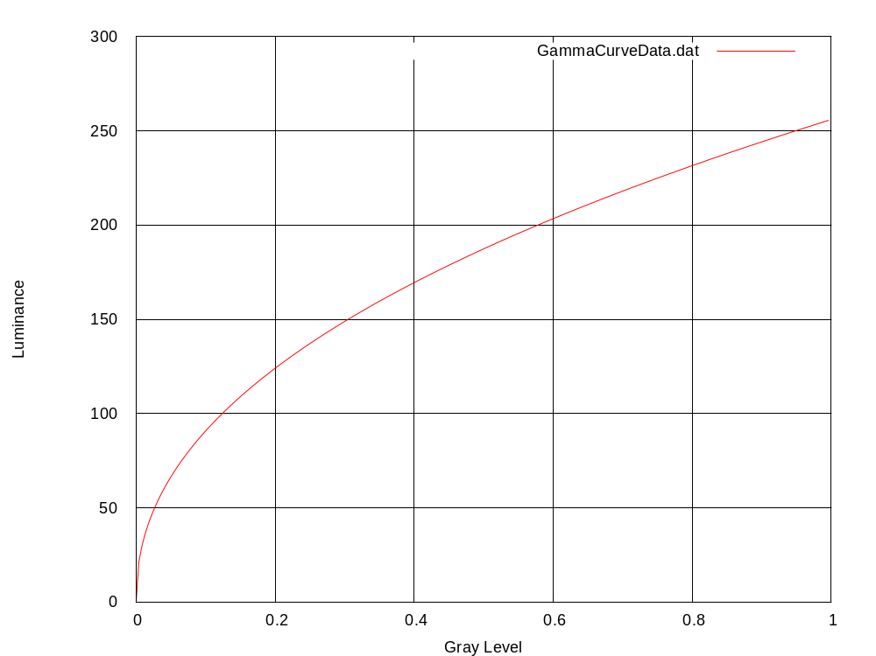
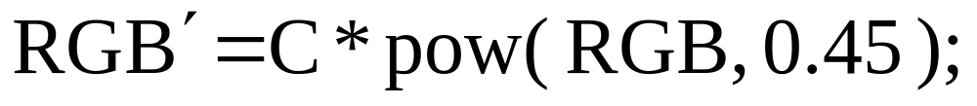
Standard Gamma Curve

Slide 4
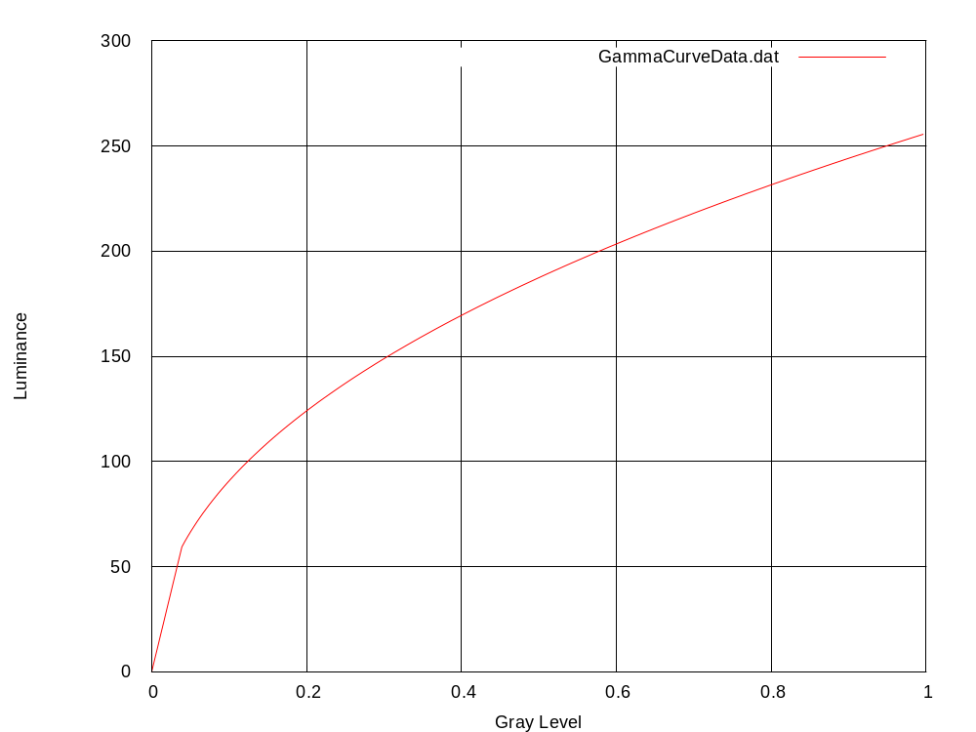
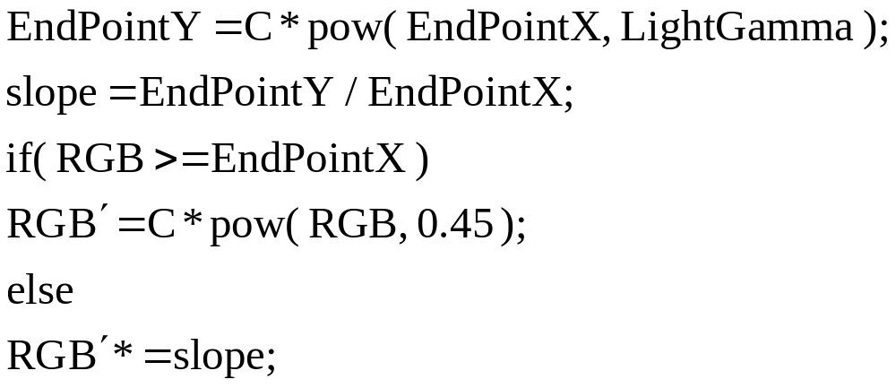
Standard Gamma Curve

