Slide 1
Weight Edge Detection

Slide 2
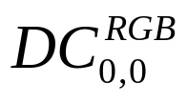
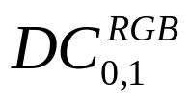
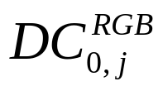
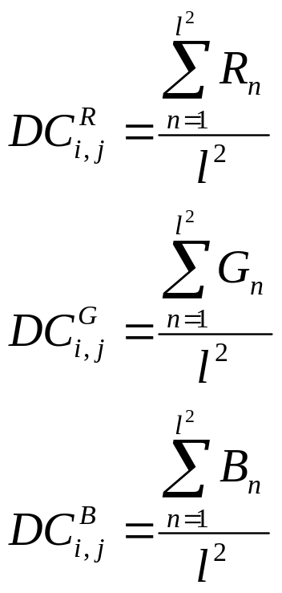
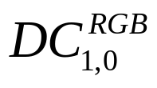
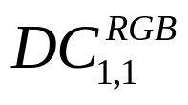
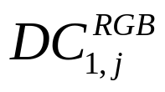
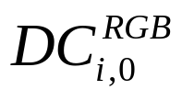
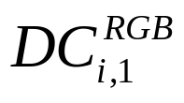
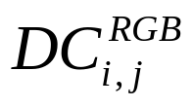
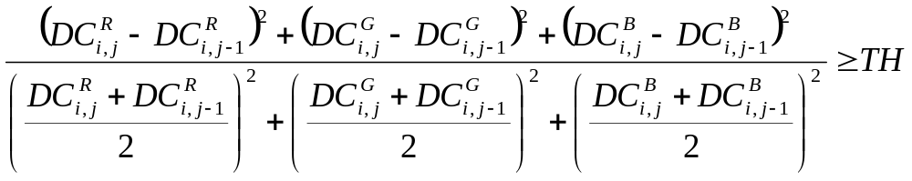
DC value calculation
16
16
Macro Block
Macro Block
Macro Block
Macro Block
Macro Block
Macro Block
Photo
Macro Block
Macro Block
Macro Block

Slide 3
L
R
0
0
No save
1
1
Save R and Save L
1
0
L is saved last time, R do not save
1
1
L is saved last time, save R only
0: Not Edge, 1: Edge

