Slide 1
Demonstration-Guided RL without Retargeting
Notes:
Opening. I want to frame the talk around one question: how can a robot learn from demonstrations without directly retargeting human motion into robot motion?
The key phrase is “without retargeting.” In many robotics pipelines, a human video is converted into body pose, end-effector targets, or joint trajectories. That can work in narrow settings, but it requires strong assumptions about correspondence between the demonstrator and the robot.
Here, I want to treat the demonstration differently. The demonstration should provide task intent: what object matters, what the goal looks like, and what kind of progress should happen. But the robot still needs to decide its own physical strategy through closed-loop interaction.
So the whole talk is about demonstration-guided RL: using demonstrations to reduce the search space, while avoiding the brittle step of copying human motion directly.
Transition: the reason we care about this is scalability.

Slide 2
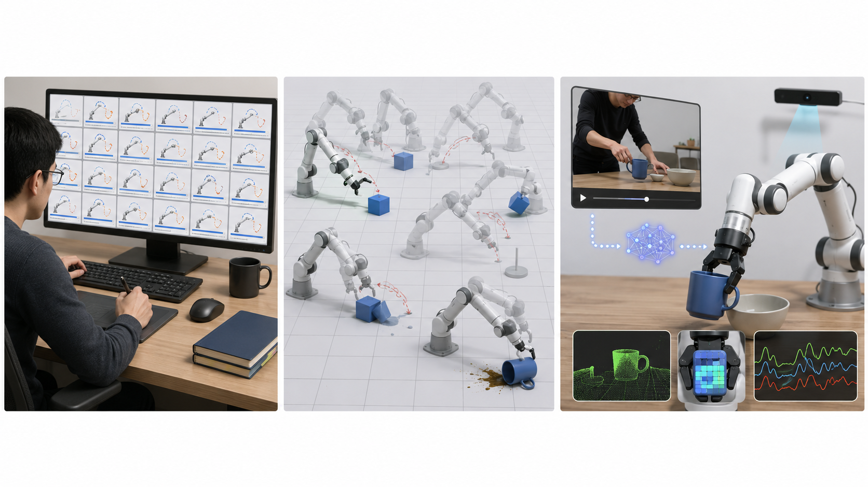
Motivation: Robots Need Scalable Learning, Like Babies
Supervised Expensive 2D/3D Annotation Retargetting & Correction & Filtering
Limited Diversity
Pure RL
Requires Explicit Success Metric
Casual Demonstrations
Any Viewpoint ✅ No Explicit Metric ✅ Minimal Annotation ✅ No Retargetting ✅
Notes:
This slide compares three ways to get robot learning signal.
On the left, supervised learning gives clear targets, but it is expensive. If we need 2D or 3D annotations, manual corrections, filtering, or retargeting for every task, then scaling to diverse objects and scenes becomes hard.
In the middle, pure RL removes some annotation requirements, but now we need an explicit success metric. The robot has to discover the task through trial and error. For long-horizon manipulation, this can be extremely inefficient, and the reward may not capture what we actually want.
On the right is the direction I want to emphasize: casual demonstrations. A demonstration can come from different viewpoints, does not require dense annotation, does not need a hand-written metric at every step, and does not require retargeting if we use it as guidance rather than a motion target.
The baby analogy is useful here. Babies do not receive 3D pose labels or dense reward functions for every action. They observe others, try things, fail, feel contact, and gradually learn how their own body can act.
Transition: given this motivation, what would an ideal learning framework look like?

Slide 3
A Potentially Ideal Learning Framework
Demonstration Video
-> Generate digital cousin world (different from real world)
-> Robot watch demo, make world state semantically similar to demo
Notes:
This slide sketches a potentially ideal framework.
We start from a demonstration video. The demonstration may not be in the same world as the robot. It may have a different camera viewpoint, different object appearance, different lighting, or even a different embodiment.
The next step is to generate a digital cousin world. I use the word “cousin” intentionally: it does not need to be an exact digital twin. The goal is not pixel-perfect reconstruction. The goal is to create a world that is semantically aligned with the demonstration: the same task, the same relevant objects, and the same kind of progress.
Then the robot watches the demo and tries to make its own world state semantically similar to the demonstration. That means the robot is not copying the human motion. It is trying to reach a similar task state using its own body and its own controller.
The important idea is semantic similarity rather than trajectory copying. If the demonstration shows a cup being placed into a bowl, the robot should understand that relation and act in its own world to create the same relation.
Transition: the next slide turns this high-level idea into a closed-loop learning diagram.

Slide 4
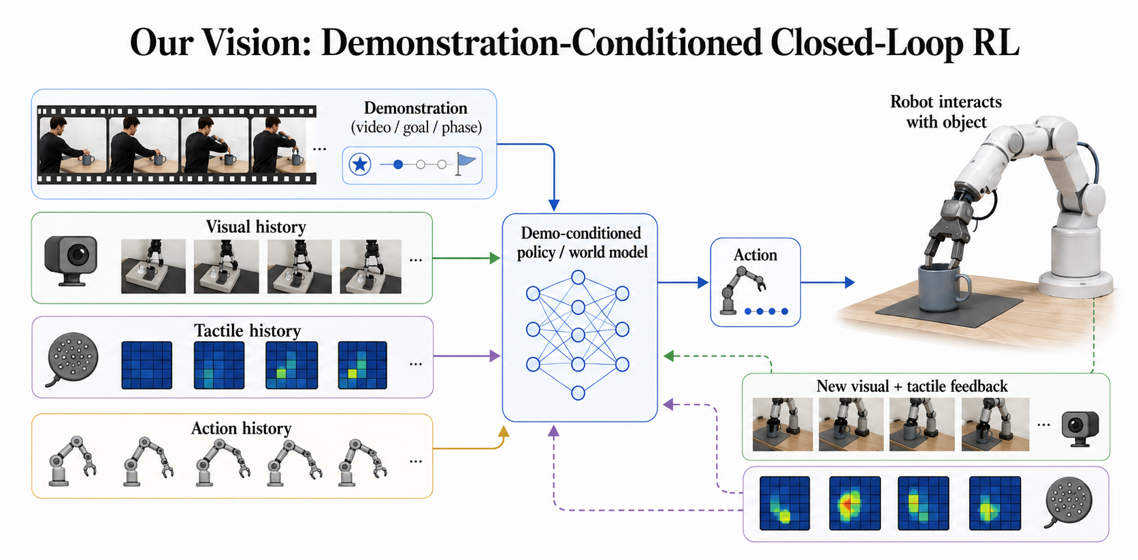
Notes:
This diagram shows the closed-loop version of demonstration-conditioned RL.
Look at the left side first. The policy does not only receive a demonstration video. It also receives visual history, tactile history, and action history. That is important because manipulation is not a single-frame problem. The robot needs to know what it has already tried and how the object responded.
The demonstration gives task-level information: the goal, the phase of the task, and the rough progress pattern. The visual history tells the robot what is currently visible. The tactile history tells whether contact is stable, slipping, or risky. The action history gives memory of previous attempts.
All of these streams go into a demo-conditioned policy or world model. The model outputs an action, the robot interacts with the object, and then new visual and tactile feedback comes back into the system.
The core message is this: the demonstration guides what to do, while interaction history decides how to do it. This is why tactile feedback matters. Many important physical properties, such as force, slip, and stability, cannot be fully inferred from the video alone.
Transition: to make this concrete, I use box carrying as a toy task.

Slide 5
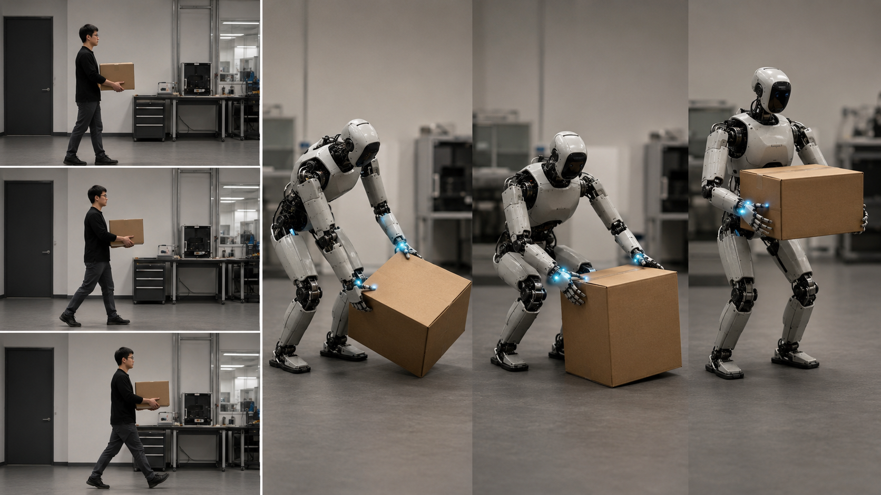
Toy Task: Learn to Carry from a Demonstration
Robot sees a box and also how human carries,
The robot imitates the human, but finds its own strategy (e.g. force, posture, contact) with minimal annotation and no retargetting
Notes:
This slide introduces the toy task: learning to carry from a demonstration.
Point to the left side of the image. The human demonstration shows the visible goal: hold the box and move it across the room. This gives the robot a clear task direction.
Now point to the robot sequence. The robot should not simply copy the human's body posture. The robot has a different body, different hand geometry, different balance constraints, and different available contact surfaces. It has to find its own strategy.
For this task, the strategy includes things that are not visible in the human video: how much force to apply, whether to support the box with the chest or forearms, how low to carry it, whether the object is slipping, and how to adjust posture while walking.
The reason this is a useful toy task is that it combines demonstration understanding with real physical interaction. The robot sees the box and the human carrying behavior, but it must use contact and feedback to decide how to carry safely.
The main takeaway is the green sentence at the bottom: minimal annotation and no retargeting. The demonstration tells the robot what task to solve, but not the exact motion to copy.
Transition: this creates a demo-to-real gap, because the demonstration and robot execution are not the same world.

Slide 6
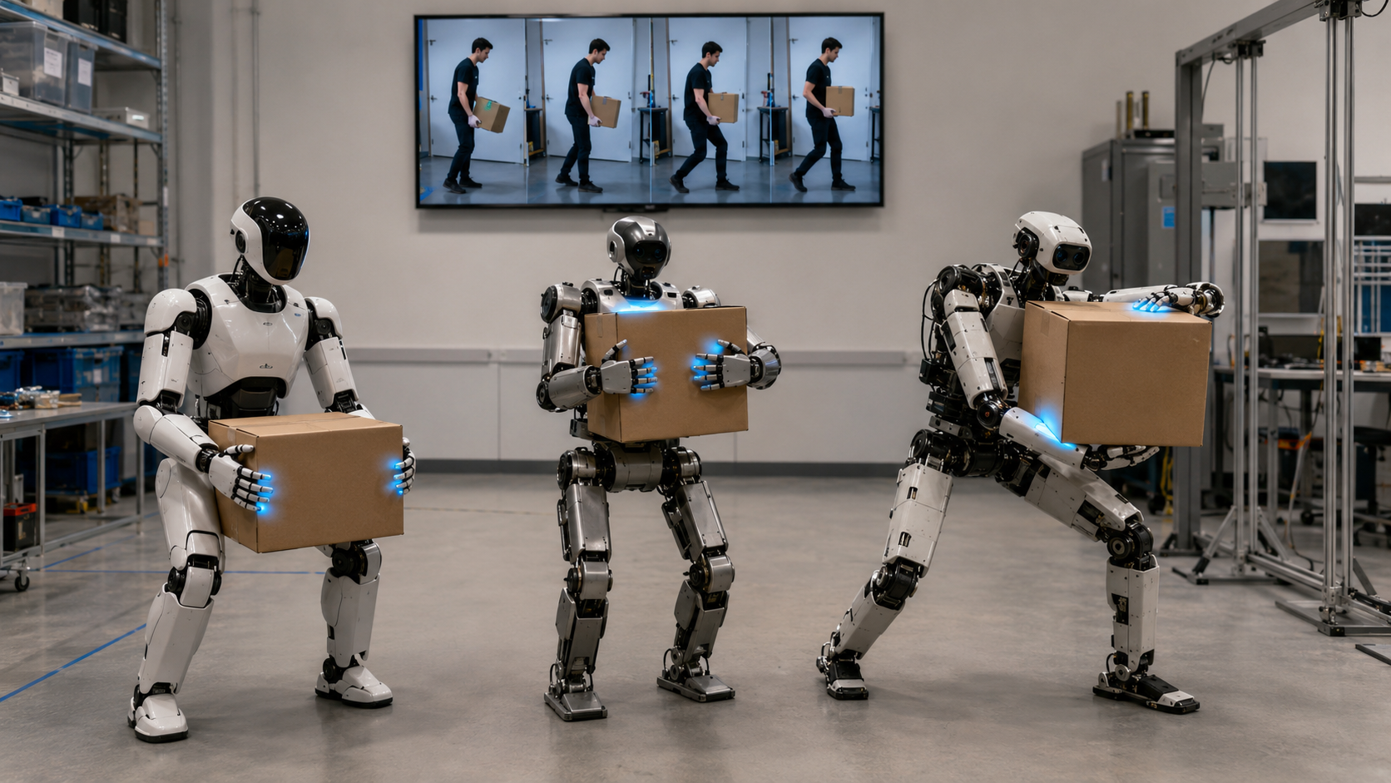
Learn to Bridge Demo2Real Gap
Demonstration shows the goal; contact and curiosity choose the strategy.
Same demo, different body, different load -> different strategy.
Notes:
This slide states the main gap visually.
At the top, the robot sees the same demonstration video. But in the real robot setting, the body can be different and the load can be different. Even if the visual goal is the same, the physically correct strategy may change.
Look at the three robots in the image. They are all carrying a box, but they use different postures. One may carry low, one may hold closer to the chest, and another may widen its stance. This is exactly the behavior we want: the same demonstration should not force the same posture.
The phrase “Demo2Real gap” here means more than a visual domain gap. It is also a physical gap. The demonstration does not directly reveal mass, center of mass, friction, softness, or required grip force. The robot must discover these through interaction.
This is where contact and curiosity enter. Contact tells whether the current strategy is safe. Curiosity decides what test to perform next: lift slightly, adjust grip, shift support, or try a different carrying height.
The key sentence is at the bottom: same demo, different body, different load, therefore different strategy.
Transition: next I show related work that addresses parts of this pipeline.

Slide 7
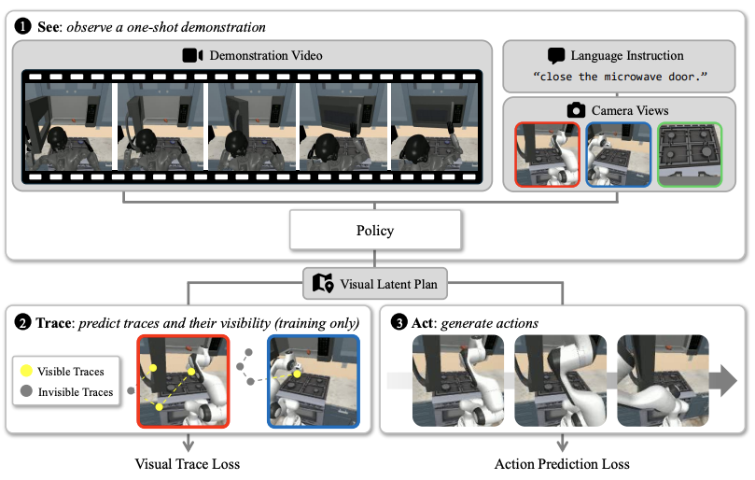
Related Work - Demo Video as Policy Condition
SeeTraceAct: one demonstration video guides an unseen tabletop task.
What/how: demo video prompt + current views -> robot action.
SeeTraceAct, 2026
Notes:
This related work slide shows demo video as a policy condition.
The example is SeeTraceAct. The figure starts with a one-shot demonstration video. The system also receives current camera views and a language instruction. From these inputs, it generates a latent visual plan and then predicts robot actions.
The important part for us is that the demonstration is used as a prompt. The policy is not just learning from a fixed dataset of action labels; it is conditioned on what the demonstration shows. This makes it relevant to our goal of using demonstrations as scalable task guidance.
Point to the lower part of the figure. The trace prediction step is a way of grounding the demonstration spatially. In other words, the model tries to determine where the robot should interact in the current scene.
The bottom summary captures the mechanism: demo video prompt plus current views gives robot action.
The limitation for our project is that this is still mostly tabletop manipulation. It does not address whole-body balance, tactile contact probing, unknown load, or morphology-dependent carrying strategy.
Transition: the next related work moves closer to humanoid whole-body behavior.

Slide 8
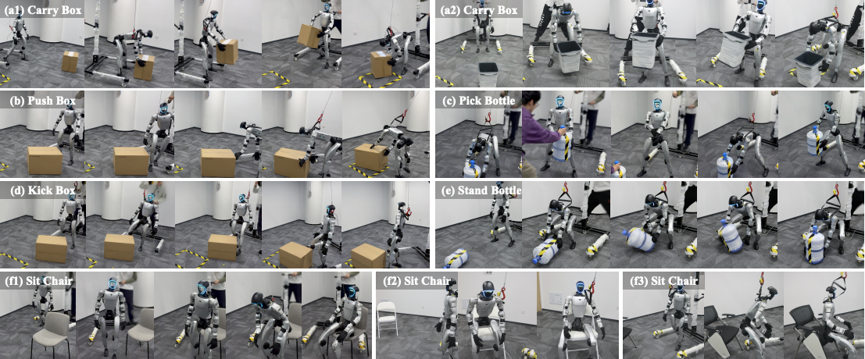
Related Work - Human Video to Humanoid Box Carrying
Sugar: human-video priors drive Unitree G1 box-carrying behavior.
What/how: human videos -> interaction priors -> humanoid carrying skill.
Sugar, 2026
Notes:
This related work slide shows human video to humanoid box carrying.
The example is Sugar. The visual result shows humanoid loco-manipulation skills, including carrying a box and interacting with large objects. This is much closer to the embodiment we care about than tabletop arm manipulation.
The key idea is that human videos can provide interaction priors. These priors are then refined into humanoid skills. So instead of hand-coding every behavior, the system can use video-derived data to learn richer whole-body interaction.
Point to the top row: the carry-box sequence is the most relevant example for us. It shows that a humanoid can coordinate arms, torso, legs, and balance while moving an object.
The bottom summary says: human videos become interaction priors, and those priors become a humanoid carrying skill.
The remaining gap is active physical discovery. Sugar shows that human-video priors can drive humanoid skills, but our focus is on what happens when the load is unknown and the robot must actively probe to choose its own strategy.
Transition: the final related work slide shows another line of work: tracking 2D motion and imitating it in simulation.

Slide 9
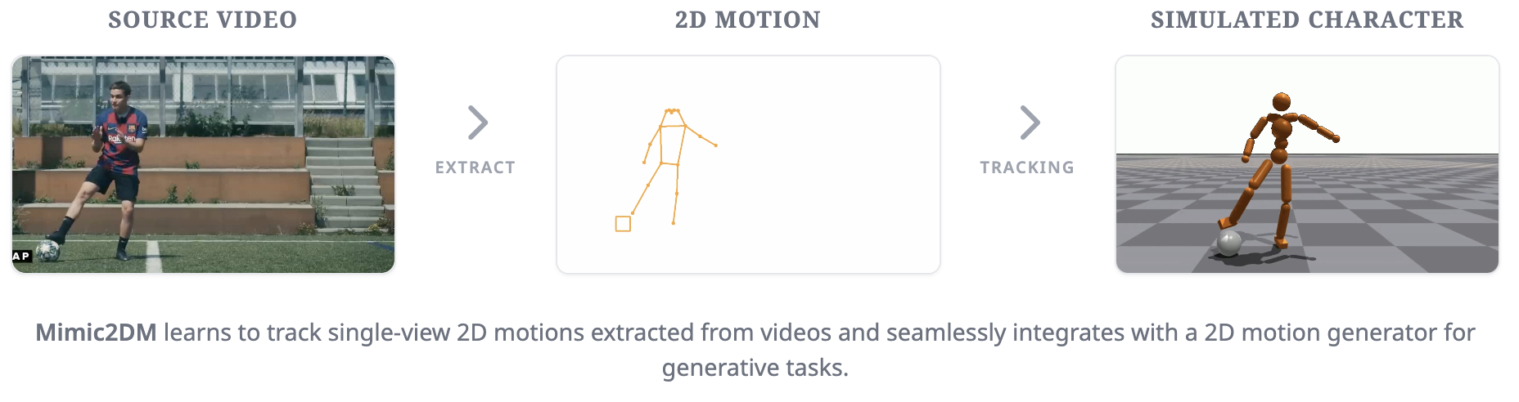
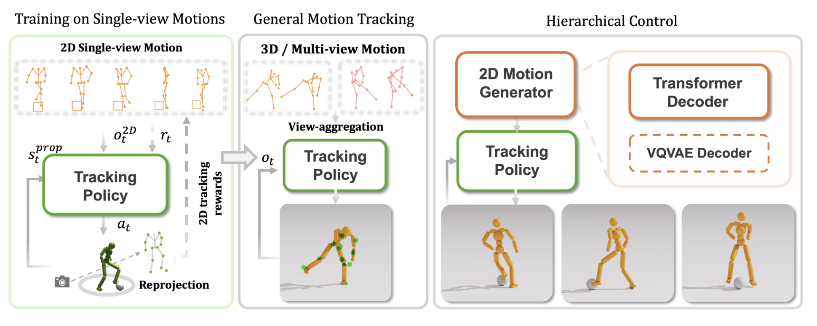
Related Work - 2D tracking -> Imitation
Learning to Control Physically-simulated 3D Characters via Generating and Mimicking 2D Motions
Sugar, 2026
Notes:
This related work slide shows a different kind of video-to-control pipeline.
The pipeline starts from a source video. A 2D motion is extracted from that video. Then a simulated character learns to track or mimic that 2D motion. This is useful because it reduces the need for full 3D motion capture.
The top row makes the idea easy to see: video on the left, extracted 2D motion in the middle, simulated character on the right. The lower diagram shows how the method uses tracking policies and motion generators to control the simulated character.
This is relevant because it shows another way to learn from ordinary videos without full 3D supervision. It also connects to the broader theme of scalable guidance from weak visual input.
But this is closer to motion imitation than to our target. The simulated character is trying to follow extracted motion. Our project is different because the demonstration should not be copied directly. The robot should use the demonstration to infer the goal, then use contact feedback to decide a physically safe strategy.
So across these related works, the message is: video can guide policies, video can provide humanoid priors, and 2D tracking can support imitation. What is still missing is demonstration-guided, tactile-aware, robot-specific strategy selection without retargeting.

