Slide 1
Accessing the deep web
By Bin He, Mitesh Patel, Zhen Zhang, Kevin Chen-Chuan Chang
Communications of the ACM, Vol. 50 No. 5, Pages 94-101
10.1145/1230819.1241670
Presented by Yanhua Feng
11/18/2014
Notes:
Today the topic is “Accessing the deep web.” This paper is authored by Bin He and three other people.

Slide 2
What is a deep web site?
A deep Web site is a Web server that provides information maintained in one or more back-end Web databases, each of which is searchable through one or more HTML forms as its query interfaces.
A deep web is also known as the "invisible or hidden web."
What is Surface Web?
A surface Web is the content on the World Wide Web that is available to the general public and for indexing by a search engine. Surface Web is also called "crawlable Web" and "public Web."
Notes:
Deep web site such as cars.com or amazon.com
Surface Web for example: my dentist web page, or Pizza Hut.com

Slide 3
Why do we need Deep Web?
The web has been rapidly “deepened” by massive database and current search engines do not reach most of the data on the Internet.
The surface Web has linked billions of static HTML page, but a far more significant amount of information is believed to be “hidden” in the deep Web.
Notes:
The reason are: The first reason is:
The Second reason is:

Slide 4
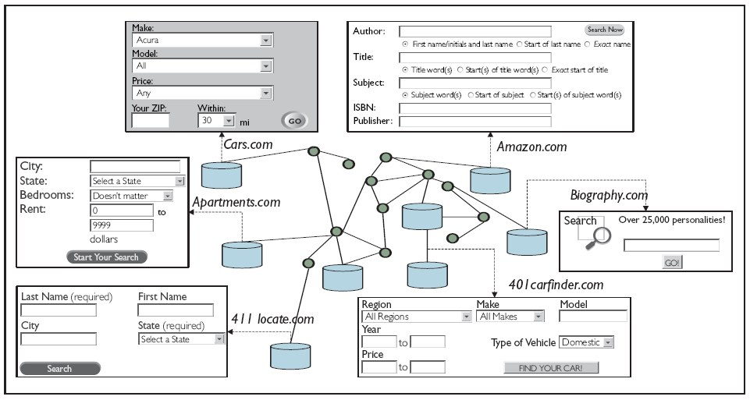
Figure 1a. The conceptual view of the deep Web.
Notes:
Here are several examples of deep Web site, they all have query interfaces accessing databases.

Slide 5
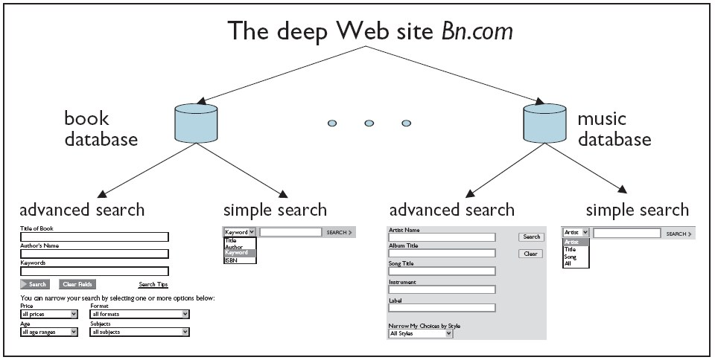
Figure 1b. Site, databases, and interface.
Access to the deep Web: deep web site, web database, and query interface
Notes:
Here is a picture showing more clearly the structure of deep Web.

Slide 6
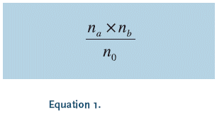
The study conducted in 2000 [1]
Find n_{a} deep Web sites in the first search engine
Find n_{b} deep Web sites in the second search engine
Find n₀ deep Web sites in the both search engines
The total number as shown in Equation 1 by assuming the two search engines randomly and independently obtain their data.
But search engines are highly correlated, therefore, such an independence assumption seems unrealistic.
Notes:
This paper was published in 2004. In 2000, there was another study on deep Web. In this study: they estimated the deep Web. Find na…. Find nb…. Find n0…They used equation1 to estimated the number of total engines. They assumed that the two search engines randomly and independently get their data.
But actually, the search engines are highly correlated. This assumption is invalid.

Slide 7
This study, April 2004
Randomly sampled 1,000,000 IPs
From the entire space of 2,230,124,544 valid IP addresses
For each IP, download HTML pages
Identified and analyzed Web databases in this sample
Deep Web: site, database, and interface
First, differentiate and exclude non-query HTML forms (which do not access back-end databases) from query interfaces
Second, compute the number of Web databases by finding the set of query interfaces (within a site) that refer to the same database.
Finally, a web site is a deep Web site if it has at least one query interface.
Notes:
In this paper, the authors used a different approach. They randomly sampled…
2.23 billion.
Remembered the deep web structures are site, web database, and interface.
First… Second…Finally…. They used these 3 steps to identify deep Web site.

Slide 8
(Q1) Where to find "entrances" to databases?
Deep crawled a sample of 10,000 IPs
found 281 Web servers
crawling these servers to depth 10, found 24 deep Web sites
Found 129 query interfaces
Found 34 Web databases
none of the 129 query interfaces had depth deeper than 5
94% (32 out of 34) Web databases appeared within depth 3
91.6% (22 out of 24) deep Web sites had their databases within depth 3.
depth-three coverage
Notes:
The first question they asked: Where to…
To answer this question: they deep crawled a sample…
From these 10 thousand IPs, they found 281…
The depth means: the minimum number of hops from the root page of the site to the interface page.
They found that none of the 129 query…
Depth_three coverage is the term they use for the percent of deep websites with depth of less than or equal to three.

Slide 9
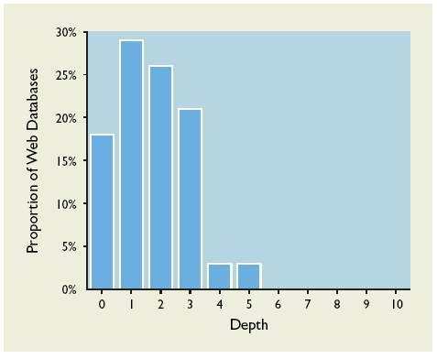
Figure 2a. Distribution of Web
databases over depth.
Notes:
This is a histogram of the distribution of Web databases over depth. You can see most of depth is equal or less than 5.

Slide 10
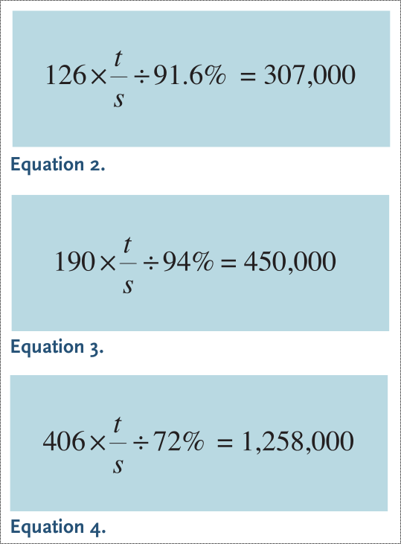
(Q2) What is the scale of the deep Web?
Crawled to depth 3 for the s=1,000,000 IPs
Found
  126 deep Web sites
  406 query interfaces
  190 Web databases
Extrapolate to entire IP space
  t=2,230,124,544 IPs
Notes:
The second question they tried to answer is What is scale….
1 million IPs
Then they extrapolate to the entire IP space
2.23 billion IPs
They use these equations to calculate, the results are: 307,000 deep web sites, 450,000 web databases and 1,258,000 query interfaces.

Slide 11
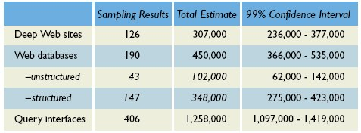
Table 1. Sampling and estimation of the deep Web scale.
Notes:
Here is a table showing the results. They also give 99 percent Confidence Interval of their total estimate.

Slide 12
(Q3) How "structured" is the deep Web?
Unstructured database:
  provide data objects as unstructured media (text, images, audio, and video.)
Structured database:
  provide data objects as structured relational records.
Inspected 190 Web databases
  43 unstructured
  147 structured
  Ratio 3.4:1
Estimated total
  102,000 unstructured
  348,000 structured
Most Web databases are structured.
Notes:
The question 3 is: how structured is the deep Web? An unstructured database provides data… A structured database provides data …
They inspected 190 Web… they found 43… From this sample, they estimated total that most Web databases are structured.

Slide 13
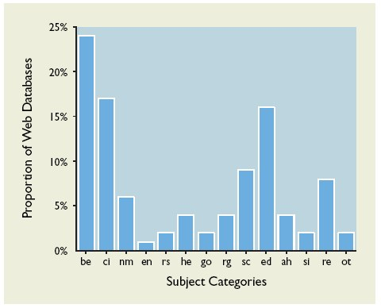
(Q4) What is the subject distribution of Web databases?
Inspected 190 Web databases
Distribution of 14 categories:
  Business and Economy (be)
  Computers and Internet (ci)
  News and Media (nm)
  Entertainment (en)
  Recreation and Sports (rs)
  Health (he)
  Government (go)
  Education (ed)
  …
Figure 2b. Distribution of Web databases
over subject category.
Great subject diversity
Notes:
Similar to question 3, they used the same approach to estimate the subject distribution of Web databases. They inspected 190 Web databases, divided them into 14 subject categories. This picture is the histogram of their findings.

Slide 14
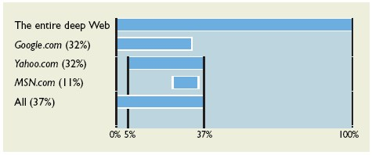
(Q5) How do search engines cover the deep Web?
Google, Yahoo, and MSN
Used 20 Web databases
Sampled 5 result pages for each Web database
For each page: searched 3 engines with key words on that page
Figure 3. Coverage of search engines.
Notes:
The question 5 is How do search engines cover…?
They used three most popular search engines: Google, Yahoo and MSN
They sampled 20 web databases, for each web database, they sampled 5…
They looked for distinct words on these pages, and searched the 3 engines with these words to see if they can find the pages.
This figure shows the coverage of engines Google and Yahoo covered 32 percent each, and MSN only 11 percent. Importantly, the results of all three engines overlapped each other to a high degree. All together they only covered 37 percent.

Slide 15
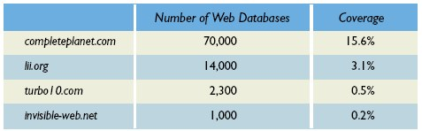
(Q6) What is the coverage of deep Web directories?
Four deep Web directories
Number of databases each directory claimed to have indexed.
Total 450,000 Web databases
Table 2. Coverage of deep Web directories.
Notes:
In addition to search engines, there are also deep Web directories.
In the four deep Web directories they investigated, each directory showed the number of databases indexed.
Here is the table showing their claimed numbers, compared to the total number of web databases .

Slide 16
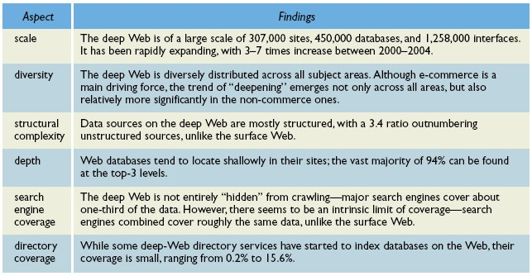
Table 3. Summary of survey findings.
Notes:
Here is a summary of the 6 questions and answers.
The scale of the deep web is large and expanding quickly.
The deep Web is diverse covering many categories.
They are mostly structured.
The depths are shallow.
The search engines can only reach small portion of them.
The coverage of deep Web directories is small.

