Slide 1
Skrak
A simple account cracker.

Slide 2
Concept
What the heck is this ?

Slide 3

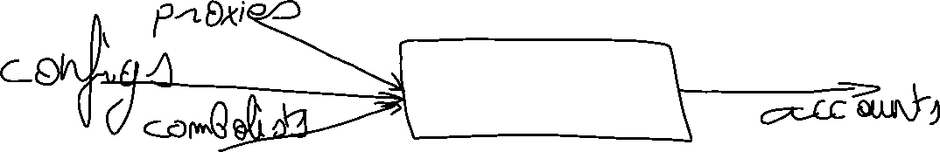



What’s the point ?
To have a simple server cracking accounts for you.
To feed it with passwords automatically with a REST API.
To feed it with proxies and VPNs automatically with a REST API.
To receive accounts automatically as they are cracked on Slack, Discord, Mail, Message, WebHook and so on...

Slide 4
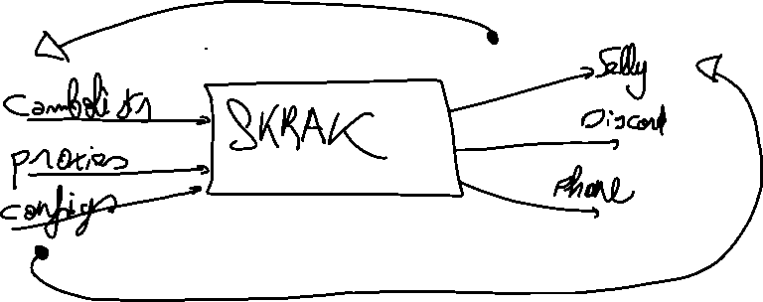
How it works ?
First, feed the server with proxies and combolists.
Next, let it crack the accounts.
Finally, send a request to the REST API and grab the accounts in the JSON response!

Slide 5
What’s innovative ?
Write a web scrapper that grabs proxies, combolists and VPNs from the web.
Create a Slack or Discord server and you have a free accounts pool !
Append your Selly.gg’s hook and you have a self-running business !

Slide 6
Architecture
Ok, that’s great, but how would it work ?

Slide 7


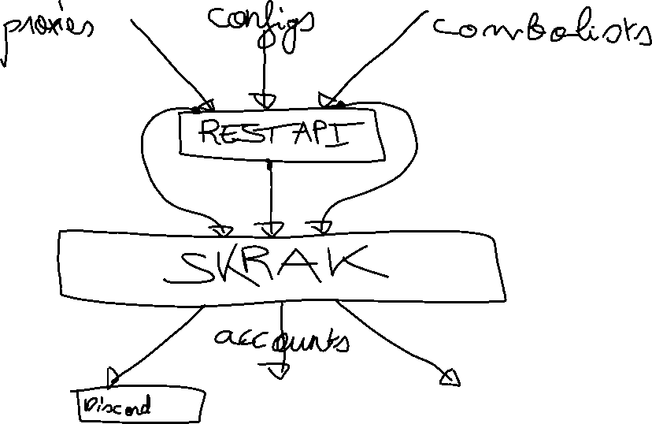
System’s architecture

Slide 8
Stack
Elixir for the project.
Phoenix for the REST API.
gRPC for using Skrak as a whole.
REST for adding configs, combolists and proxies and getting accounts.
Kubernetes for scaling Skrak up.

