Slide 1
What is DeepTCR ?
A deep learning method for representation of TCRs
Where supervised and unsupervised methods are explored
But also, a Python framework simplifying the analysis of TCRs
MAIN OBJECTIVES
One common method used for TCR embedding and featurization
Variational autoencoder for unsupervised learning
Perturbation analysis explored for the supervised learning case → sensitivity and importance analysis
“Weakly supervised” method explored
METHODS USED
Use Deep Learning (in particular CNNs) in order to extract important features from sequencing data
Learn sequence motifs and hence patterns useful for both descriptive and predictive purposes

Slide 2
TCR featurization:
One common method used for multiple architectures:
  Embedding of the sequences with a trainable (or not) embedding layer
  Three-layer CNN used to extract the most important features from the chains
  Use of the V/D/J gene sequences with “one-hot” representation through an additional embedding layer
  Combination of both CDR3 embeddings and V/D/J features to obtain an accurate and complete joint representation

Slide 3
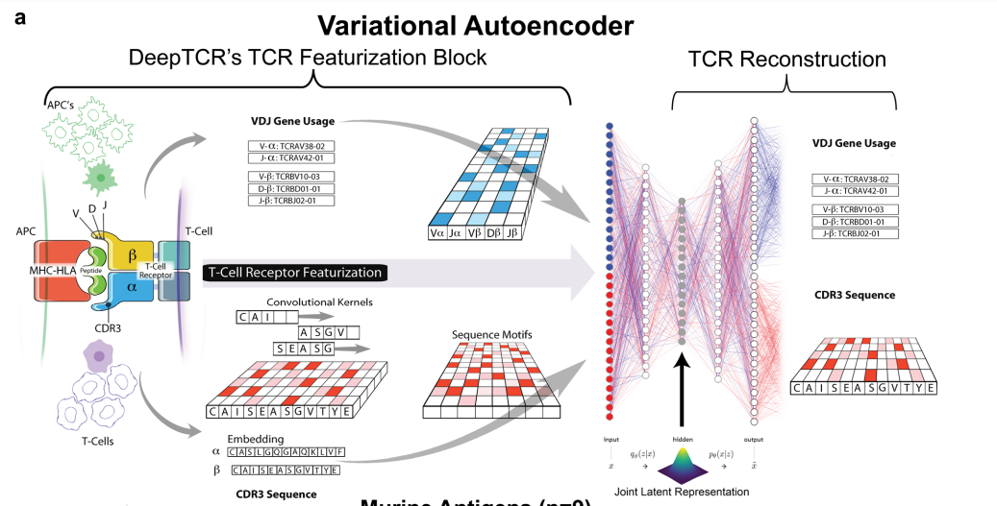
Use of Variational Autoencoder in order to learn the underlying distribution of the sequence data to cluster TCR sequences (based on Hamming distances)

Slide 4
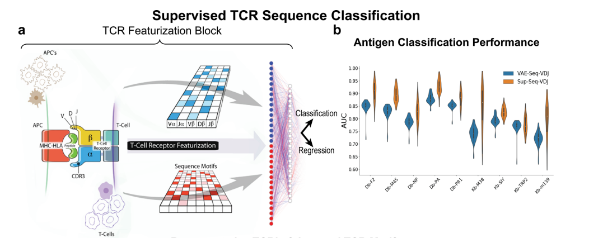
Supervised Classification:

Slide 5
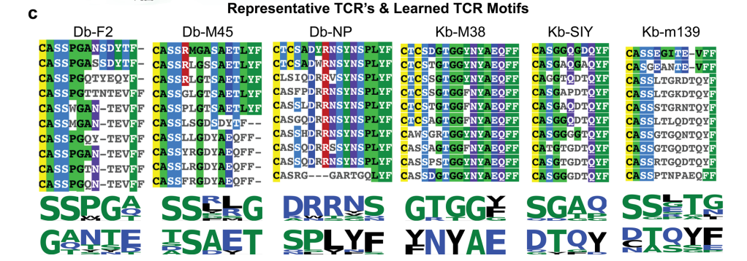
Perturbation analysis:
Ability to perturb the inputs and measure the change in the output of the supervised model ➔ Hence, determining the relative importance of antigen-specific binding

Slide 6
DeepTCR Python package:
All the code is available freely on GitHub and it can be easily re-used if necessary
Clear and understandable code used throughout the package
Availability of easy tutorials to reproduce easy tasks with Jupyter notebooks
LINK TO REPO

Slide 7
Paths not explored by DeepTCR:
Transfer learning pipeline for more performant model results → use today state-of-the-art NLP-like methodology
Determine the interpretability of the weights for the unsupervised case through a perturbation analysis
Try different distances metrics to evaluate our model (TCRdist3?)
Not clear which regularization is used
Generate “artificial TCR sequences” that would have a similar binding specificity as other TCRs
Clustering methods in general are not really explored → use and evaluation of the embeddings obtained with VAE in clustering

