Slide 1
a gentle introduction into a microframework with good intentions

Slide 2

What is Flask?
» A microframework
» Reusing existing code
» Lots of documentation
» Neat way to write small apps

Slide 3

Another µFramwork?
YES!

Slide 4

Under the Hood
» Full power of Werkzeug
» Jinja2 as a capable template engine

Slide 5
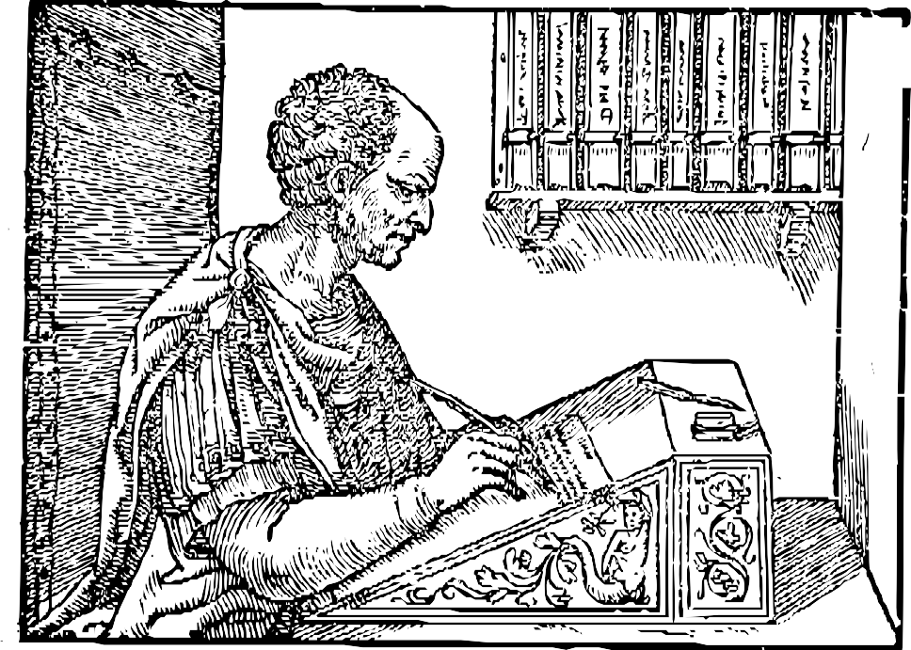
Under the Hood
» 450 Lines of actual Code
» 1000 Lines of Tests
» 5000 Lines of Documentation

Slide 6

What does it do?
» Cookie-based session support
» Flashing of messages
» Preconfigured Jinja2 with autoescaping
» Serves static files from “static”
» Before/After Request hooks
» Context local objects
» RESTful URL mapping

Slide 7

What else?
» Lots of documentation (120 A4 pages)
» Website with lots of snippets
» Extension registry (OAuth, OpenID, XML- RPC, CSRF protection …)
» Active Mailinglist and IRC Channel

Slide 8
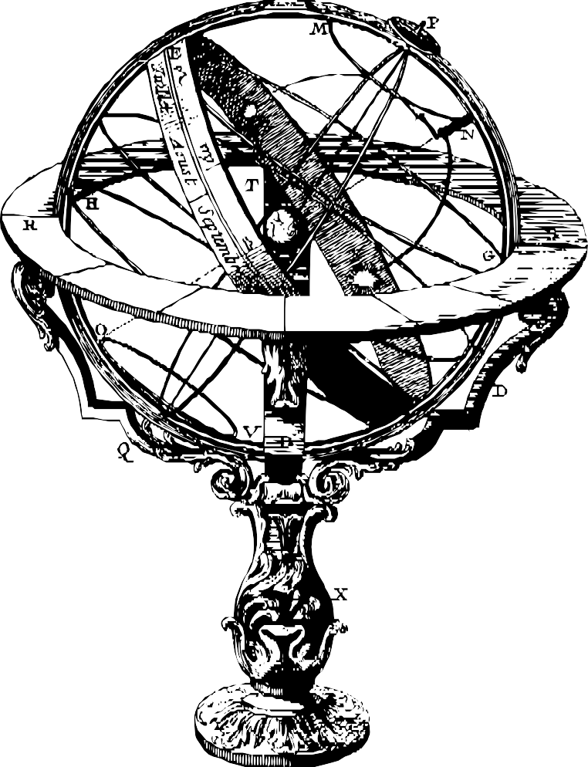
Hello Flask
from flask import Flask app = Flask( name )
@app.route('/')
def index():
return 'Hello World!'
if name == ' main ': app.run(debug=True)

Slide 9
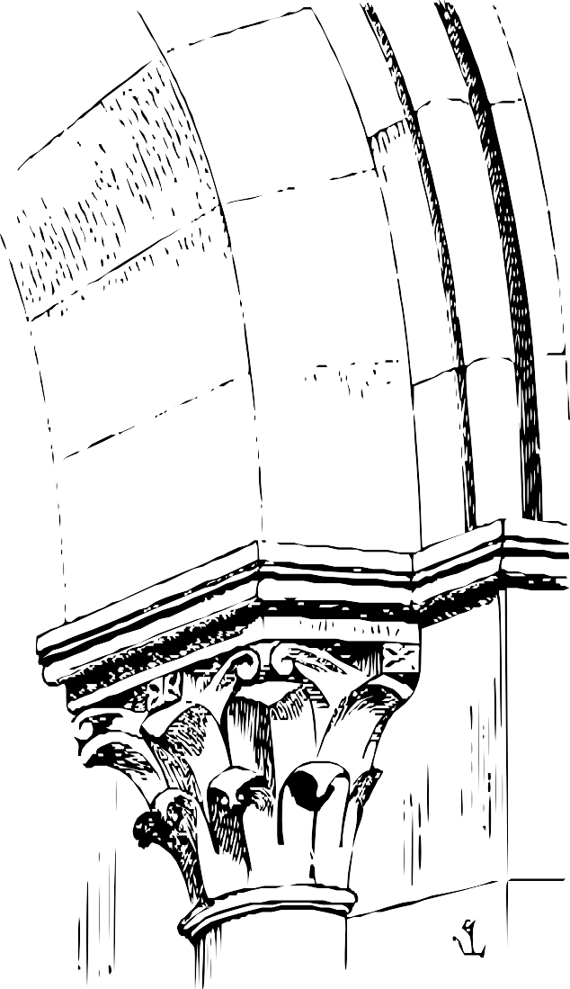
Hello Localhost
$ python hello.py
* Running on http://127.0.0.1:5000/
* Restarting with reloader...

Slide 10
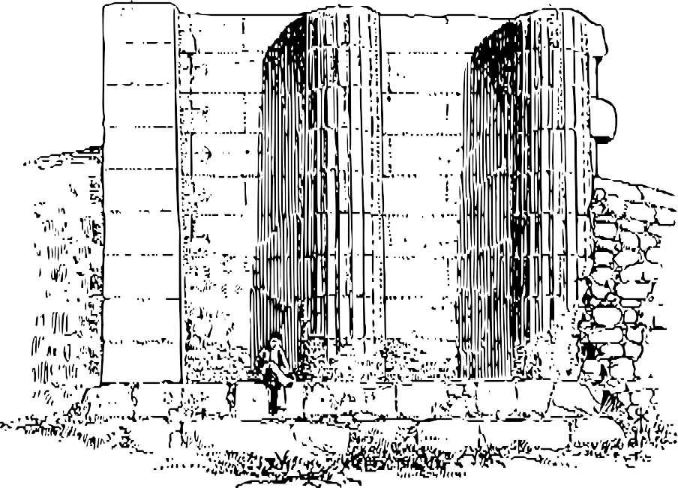
Rendering Templates
from flask import render_template
@app.route('/')
def index():
return render_template('index.html', variable='value'
)

Slide 11
The Request Data
from flask import request, flash, redirect, \ url_for, request
@app.route('/new-­‐comment', methods=['GET', 'POST'])
def new_comment():
if request.method == 'POST': Comment(request.form['name'],
request.form['text']).save() flash('Comment was added')
return redirect(url_for('show_comments')) return render_template('new_comment.html')

Slide 12
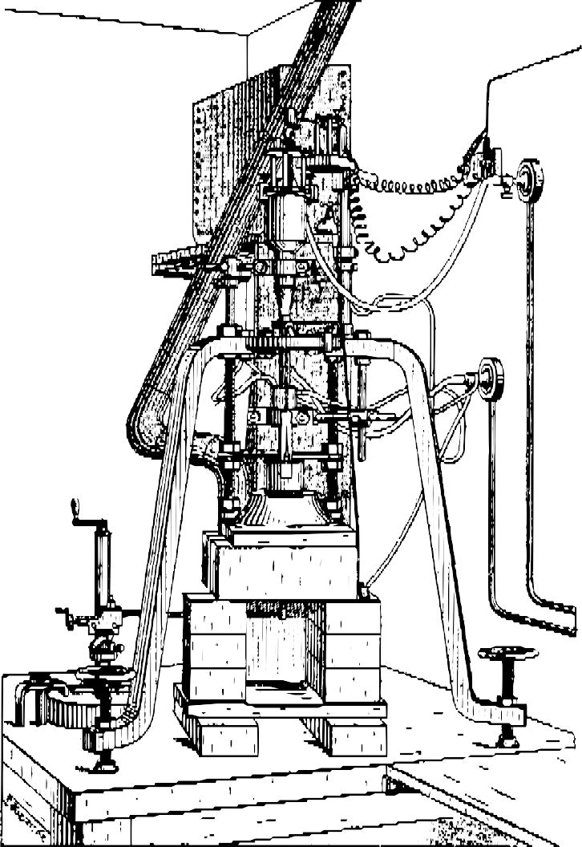
Before/After Request
import sqlite3
from flask import g
@app.before_request
def before_request():
g.db = sqlite3.connect(…)
@app.after_request
def after_request(response): g.db.close()
return response

Slide 13

Where to get?
$ pip install Flask
http://github.com/mitsuhiko/flask http://flask.pocoo.org/

