Slide 1


Everything You Need to Know About
ChatGPT

Slide 2


ChatGPT is an AI chatbot developed by OpenAI that is designed to provide human- like conversational interactions. It is built on large language models (LLMs), which are advanced machine learning models that can understand and generate natural language.

Slide 3

The history of
ChatGPT starts in 2018, when OpenAI first
introduced its GPT language model. This model was capable of generating human-like responses to questions and conversations, inspiring the creation of ChatGPT.
OpenAI officially launched ChatGPT in November 2022 and it was an instant hit. Building upon the success of GPT-3.5, OpenAI introduced GPT-4, an iteration that brought notable enhancements in ChatGPT’s performance, scalability, and overall capabilities.

Slide 4
It is the largest, most powerful language model ever created, with 175 billion parameters and the ability to process billions of words in a single second.
As an AI-powered natural language processing tool, ChatGPT is capable of understanding and generating text based on the prompts you give it. It has a wide range of applications, from answering your questions to helping you draft content, translate languages, and more.

Slide 5


5
However, on the flip side, some serious concerns are doing the rounds over the potential misuse of ChatGPT. It can lead to spreading misinformation or even creating content that is convincing enough but still fake. OpenAI has already implemented measures to limit such possibilities. For instance, human moderators have been put in place to review potentially sensitive content

Slide 6
The foundation of ChatGPT is the GPT (Generative Pre-trained Transformer) architecture, and the acronym highlights the key characteristics of this AI model
6
Generative: GPT models are capable of generating new content based on the patterns and context they have learned from the training data.
Pre-trained: The models are pre-trained on vast amounts of text data from diverse sources, allowing them to learn a wide range of linguistic patterns, grammar, facts, and context.

Slide 7

7
Transformer: GPT models are built on the Transformer architecture, a neural network model designed for natural language processing tasks. The Transformer architecture employs self-attention mechanisms and parallel processing to efficiently handle large-scale language tasks and generate contextually accurate text

Slide 8


How does ChatGPT work?
ChatGPT uses a transformer-based neural network architecture to generate consistent and contextually relevant responses
The model is typically trained on large amounts of text that allows the bot to learn the statistical patterns of language, such as grammar, syntax, and semantics, which are generally used by humans while communicating.
When the user interacts over the chat interface, text input is initially tokenized into a series of numerical vectors that the model can interpret. These vectors are then processed via multiple layers of neurons to generate a probability distribution function, which determines the next set of possible words. The word with the highest probability is chosen and used as the starting point to generate the next word. This process continues until a complete response is generated.

Slide 9

LLM (Large Language Model)
9
A computer algorithm that processes natural language inputs and predicts the next word based on what it’s already seen. Then it predicts the next word, and the next word, and so on until its answer is complete.

Slide 10
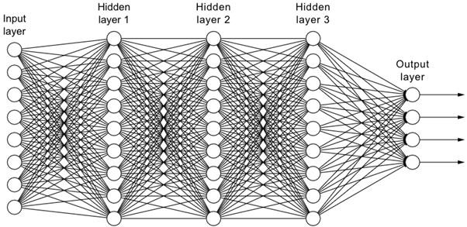
What Is a Neural Network?
A neural network is a software solution that leverages machine learning (ML) algorithms to ‘mimic’ the operations of a human brain.

Slide 11
11
The architecture of a neural network comprises node layers that are distributed across an input layer, single or multiple hidden layers, and an output layer. Nodes are ‘artificial neurons’ linked to each other and are associated with a particular weight and threshold.
Neural networks are capable of classifying and clustering data at high speeds
Additionally, traditional computers operate using logic functions based on a specific set of calculations and rules. Conversely, neural computers can process logic functions and raw inputs such as images, videos, and voice.

Slide 12
Four critical steps that neural networks take to operate effectively are:
Associating
Classification
Clustering
Prediction

Slide 13
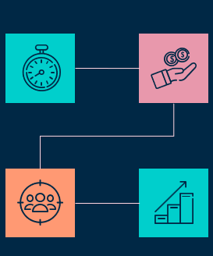
Characteristics of ChatGPT
13
1)Language understanding and generation
2) Contextual understanding
3) vocabulary
4) Multilingual features
6) Self-improvement abilities
5) Creative offerings

Slide 14
How does the ChatGPT Tool accomplish its goals?
Generating Text: ChatGPT is capable of producing text that has a human-like appearance. This can be put to use for a variety of tasks, including writing and the production of information
Create A Virtual Assistant or a Chatbot: We can integrate ChatGPT with our
chatbot or VA and even customize it according to our needs.
Text Summarizing
Language Translation, Dialogue Generation
Generate Reports
Implement an Automated Customer Service System

Slide 15
15
Where Does ChatGPT Get it’s Data?
Web scraping: Web scraping involves extracting data from websites by using automated tools. The chatbot scans the web for relevant information and stores it in its database.
User feedback: ChatGPT also uses user feedback to improve its responses. When a user interacts with the chatbot, they can rate their responses.
Knowledge databases: Knowledge databases are created by experts in various fields and provide detailed information on specific topics

Slide 16
Social media: This allows ChatGPT to provide users with real- time information on trending topics.
Open data sources: ChatGPT also uses open data sources to gather information on various topics. Open data sources are publicly available datasets that provide information on specific topics.

Slide 17
How to use ChatGPT effectively?
17
Clearly Define Your Goal
Use Specific and Clear Language
Provide Context
Experiment with Different Inputs
Provide Feedback
Aware of what you feeding into the chat

Slide 18
Pros and Cons of using chat GPT
Pros
Improved natural language understanding
Faster response time
Abiltiy to generate more natural-
sounding conversation
Enhance work in various industries, marketing, programming, research, and more
Cons
Difficulty in training models to respond appropriately to a wide range of topics.
Potential bias from data used to
train the models
Lack of academic integrity and potential for providing inaccurate information

Slide 19

Let’s
Innovate
Together
www.expeed.com

