Slide 1
Payments Analytics with Elastic
Synthetic transactions • Elasticsearch analytics • Kibana dashboards
Transactions
Revenue
Approval Rate
Dashboards
1,000,000
$35,128,691
93.02%
7

Slide 2
What was built
A complete payments analytics demo using Elasticsearch + Kibana
1M synthetic payments
Elasticsearch index
Kibana dashboards
Generated and streamed using the Bulk API
Search, aggregations, runtime fields, templates
Executive, operational, anomalies, maps, capabilities
End-to-end demonstration from data generation to executive insights.
Dashboards are powered by ES|QL, aggregations, runtime fields and full-text search.
Designed to show both business value and technical Elasticsearch capabilities.
Elastic Payments Analytics Demo
Jun 09, 2026

Slide 3
Data overview
Synthetic payment transaction dataset indexed into Elasticsearch
Total Transactions
Total Revenue
Approval Rate
1,000,000
$35,128,691
93.02%
Decline Rate
Avg Processing
P95 Processing
5.00%
1,256 ms
2,376 ms
Top countries by payment count
Country
Payments
Amount
Core fields: amount, country, merchant, payment method, status, latency, risk score.
Additional fields: error_message and runtime fields for live calculations.
Singapore
100,647
$4,098,473
Brazil
100,318
$4,096,100
United Kingdom
100,297
$4,101,933
India
100,058
$4,104,417
Canada
99,976
$4,094,552
Elastic Payments Analytics Demo
Jun 09, 2026

Slide 4
Executive Dashboard
Management-level view of payment performance
Total Transactions
Total Revenue
Approval Rate
Decline Rate
Avg Processing
1,000,000
$35,128,691
93.02%
5.00%
1,256 ms
KPI cards summarize transaction volume, revenue, approval and decline rates.
Trend chart shows transactions over time.
Breakdowns by country, merchant and payment method explain where volume comes from.
Business message
Fast answer for leaders: Are payments healthy?
Combines financial metrics and operating metrics in one view.
Open Executive Dashboard
Elastic Payments Analytics Demo
Jun 09, 2026

Slide 5
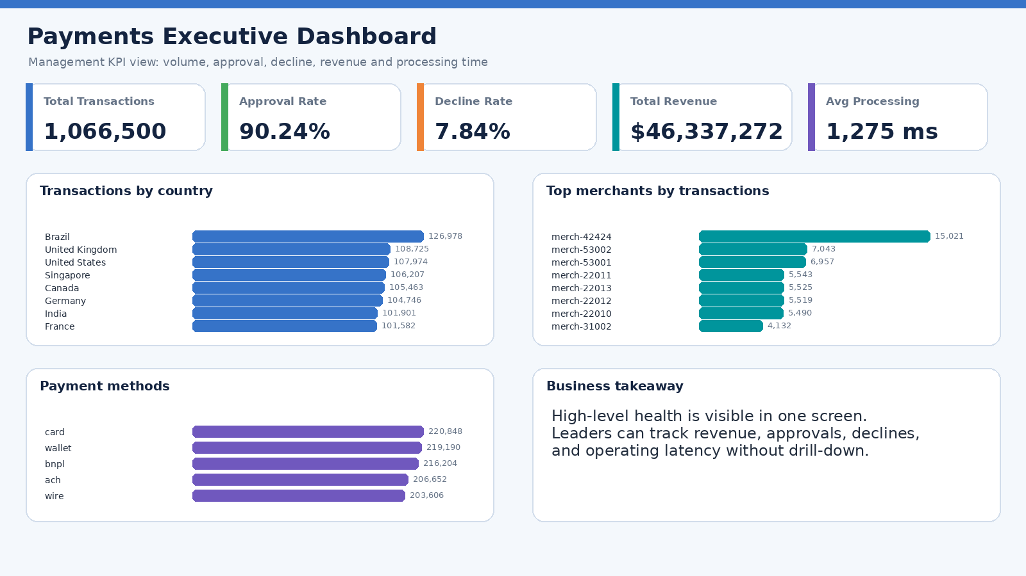
Screenshot: Payments Executive Dashboard
Generated snapshot based on live Elasticsearch/Kibana dashboard data
Elastic Payments Analytics Demo
Jun 14, 2026

Slide 6
Operational Dashboard
Investigate failed payments and processing latency
Failed Transactions
Failure Rate
High Latency Txns
P95 Processing
51,887
5.19%
201,523
2,376 ms
Top decline reasons
Drill-down tables expose the latest failed transactions and highest latency transactions.
Operations teams can isolate issues by country, payment method, merchant and reason.
Useful for incident response and payment processor troubleshooting.
Decline reason
Txns
Issuer declined
21,029
Processor timeout
13,700
ACH verification failed
6,997
Wallet authorization failed
6,986
Amount limit
1,250
Open Operational Dashboard
Elastic Payments Analytics Demo
Jun 09, 2026

Slide 7
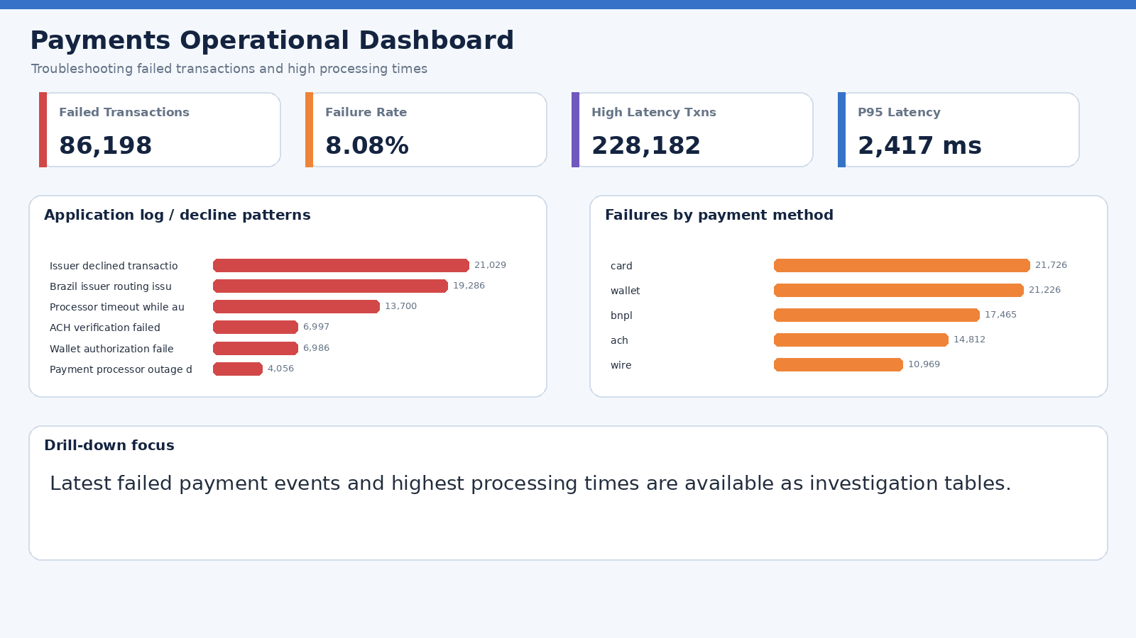
Screenshot: Payments Operational Dashboard
Generated snapshot based on live Elasticsearch/Kibana dashboard data
Elastic Payments Analytics Demo
Jun 14, 2026

Slide 8
Visibility Dashboard
Service visibility view built from the current payment transaction data
Availability SLI
Failure Rate
P95 Latency
P99 Latency
Latency SLO <=2s
Error Log Events
94.81%
5.19%
2,376 ms
2,475 ms
79.89%
51,887
Treats each payment transaction as a service event for payments-api.
Shows throughput, failure-rate and latency trends over time.
Uses error_message as application log events for troubleshooting.
Includes trace-style drill-down for slowest and failed transactions.
Production extension
Add real APM traces for end-to-end request paths.
Ingest application logs and infrastructure metrics.
Create alert rules and official Elastic SLO objects.
Open Payments Visibility Dashboard
Elastic Payments Analytics Demo
Jun 09, 2026

Slide 9
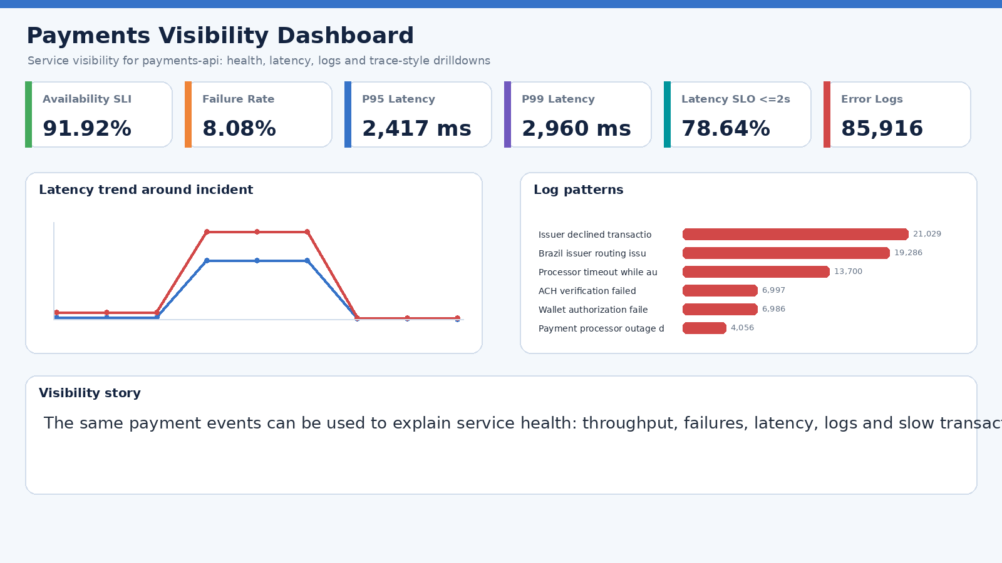
Screenshot: Payments Visibility Dashboard
Generated snapshot based on live Elasticsearch/Kibana dashboard data
Elastic Payments Analytics Demo
Jun 14, 2026

Slide 10
Anomaly Detection Dashboard
Rule-based anomaly detection without Machine Learning
High Amount Txns
Off-hours Txns
High Decline Countries
Merchant Spikes
5,259
273,850
4
Detected
Flags transactions above an amount threshold.
Finds merchants with unusual volume increases.
Highlights countries with abnormal decline rates.
Shows payments outside business hours.
Demo thresholds
High amount: amount >= 250
Off-hours: before 06:00 or after 22:00 UTC
Country decline threshold: >= 5.2%
Open Anomaly Detection Dashboard
Elastic Payments Analytics Demo
Jun 09, 2026

Slide 11
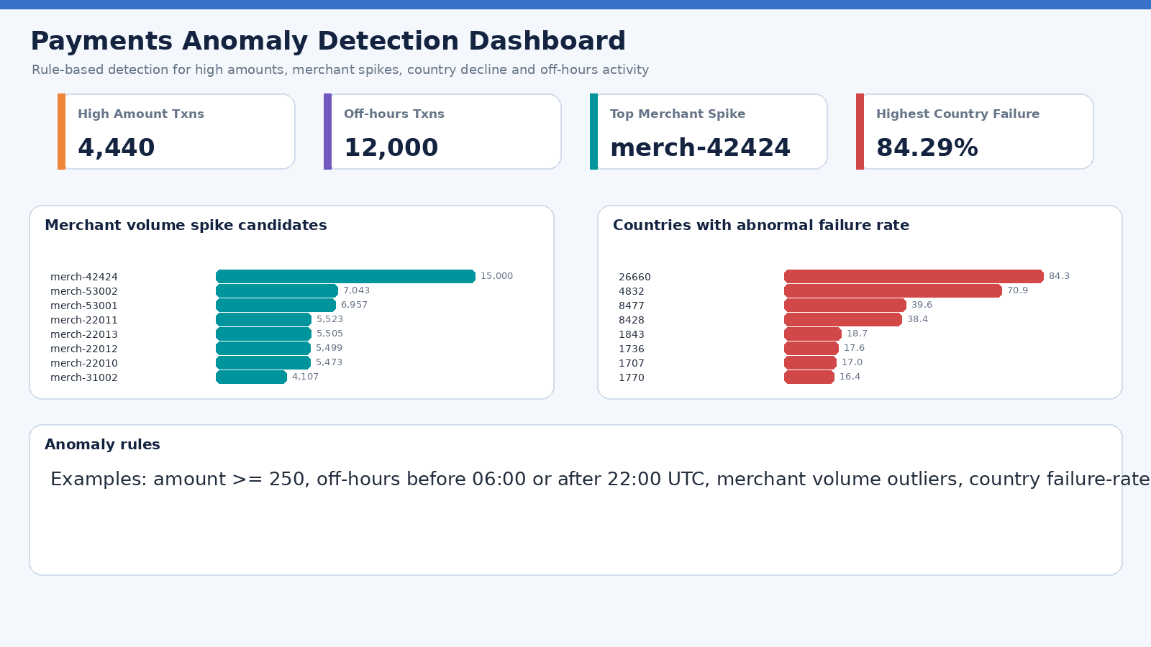
Screenshot: Payments Anomaly Detection Dashboard
Generated snapshot based on live Elasticsearch/Kibana dashboard data
Elastic Payments Analytics Demo
Jun 14, 2026

Slide 12
Business Scenarios Dashboard
Realistic payment incidents added to make the demo story feel like production data
Scenario Txns
02:00 Failures
Top Merchant
Brazil Failure Rate
Latency P95
66,500
12,000
merch-42424
84.29%
3,279 ms
Adds a visible failure spike between 02:00 and 03:00 UTC.
Merchant merch-42424 becomes an obvious volume outlier with 15,000 transactions.
Brazil shows an elevated failure rate of 84.29%.
High-value transactions reach $9,496.
Latency incident shows baseline around 100ms, jump near 3000ms, and recovery.
Scenario volumes
Scenario
Txns
Brazil elevated decline rate
22,000
merchant flash-sale volume spike
15,000
02:00-03:00 failure spike
12,000
processor latency incident 100ms to 3000ms
9,000
high-value transaction cluster
3,500
latency recovery after incident
2,500
Open Payments Business Scenarios Dashboard
Elastic Payments Analytics Demo
Jun 10, 2026

Slide 13
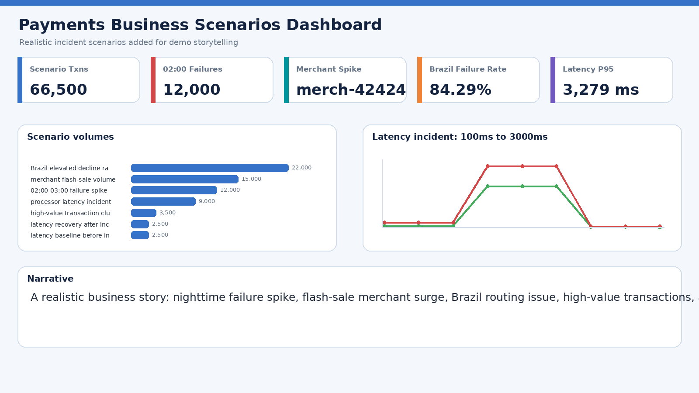
Screenshot: Payments Business Scenarios Dashboard
Generated snapshot based on live Elasticsearch/Kibana dashboard data
Elastic Payments Analytics Demo
Jun 14, 2026

Slide 14
Payments World Map
Geographic distribution of payment count and total amount
Map 1: Number of payments
Map 2: Total payment amount
Country-level region map
Metric: payments = COUNT(*)
Uses ISO country codes internally for map matching
Country-level region map
Metric: total_amount = SUM(amount)
Supporting table shows full country names
Top countries displayed with full names
Country
Payments
Amount
Singapore
100,647
$4,098,473
Brazil
100,318
$4,096,100
United Kingdom
100,297
$4,101,933
India
100,058
$4,104,417
Canada
99,976
$4,094,552
Open Payments World Map
Elastic Payments Analytics Demo
Jun 09, 2026

Slide 15
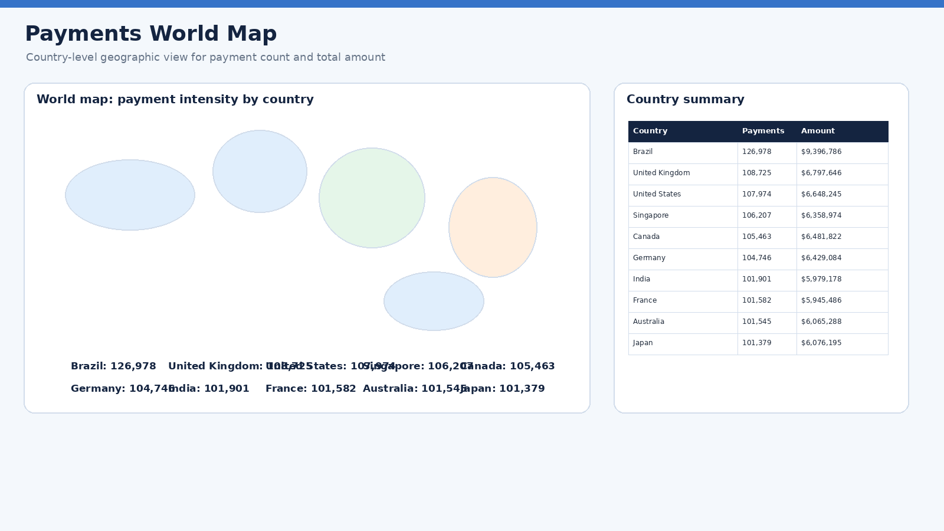
Screenshot: Payments World Map
Generated snapshot based on live Elasticsearch/Kibana dashboard data
Elastic Payments Analytics Demo
Jun 14, 2026

Slide 16
Elasticsearch capabilities demonstrated
Search, analytics, runtime fields, schema management and lifecycle awareness
Aggregations
Full-text search
Revenue by merchant, approval rate by country, avg/P95 processing time
Transaction ID, merchant/category and error_message timeout searches
Runtime fields
Index templates
Live calculations for approval status, revenue, amount bands, country names
Reusable schema for future synthetic-transactions-* indices
Lifecycle / ILM
Serverless note plus hot/warm/delete ILM concept for Stack deployments
Open Elasticsearch Capabilities Demo
Elastic Payments Analytics Demo
Jun 09, 2026

Slide 17
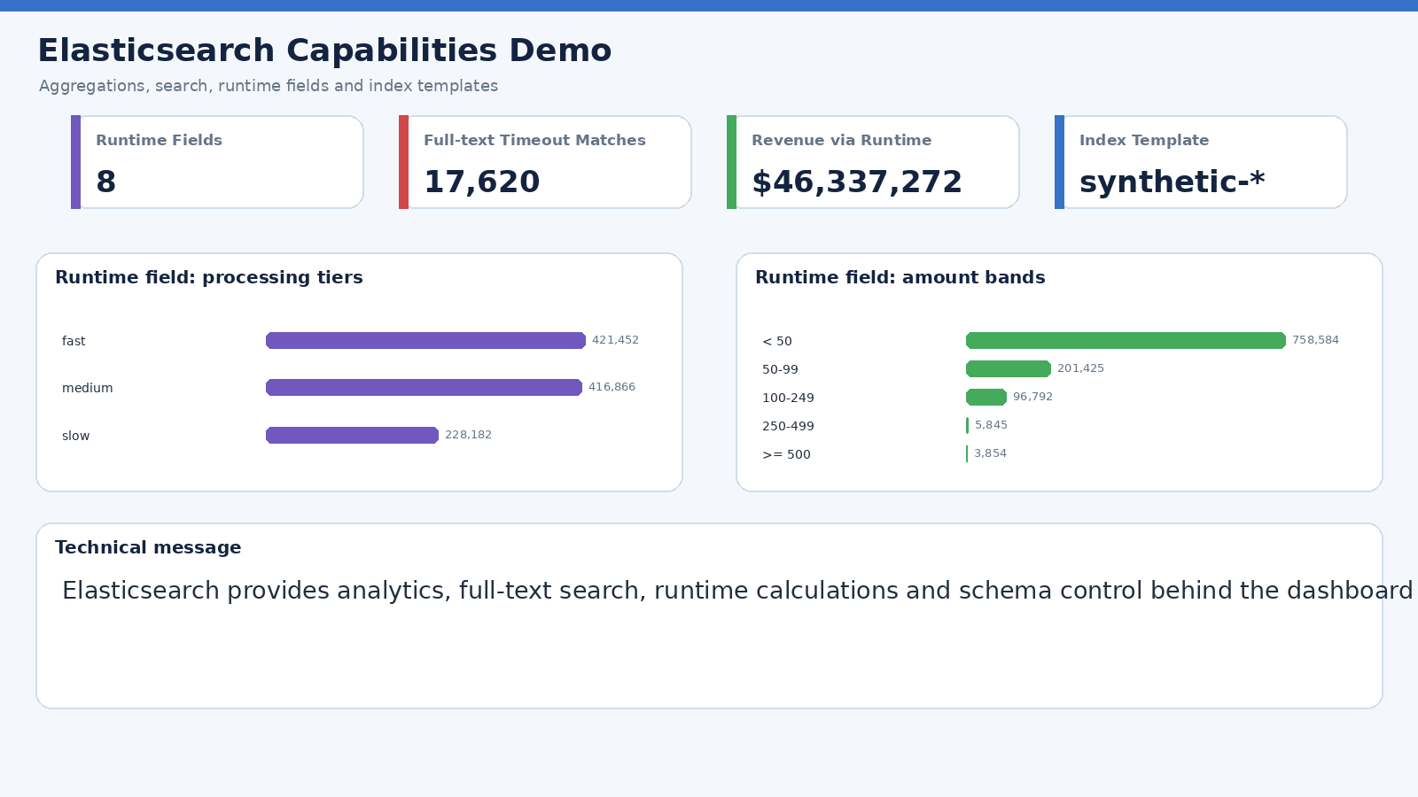
Screenshot: Elasticsearch Capabilities Demo
Generated snapshot based on live Elasticsearch/Kibana dashboard data
Elastic Payments Analytics Demo
Jun 14, 2026

Slide 18
Key insights to communicate
Business and technical outcomes from the dashboards
Payment approval rate is 93.02%, showing a healthy baseline.
Total synthetic revenue is approximately $35,128,691 across 1,000,000 transactions.
Operational risk: 51,887 failed transactions and 201,523 high-latency transactions.
Country and merchant breakdowns make it easy to explain where performance changes originate.
Runtime fields and ES|QL enable new calculations without reindexing the data.
Presentation narrative
1. Start with executive KPIs
2. Show operational drill-down
3. Demonstrate anomaly monitoring
4. Close with Elasticsearch platform capabilities
Elastic Payments Analytics Demo
Jun 09, 2026

Slide 19
Recommended next steps
How to take the demo toward production
Connect real payment streams or batch exports.
Add alerts for high decline rate, high latency and off-hours spikes.
Introduce ML anomaly detection after baseline behavior is established.
Define production index lifecycle policy where ILM is available.
Add role-based access and scheduled PDF/PNG dashboard reports.
Suggested closing statement
Elastic provides one platform for payment search, analytics, operations, anomaly detection and geographic insight.
Deliverable
This deck summarizes five live Kibana dashboards and the Elasticsearch capabilities behind them.
Elastic Payments Analytics Demo
Jun 09, 2026

Slide 20
Appendix: live dashboard links
Use these links during the demo or Q&A
Executive Dashboard
Open dashboard
https://payments-c225aa.kb.us-central1.gcp.elastic.cloud:443/app/dashboards#/view/4175393e-6f7a-4ff6-b800-0a6cc952fb08
Operational Dashboard
Open dashboard
https://payments-c225aa.kb.us-central1.gcp.elastic.cloud:443/app/dashboards#/view/f95d1796-ed29-40c4-af2c-a05a0f834039
Anomaly Detection Dashboard
Open dashboard
https://payments-c225aa.kb.us-central1.gcp.elastic.cloud:443/app/dashboards#/view/3b55a52b-7342-469d-8ebc-317ec4450018
Elasticsearch Capabilities Demo
Open dashboard
https://payments-c225aa.kb.us-central1.gcp.elastic.cloud:443/app/dashboards#/view/d5e44534-8afb-438e-ae72-aa908ab2bb11
Payments World Map
Open dashboard
https://payments-c225aa.kb.us-central1.gcp.elastic.cloud:443/app/dashboards#/view/9a0f1247-c2d0-475a-9d11-b5c21e950fa2
Payments Visibility Dashboard
Open dashboard
https://payments-c225aa.kb.us-central1.gcp.elastic.cloud:443/app/dashboards#/view/250b10ed-6fa9-4032-bec9-8d7d1a3632f6
Elastic Payments Analytics Demo
Jun 09, 2026

Slide 21
Appendix: business scenario dashboard
Additional live link for the realistic incident scenarios
Payments Business Scenarios Dashboard
https://payments-c225aa.kb.us-central1.gcp.elastic.cloud:443/app/dashboards#/view/37d8487c-132f-4c80-9bef-a760f75cf5a0
Open dashboard
Use this dashboard when presenting the business story: incident spike, merchant outlier, country decline issue, high-value payments and latency outage.
The dashboard uses a fixed June 10 time range so the scenario remains stable for demos.
Elastic Payments Analytics Demo
Jun 10, 2026

