Slide 1
SECTION 2 — MCP & THE TOOL LAYER
Why n8n?
Zapier
Custom Scripts
K8s Operators
n8n
❌ Not for us
⚠️ Gets messy
⚠️ Different layer
✅ Just right
No code execution
Hard to maintain
Great for reconciliation
AI Agent + tools natively
No kubectl/SSH
No visual flow
Overkill for workflows
Self-hosted, full control
SaaS-only, no self-host
No built-in retries
Needs CRD + Go code
Visual + version control
No AI Agent nodes
Brittle on API changes
No human-in-the-loop
Human approval gates
n8n gives you the power of code with the visibility of a flowchart — and native AI Agent support out of the box

Slide 2
SECTION 2 — MCP EXPLAINED
MCP — Model Context Protocol
🧩 WHAT IS MCP?
⚡ HOW IT WORKS
Protocol:
Standard way for AI models to call external tools
AI Agent (Gemini)
▼
Tool Definition:
JSON schema tells the AI what params each tool needs
MCP Tool Call: kubectl_read
▼
HTTP-based:
Any language can implement MCP tools over HTTP
MCP Server (FastAPI)
▼
n8n native:
n8n's AI Agent node speaks MCP out of the box
kubectl / Prometheus
▼
Our server:
FastAPI in the cluster — kubectl, promql, write & incidents
Result returned to AI Agent

Slide 3
SECTION 2 — OUR MCP SERVER
Our MCP Server
🔍 kubectl_read
FREE
📊 promql
FREE
Any read-only kubectl command. get pods, describe deployment, get events, logs.
Any PromQL query against Prometheus. Live metrics, ranges, custom aggregations.
kubectl get pods -n workshop
target_chaos_cpu_active{namespace="workshop"}
✍️ kubectl_write
TOTP GATED
🗄️ /incidents
SQLITE
Write operations — rollout restart, delete, scale. Requires 6-digit TOTP code from Authenticator.
Incident audit store. POST creates with 4-char key. GET retrieves. PATCH updates status.
kubectl rollout restart deployment/target-app -n workshop
GET /incidents/k42a → {command, status, resolved_at}
Runs as a pod in clawops • reached at mcp-server.clawops…:8000 • auth via in-cluster ServiceAccount (no kubeconfig) • docs at /mcp/docs

Slide 4
SECTION 2 — OUR MCP SERVER
kubectl-read — read the cluster (FREE)
🔍
📥
🛡️
Endpoint
Input
Guard
POST /tools/kubectl-read
KubectlRequest { command }
is_write_command() → write verbs rejected (403)
⚙️
📤
💡
Runs
Returns
Smart
kubectl <command> via subprocess (30s)
{ output, command, error, exit_code }
kubectl errors return as data, not 500 — the AI reasons on them
The agent calls this freely — it can look, but a write verb is rejected before it ever runs

Slide 5
SECTION 2 — OUR MCP SERVER
promql — live metrics (FREE)
📊
📥
⚙️
Endpoint
Input
Runs
POST /tools/promql
PromQLRequest { query }
GET {PROMETHEUS_URL}/api/v1/query
📤
⚠️
🔥
Returns
Gotcha
Example
{ result, query }
URL needs the /prometheus routePrefix, or → 503
target_chaos_cpu_active{namespace="workshop"}
A thin proxy to Prometheus — the agent writes PromQL, the server runs it

Slide 6
SECTION 2 — OUR MCP SERVER
kubectl-write — the gated write (TOTP)
✍️
📥
🔐
Endpoint
Input
Gate 1
POST /tools/kubectl-write
{ command, approved_by, approval_token }
validate_token(): pyotp TOTP, ±30s window
🛡️
📝
🤝
Gate 2
Audit
Pattern
must be a write verb, else 400
logs: AUDIT | WRITE_EXECUTED | approved_by | cmd
AI diagnoses · human approves · MCP executes
The agent NEVER calls this — n8n does, only after a human approves with a TOTP code

Slide 7
SECTION 2 — OUR MCP SERVER
incidents — the audit store (SQLite)
🗄️
🆕
🔎
Store
POST /incidents
GET /incidents/{key}
SQLite at /data/incidents.db (on a PVC)
creates a row → returns a 4-char key (e.g. k42a)
fetch one incident by key
🔄
🧹
🔑
PATCH /incidents/{key}
DELETE /incidents
Why
set status: resolved (+ resolved_at)
clear all (bootstrap option 6)
the key links chat → approval → execution → audit
Every action gets a 4-char key — the trail of who approved what, and when

Slide 8
SECTION 2 — A SECOND MCP
The Linux MCP — same pattern, safer
🖥️
📥
✅
Server
Endpoint
Allowlist
linux-mcp-server (FastAPI) · port 8001
POST /tools/linux-read { command }
ALLOWED_PREFIXES: df, free, ps, uptime, top -bn1…
🛡️
🔒
📤
Guard
Safer
Returns
is_allowed(): startswith a prefix, else 400
allowlist (only these) vs kubectl-read’s verb-block
{ output, command, error, exit_code }
A second FastAPI server proves the pattern repeats: a new MCP = a new set of tools

Slide 9
SECTION 2 — BUILD YOUR OWN
Build Your Own Tool
1️⃣
2️⃣
3️⃣
A FastAPI endpoint
An allowlist
A JSON response
POST /tools/<name> with a Pydantic input model
guard what it can run (verbs or prefixes)
{ output, error, exit_code } the AI can read
4️⃣
5️⃣
♻️
A description
Wire it in n8n
That’s it
tells the AI when to call it — the routing logic
HTTP Request Tool node → the Agent (Lab B1!)
every new AI power = one HTTP endpoint + a description
Next: S4 / S5 wire kubectl-write + incidents into the alert → approve → execute loop

Slide 10
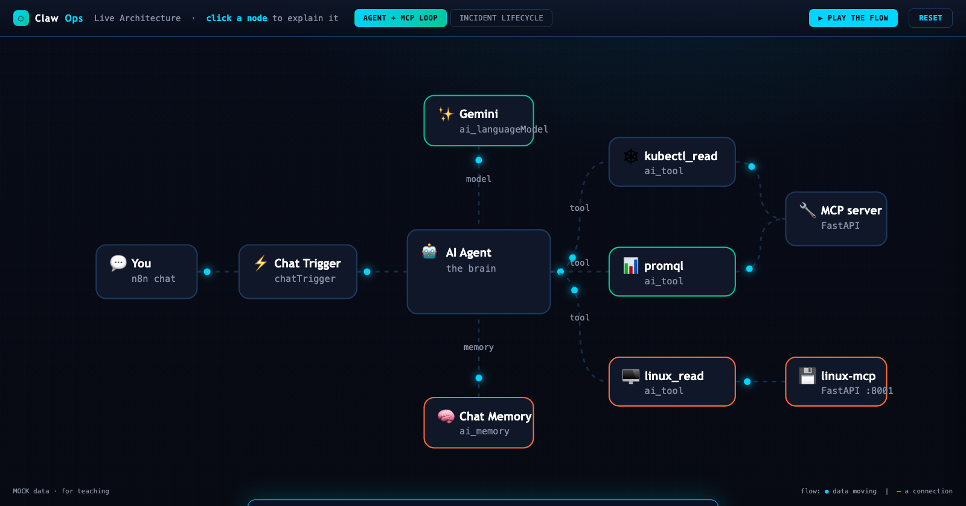
SECTION 2 — SEE IT LIVE
ClawOps Live — your architecture, in motion
In the dashboard, click ◆ ARCHITECTURE · click any node for its code · ▶ Play for the guided walkthrough

