Slide 1


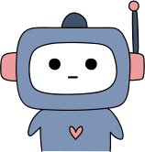
Can
AI
?
Make Mistakes?

Slide 2
Warm-up question
Are computers always right?

Slide 3
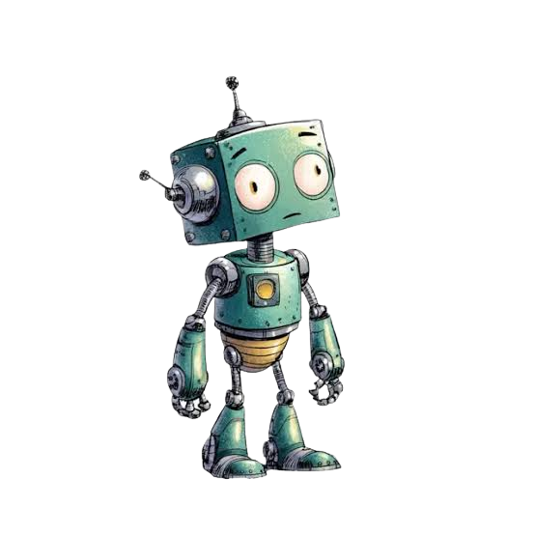
Ai can makes mistakes
How?
Relies on old data they’ve used before
Relies on guesses
It doesn’t think, it predicts patterns

Slide 4
TYpes of mistakes ai can make
Factual errors: missing important information
Bias: unfair patterns learned from data
Hallucinations: making information up
Misunderstanding context

Slide 5
Real life EXAMPLES
Factual errors: Told a customer they could get a refund under a real policy, but got the policy details wrong. Airline was held responsible for what its AI told the customer.
Bias: Amazon built an AI to help sort job applications. But it had learned from old hiring data that was mostly men, so it started downgrading resumes that had the word "women's" in them (like "women's chess club"). Amazon found out and shut the tool down before it was fully used.
Hallucinations: A lawyer used ChatGPT for legal research. It invented 6 fake court cases with fake quotes. When he asked the AI to double check, it said they were real. He got fined because he never checked if the cases were real before submitting them to court

Slide 6
How to Spot an AI Picture
Look closely at:
Hands & fingers: too many, too few, or bent wrong
Text & symbols: letters that look like scribbles or gibberish
Patterns: things that repeat weirdly (extra chair legs, doubled objects)
Light & shadows: shadows going the wrong way, or missing
Edges: blurry or melted-looking where two things meet

Slide 7
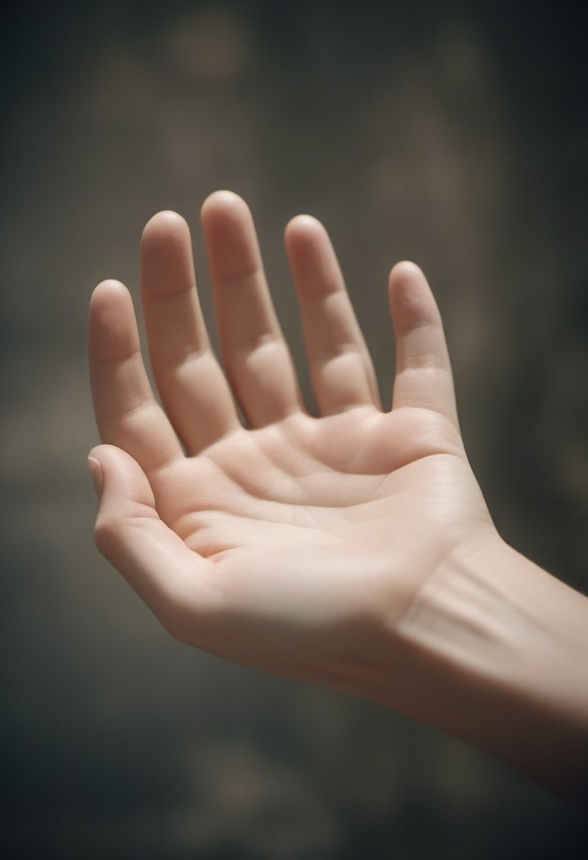
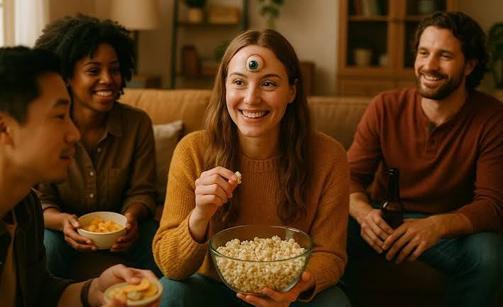
Examples

Slide 8

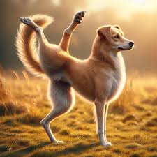
Examples

Slide 9
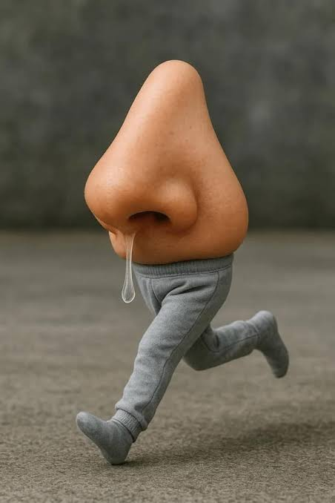

Examples

Slide 10
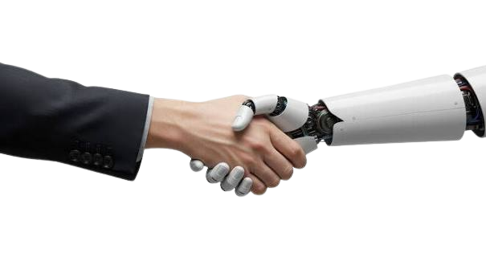
hOW hUMANS HELP AI
If we notice a mistake from the AI, we write it down in the prompt
The AI will try its best to notice the mistake and start over.

Slide 11
REFLECTION QUESTIOn
Why should we check AI answers?

