Slide 1
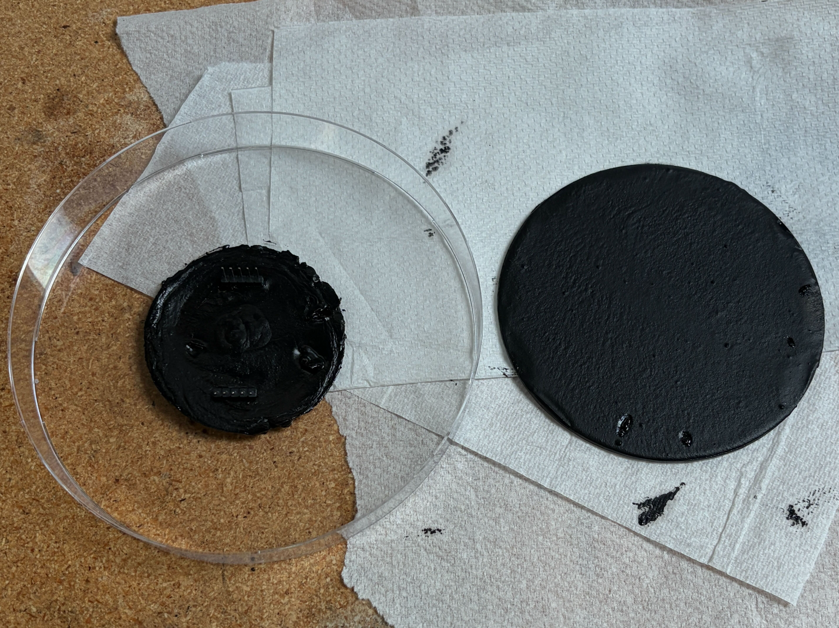
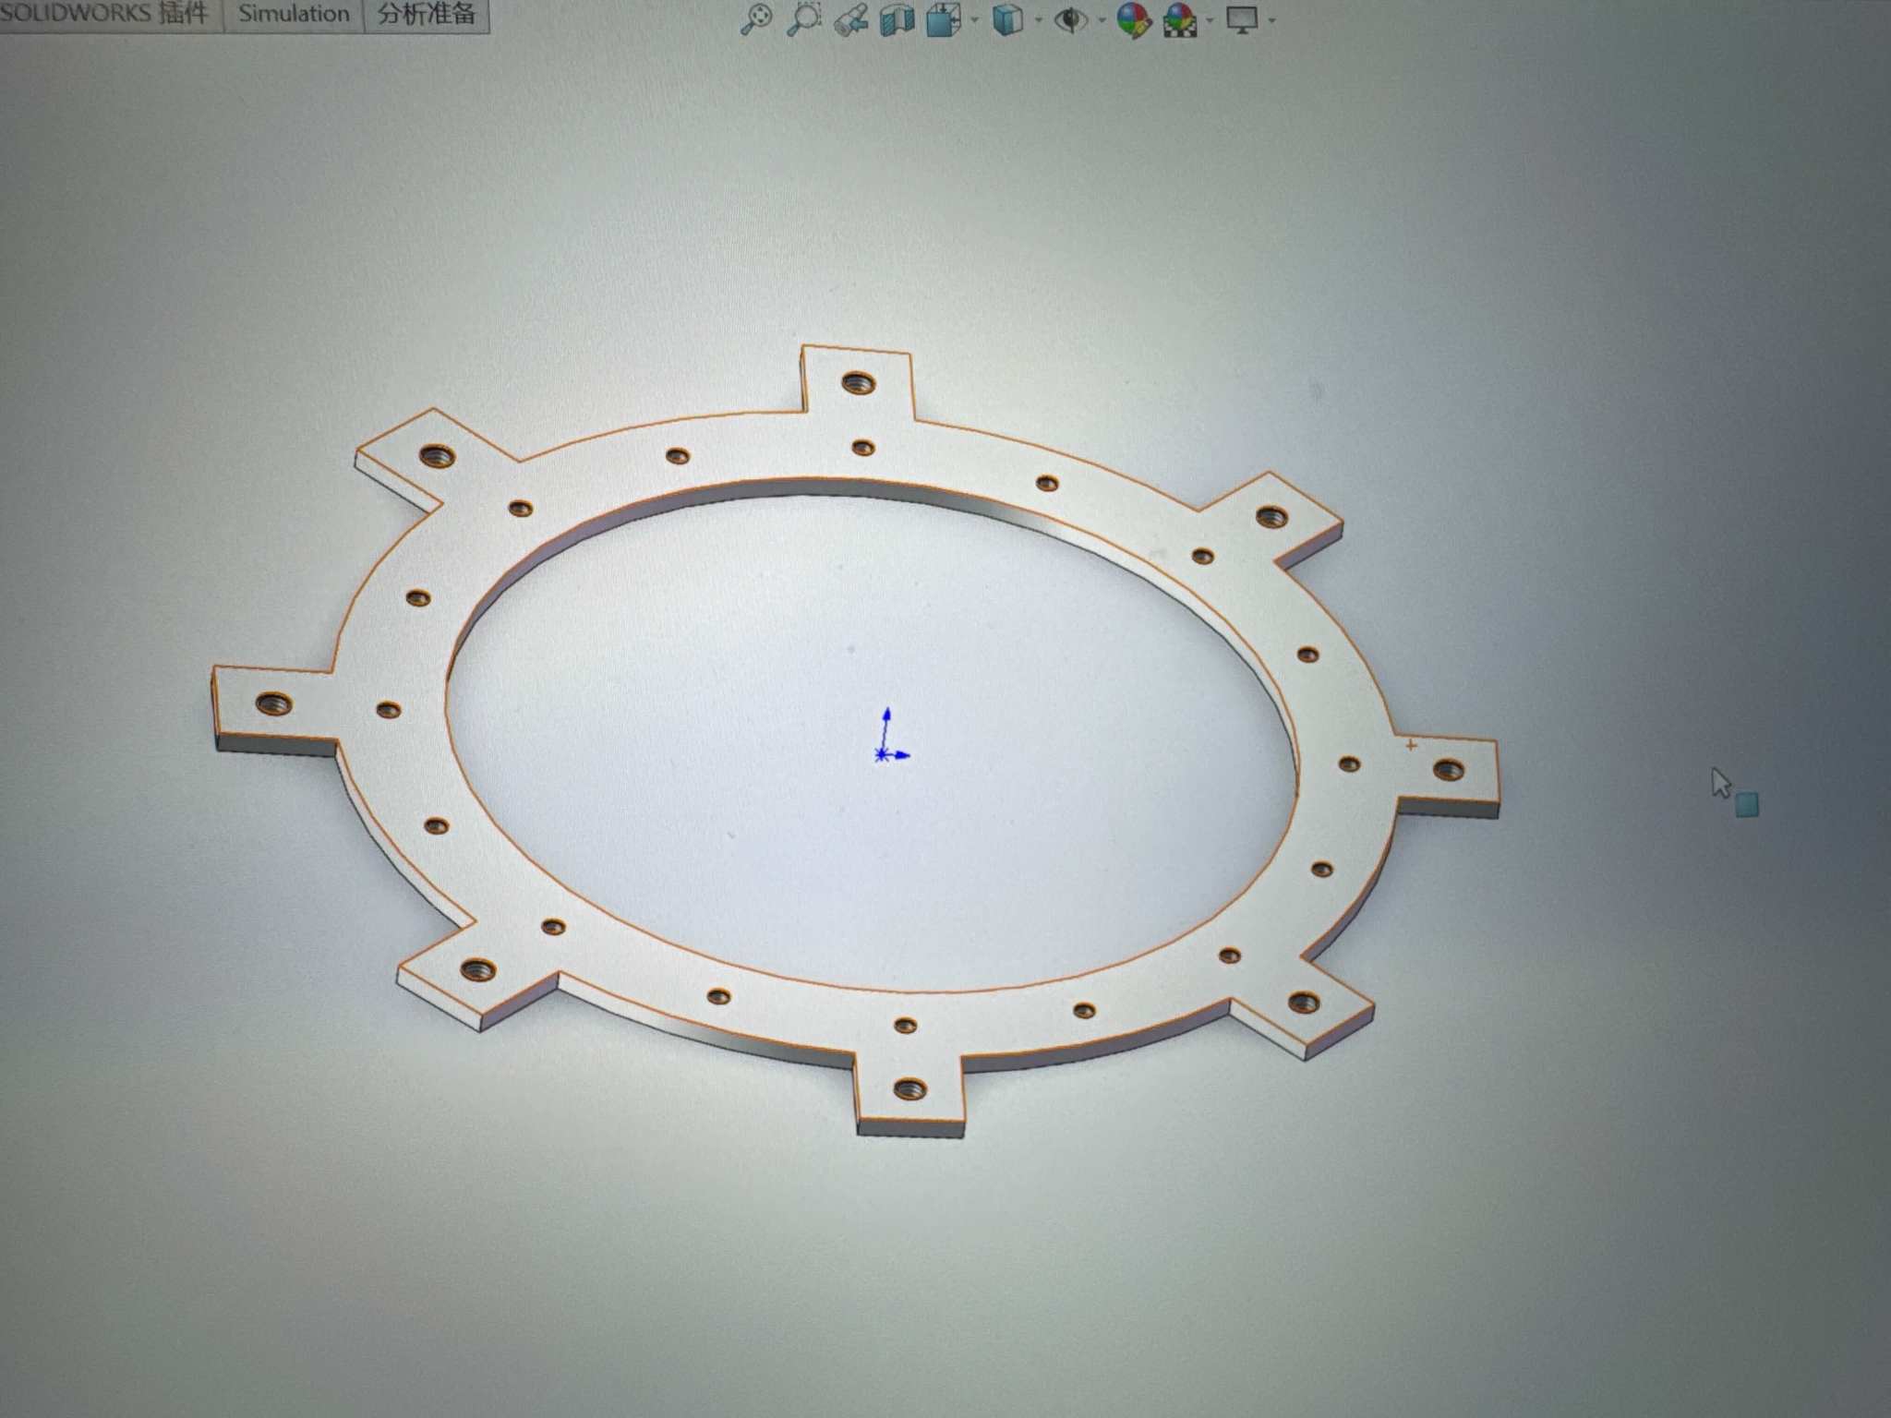
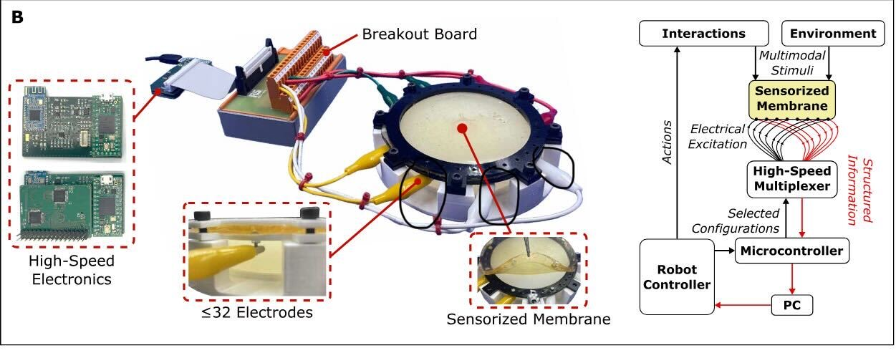
Jinghong Yan
Current research project(s)
Project title: Tri-layer wrinkling study
Project goal: proof of new wrinkling theory
Key team members: Yang Yang and me
A high-level image of your project :
Recent updates
Feel free to share images/videos/plots/graphs/tips/lessons learnt from your recent research efforts in any format you prefer
Current research project(s)
Project title: Soft robotics tactile sensing
Project goal: To develop a scalable, soft robotic tactile sensing system that uses EIT and data-driven methods to accurately reconstruct contact location, force distribution, and interaction dynamics.
Key team members: Yang Yang and me
A high-level image of your project :

