Slide 1

DIGITAL SYSTEM · EEE3822 · ASSIGNMENT 2
FPGA-Based Digital Door Lock System
Verilog HDL Implementation on the Cyclone IV Platform — Password Verification, LED Status Indication, and 7-Segment Message Display
PROJECT TEAM
Peh Yan Jiun
229196
Li Xinyuan
226838
Lecturer: Dr Roslina binti Mohd Sidek
23 June 2026 · Faculty of Engineering, UPM

Slide 2






Project Overview
A password-based access-control system implemented entirely in synchronous Verilog HDL
WHAT THE SYSTEM DOES
CONCEPTS DEMONSTRATED
Implements a 10-bit password-based digital door lock on an Intel/Altera Cyclone IV FPGA (DE2-115 board)
Synchronous sequential logic clocked at 50 MHz
Rising-edge detection on control switches
Slide switches SW[9:0] act as the password input; SW17 sets a new password and SW16 verifies the entered password
Register-based password storage & comparison
A lock_status register drives two output displays: 18 LEDs (green = unlocked, red = locked) and 8 seven-segment displays spelling “UNLOCKED” or “LOCKED”
Finite-state output control (IDLE / LOCKED / UNLOCKED)
Combinational 7-segment character decoding
Verified through a self-checking testbench in ModelSim before synthesis in Quartus Prime Lite
Simulation-based functional verification

Slide 3
Target Hardware Specifications
Design parameters for the Cyclone IV development platform
Item | Specification
FPGA Family | Intel / Altera Cyclone IV E
FPGA Device | EP4CE115F29C7
Board Type | DE2-115 / Cyclone IV development platform
Design Language | Verilog HDL
Top Module | custom_FPGA_door_lock
Clock Period | 20 ns
Operating Frequency | 50 MHz
Input Interface | CLOCK_50 and 18 slide switches: SW[17:0]
Output Interface | 9 green LEDs, 18 red LEDs, and 8 seven-segment displays
Source: Lab report §3.1 — Technical Specifications

Slide 4
System Components & I/O Mapping
Every input and output signal used in the custom_FPGA_door_lock module
Signal | Direction | Width | Function
CLOCK_50 | Input | 1-bit | 50 MHz system clock — drives all sequential logic
SW[9:0] | Input | 10-bit | Password value entered via slide switches
SW[16] | Input | 1-bit | Verify trigger — rising edge compares entered password
SW[17] | Input | 1-bit | Set trigger — rising edge stores a new password
LEDG[8:0] | Output | 9-bit | Green LEDs — all ON when status is UNLOCKED
LEDR[17:0] | Output | 18-bit | Red LEDs — all ON when status is LOCKED
HEX0–HEX7 | Output | 7-bit × 8 | Seven-segment displays — show “UNLOCKED” or “LOCKED”
saved_password | Internal reg | 10-bit | Stores the currently active password
lock_status | Internal reg | 2-bit | Holds IDLE / LOCKED / UNLOCKED state

Slide 5
Top-Level System Architecture
SW17 sets the password; SW16 verifies it. lock_status drives both display blocks consistently.
LED OUTPUTS
INPUTS
custom_FPGA_door_lock
status LEDs
LEDG[8:0] — all ON when UNLOCKED
LEDR[17:0] — all ON when LOCKED
CLOCK_50: 50 MHz clock
SW[9:0]: 10-bit password
SW16: verify trigger
SW17: set trigger
Rising-edge detectors (SW16, SW17)
10-bit password register
Comparator (SW[9:0] vs saved password)
Lock-status register (IDLE / LOCKED / UNLOCKED)
7-segment message decoder
message display
HEX OUTPUTS
switch & clock inputs
HEX7..HEX0 display “UNLOCKED”
HEX5..HEX0 display “LOCKED”
Active-low segment encoding
BEHAVIOR SUMMARY
SW17 rising edge → stores SW[9:0] into saved_password and returns lock_status to IDLE.
SW16 rising edge → compares SW[9:0] with saved_password. A match sets UNLOCKED; a mismatch sets LOCKED.
Figure 1 (adapted) — Updated top-level block diagram of the FPGA-based digital door lock system

Slide 6
Flowchart of Verilog Code Operation
Formal flowchart — every decision diamond shows an explicit Yes and No exit path
START / POWER-ON
saved_password = 0; lock_status = IDLE
On posedge CLOCK_50: latch sw16_prev, sw17_prev
SW17 rising edge?
No
Yes
saved_password ← SW[9:0]; lock_status ← IDLE
SW16 rising edge?
No
repeat every clock cycle
Yes
Compare SW[9:0] with saved_password
Yes
SW[9:0] == saved_password?
No
lock_status ← UNLOCKED
lock_status ← LOCKED
Drive LEDG / LEDR / HEX0–HEX7 from lock_status
WAIT FOR NEXT EDGE
Yes branch
No branch

Slide 7
RTL Design — Module Ports & Registers
custom_FPGA_door_lock.v — declaration and storage elements (lines 1–16)
custom_FPGA_door_lock.v
WHAT THIS CODE DOES
1 module custom_FPGA_door_lock (
2 input CLOCK_50,
3 input [17:0] SW,
4 output reg [8:0] LEDG,
5 output reg [17:0] LEDR,
6 output reg [6:0] HEX0, HEX1, HEX2,
7 HEX3, HEX4, HEX5,
8 HEX6, HEX7
9 );
10
11 reg [9:0] saved_password = 10'b0;
12 reg [1:0] lock_status = IDLE;
13 reg sw16_prev = 1'b0;
14 reg sw17_prev = 1'b0;
15 wire sw16_rising, sw17_rising;
Ports (input / output)
CLOCK_50 drives all timing. SW[17:0] carries the password bits plus the two control switches. LEDG/LEDR are the green/red status LEDs, and HEX0–HEX7 are the eight seven-segment displays — all declared as reg because they're driven inside always blocks.
saved_password / lock_status
saved_password is a 10-bit register holding the currently active password. lock_status is a 2-bit register holding one of three states: IDLE, LOCKED, or UNLOCKED.
sw16_prev / sw17_prev
These registers remember last cycle's switch values so the design can detect a rising edge (a switch flipping 0→1) rather than reacting every cycle the switch is simply held high.
sw16_rising / sw17_rising
Declared as wire because they're combinational — continuously recomputed from the current and previous switch values (see next slide).

Slide 8
RTL Design — Edge Detection & Password Control
custom_FPGA_door_lock.v — the main sequential always block (lines 17–33)
custom_FPGA_door_lock.v
WHAT THIS CODE DOES
17 assign sw16_rising = SW[16] & ~sw16_prev;
18 assign sw17_rising = SW[17] & ~sw17_prev;
19
20 // Main password control logic
21 always @(posedge CLOCK_50) begin
22 sw16_prev <= SW[16];
23 sw17_prev <= SW[17];
24
25 if (sw17_rising == 1'b1) begin
26 saved_password <= SW[9:0];
27 lock_status <= IDLE;
28 end
29 else if (sw16_rising == 1'b1) begin
30 if (SW[9:0] == saved_password)
31 lock_status <= UNLOCKED;
32 else
33 lock_status <= LOCKED;
34 end
35 end
Rising-edge detectors
sw16_rising / sw17_rising go high for exactly one clock cycle: the AND of the current switch value with the inverted previous value is true only on the 0→1 transition. This stops one switch flip from being read multiple times.
always @(posedge CLOCK_50)
Everything inside runs once per rising clock edge — this is the synchronous sequential block that gives the design its clocked, register-based behaviour.
if (sw17_rising) … set password
When SW17 has just been flipped on, the current SW[9:0] value is captured into saved_password, and the status resets to IDLE — the lock isn't shown as locked or unlocked right after a password change.
else if (sw16_rising) … verify
When SW16 has just been flipped on instead, SW[9:0] is compared against saved_password. A match sets UNLOCKED; any mismatch sets LOCKED.

Slide 9
RTL Design — LED & Message Display Logic
custom_FPGA_door_lock.v — combinational output blocks (lines 34–57, condensed)
custom_FPGA_door_lock.v
WHAT THIS CODE DOES
34 // LED output control
35 always @(*) begin
36 case (lock_status)
37 UNLOCKED: begin
38 LEDG = 9'b111111111; LEDR = 18'b0;
39 end
40 LOCKED: begin
41 LEDG = 9'b0; LEDR = 18'b111111111111111111;
42 end
43 default: begin LEDG = 9'b0; LEDR = 18'b0; end
44 endcase
45 end
46
47 // 7-segment message display (HEX7..HEX0)
48 always @(*) begin
49 case (lock_status)
50 UNLOCKED: begin // U N L O C K E D
51 HEX7=seg7_char("U"); HEX6=seg7_char("N");
52 HEX5=seg7_char("L"); HEX4=seg7_char("O");
53 HEX3=seg7_char("C"); HEX2=seg7_char("K");
54 HEX1=seg7_char("E"); HEX0=seg7_char("D");
55 end
56 LOCKED: begin // blank blank L O C K E D
57 HEX7=seg7_char(" "); HEX6=seg7_char(" ");
58 HEX5=seg7_char("L"); HEX4=seg7_char("O");
59 HEX3=seg7_char("C"); HEX2=seg7_char("K");
60 HEX1=seg7_char("E"); HEX0=seg7_char("D");
61 end
62 default: HEX7=seg7_char(" "); // all blank
63 endcase
64 end
always @(*) — combinational
Both blocks use a sensitivity list of (*), meaning they are pure combinational logic: outputs update immediately whenever lock_status changes, with no clock edge involved.
LED case statement
UNLOCKED lights all 9 green LEDs and turns red LEDs off; LOCKED does the opposite. The default case (IDLE) turns every LED off, giving a clear neutral state right after a password change.
7-segment message case
Each branch assigns one decoded character per HEX digit to spell out UNLOCKED or LOCKED across the 8 displays. seg7_char() is the lookup function shown on the next slide.

Slide 10
RTL Design — 7-Segment Character Decoder
custom_FPGA_door_lock.v — the seg7_char lookup function (lines 58–70)
custom_FPGA_door_lock.v
WHAT THIS CODE DOES
58 // Active-low 7-seg decoder
59 // segments [a b c d e f g], 0 = ON
60 function [6:0] seg7_char;
61 input [7:0] ch;
62 begin
63 case (ch)
64 "U": seg7_char = 7'b1000001;
65 "N": seg7_char = 7'b1101010;
66 "L": seg7_char = 7'b1000111;
67 "O": seg7_char = 7'b1000000;
68 "C": seg7_char = 7'b1000110;
69 "K": seg7_char = 7'b1001000;
70 "E": seg7_char = 7'b0000110;
71 "D": seg7_char = 7'b0100001;
72 " ": seg7_char = 7'b1111111;
73 default: seg7_char = 7'b1111111;
74 endcase
75 end
76 endfunction
function [6:0] seg7_char
A Verilog function: given one ASCII character input, it returns a 7-bit pattern. Because it has no timing behaviour of its own, it can be called directly inside the combinational always block on the previous slide.
Active-low encoding, 0 = ON
Each bit controls one segment (a through g). A 0 lights that segment and a 1 leaves it off — this matches how the DE2-115's seven-segment displays are wired.
One case per letter
Only the 8 letters needed to spell UNLOCKED and LOCKED (plus a blank space) are defined. Any other character falls through to the default case, which blanks the display.

Slide 11
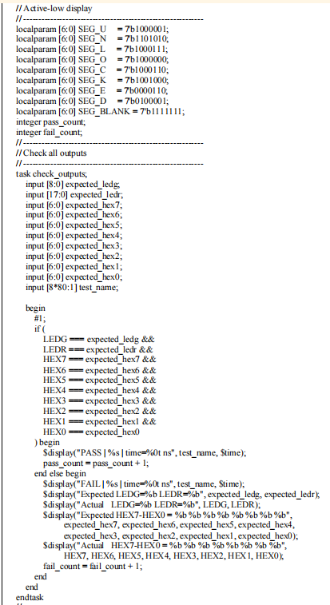
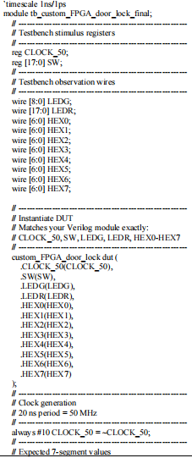
Testbench — Structure & DUT Instantiation
tb_custom_FPGA_door_lock_final.v — stimulus signals, clock generator, and the checker (lines 1–18)
tb_custom_FPGA_door_lock_final.v
WHAT THIS CODE DOES
reg vs wire
CLOCK_50 and SW are reg because the testbench drives them directly. LEDG, LEDR, and HEX0–HEX7 are wire because they're outputs read back from the DUT.
dut ( ... ) instantiation
This creates one instance of custom_FPGA_door_lock named dut, with each port connected by name to a matching testbench signal — the standard way to wire a design under test into its testbench.
always #10 CLOCK_50 = ~CLOCK_50;
A self-toggling clock generator: CLOCK_50 flips every 10 ns, giving a 20 ns period and matching the DE2-115's real 50 MHz clock.
check_outputs() (not shown)
A task that compares every LEDG/LEDR/HEX bit against an expected value, prints PASS or FAIL with the test name and simulation time, and increments pass_count or fail_count.

Slide 12
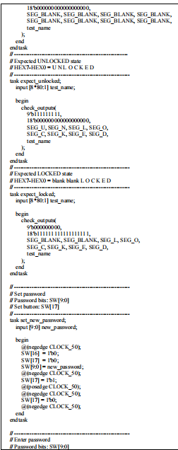
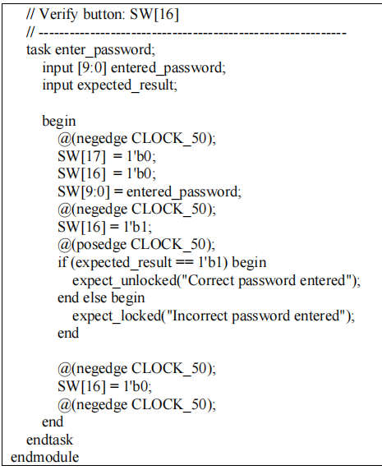
Testbench — Stimulus Tasks
tb_custom_FPGA_door_lock_final.v — reusable routines that drive SW17 and SW16 (lines 19–38)
tb_custom_FPGA_door_lock_final.v
WHAT THIS CODE DOES
task set_new_password
Loads new_password onto SW[9:0], then pulses SW17 high for exactly one clock cycle and drops it again — reproducing a real rising-edge switch flip on SW17.
task enter_password
Loads entered_password onto SW[9:0] and pulses SW16 the same way, then calls expect_unlocked() or expect_locked() depending on whether the password was supposed to match.
@(negedge / posedge CLOCK_50)
These event controls line stimulus changes up with the clock: switches change on a falling edge (so they're stable before the next rising edge), and results are checked right after a rising edge — exactly when the DUT updates.
Why use tasks at all?
Both directed test cases below (set password, then verify) reduce to one call each: set_new_password(...) and enter_password(...). This keeps the test sequence short and readable.

Slide 13
Directed Simulation Test Cases
Stimulus sequence applied to the testbench and the expected response at each step
# | Test Stimulus / Operation | LEDG | LEDR | HEX Display | Verification Result
1 | Set password = 1010101010 | all OFF | all OFF | Blank | Password stored on SW17 rising edge
2 | Enter incorrect password = 1110001110 | all OFF | all ON | LOCKED | Failure indication expected
3 | Enter correct password = 1010101010 | all ON | all OFF | UNLOCKED | Success indication expected
4 | Set second password = 0011110011 | all OFF | all OFF | Blank | Stored password updated
5 | Enter previous password = 1010101010 | all OFF | all ON | LOCKED | Old password rejected after update
6 | Enter correct second password = 0011110011 | all ON | all OFF | UNLOCKED | Updated password accepted
All six directed cases produced PASS results in simulation (pass_count = 6, fail_count = 0)

Slide 14
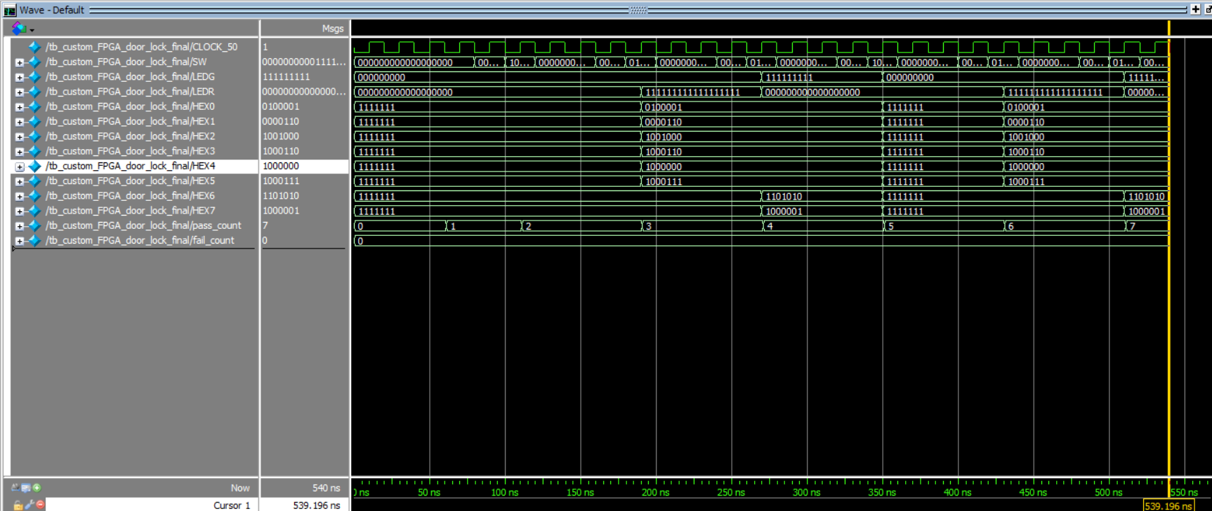

Video demo set password
Simulation Results
Video demo enter password
ModelSim-Altera waveform — pass_count reaches 7, fail_count remains 0
Figure (Appendix) — ModelSim-Altera waveform from the lab report, captured at the end of simulation
WHAT THE WAVEFORM SHOWS
ALL TESTS PASSED
SW17 pulses mark password-set events; SW16 pulses mark verification events
pass_count = 7 | fail_count = 0
Covers password set, correct/incorrect verification, and password update across two full cycles.
LEDG (green) and LEDR (red) bands never overlap — confirms mutually exclusive states

Slide 15
Conclusion
What the updated design achieved
Stores a 10-bit password and uses SW17 / SW16 as dedicated set and verify triggers
Lights all green LEDs for UNLOCKED and all red LEDs for LOCKED — clear, unambiguous status indication
Displays the words “UNLOCKED” or “LOCKED” across the eight seven-segment displays
Fully verified in simulation: 7/7 directed test cases passed with zero failures
Demonstrates synchronous sequential design, edge detection, register-based comparison, and combinational display decoding — the core building blocks of real access-control electronics
Course: EEE3822 Digital System · Faculty of Engineering, UPM · 23 June 2026

