Slide 1
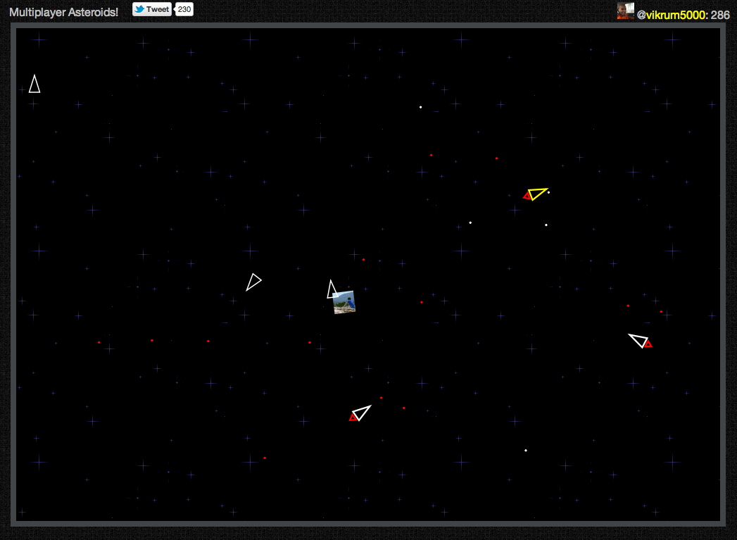
Asteroids meets Firebase

Slide 2
Single player → Multiplayer
Asteroids HTML5 game off of Github:
~1,000 lines of JavaScript
Made multiplayer with:
Updating my ship & bullets
Handling collisions
React on other players’ data
~50 lines of Firebase code

Slide 3
Step 1: Updating my ship & bullets
Update ship position:
myship
.set({ship: { /* Ship’s acceleration & velocity */},
user: { /* User’s Twitter handle & photo */});
Add bullets to game:
asteroids
.child('bullets’)
.push({ /* Bullet’s position and velocity */ })
.removeOnDisconnect();

Slide 4
Step 2: Handling collisions
this.collision = function (other) {
SFX.explosion();
Game.explosionAt(other.x, other.y);
this.visible = false;
this.currentNode.leave(this);
this.currentNode = null;
Game.lives--;
this.firebaseRef.remove();
};

Slide 5
Step 3: React on other players’ data
var handleShip = function(snapshot) {
var shipName = snapshot.name();
if(shipName != myship.name()) {
var enemy = Game.sprites[shipName ] == null
? new EnemyShip()
: Game.sprites[shipName];
copyObject(snapshot.val().ship, enemy);
enemy.firebaseRef = asteroids.child('players/’ + shipName);
Game.sprites[shipName] = enemy;
}
}
asteroids.child('players').on('child_added', handleShip);
asteroids.child('players').on('child_changed', handleShip);
(ditto for bullets)

Slide 6
Ship it!
Entire new realm of possibilities:
Team { Designer & Front-End person}
+ Firebase

