Slide 1
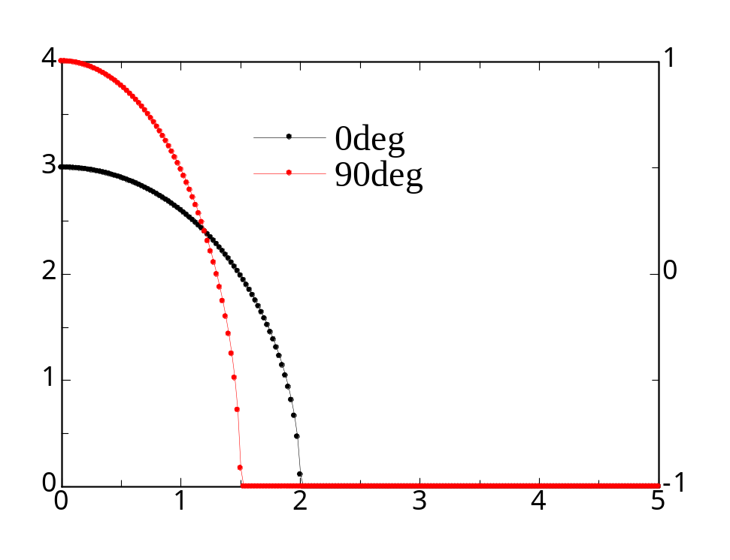

10 profiles
(0, 10, .., 90)
Ellips10_test.txt Ellips10.input

Slide 2



4 profiles
(0, 30, 60, 90)
10 profiles
(0, 10, .., 90)
91 profiles
(0, 1, 2,.., 90)
A=1.5, B=2 ellipse

Slide 3



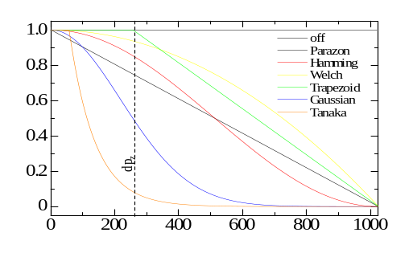



off
Parzon(triangle)
Hamming(Cos)
Welch(parabola)
A=1.5, B=2 ellipse
10 profiles
trapezoid
Gaussian
Tanaka(log)
Resolution=0.10a.u.

Slide 4
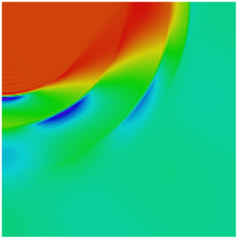
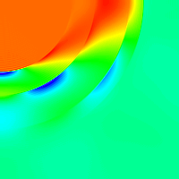
Tanaka
J(pz) smoothing - off
Filter ON
Itou
Smoothing – off
Filter - off
A=4, B=2 ellipse
0, 30, 60, 90 4-profiles reconstruction

