Slide 1


CS7290 Project Load/Store dependency prediction
Member: Kanghong Yan, Hanning Chen, Jiong Feng
Mentor: Pranith Kumar

Slide 2

Motivation
The advances in core performance have outpaced the advances in memory subsystem performance over the previous decade.
Avoiding the processor to be stalled by the memory subsystem contributes a lot to performance in overall.
Modern processor speculatively issues multiple independent memory accesses to improve memory level parallelism (MLP) to mitigate stalls effect from the memory delay.

Slide 3
Motivation
Speculative problem: dependent memory instructions, store-load dependencies causing RAW hazard, need to be serialized
Causes pipeline flushing when they are speculatively executed.
This dependency can be dynamic based on the memory access pattern in a program. Detecting and predicting this dependency accurately helps avoid the pipeline flush overhead.

Slide 4
idea
Utilize machine learning methodology to gain insights and find solution to the load/store dependency problem
Memory access streams can be viewed as a sequence
Try recurrent neural network/transfomer to solve this problem
Propose a model to make future predictions of possible store-load dependencies.
We will use these predictions to achieve better performance by extending a store-sets based dependency predictor.

Slide 5
Problem Abstraction
PCs
Seq2Seq model
Predictions
IW
PCs of load and store instructions are correlated in time
Memory dependency prediction can be viewed as a kind of Sequence to Sequence transformation.
The model takes a stream of PCs within an instruction window (IW) with specific size as inputs and output a sequence of binary decisions to indicate whether dependency exist or not

Slide 6
example
Instruction Window:
PC INST
1 LD R2, A
2 ADD R1, R2, R3
3 ST R1, B
4 ST R1, C
5 LD R3, C
6 SUB R1, R2, R3
7 MUL R1, R1, R2
8 ST R1, B
9 ST R2, C
10 LD R2, A
11 LD R3, B
Input:
The size of input vector will be equal to the size of instruction window. The rest will be padded zero
Only the PC of mem-ory instructions are kept and the other types of instruc-tion are filtered out. Hence input PCs is {1,3,4,5,8,9,10,11, 0, 0, 0}.
Output:
If the 𝑖-𝑡ℎ bit of output predictions is set to one, then it means that the 𝑖-𝑡ℎ PC in the input vector has memory dependency with the last load in current instruction window.
In this example, PCs {3, 8} have dependency with PC 11 (last load), hence the corresponding bit in output is set
Input PC Vector:
[1 3 4 5 8 9 10 11 0 0 0]
Expected Model Output:
[0 1 0 0 1 0 0 0 0 0 0]

Slide 7
Seq2seq model diagram
Decoder
L
L
L
Encoder
Context
GRU
GRU
…
GRU
C
GRU
GRU
…
GRU
Embedding Layer
Embedding Layer
Encoder: distill information from input sequence
Context vector: represents the information of input sequence
Decoder: give predictions by utilizing context vector and previous prediction

Slide 8
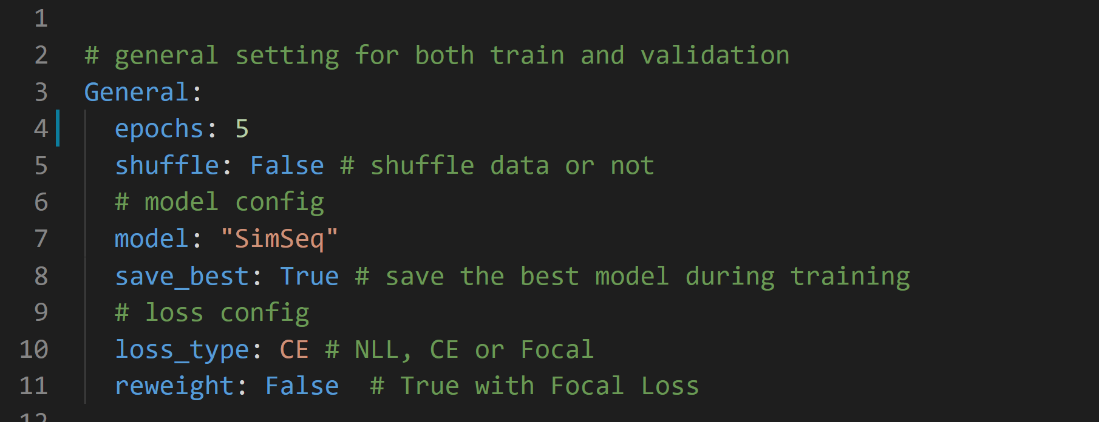
Seq2seq model TRaINING
Platform: PACE-ICE
Training traces: TAMU ChampSim Traces (SPEC2017)
General configuration:

Slide 9
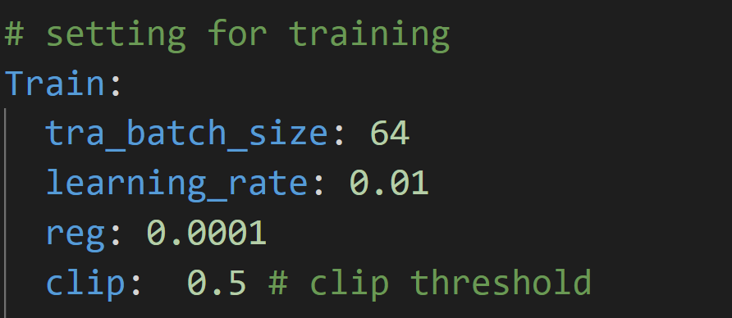
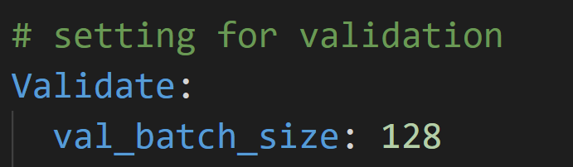
Seq2seq model TRaINING Result
Training process hyperparameter:
Performance for different traces
 | Train loss | Validate loss | Train PPL* | Validate PPL
625.x264 | 0.002 | 0.002 | 1.002 | 1.002
628.pop2 | 0.008 | 0.004 | 1.008 | 1.004
641.leela | 0.029 | 0.005 | 1.029 | 0.9993
649.fotonik3d | 0.001 | 0.001 | 1.001 | 1.001
600.perlbench | 0.011 | 0.015 | 1.012 | 1.015
*PPL: abbr of perplexity, which is cross entropy’s application in NLP problem

Slide 10
Seq2seq model TRaINING Result
Tuning hyperparameter: (641.leela)
 | Validate Accuracy | Train loss | Validate loss | Train PPL* | Validate PPL
tra_batch_size = 64 | 0.9993 | 0.029 | 0.005 | 1.029 | 1.005
tra_batch_size = 32 | 0.9993 | 0.041 | 0.007 | 1.042 | 1.007
tra_batch_size = 128 | 0.9993 | 0,017 | 0.009 | 1.017 | 1.009
*PPL: abbr of perplexity, which is cross entropy’s application in NLP problem

Slide 11
Hardware idea
From the sequence to sequence model, one implication is to have both global and local information
Global information represents program memory access behavior pattern
Local information indicates correlation between two instructions
What kind of global information is important?
Remember past accessed memory address?
Past load/store PC?
Local information?
Use a perceptron-like design -> a weight table to indicate whether a load and store has dependency
Build upon store-set design

Slide 12
What we learned
Details about memory dependency
Load store queue design
Store sets…
How to help architecture design with machine learning methodology
Interaction between processor and memory subsystem

Slide 13
Thank you

Slide 14
Questions?

Slide 15
appendix

Slide 16
Milestone
RNN Memory Dependency Model
(1-2 weeks):
We firstly design a RNN model to predict memory dependency for a give program.
Training and validation data comes from the traces of SPEC 2017.
RNN Model Analysis
(1 week):
Gain insights from visualizations and understand why model performs well.
Would be helpful to remove redundancy from our model and prepare us for the next step.
Practical Model for Hardware Implementation
(2-3 weeks)
Simplified the previous proposed RNN model and implement on MacSim or Gem5.
Evaluate the result and write the paper

Slide 17
Instruction Window:
PC INST
1 LD R2, A
2 ADD R1, R2, R3
3 ST R1, B
4 ST R1, C,
5 LD R3, C
6 SUB R1, R2, R3
7 MUL R1, R1, R2
7 ST R1, B
7 ST R2, C
8 LD R2, A
9 LD R3, B
Model’s target/label represents the dependency w.r.t. latest LD in the current instruction window
Model output plan A: [chosen]
Same size as instruction window (dependency w.r.t. PC 9, aka the last load in IW):
[0 1 0 0 1 0 0]
Model input :
Unified memory access vector:
[1 3 4 5 7 8 9]

