Slide 1
NestFinder: Search That Understands What You Actually Mean
Akmal Ashirmatov , Diego Zafferani, Jing Yan, Darya Zare

Slide 2
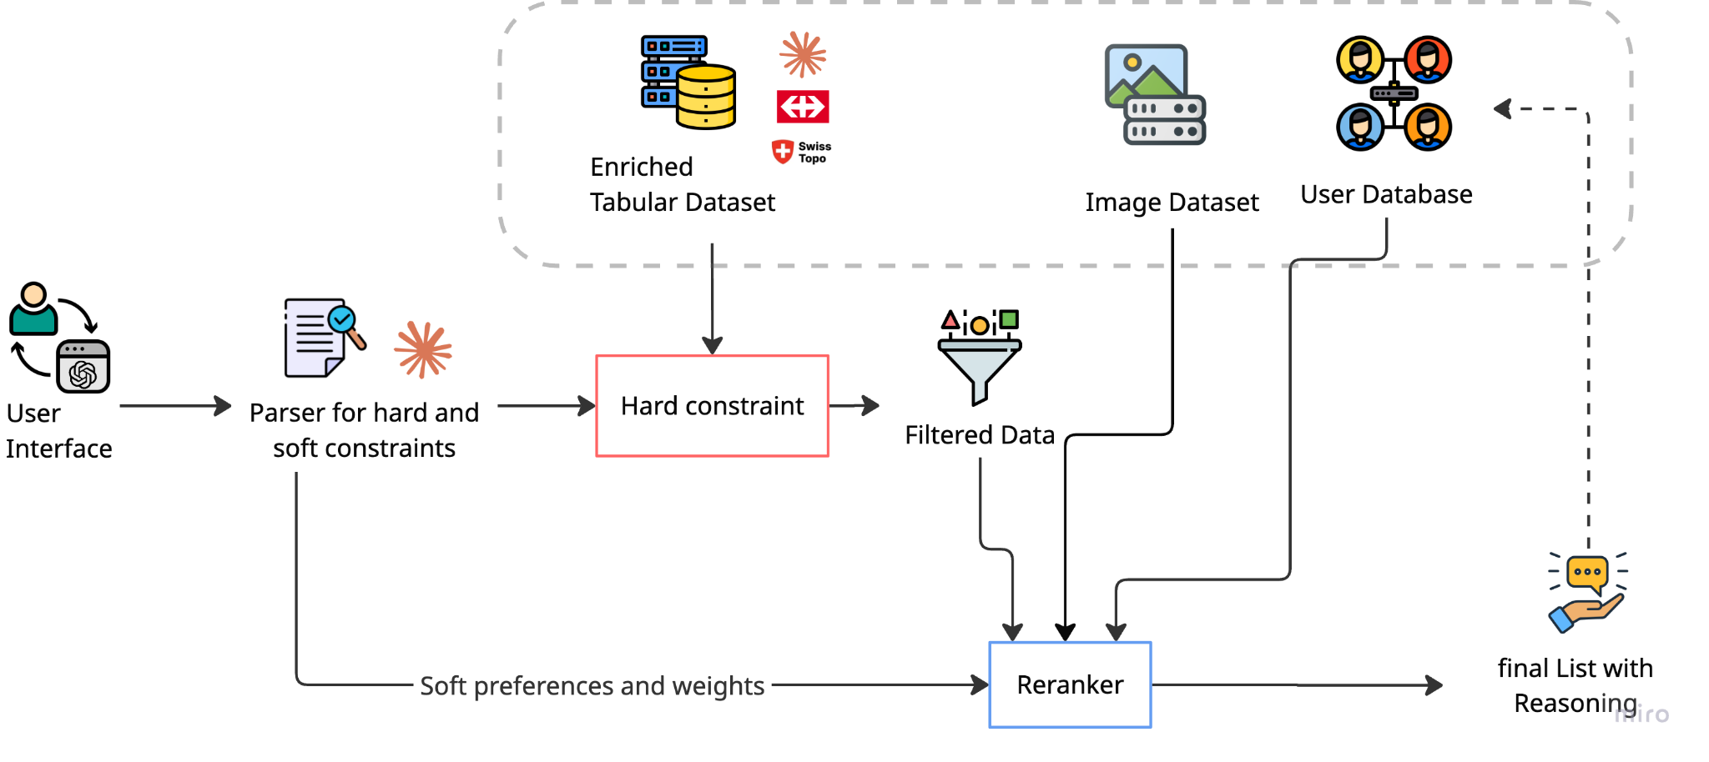
Databases
Hard constraints
User Interactions
Personalization in action

Slide 3
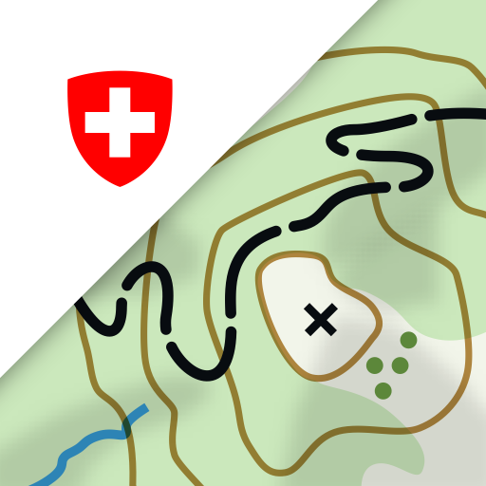


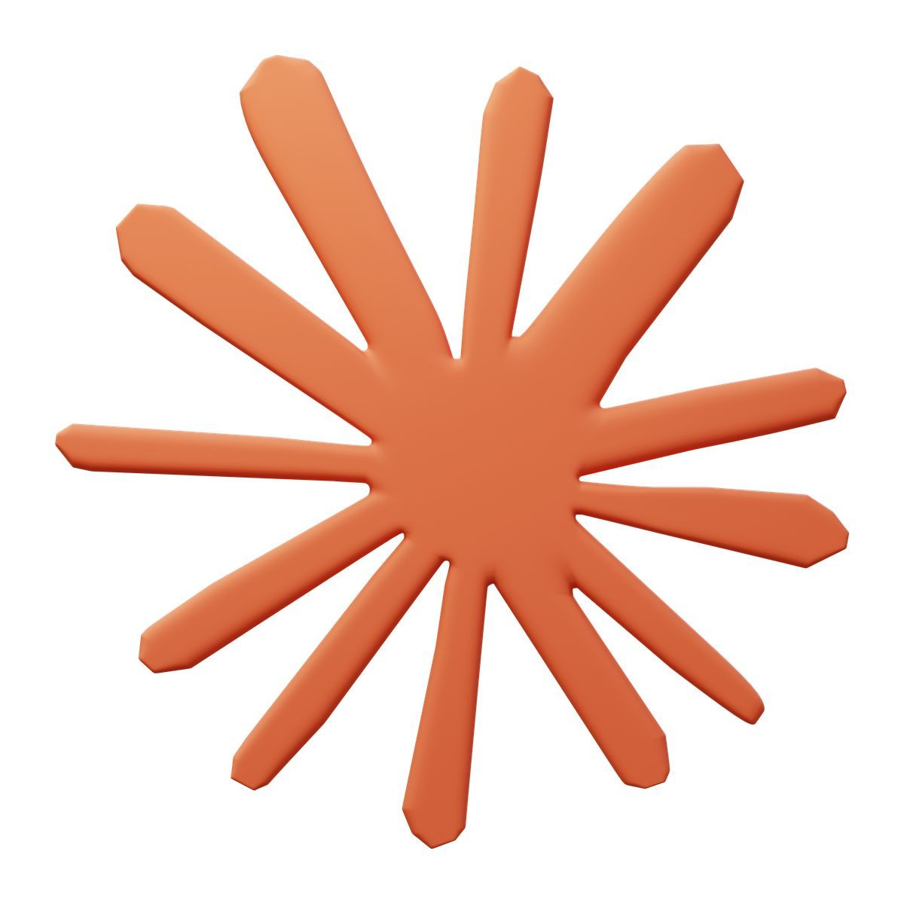
Data Enrichment
5 sources, 40+ features, zero labeling
Where?
Municipality, district, canton, population density (swissBOUNDARIES3D)
How connected?
What's nearby?
Nearest stop, train station & Hauptbahnhof (SBB API)
12 POI types (OpenStreetMap)
Fair price?
What's inside?
CHF/m2 vs. municipality, district & canton avg
12 features from descriptions (Claude Haiku)

Slide 4
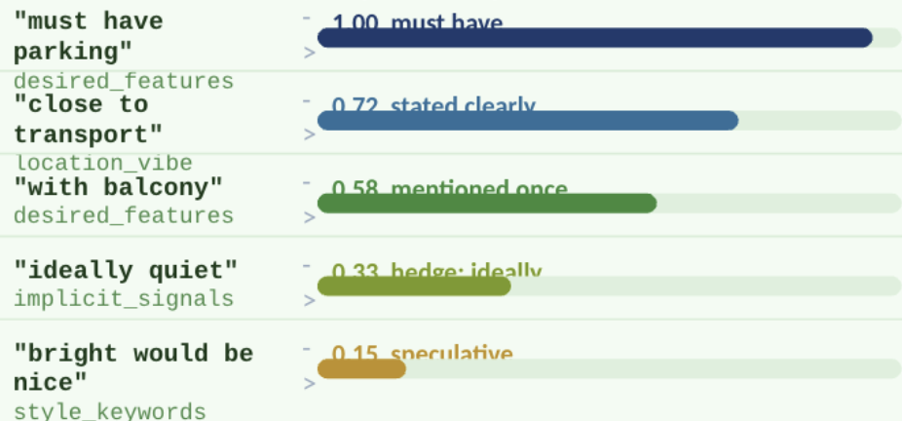
Query understanding
Raw query input
"3-room bright apartment
in Zurich under 2800 CHF
with balcony, close to
public transport,
ideally quiet"
Claude (LLM parser)
Structured JSON output prompt
Detects intent, intensity,
hedge words, Swiss terms
(3.5-Zimmer, ab sofort)
Hard filters
city: Zurich
rooms: 3.0 exactly
max_price: CHF 2800
offer_type: RENT
Fail any -> listing excluded
Soft filters: intensity-weighted scoring
Key insight: "must have parking" scores 6x higher than "bright would be nice" — intensity detected from language, not from explicit settings.
Claude identifies hedge words (ideally, would be nice, if possible) and certainty markers (must, essential, required), mapping them to weight multipliers 0.15 to 1.00.
Notes:
add a dashboard

Slide 5
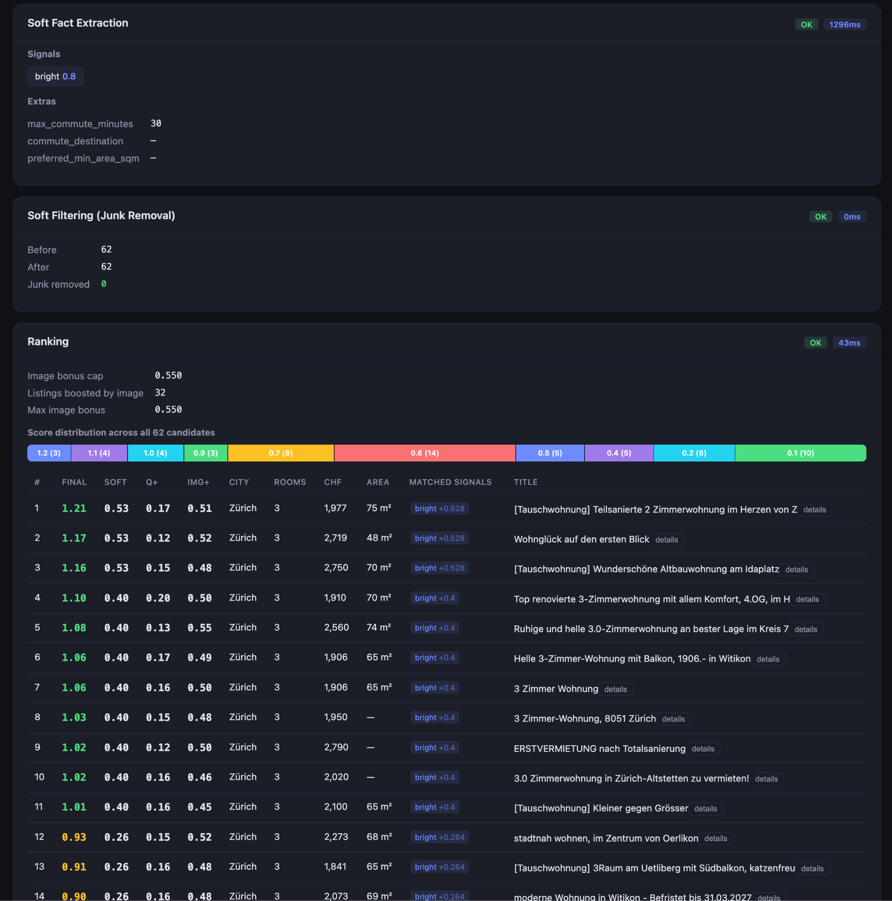
Soft Signal

Slide 6
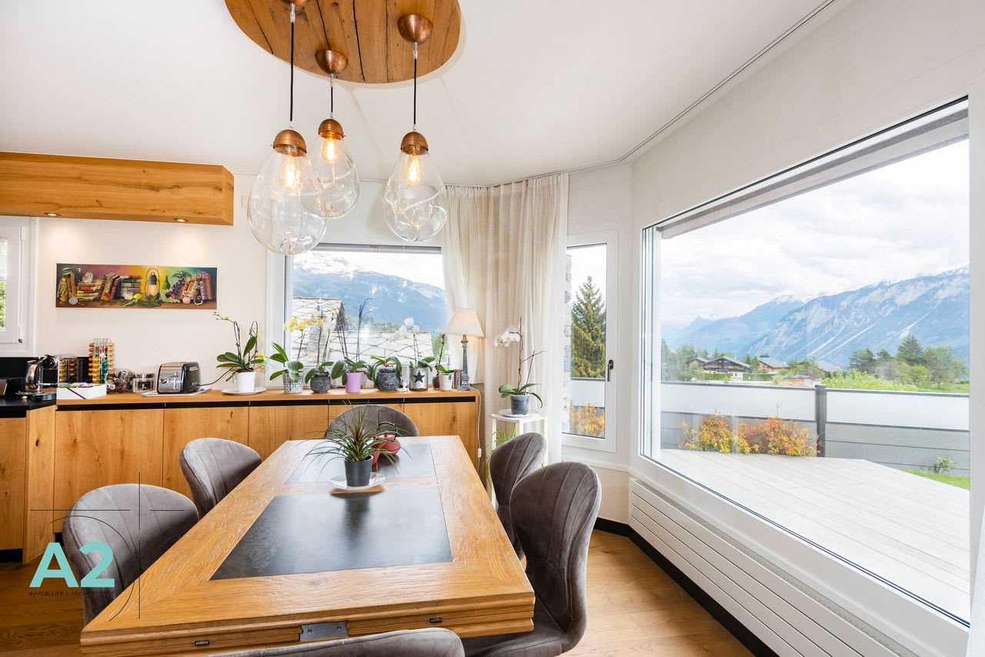
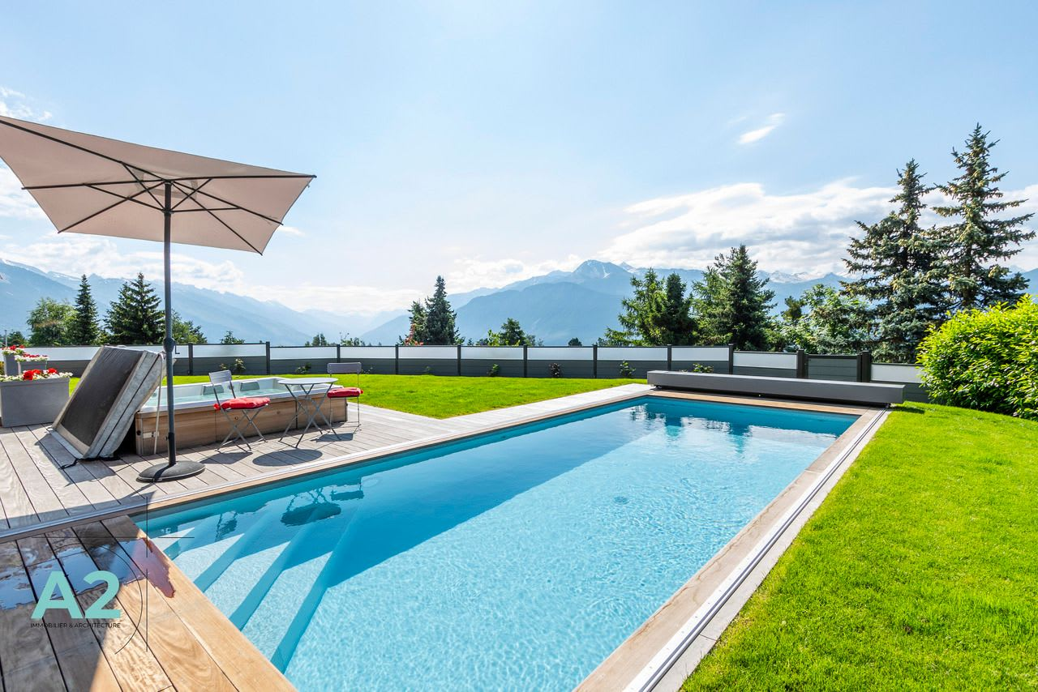
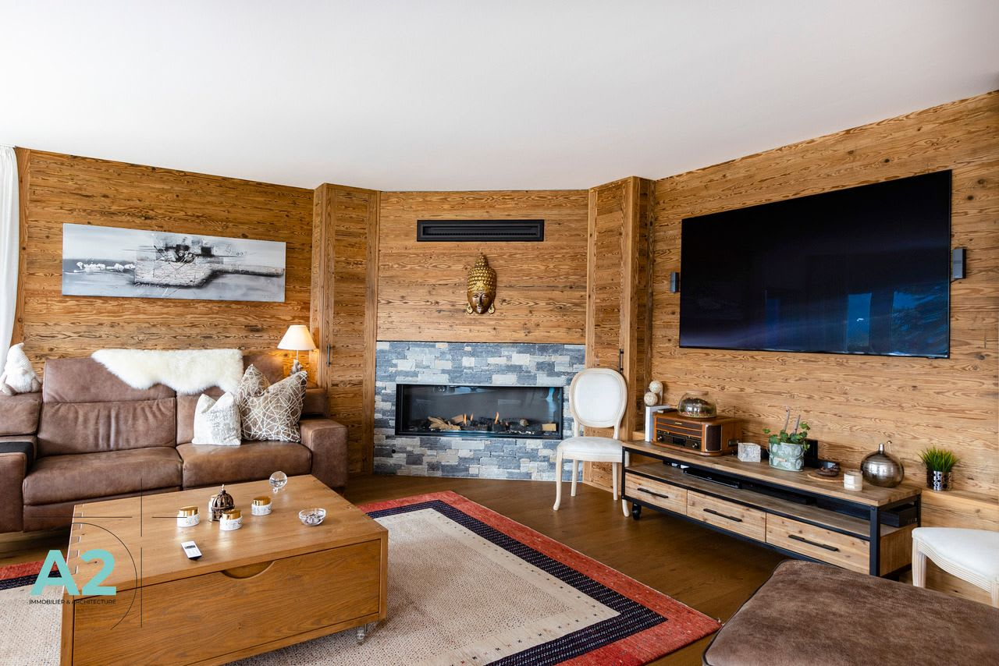
Image RAG Service
Rerank candidate listings by visual similarity
“I am looking for …”
{
Listing a : 0.95
Listing b : 0.92
Listing c : 0.85
}
Notes:
add a dashboard

Slide 7
Ranking
Extract Preferences
1
bright, quiet, balcony, public_transport, …
2
Assign Weights
each signal gets a weight value
Calculate Score
3
weight × match_strength per signal
4
Apply Quality Bonus
for stronger tie-breaking
Boost by Images
5
match query images
6
Boost by History
align with past preferences

Slide 8
Personlization in action
“quiet apartment in Zurich,
must have parking,
balcony would be nice”
NestFinder | same query | cold vs warm | real demo output
COLD
No history | flat weights | generic reasons
WARM
Profile applied | clicks, favorites, price range
#1 Studio Apt — Weinbergstrasse CHF 1900
Zurich | 1.0r | Score: 2.200
quiet | balcony | weights x1.0
Matched soft filters. Flat weights, no personalization.
#1 Studio Apt — Weinbergstrasse CHF 1900
Zurich | 1.0r | Score: 2.345 (+0.145) | clicked
quiet | balcony | preferred city | price CHF 1910-2073
Personalised: preferred city, price range, previously clicked.
#2 Neubauwohnung in Zurich CHF 3080
Zurich | 3.5r | Score: 1.660
parking | balcony | weights x1.0
Matched soft filters. No preference signal.
#2 Neubauwohnung in Zurich CHF 3080
Zurich | 3.5r | Score: 1.780 (+0.120)
parking | balcony | preferred city boost
Personalised: preferred city boost applied.
#3 Modernes Wohnen im Guggachpark CHF 3910
Zurich | 4.5r | Score: 1.660
parking | balcony | weights x1.0
Matched soft filters. Flat weights.
#3 Modernes Wohnen im Guggachpark CHF 3910
Zurich | 4.5r | Score: 1.740 (+0.080)
parking | balcony | preferred city boost
Personalised: preferred city boost applied.
#4 v Wohnung an ruhiger und zentraler Lage CHF 2330
Zurich | 3.0r | Score: 0.400
balcony only | no elevator signal
Will drop to #5 in warm — outranked by elevator affinity.
#4 ^ Wohnen im Trendquartier — 3.5 Zimmer CHF 3190
Zurich | 3.5r | Score: 0.520 (+0.120)
balcony | elevator match | preferred city
Rose from #5 — elevator preference in user profile matched.
#5 ^ Wohnen im Trendquartier — 3.5 Zimmer CHF 3190
Zurich | 3.5r | Score: 0.400
balcony | elevator in description
Will rise to #4 in warm — elevator matches user affinity.
#5 v Wohnung an ruhiger und zentraler Lage CHF 2330
Zurich | 3.0r | Score: 0.480
balcony | preferred city | no elevator
Dropped from #4 — no elevator signal, outranked by Trendquartier.
RANKING DELTA — COLD TO WARM
#1 Studio — Weinbergstrasse was #1 | score +0.145
#2 Neubauwohnung Zurich was #2 | score +0.120
#3 Modernes Wohnen Guggachpark was #3 | score +0.080
#4 ▲ Trendquartier was #5 | elevator boost
#5 ▼ Wohnung ruhiger Lage was #4 | no elevator
USER PROFILE APPLIED
Preferred city: Zurich
Price range: CHF 1910-2073
Feature affinity: elevator
Clicked: listings 58963, 2671
Favorited: listing 2671
Built from: 0 explicit inputs | behavior only
Notes:
add a dashboard

Slide 9


Same query. Better ranking with personalization.
quiet apartment in Zurich, must have parking, balcony would be nice
COLD SEARCH
WARM SEARCH
No user context
Profile-aware ranking
2.20
1.66
2.35
1.78
Top score
Runner-up
Top score
Runner-up
#1 Studio Apartment · Zürich
#2 Neubauwohnung
#1 Studio Apartment · Zürich
#2 Neubauwohnung
Top result
Top result
quiet • balcony
quiet • balcony • parking fit
Zürich preference · Budget CHF 1910–2073
Likes elevator · Click/favorite history
Insight · Personalization resolves close matches using learned intent.

Slide 10
Thanks!

