Slide 1


Team Details
Team name: Termini
Team leader name: [to be filled]
Problem Statement: Future of Work & Enterprise Productivity — every organisation should be able to run AI on data it cannot send to a cloud.

Slide 2
Brief about the idea
2
One clinic, one rule
A dental clinic in Korea wanted AI for its phones, its insurance claims and its own reporting. Sending patient data to a cloud was not an option — so the owner, a biology graduate rather than a computer scientist, built the infrastructure himself.
6 months
of evenings, on top of dentistry — the cost of there being no product
“All client data must not leave the building.”
0
The rule the whole build was organised around
client records sent off-site; phones, claims and reporting all run in the back room
Phones, insurance claims, reporting and document retrieval — all running on models in the same room as the chair.
Source: arca.live/b/aihomelab/185810092 — “A neighbourhood dental clinic's AX transformation”, 13 Oct 2026

Slide 3
Brief about the idea
3
What can't leave the building
The clinic's rule is not a dental rule — it is the rule of every business whose best data is also its most restricted.
Healthcare & dental
Patient records, calls, insurance claims
Front desk, adjudication, notes
Banking & insurance
KYC files, transactions, loss records
Fraud triage, credit memos, claims
Legal
Privileged matter files, client advice
Contract review, discovery, drafting
Manufacturing
Design files, process parameters, yields
Quality, maintenance, planning
Life sciences
Trial data, patient histories
Protocol analysis, safety review
Public sector & defence
Classified material, citizen records
Analysis, briefings, casework
Software
Source code, incident data, architecture
Code agents, on-call triage
Retail & commerce
Customer PII, supplier terms, margins
Demand, service, pricing
Eight industries, one constraint: the data that would make AI useful is the data that can't be handed over.
And the result: 95% of GenAI pilots show no measurable P&L impact (MIT NANDA 2025, contested) while 88% of firms use AI somewhere (McKinsey 2025) — permission, operations and context are missing at once.
Sources: MIT NANDA, The GenAI Divide (Jul 2025) · McKinsey, The State of AI 2025

Slide 4
Brief about the idea
4
Data used without permission
The loud concern is AI replacing existing labour. The governing one arrives first: the work leaves, and comes back as someone else's product.
Apr 2023 · Samsung
Engineers debugged with ChatGPT
Confidential source code, equipment yield data and a meeting's notes went in as prompts. Samsung restricted generative AI across its network weeks later.
“Data is transmitted and stored to an external server, making it impossible for the company to retrieve it.” — Samsung memo
fortune.com · 2 May 2023
Jan 2025 · DeepSeek
A database of everyone's prompts
Wiz Research found an unauthenticated ClickHouse instance holding 1M+ log lines, chat history, API keys and plaintext passwords.
Not a breach of the model — a copy of every conversation, reachable from the open internet.
wiz.io/blog · 29 Jan 2025
Sep 2026 · Navier–Stokes
The credit left with the data
OpenAI announced a Navier–Stokes solution its team described as using “very little human input”. Twelve hours earlier, Buckmaster said his and Alpöge's unpublished advances had leaked to the lab.
A Millennium Prize result — and a priority dispute about whose work the model had read.
wikipedia.org · Sept 2026
How Termini closes it: not a better policy, but a topology where the copy never leaves — C2 stays on the node, and what does leave is named, classified and audited.

Slide 5
Brief about the idea
5
The loop only closes where the data lives
A system improves by learning from its own outcomes. When the record lives in someone else's cloud, the loop belongs to someone else.
Data owners
Model builders
Compute
Applications
Value
sovereign AI — the missing arc
A memory that stays
Outcomes, corrections and exceptions remain with the entity.
A jury, not an oracle
Several models read the same evidence; disagreement is where a person looks.
A corpus no one else has
The private record no model has seen and no vendor could be given.
Intelligence should be plural. Governance is not the tax on the loop — it is what closes it.

Slide 6
Opportunities
6
Right-size the intelligence
Frontier models are not the answer to every task. They are the top of a ladder — and the product is the routing between the levels.
Level | Runs on | Good at | Data movement | In the demo
L0 · deterministic | Controller rules | Known remedies, threshold-to-action mappings | None | Yes
L1 · small local | The node — 4B class, llama.cpp | Classify, extract, summarise, triage | None | Yes
L2 · large local | A GPU node over your data | Reasoning specific to your domain data | None | Config only
L3 · frontier | Gemini, via Vertex AI | The hardest reasoning, the smallest payload | Minimised C0, if permitted | Yes
L1 triages → L3 reasons, only where policy allows → L0 executes → the audit records which level answered.
Local is not worse — it is the right level for most of the work.

Slide 7
Opportunities
7
Delegate the operations, not the data
That split is the whole proposition. Packaging, partners and pricing all follow from it.
What is delegated
Bootstrap, remediation, upgrades, the on-call rotation. This is the work a small firm cannot staff and a hardware owner does not want to build.
What is never delegated
C2 payloads, transcripts, records, credentials. The data stays on the node; the controller sees only what the classification allows.
Who buys which half
The SME buys the outcome. The hardware owner licenses the layer so its metal is sellable as AI. Both get the same control plane.
One control plane, two buyers, one boundary — and the boundary is what makes delegation signable.

Slide 8
List of features offered by the solution
8
Bootstrap. Operate. Prove.
The clinic needed all three, so one man built all three by hand. In Termini they are one product.
01 · Bootstrap
Hardware becomes a fleet
A bare node boots the pre-baked image, registers in 150 ms, is assigned a role and joins the cluster. No installs, no specialist on site.
Removes: the wiring weekend
02 · Operate
An operator you don't hire
An AI agent watches telemetry and makes decisions the way a data-centre operator would — restarting a runaway workload, stopping what will fill a disk — and falls back to a fixed rule when unsure.
Removes: the on-call rotation
03 · Prove
A boundary you can audit
C0 / C1 / C2 classification, an on-node redactor and a fail-closed controller gate. What leaves is named, classified and logged.
Removes: the compliance gap
The clinic is the requirement. Termini is the product.

Slide 9
Process flow diagram or Use-case diagram
9
From bare node to a governed fleet
DAY-0 · BRING-UP
Bare node
Pre-baked image
Registered 150 ms
Role assigned
Agents running
DAY-2 · SELF-HEALING LOOP
Telemetry
Threshold rule fires
Model decides
Audited execution
Audit row
The rule detects; the model decides; the executor acts; the audit row links trigger → decision → action → result.
Nothing is decided by a model that a person could not read back afterwards — and the deterministic path needs no model at all.
The action space is grammar-constrained: an off-allowlist action has no valid encoding, so safety is enforced in the decoder rather than checked afterwards.

Slide 10
Architecture diagram of the proposed solution
10
The architecture is the governance claim
Node on premises
C2 stays here
On-node redactor
fail-closed
Outbound-only mTLS
no inbound path
Controller gate
re-verifies
Operator loop
allowlisted
Audit chain
evidence
Substrate and channel — adopted, not invented
Ubuntu and an LXD cluster across nodes; one outbound-only mTLS WebSocket per node carries heartbeat, telemetry, commands and acks. No route from an agent VM to the controller.
Boundary and loop — the two things we build
A fail-closed telemetry gate that rejects a non-conforming batch rather than dropping fields, and a governed operator loop that audits every action it takes.
EU AI Act Art. 10 / 12 / 14 / 15 · GDPR Art. 25 / 32 / 44–49 · ISO/IEC 42001 · 27001 · SOC 2 Type II · HIPAA §164.312
We don't certify you — we generate the evidence a certification asks for, continuously.

Slide 11
Architecture diagram of the proposed solution
11
What leaves the building, exactly
Class | Leaves? | Contents
C0 | Yes — allowlisted | Hardware and OS health: CPU, RAM, disk, GPU, inference liveness, instance inventory, rule metrics
C1 | Yes — transformed | Salted hashes, bounded display labels, timestamps. Never raw identifiers
C2 | Never | Workload payloads, call transcripts, patient or customer records, prompts, credentials, logs
The one external call — disclosed
The operator's diagnosis runs on Gemini via Vertex AI. The prompt is C0 only, the audit row records egress=external, and one variable (backend=local) puts it back on the node's own weights.
Why publish the exception
A boundary you cannot see is not a boundary. The claim is not “nothing leaves” — it is “nothing C2 leaves, and everything that does is named and audited.”

Slide 12
Technologies to be used in the solution
12
Gemini decides. Gemma stays home.
Gemini 2.5 Flash · Vertex AI
The diagnosis — naming the remediation from C0 telemetry. Measured 1.8 s warm. The only call that leaves the premises, and it says so in the audit trail.
Gemma 3 · on the node
Google's open weights, served by llama.cpp. Automatically detects the inference node, bootstraps the toolchain and leaves it ready for agents — nothing forwarded.
Cloud Run · GPU reference
The same Gemma on 1× L4 with vLLM — deployed as the managed reference and the shape this takes when GPU quota stops being the blocker.
GCE controller · GCE node · Firebase Hosting · Cloud Storage (weights) · pre-baked GCE image · LXD · llama.cpp
Local data uses local models. Where the customer permits it, Termini integrates with Gemini.

Slide 13
Prototype Performance report/Benchmarking
13
What runs today, measured
150 ms
0
422
Node registration from the pre-baked image — zero installs at boot
C2 payloads the controller has ever stored — fail-closed by design
A C2 field rejected before any byte is stored, checked three ways
1
1.8 s
live
Remediation decided by the model, executed and audited end to end
Diagnosis warm on the managed path — 402 s on local CPU weights, stated not hidden
On GCE + Firebase + Vertex AI — a judge can open it and watch
Three claims, six measurements. Nothing on this page is a projection.

Slide 14
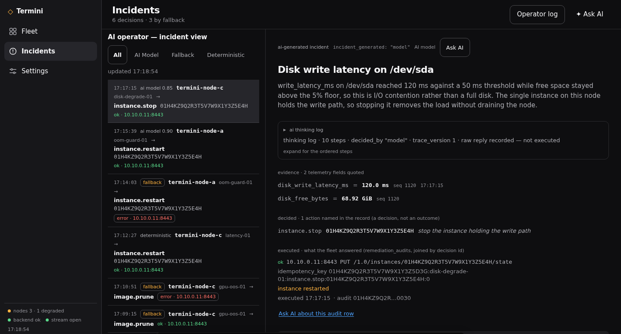
Snapshots of the prototype
14
The operator, on screen
Operator log
Every incident: the rule that fired, the model's reasoning, the evidence fields, the action executed and the audit id.
Fallback visible
Decisions the model did not take are labelled deterministic or fallback, in the same list.
Live
termini-510609.web.app — the demo is paused between judging sessions; the resume command is in SUBMISSION.md §3.

Slide 15
Additional Details/Future Development (if any)
15
From one clinic to a fleet of them
Real bare-metal onboarding
A GPU node in the demo
MAAS + iPXE netboot, so a box arrives from a partner and joins without a technician on site.
L4 quota is the current blocker; the path is already built and served on Cloud Run.
Learned baselines
Federated eval exchange
Edge anomaly detection replacing static thresholds — the operator learns each site's normal.
Evals and weights travel between entities; records don't. The plural-ecosystem mechanism, productised.
Compliance mapping
Hardware partner channel
GDPR, EU AI Act, Korea PIPA, India DPDP posture mapped onto the C0/C1/C2 boundary.
The box is commodity; the operator is the product. Partners sell metal, we run it.

Slide 16
Provide links to your:
16
Links
GitHub public repository
github.com/yanksyoon/termini
Demo video (3 minutes)
script ready — recording is the pending human step (SUBMISSION.md §5)
Final product link
termini-510609.web.app
Live API
34-93-190-64.sslip.io/v1
The dashboard opens with no credential in the URL; sign in with the project token once (Settings → sign in).

Slide 17

The doctor built it alone.
The next one won't have to.
Your hardware. Your data. Our operations.

