Slide 1



Blogel: A Block-Centric Framework for Distributed Computation on Real-World Graphs
Da Yan (CUHK), James Cheng (CUHK), Yi Lu (CUHK), Wilfred Ng (HKUST)

Slide 2
Outline
Motivation
Blogel System Overview
Blogel Algorithm Design
Blogel Graph Partitioning
Related Work & Conclusion

Slide 3
Background
Big graphs in real applications
Social networks, web graphs, road networks, …
State-of-the-art big graph systems
Google’s Pregel
Pioneering “think like a vertex” framework
Synchronous
Data pushing (sending msgs)
Already introduced in our presentation before

Slide 4
Background
Big graphs in real applications
Social networks, web graphs, road networks, …
State-of-the-art big graph systems
Open-source Pregel-like systems
Apache Giraph (master-compute)
Stanford’s GPS (mirroring high-degree vertices)
Our Pregel+ (message reduction)
UCI’s Pregelix (out-of-core execution)
Trinity, Mizan, CatchWind, …

Slide 5
Characteristics of Real Graphs
Graph characteristics adverse to Pregel
Skewed vertex degree distribution
Large graph diameter
High average vertex degree

Slide 6
Characteristics of Real Graphs
Skewed vertex degree distribution
MAX-degree ≫ AVG-degree
Power-law graphs
Imbalanced communication workload
Data | Type | |V| | |E| | AVG Deg | Max Deg
WebUK | directed | 133,633,040 | 5,507,679,822 | 41.21 | 22,429
LiveJournal | directed | 10,690,276 | 224,614,770 | 21.01 | 1,053,676
Twitter | directed | 52,579,682 | 1,963,263,821 | 37.34 | 779,958
BTC | undirected | 164,732,473 | 772,822,094 | 4.69 | 1,637,619

Slide 7
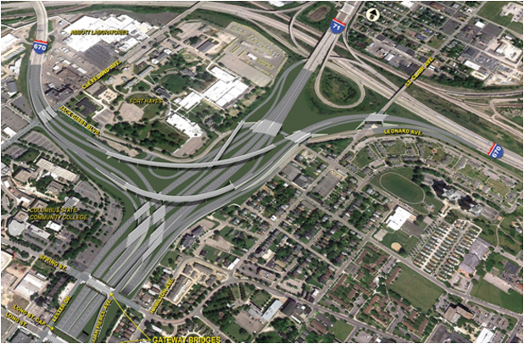
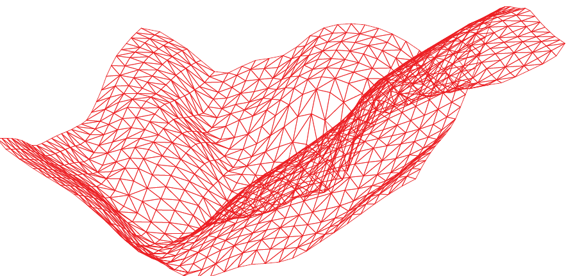
Characteristics of Real Graphs
Large diameter
Spatial networks
Road networks
Terrain meshes
Web graphs
De Brujin Graphs
Too many supersteps
(or, synchronization barriers)

Slide 8
Characteristics of Real Graphs
High average vertex degree
In a social network, an average user can have tens to over a hundred friends
Friendster has an average degree of 55
Heavy communication workload

Slide 9
Characteristics of Real Graphs
Solution: block-centric computation
A block refers to a connected subgraph of the graph
Message exchanges occur only among blocks
Serial in-memory algorithm is run within a block

Slide 10
Characteristics of Real Graphs
Benefits of block-centric computation
High-degree vertices inside a block send no msgs
Much less number of supersteps
Much less number of blocks than vertices

Slide 11
Outline
Motivation
Blogel System Overview
Blogel Algorithm Design
Blogel Graph Partitioning
Related Work & Conclusion

Slide 12
System Overview
Blogel programmers may think in coarser-grained graph units called blocks
Pregel API extension
New base class: Block
UDF: compute(block-level-msgs)
Both Vertex and Block classes may call
send_vertex_msg(vertex-ID, msg)
send_block_msg(block-ID, msg)
Two message buffers, two combiners

Slide 13
System Overview
Data structure of a Blogel worker
A block can access its vertices
Blocks:
size = 3
size = 4
size = 2
…
begin = 0
begin = 3
begin = 7
Vertices:
0
1
2
3
4
5
6
7
8
…

Slide 14
System Overview
Data structure of a Blogel worker
UDF block_init() of class Block
Called by each block after graph loading
Blocks:
size = 3
size = 4
size = 2
…
begin = 0
begin = 3
begin = 7
Vertices:
0
1
2
3
4
5
6
7
8
…

Slide 15
System Overview
Data structure of a Blogel worker
UDF block_init() of class Block
To initialize the fields of a block (from its vertices)
e.g., to construct block-level adjacency list
Blocks:
size = 3
size = 4
size = 2
…
begin = 0
begin = 3
begin = 7
Vertices:
0
1
2
3
4
5
6
7
8
…

Slide 16
Execution Modes
V-mode
Only vertex-wise message passing, and only vertex.compute(.) are called
Like vertex-centric computation
Less inter-worker message passing

Slide 17
Execution Modes
B-mode
Only block.compute(.) are called
Only block-wise message passing
Terminate when all blocks are halted

Slide 18
Execution Modes
VB-mode
In a superstep, first runs vertex.compute(.) and then block.compute(.)
Both vertex-level and block-level messages are allowed
Terminate when vertices & blocks are all halted

Slide 19
Outline
Motivation
Blogel System Overview
Blogel Algorithm Design
Blogel Graph Partitioning
Related Work & Conclusion

Slide 20
B-Mode Example: Hash-Min
Vertex-centric algorithm
Already introduced in our presentation before
B-mode algorithm
Condense each block into a supervertex, to get block-level graph
i.e., to construct an adjacency list for each block
Run Hash-Min over block-level graph
To propagate min block ID instead of min vertex ID

Slide 21
B-Mode Example: Hash-Min
Performance
Results on Friendster social network with 65.6 M vertices and 3.6 B edges

Slide 22
VB-Mode Example: SSSP
Single source shortest paths (SSSPs)
Source s∈V
Length of edge (u, v): len(u, v)
Goal: to compute distance from s to each v∈V

Slide 23
VB-Mode Example: SSSP
Vertex-centric algorithm
Initialization
Only s is active, dist(s) = 0
dist(v) = ∞, for all v ≠ s

Slide 24
VB-Mode Example: SSSP
Vertex-centric algorithm
Superstep 1: only source s is active
Sends <dist(s) + len(s, u)> to each out-neighbor u
Votes to halt

Slide 25
VB-Mode Example: SSSP
Vertex-centric algorithm
Superstep i (i > 1):
Receives messages <d(w)> from each in-neighbor w
Finds the smallest message <d(w*)>
If d(w*) < dist(v)
Sets dist(v) = d(w*)
Sends <dist(v) + len(v, u)> to each out-neighbor u
Votes to halt

Slide 26
VB-Mode Example: SSSP
VB-mode algorithm
Recall: each superstep first calls vertex.compute(.), and then calls block.compute(.)

Slide 27
VB-Mode Example: SSSP
VB-mode algorithm
vertex.compute()
Each vertex v receives distance estimations d(w)
If the smallest message d(w*) is less than dist(v), v updates dist(v) = d(w*), and stays active
Otherwise, v votes to halt

Slide 28
VB-Mode Example: SSSP
VB-mode algorithm
block.compute()
Collect all its active vertices into a priority queue Q, and vote these vertices to halt
Run Dijkstra’s algorithm over the block using Q
Only local neighbors are enqueued
Remote neighbors are sent the distance estimations
Vote to halt

Slide 29
VB-Mode Example: SSSP
Performance
Results on USA road network with 24 M vertices and 58 M edges

Slide 30
Outline
Motivation
Blogel System Overview
Blogel Algorithm Design
Blogel Graph Partitioning
Related Work & Conclusion

Slide 31
Partitioners
Graph partitioning methods
METIS
Used by most existing work
Poor scalability

Slide 32
Partitioners
Graph partitioning methods
URL-based partitioning for web graphs

Slide 33
Partitioners
Graph partitioning methods
2D partitioning for spatial graphs
Each vertex has (x, y) coordinates
Two rounds
First round: partition into cells (computed from samples)
Second round: BFS in each cell, get connected blocks

Slide 34
Partitioners
Graph partitioning methods
2D partitioning for spatial graphs

Slide 35
Partitioners
Graph partitioning methods
Graph Voronoi Diagram (GVD) partitioning for general graphs
Three seeds
v is 2 hops from red seed
v is 3 hops from green seed
v is 5 hops from blue seed
v

Slide 36
Partitioners
GVD partitioning algorithm
Sample seed vertices with probability p

Slide 37
Partitioners
GVD partitioning algorithm
Sample seed vertices with probability p

Slide 38
Partitioners
GVD partitioning algorithm
Sample seed vertices with probability p
Compute GVD grouping using vertex-centric computing
Multi-source BFS
compute(color_msgs)
{
if (unmarked)
{
mark with an incoming color
broadcast the color to neighbors
}
vote to halt
}

Slide 39
Partitioners
Multi-source BFS illustration
State after Seed Sampling

Slide 40
Partitioners
Multi-source BFS illustration
State after Seed Sampling

Slide 41
Partitioners
Multi-source BFS illustration
Superstep 1

Slide 42
Partitioners
Multi-source BFS illustration
Superstep 2

Slide 43
Partitioners
Multi-source BFS illustration
Superstep 3

Slide 44
Partitioners
GVD partitioning algorithm
Sample seed vertices with probability p
Compute GVD grouping using vertex-centric computing
Repeat: resample large blocks using higher probability p’ and compute GVD

Slide 45
Partitioners
GVD partitioning algorithm
Sample seed vertices with probability p
Compute GVD grouping using vertex-centric computing
Repeat: resample large blocks using higher probability p’ and compute GVD
Run Hash-Min over unassigned vertices
Why is this step necessary?
Consider a graph composed of many triangles

Slide 46
Partitioners
GVD partitioning performance

Slide 47
Outline
Motivation
Blogel System Overview
Blogel Algorithm Design
Blogel Graph Partitioning
Related Work & Conclusion

Slide 48
Related Work
Giraph++ [Tian et al., PVLDB 7(3)]
Extends Giraph API to open vertex set of each worker to programmer
Still vertex-centric
No block-level message
Block can not maintain any state
A special case of VB-mode, but less user-friendly
Needs to handle logics of both vertex.compute(.) and block.compute(.) in partition.compute(.)
METIS-based graph partitioning

Slide 49
Related Work
GRACE [Xie et al., PVLDB 6(14)]
Single-machine in-memory system
One only needs to specify vertex.compute() and a predefined scheduler
A scheduler is similar to block.compute() but needs no effort from a programmer
A special case of VB-mode, but less flexible
Graph partitioning by METIS

Slide 50
Conclusions
Adverse Graph Characteristics
Skewed vertex degree distribution
Imbalanced communication workload
Large graph diameter
A large number of supersteps
High average vertex degree
Heavy communication

Slide 51
Conclusions
Novel Computing Model
Block-centric
V-mode, B-mode, VB-mode
Naturally address the three adverse graph characteristics
Efficient Graph Partitioners
URL partitioner
2D partitioner
GVD partitioner
Critical to block-centric computation

Slide 52

http://bit.do/blogel

