Slide 1


Da Yan, Raymond Chi-Wing Wong, and Wilfred Ng
The Hong Kong University of Science and Technology

Slide 2

Outline
Introduction
FILM Algorithm
Experiments
Conclusion

Slide 3
Introduction
Given a set S of servers and a set C of clients, where to set up a new server to attract the greatest number of clients?
Where to set up a new store s₃?
c₁
c₃
s₁
c₂
c₄
c₅
s₂
S —— Convenience stores
C —— Customers

Slide 4
Introduction
Assume that a client always visits its nearest server
Customer c₁’s distance to its NN s₁
c₁
c₃
s₁
s₃
s₃ wins customer c₁ from s₁
c₂
c₄
c₅
s₂
S —— Convenience stores
C —— Customers

Slide 5
Introduction
Assume that a client always visits its nearest server
Customer c₃’s distance to its NN s₂
s₃ wins customer c₃ from s₂
c₁
c₃
s₁
s₃
c₂
c₄
c₅
s₂
S —— Convenience stores
C —— Customers

Slide 6
Introduction
Nearest Location Circle (NLC)
  NLC(c_{i}): a circle with center c_{i} and radius ||c_{i,} NN(c_{i})||
s₃ wins customer c_{i} from NN(c_{i})
if s₃ locates in NLC(c_{i})
c₁
c₃
s₁
s₃
c₂
c₄
The more overlap, the better
c₅
s₂
S —— Convenience stores
C —— Customers

Slide 7
Introduction
Nearest Location Circle (NLC)
  NLC(c_{i}): a circle with center c_{i} and radius ||c_{i,} NN(c_{i})||
①
②
Region for optimal locations
①
③
②
③
④
④
c₁
c₃
②
s₁
⑤
③
c₂
c₄
④
①
④
②
③
c₅
s₂
②
S —— Convenience stores
C —— Customers
①

Slide 8
Introduction
Other Applications
  Profile-based marketing
  Emergency schedules
  Military medical supply
  ……

Slide 9
Introduction
Limitation 1:
  A client may not always visit its nearest server
  A restaurant 55m away that serves better food is more attractive even if the nearest restaurant is 40m away
  However, people may be reluctant to go to a restaurant 500m away

Slide 10
Introduction
Relaxed Nearest Location Circle (RNLC)
  RNLC(c_{i}): a circle with center c_{i} and radius (1+α)·||c_{i,} NN(c_{i})||, where α > 0
NLC(c_{i})
RNLC(c_{i})
c_{i}
s_{i} = NN(c_{i})

Slide 11
Introduction
Influence Value
  Given a location p, its influence value inf(p) is the number of clients c_{i}∈C such that p∈RNLC(c_{i})
Relaxed Optimal Location Query
  Given a set S of servers and a set C of clients, return a location p with maximum inf(p)
K-Influential Location Query
  Locating k new servers to maximize the total number of clients attracted “collectively”

Slide 12
Introduction
Limitation 2:
  Fastest existing algorithm is MaxOverlap (VLDB’09)
  MaxOverlap checks the intersection points between the NLC boundaries
  Time complexity of MaxOverlap is super-quadratic to the number of clients
  MaxOverlap takes hours to answer an optimal location query on typical real world datasets

Slide 13
Outline
Introduction
FILM Algorithm
Experiments
Conclusion

Slide 14
FILM Algorithm
Basic Algorithm:
  Bulk-load a balanced kd-tree on the server points in S
  For each client c∈C, find server s=NN(c) to obtain NLC(c)
  “Draw” the NLCs on the grid partitioning of the space
How?

Slide 15
FILM Algorithm
Grid Partitioning:
  Each grid cell is a small square with side length ε
  A counter is attached with each grid cell to record the number of NLCs overlapping with it, which is initialized to 0
  When “drawing” each NLC, we add counters of its overlapping grid cells by 1

Slide 16
FILM Algorithm
Grid Cells with Counters Added:

Slide 17
FILM Algorithm
Analysis
  If a grid cell g overlaps with NLC(c) with radius r ≥ δε (δ > 1), then any location in g is within the RNLC(c) with α ≥ sqrt(2)/δ
ε
r ≥ δε
||c, s’||
≤ r + sqrt(2) ε
≤ r + sqrt(2) (r/δ)
≤ (1 + sqrt(2)/δ) r
≤ (1 + α) r
s'
r'
c
s

Slide 18
FILM Algorithm
Relationship between α and δ
  For a grid with grid side length ε, δε defines the lower bound of the radius of any NLC “drawn” on it
  On the one hand, we require α ≥ sqrt(2)/δ, or δ ≤ sqrt(2)/α
  On the other hand, smaller ε leads to better approximation, and thus we want δ ≤ r/ε to be as large as possible
  So we have δ = sqrt(2)/α

Slide 19
FILM Algorithm
Grid cell counter value is a conservative estimation of the influence value of any location in it
Overlap with RNLC,
but without counter added
As δ → +∞ (α → 0⁺),
Pr{underestimation} → 0
NLC(c)
RNLC(c)

Slide 20
FILM Algorithm
Grid cell storage
  Grid cell format: key-value pair with key being the cell index <i, j> and the value being the cell counter
  Cells are organized by a balanced search tree
  Only those cells that overlap with at least one NLC are stored in the tree

Slide 21
FILM Algorithm
Adaptive Gird Hierarchy
  One grid is insufficient for “drawing” all NLCs whose radius can be different by orders of magnitude
  Large NLCs may involve too many cells
  We need to adapt the grid structure to NLC size automatically

Slide 22
FILM Algorithm
Adaptive Gird Hierarchy
  Given a grid structure with grid side length ε, any NLC “drawn” on it should have radius δε ≤ r < δ²ε
  FILM uses a set of grids such that consecutive grids have grid side lengths being different by a factor of δ

Slide 23
FILM Algorithm
Algorithm for Influential Location Query
  Build grid hierarchy from NLCs
    Sort NLCs in non-decreasing order of radius
    A pass through the sorted list allocates the NLCs to the corresponding grids
  Evaluate the influence value estimation of each grid cell and pick the maximum one

Slide 24
FILM Algorithm
Algorithm for Influential Location Query
Smallest radius r_{min}
Sorted NLC List
1
2
i₁
i₁+1
i₁+2
i₂
i₂+1
i₂+2
i₃
C’
…
…
…
…
len | ε_{min}
[start, end] | [1, i₁]
tree | Ø
len | δε_{min}
[start, end] | [i₁+1, i₂]
tree | Ø
len | δ²ε_{min}
[start, end] | [i₂+1, i₃]
tree | Ø
GList
…
ε_{min} is chosen as r_{min} /δ
Grid side length
Entry for a grid
Binary search tree to store grid cells

Slide 25
FILM Algorithm
Algorithm for Influential Location Query
  Since each grid only handles the NLCs of a subset of clients, the counter value of a grid cell g is just a conservative influence value estimation on this subset
  To get a conservative influence value estimation for a cell in terms of the whole client set, we need to sum up the counter values of all its covering cells in the upper level grids, besides its own counter value

Slide 26
FILM Algorithm
Illustration
  NLCs c₁ and c₂ are drawn on the lower level grid
  NLCs c₃ and c₄ are drawn on the higher level grid
  counter(A) = 2
  counter(g) = 2
Cell g
c₁
c₃
A
c₂
O
c₄

Slide 27
FILM Algorithm
Illustration
  c₃ and c₄ overlap with Cell g
  All locations in Cell g are in the RNLCs of c₃ and c₄
  All locations in Cell A are in the RNLCs of c₃ and c₄
  inf(A) = counter(A) + counter(g) = 4
Cell g
c₁
c₃
A
c₂
O
c₄

Slide 28
FILM Algorithm
K-Influential Location Query
  Equivalent to maximum coverage problem
  Though NP-hard, the greedy algorithm of choosing a subset which contains the largest number of uncovered elements at each stage, achieves an approximation ratio of 1 − 1/e

Slide 29
FILM Algorithm
K-Influential Location Query
  Our algorithm (after the previous cell g_{p} is picked)
  Find the NLCs overlapping with g_{p}, and cancel them out from the grid hierarchy (i.e. subtract the counters of relevant cells)
  Only grids of g_{p}’s level and higher are checked
  Pick the cell with maximum influence value estimation from the grid hierarchy as the next result cell

Slide 30
Outline
Introduction
FILM Algorithm
Experiments
Conclusion

Slide 31
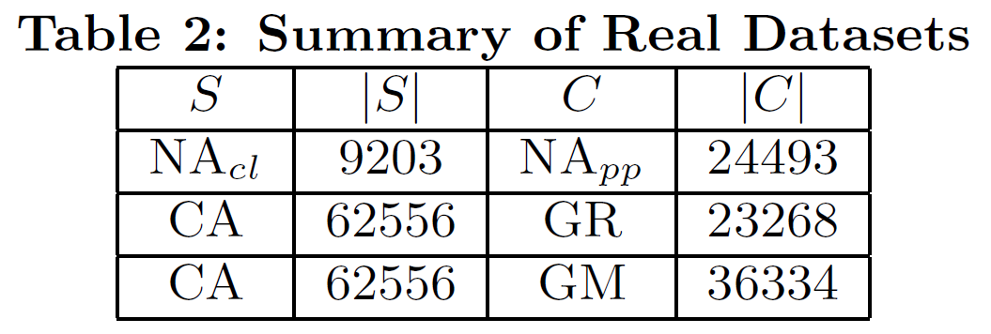
Experiments
Real Dataset
  Populated places and cultural landmarks in North American, available from RTreePortal
  Other datasets from prior work (i.e. MaxOverlap)

Slide 32
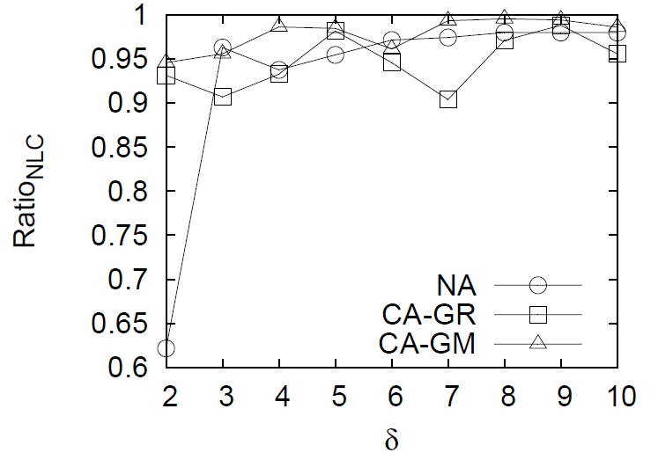
Experiments
Result Quality
  Let the result cell be g, Ratio_{NLC} = inf(g) / inf(OPT)

Slide 33
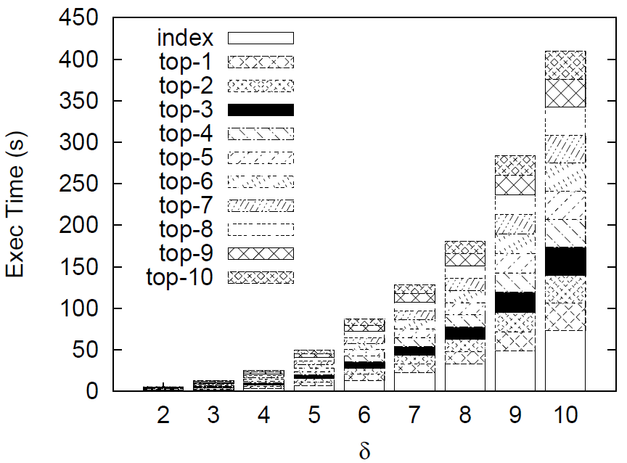
Experiments
Running Time
  Results from the NA dataset

Slide 34
Outline
Introduction
FILM Algorithm
Experiments
Conclusion

Slide 35
Conclusion
An efficient influential location miner called FILM is designed, which returns a small grid cell in which all locations have an influence guarantee
FILM returns near-optimal locations in considerably less time than existing approaches
FILM is practical for time-critical applications that require short response time of finding influential locations

Slide 36
Thank you!

