Slide 1

Da Yan, Zhou Zhao and Wilfred Ng
The Hong Kong University of Science and Technology

Slide 2
Outline
Motivation
PassTrack System Overview
Reader Detection Model
Location Inference Model
Experiments
Conclusion

Slide 3
Motivation
Tracking Technologies
  Passive RFID technologies
    Inventory monitoring, product flow tracking
  GPS technologies
    Outdoor location tracking
  Active RFID technologies
    Indoor location tracking
Our focus

Slide 4
Motivation
Indoor Localization
  GPS has poor performance for indoor applications, due to its requirement of line-of-sight signal reception from the satellites
  Active-tag-based RFID localization systems
    RADAR
    LANDMARC
    ...
Can we use passive RFID technology?

Slide 5
Motivation
Passive RFID tags are more attractive than active ones
  Lower tag cost
    Can be used in a one-off manner
  Easier maintenance
    No maintenance overhead such as battery replacement
  Smaller error
    Active-tag-based systems usually incur meters of error

Slide 6
Outline
Motivation
PassTrack System Overview
Reader Detection Model
Location Inference Model
Experiments
Conclusion

Slide 7
System Overview
The setting for tracking u objects
  n RFID readers/antennae {R₁, R₂, ..., R_{n}}
  m passive reference tags {T₁, T₂, ..., T_{m}}
  u passive tracking tags {O₁, O₂, ..., O_{u}}

Slide 8
System Overview
External factors that influence the reader detection performance
  changes in temperature and humidity
  number of objects nearby
Decouple the reader detection model from the location inference process
Dynamically adapt the reader detection model to the changing environment

Slide 9
System Overview
Decoupling Strategy
  For each reader/antenna R_{i}, its detection model is “learned” from the current read rate of the reference tags dynamically
  Using the learned reader detection models, for each tracking tag O_{i}, we find its most likely location based on the observed read rate of O_{i} from each reader.

Slide 10
Outline
Motivation
PassTrack System Overview
Reader Detection Model
Location Inference Model
Experiments
Conclusion

Slide 11
Reader Detection Model
Reader detection model estimates the distance of a tag T to an RFID antenna R
  Estimation is based on the readings of T received by R
  Metrics
    RSSI (received signal strength indicator) for active tags
    Read rate for passive tags
    If R detects the response from T in 3 out of a series of 10 interrogation cycles, the read rate is estimated to be 0.3

Slide 12


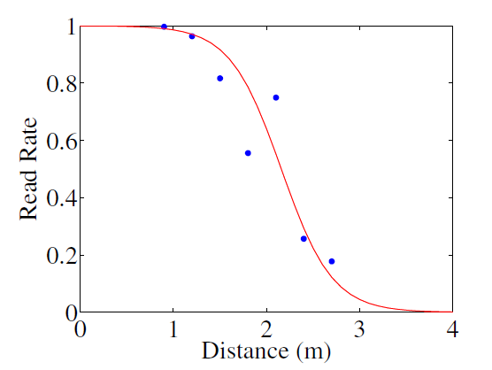


Reader Detection Model
Define the Euclidean distance:
Read rate is a function:
Observations
Minor Detection Range
P(l) decreases almost linearly to 0
Major Detection Range
P(l) is close to 1

Slide 13

Reader Detection Model
The curve is like an upside-down curve of the logistic function

Slide 14





Reader Detection Model
Reader detection model for Reader R_{i}
l_{i} is the distance from tag T and to R_{i}
  Location of T:
  Location of R_{i} :
Model Parameters

Slide 15


Reader Detection Model
How to learn a_{i} and b_{i}?
  p_{ij}: current read rate of each reference tag T_{j} estimated by reader R_{i}
  Since the locations of reference tags and readers are fixed, is directly available
  At each time step, we have

Slide 16
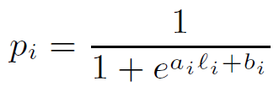


Reader Detection Model
How to learn a_{i} and b_{i}?
  a_{i} and b_{i} are estimated using least square method, using

Slide 17
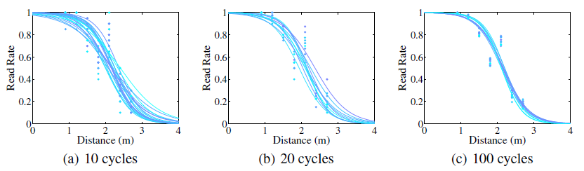
Reader Detection Model
More interrogation cycles lead to more stable reader detection model

Slide 18
Outline
Motivation
PassTrack System Overview
Reader Detection Model
Location Inference Model
Experiments
Conclusion

Slide 19
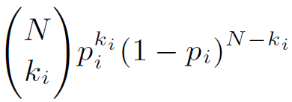
Location Inference Model
Maximum Likelihood Estimation
  O: the tracking tag of a tracking object
  p_{i} (or p_{i}(l_{i})): read rate of R_{i}
  Pr{O responds k_{i} times to R_{i} in the latest N interrogation cycles} =

Slide 20
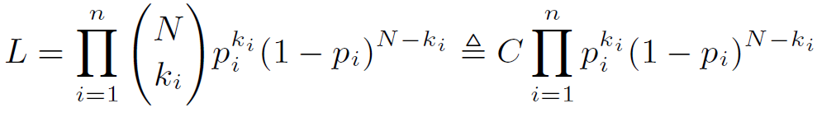

Location Inference Model
Maximum Likelihood Estimation
  Assume that each reader R_{i} detects O independently
  Likehood (to maximize):

Slide 21
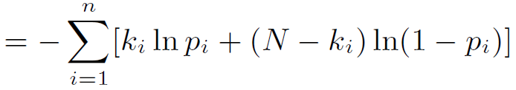



Location Inference Model
Maximum Likelihood Estimation
  Negative log-likelihood (to minimize):
  L is a function of the location (x, y) of O
    L is a function of p_{i}
    p_{i} is a function of l_{i}
    l_{i} is a function of (x, y)

Slide 22
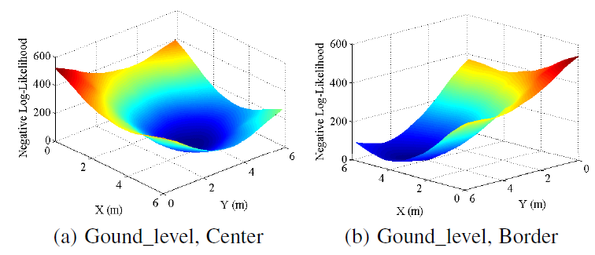
Location Inference Model
The shape of L(x, y)
  Almost convex

Slide 23
Location Inference Model
Method for finding the location (x, y) that minimizes L(x, y)
  Grid search
  Gradient descent
    First-order Taylor approximation of L
  Newton’s method
    Second-order Taylor approximation of L
    Requires the Hessian matrix of L besides its gradient
    Converges faster than gradient descent

Slide 24
Location Inference Model
  Implementation of Newton’s method
  Initial location: obtained by a coarse-grained grid search
  Location update requires computing the Hessian matrix, which is the key to the efficiency
  The Hessian matrix of L at the current location (x, y) can be efficiently computed

Slide 25
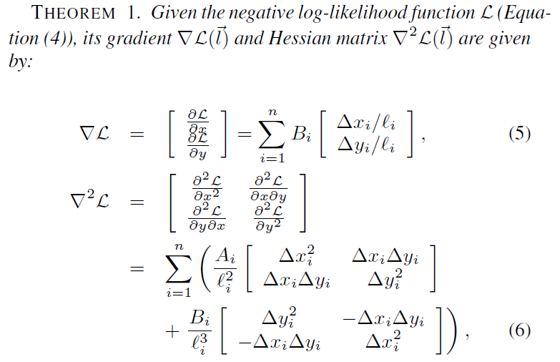
Location Inference Model

Slide 26
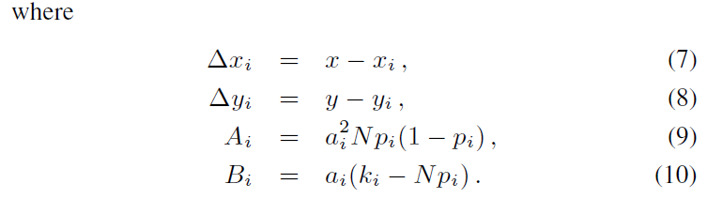
Location Inference Model

Slide 27



Location Inference Model
  Alternative Method
  Nearest-neighbor-based heuristics
or

Slide 28
Outline
Motivation
PassTrack System Overview
Reader Detection Model
Location Inference Model
Experiments
Conclusion

Slide 29
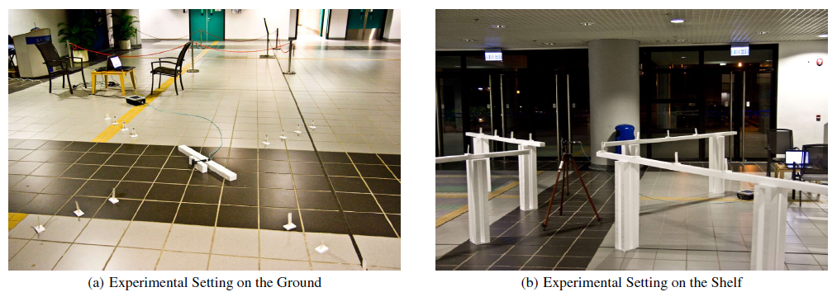
Experiments
  Two Experimental Settings

Slide 30
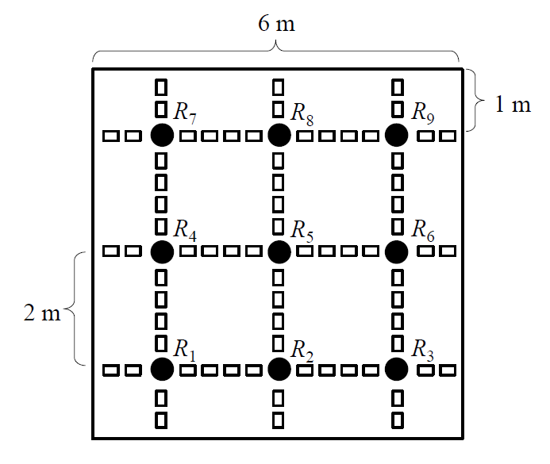
Experiments
  Experimental Environment

Slide 31
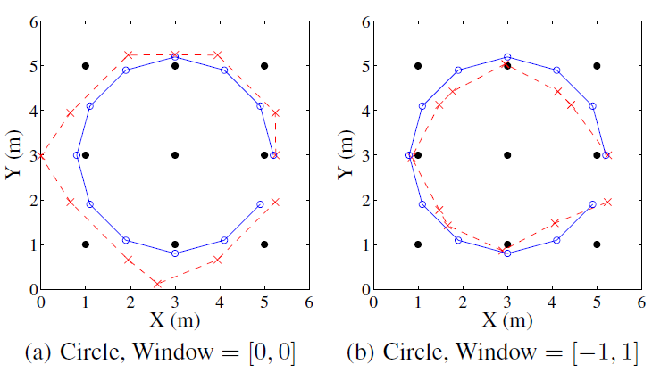
Experiments
  Location Accuracy for Moving Objects

Slide 32
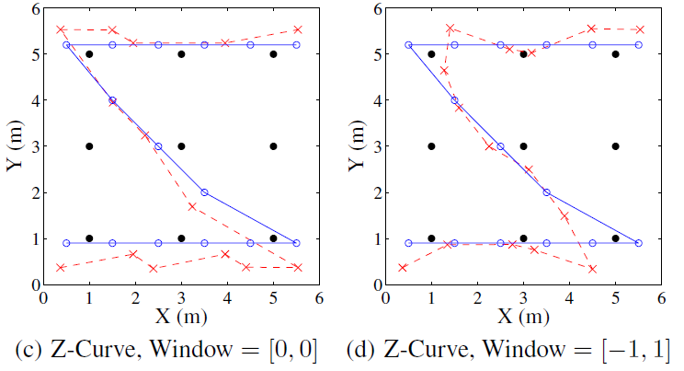
Experiments
  Location Accuracy for Moving Objects

Slide 33
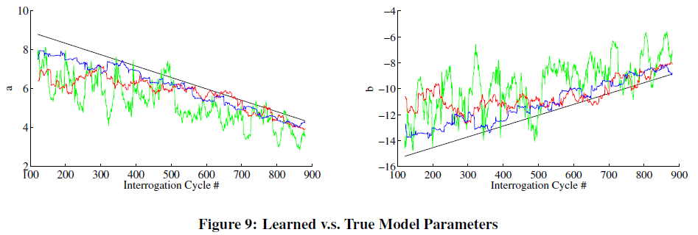
Experiments
  Reader Detection Model Learning

Slide 34
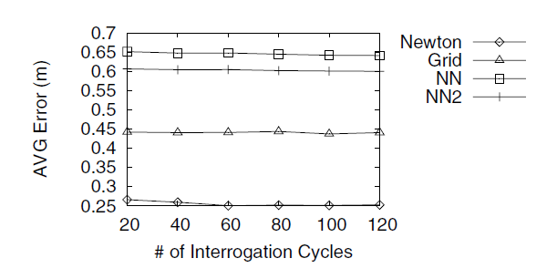
Experiments
  Accuracy of different algorithms

Slide 35
Outline
Motivation
PassTrack System Overview
Reader Detection Model
Location Inference Model
Experiments
Conclusion

Slide 36
Conclusion
  Contribution of PassTrack
  Sigmoid-like reader detection model that dynamically adapts to the changing environment
  A sound probabilistic inference model

Slide 37
Conclusion
  Contribution of PassTrack
  PassTrack estimates the location of a constantly moving object (or a static object) with an average error of around 30cm (or below 20cm)
  The most accurate algorithm (Newton’s Method) is able to perform over 7500 location estimations per second on an ordinary computer

Slide 38
Thank you!

