Slide 1

Da Yan, Zhou Zhao and Wilfred Ng
The Hong Kong University of Science and Technology

Slide 2
Outline
Introduction
Related Work
Baseline Algorithm
Convex-Hull-Based Pruning
Fast Greedy Algorithm
Experiments
Conclusion

Slide 3
Introduction
How to define an optimal meeting point on road networks?
Min-max OMP
q₂
9 km
q₃
q₁
q₄
x
6 km
3 km
q₅
Six people
q₆
arg min_{x} [max_{i} dist(q_{i}, x)]

Slide 4
Introduction
How to define an optimal meeting point on road networks?
Min-sum OMP
q₂
9 km
q₃
q₁
q₄
x
3 km
q₅
Our focus
q₆
arg min_{x} [∑_{i} dist(q_{i}, x)]

Slide 5
Introduction
Network distance d_{N}(p₁, p₂) is the length of the shortest path connecting p₁ and p₂
Problem Definition
  Given a set of query points Q ={q₁, q₂, …, q_{n}} on a road network G = (V, E), an optimal meeting point (OMP) query returns the point x’ = arg min_{x} [∑_{i} d_{N}(q_{i}, x)]

Slide 6
Introduction
Applications:
  Minimizing the total travel cost for a group of people who want to find a location for gathering
  Helping a travel agency decide the location for a tourist bus to pick up the tourists
  Part of AI for computer players in strategy games such as WorldofWarcraft

Slide 7
Outline
Introduction
Related Work
Baseline Algorithm
Convex-Hull-Based Pruning
Fast Greedy Algorithm
Experiments
Conclusion

Slide 8
Related Work
Min-sum OMP query in the Euclidean space: a.k.a. the Weber problem
Min-sum OMP in the Euclidean space: geometric median of Q ={q₁, q₂, …, q_{n}}
No closed form formula exists
Solved by gradient descent methods

Slide 9
Related Work
Min-sum OMP query on a road network G = (V, E)
Split-point-based method
A split point is defined for each query point q_{i} ∈ Q and each edge (u, v) ∈ E
4 km
u
v
6 km
12 km
q_{i}
14 km

Slide 10
Related Work
Existing work has proved the following:
  An OMP must exist among all the split points
Search space: |Q| · |E|
Computational cost:
  Split point evaluation
  Min-sum distance computation

Slide 11
Outline
Introduction
Related Work
Baseline Algorithm
Convex-Hull-Based Pruning
Fast Greedy Algorithm
Experiments
Conclusion

Slide 12
Baseline Algorithm
Theorem 1: Given an OMP query with query point set Q on a road network G = (V, E), an OMP must exist among V ∪ Q
Search space: |V| + |Q|
Computational cost:
  Only min-sum distance computation
Search Space
|Q| · |E|
|V| + |Q|

Slide 13
Baseline Algorithm
Main idea:
  Suppose that no point in Q is on edge (u, v)
+ 2 ·δ
− 6 ·δ
shorter
q₁
q₂
q₄
q₅
X
q₃
q₆
δ
δ
q₇
q₈
v
x
x'
u
Part of q₁’s shortest path to x

Slide 14
Baseline Algorithm
Theorem 1 only relies on the fact that the road network G = (V, E) is a graph
Edge length can refer to
  Physical distance
  Travel delay
  ……
Can we do more ?

Slide 15
Outline
Introduction
Related Work
Baseline Algorithm
Convex-Hull-Based Pruning
Fast Greedy Algorithm
Experiments
Conclusion

Slide 16
Convex-Hull-Based Pruning
Existing method:
  Cut the whole road network into partitions
  Check only those split points that are in the smallest enclosing partition

Slide 17
Convex-Hull-Based Pruning
First Trial
  Collect into a set P those end points of all the edges which the query points in Q are on
  Compute the convex hull of the point set P
u
a
v
OMP
b

Slide 18
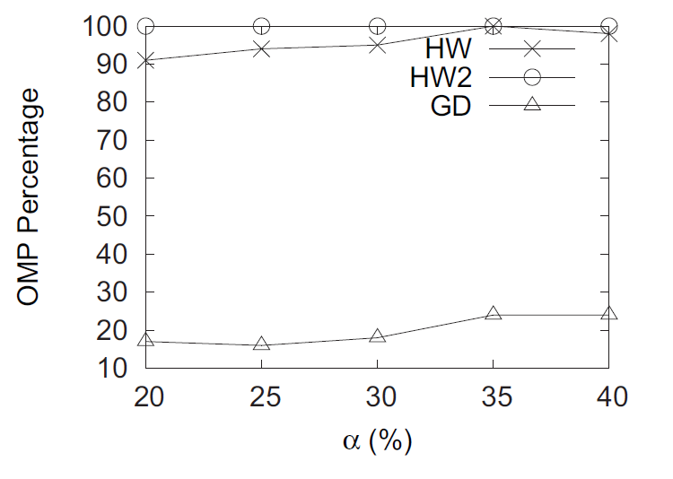
Convex-Hull-Based Pruning
First Trial
  Collect into a set P those end points of all the edges which the query points in Q are on
  Compute the convex hull of the point set P

Slide 19
Convex-Hull-Based Pruning
Second Trial
  Collect into a set P those end points of all the edges which the query points in Q are on
  Compute the convex hull of the point set P as H
  Find the shortest path for each pair of neighboring points on H, add all the points on these paths into a set S
  Compute the convex hull of the point set S

Slide 20
Convex-Hull-Based Pruning
Second Trial
  Only fails to return the OMP in 5 of the 79900 queries tested in total
  Sum-of-distances values of these meeting points are all within 0.1% more than the smallest value
u
a
v
b

Slide 21
Convex-Hull-Based Pruning
All vertices in V are organized as a kd-tree
Check only those vertices that are in the convex hull of the point set S
Range query on kd-tree, refinement step using ccw(p₁, p₂, p₃) = (p₂.x − p₁.x) (p₃.y − p₁.y) − (p₃.x − p₁.x) (p₂.y − p₁.y)
p_{out}
p₀
p₁
p_{in}

Slide 22
Outline
Introduction
Related Work
Baseline Algorithm
Convex-Hull-Based Pruning
Fast Greedy Algorithm
Experiments
Conclusion

Slide 23
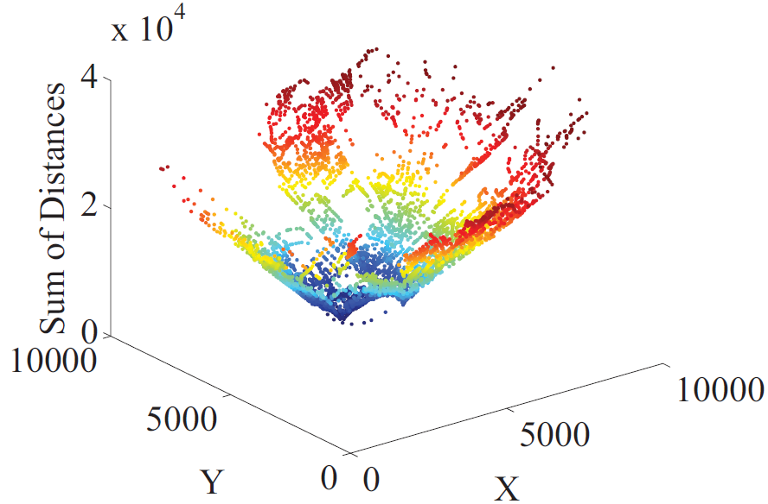
Fast Greedy Algorithm
Road network is a metric space
Sum-of-distances function: almost convex

Slide 24
Fast Greedy Algorithm
Compute the center of gravity of Q as (x_{c}, y_{c})
NN query on vertex kd-tree with query point (x_{c}, y_{c}), find its NN vertex v_{nn}
Initialize the current vertex as v_{nn}
In each iteration, find the neighboring vertex v_{min} with minimum sum-of-distances value
  If the value is smaller than the current one, set the current vertex as v_{min}
  Otherwise, terminate

Slide 25
Outline
Introduction
Related Work
Baseline Algorithm
Convex-Hull-Based Pruning
Fast Greedy Algorithm
Experiments
Conclusion

Slide 26
Experiments
Datasets:
  Road network datasets of 46 states in US
  http://data.geocomm.com/catalog/US
  Query points are randomly generated in a rectangular query window
  Given OMP x and a result meeting point x’, Ratio(x’) = [∑_{i} d_{N}(q_{i}, x’) − ∑_{i} d_{N}(q_{i}, x)] / ∑_{i} d_{N}(q_{i}, x)

Slide 27
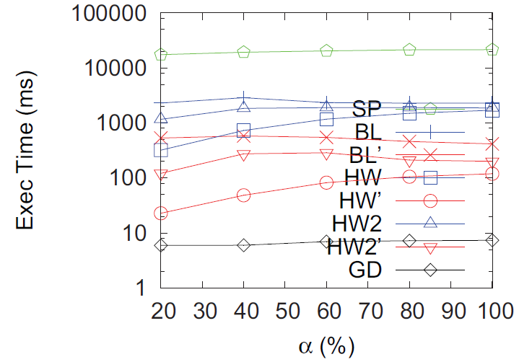
Experiments
Effect of window size

Slide 28
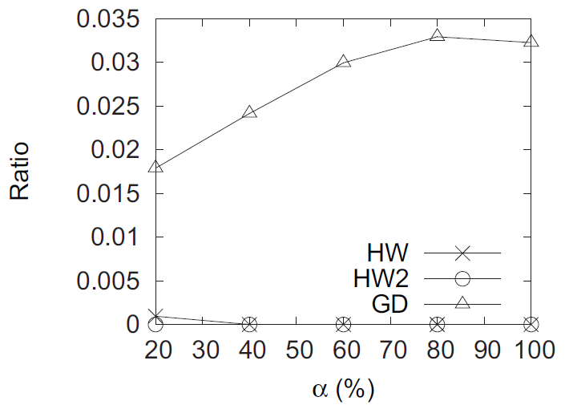
Experiments
Effect of window size

Slide 29
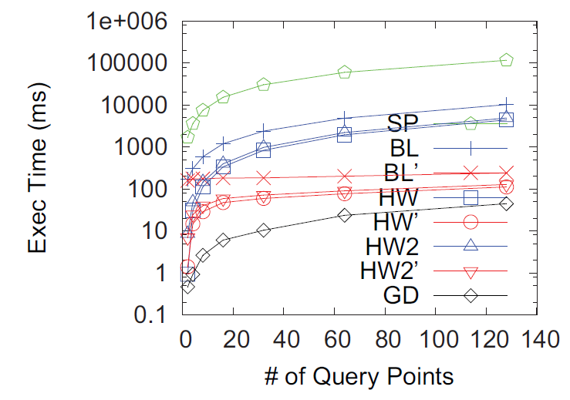
Experiments
Effect of |Q|

Slide 30
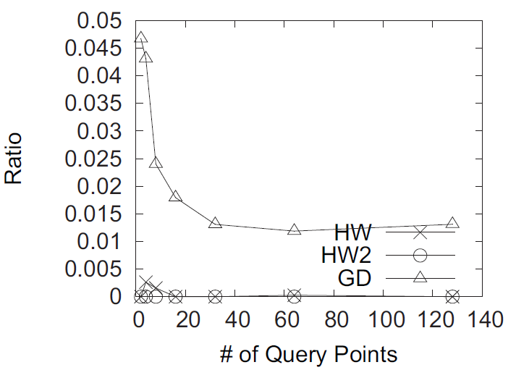
Experiments
Effect of |Q|

Slide 31
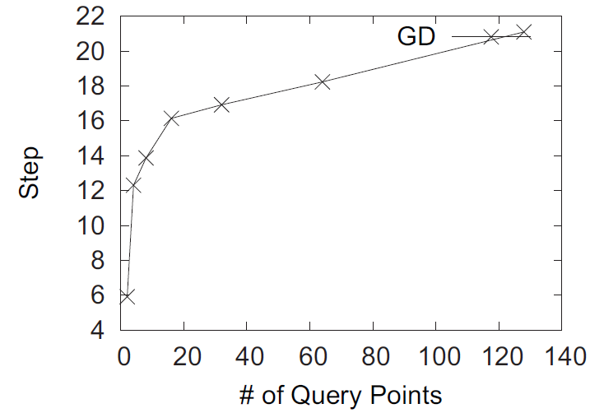
Experiments
Effect of |Q|

Slide 32
Outline
Introduction
Related Work
Baseline Algorithm
Convex-Hull-Based Pruning
Fast Greedy Algorithm
Experiments
Conclusion

Slide 33
Conclusion
Our baseline algorithm substantially reduce the search space of the OMP query from |Q| · |E| to |V| + |Q|
Our two-phase convex-hull-based pruning technique is accurate and effective
We develop an extremely efficient greedy algorithm to find a high-quality near-optimal meeting point

Slide 34
Thank you!

