Slide 1

Da Yan (HKUST)
James Cheng (CUHK)
Wilfred Ng (HKUST)
Steven Liu (HKUST)

Slide 2
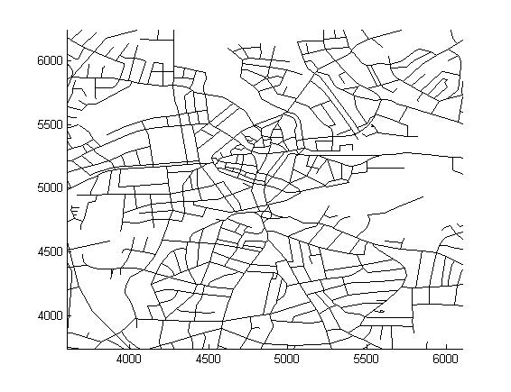
Introduction
Problem Definition
  What is a Distance-Preserving Subgraph (or DPS)?
Given a road network G = (V, E)

Slide 3
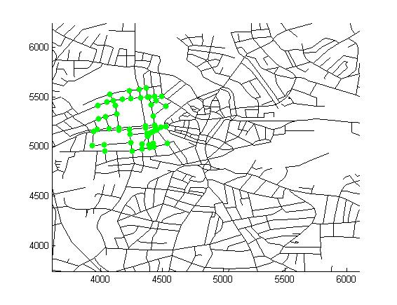
Introduction
Problem Definition
  What is a Distance-Preserving Subgraph (or DPS)?
Source query set S

Slide 4
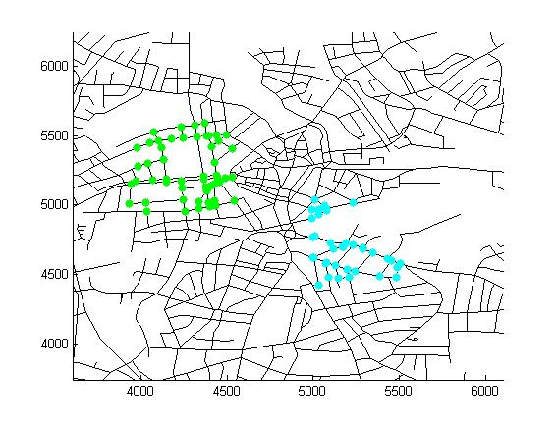
Introduction
Problem Definition
  What is a Distance-Preserving Subgraph (or DPS)?
Target query set T

Slide 5
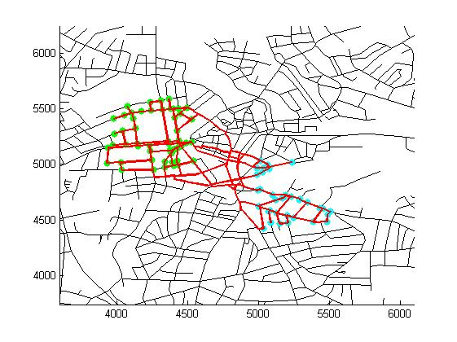
Introduction
Problem Definition
  What is a Distance-Preserving Subgraph (or DPS)?
Find subgraph G’
(induced by V’ )

Slide 6
Introduction
Problem Definition
  What is a Distance-Preserving Subgraph (or DPS)?
s
t

Slide 7
Introduction
Problem Definition
  Special case: S = T = Q
    Q may be specified by a region (e.g., a district/city)

Slide 8
Introduction
Problem Definition
  Special case: S = T = Q
    Q may be specified by a region (e.g., a district/city)
  We assume S, T ⊆ V
    If q is on edge (u, v), add u & v to query set

Slide 9
Introduction
Problem Definition
  Assumptions about road network
    Undirected
    Near planar: some edges may cross another edge
      Tunnels, flyovers

Slide 10
Introduction
Problem Definition
  Assumptions about road network
    Undirected
    Near planar: some edges may cross another edge
      Tunnels, flyovers
We call such edges as bridges

Slide 11
Introduction
Motivation
  Server maintains a large road network
  Applications pose DPS queries

Slide 12
Introduction
Motivation
  Server maintains a large road network
  Applications pose DPS queries
  Benefits
    Smaller space
    Faster query processing

Slide 13
Introduction
Motivating Application
  Route planning for a French logistics company
    Delivery service between Paris and Munich, Rome, Madrid
Munich
Paris
Rome
Madrid

Slide 14
Introduction
Motivating Application
  Route planning for a French logistics company
    Delivery service between Paris and Munich, Rome, Madrid
Munich
(S, T)-DPS query #1
Paris
Rome
Madrid

Slide 15
Introduction
Motivating Application
  Route planning for a French logistics company
    Delivery service between Paris and Munich, Rome, Madrid
Munich
(S, T)-DPS query #1
(S, T)-DPS query #2
Paris
Rome
Madrid

Slide 16
Introduction
Motivating Application
  Route planning for a French logistics company
    Delivery service between Paris and Munich, Rome, Madrid
Munich
(S, T)-DPS query #1
(S, T)-DPS query #2
(S, T)-DPS query #3
Paris
Rome
Madrid

Slide 17
Introduction
Motivating Application
  Route planning for a French logistics company
    Delivery service between Paris and Munich, Rome, Madrid
Munich
(S, T)-DPS query #1
(S, T)-DPS query #2
(S, T)-DPS query #3
Merge the three DPSs
Paris
Rome
Madrid

Slide 18
Introduction
Contributions
  Formalize the DPS query in road networks

Slide 19
Introduction
Contributions
  Formalize the DPS query in road networks
  Propose 4 algorithms for finding DPS
    Different trade-off between query efficiency and DPS quality
DPS Size
BL-Efficiency
RoadPart
Hull
BL-Quality
Runtime

Slide 20
Outline
Introduction
Algorithms
  Algorithm 1: Quality Centric Baseline
  Algorithm 2: Efficiency Centric Baseline
  Algorithm 3: RoadPart Framework
  Algorithm 4: Convex Hull Method
Experiments
Conclusions

Slide 21
Algorithms
Algorithm 1: Quality Centric Baseline
  BL-Quality (BL-Q) algorithm
    Run SSSP computation (Dijkstra’s algorithm) from all s ∈ S

Slide 22
Algorithms
Algorithm 1: Quality Centric Baseline
  BL-Quality (BL-Q) algorithm
    Run SSSP computation (Dijkstra’s algorithm) from all s ∈ S
    Terminates when all vertices in T are reached

Slide 23
Algorithms
Algorithm 1: Quality Centric Baseline
  BL-Quality (BL-Q) algorithm
    Run SSSP computation (Dijkstra’s algorithm) from all s ∈ S
    Terminates when all vertices in T are reached
  DPS quality: smallest
  # of SSSP computations: |S|

Slide 24
Outline
Introduction
Algorithms
  Algorithm 1: Quality Centric Baseline
  Algorithm 2: Efficiency Centric Baseline
  Algorithm 3: RoadPart Framework
  Algorithm 4: Convex Hull Method
Experiments
Conclusions

Slide 25
Algorithms
Algorithm 2: Efficiency Centric Baseline
  BL-Efficiency (BL-E) algorithm
    Locate a vertex v_{c} in the middle of Q or S∪T
v_{c}

Slide 26
Algorithms
Algorithm 2: Efficiency Centric Baseline
  BL-Efficiency (BL-E) algorithm
    Locate a vertex v_{c} in the middle of Q or S∪T
    Run SSSP computation from v_{c} until all query points are reached; Denote by r the length of the longest sp(v_{c}, 𝑞)
v_{c}
r

Slide 27
Algorithms
Algorithm 2: Efficiency Centric Baseline
  BL-Efficiency (BL-E) algorithm
    Locate a vertex v_{c} in the middle of Q or S∪T
    Run SSSP computation from v_{c} until all query points are reached; Denote by r the length of the longest sp(v_{c}, 𝑞)
    Continue SSSP computation to reach all vertices v with sp(v_{c}, v) ≤ 2r
2r
v_{c}
r

Slide 28
Algorithms
Algorithm 2: Efficiency Centric Baseline
  BL-Efficiency (BL-E) algorithm
    Locate a vertex v_{c} in the middle of Q or S∪T
    Run SSSP computation from v_{c} until all query points are reached; Denote by r the length of the longest sp(v_{c}, 𝑞)
    Continue SSSP computation to reach all vertices v with sp(v_{c}, v) ≤ 2r
  # of SSSP computations: 1
2r
v_{c}
r

Slide 29
Outline
Introduction
Algorithms
  Algorithm 1: Quality Centric Baseline
  Algorithm 2: Efficiency Centric Baseline
  Algorithm 3: RoadPart Framework
  Algorithm 4: Convex Hull Method
Experiments
Conclusions

Slide 30
Algorithms
RoadPart Framework
  Offline indexing phase
    Partition the road network into small regions
    Assign vertices with region IDs

Slide 31
Algorithms
RoadPart Framework
  Offline indexing phase
    Partition the road network into small regions
    Assign vertices with region IDs
  Online querying phase
    Answer a DPS query using the region IDs of the query vertices

Slide 32
Algorithms
RoadPart Framework
  Offline indexing phase
    Compute a contour of the road network

Slide 33
Algorithms
RoadPart Framework
  Offline indexing phase
    Compute a contour of the road network

Slide 34
Algorithms
RoadPart Framework
  Offline indexing phase
    Compute a contour of the road network
    Partition it by cuts
      Cut: a shortest path between vertices on the contour
b₂
b₁

Slide 35
Algorithms
RoadPart Framework
  Offline indexing phase
    Border points B = {b1, …, b_{ℓ}} are selected evenly on the contour
    Cuts from b_{i} partition the road network into zones
b_{i}
1
6
2
5
3
4

Slide 36
Algorithms
RoadPart Framework
  Offline indexing phase
    Border points B = {b1, …, b_{ℓ}} are selected evenly on the contour
    Cuts from b_{i} partition the road network into zones
    Each vertex is assigned a unique interval label
b_{i}
b_{i}
1
v₃
6
v₁
[4, 6]
2
5
[2, 3]
v₂
3
4
[3, 3]

Slide 37
Algorithms
RoadPart Framework
  Offline indexing phase
    Each vertex has a |B|-dimensional label vector
    Cuts from b_{i} decides the interval label of the i-th dimension

Slide 38
Algorithms
RoadPart Framework
  Offline indexing phase
    Each vertex has a |B|-dimensional label vector
    Cuts from b_{i} decides the interval label of the i-th dimension
    All vertices with the same label vector compose a region

Slide 39
Algorithms
RoadPart Framework
  Online querying phase (planar graph)
    Step 1: compute a |B|-dimensional label vector, called window W, from query sets S and T
      All points in S∪T are contained in the region represented by W
1
6
2
W
5
4
3

Slide 40
Algorithms
RoadPart Framework
  Online querying phase (planar graph)
    Step 2: find all the regions contained in W, and add their vertices to V’
      Region R is pruned if there exists a dimension i such that vec(R)[i]∩W[i] = ∅
1
R
6
2
W
5
4
3

Slide 41
Algorithms
RoadPart Framework
  Online querying phase (planar graph)
    Correctness
1
m₂
R
6
m₁
t
2
s
W
5
4
3

Slide 42
Algorithms
RoadPart Framework
  Online querying phase (non-planar graph)
    In USA road network, # of bridges = 0.377% |E|

Slide 43
Algorithms
RoadPart Framework
  Online querying phase (non-planar graph)
    In USA road network, # of bridges = 0.377% |E|
    Each bridge may introduce additional vertices into V’
1
m₂
R
6
m₁
t
2
s
W
5
4
3

Slide 44
Algorithms
RoadPart Framework
  Online querying phase (non-planar graph)
    What vertices should be added to V’ due to bridge (u, v)?

Slide 45
Algorithms
RoadPart Framework
  Online querying phase (non-planar graph)
    What vertices should be added to V’ due to bridge (u, v)?
      UD contains all vertices x with sp(x, u) passing through v
      VD contains all vertices x with sp(x, v) passing through u
      UD* = UD∩(S ∪ T); VD* = VD∩(S ∪ T)
      For all x ∈UD*∪VD*, add all vertices in sp(x, u) and sp(x, v) into V’
u
v
VD
UD
S
T

Slide 46
Algorithms
RoadPart Framework
  Online querying phase (non-planar graph)
    Is it practical to process all the bridges for each DPS query?

Slide 47
Algorithms
RoadPart Framework
  Online querying phase (non-planar graph)
    Is it practical to process all the bridges for each DPS query?
      In USA road network, # of bridges > 10⁵
      Computing UD* and VD* for each bridge is expensive

Slide 48
Algorithms
RoadPart Framework
  Online querying phase (non-planar graph)
    Is it practical to process all the bridges for each DPS query?
      In USA road network, # of bridges > 10⁵
      Computing UD* and VD* for each bridge is expensive
Require effective methods for pruning bridges

Slide 49
Algorithms
RoadPart Framework
  Online querying phase (non-planar graph)
    With respect to window W, a bridge (u, v) belongs to one of the following three types:
      (1) Interior bridge
u₁
v₁

Slide 50
Algorithms
RoadPart Framework
  Online querying phase (non-planar graph)
    With respect to window W, a bridge (u, v) belongs to one of the following three types:
      (1) Interior bridge
      (2) Cut bridge
u₃
u₂
v₃
v₂
u₁
v₁

Slide 51
Algorithms
RoadPart Framework
  Online querying phase (non-planar graph)
    With respect to window W, a bridge (u, v) belongs to one of the following three types:
      (1) Interior bridge
      (2) Cut bridge
      (3) Exterior bridge
u₃
u₂
v₃
v₂
u₄
u₁
v₁
v₄

Slide 52
Algorithms
RoadPart Framework
  Online querying phase (non-planar graph)
    Interior and exterior bridges are pruned by cut bridges

Slide 53
Algorithms
RoadPart Framework
  Online querying phase (non-planar graph)
    Interior and exterior bridges are pruned by cut bridges
    Most cut bridges are pruned by a small fraction of cut bridges

Slide 54
Algorithms
RoadPart Framework
  Online querying phase (non-planar graph)
    Interior and exterior bridges are pruned by cut bridges
    Most cut bridges are pruned by a small fraction of cut bridges
    Pruning rule checking is efficient
      Comparison of the label vectors of u, v and W

Slide 55
Algorithms
RoadPart Framework
  Online querying phase (non-planar graph)
    Interior and exterior bridges are pruned by cut bridges
    Most cut bridges are pruned by a small fraction of cut bridges
    Pruning rule checking is efficient
      Comparison of the label vectors of u, v and W
    Pruning rules are effective
      In USA road network, # of bridges > 10⁵
      After bridge pruning, only several to tens of bridges remain

Slide 56
Algorithms
RoadPart Framework
  Online querying phase (non-planar graph)
    Interior and exterior bridges are pruned by cut bridges
    Most cut bridges are pruned by a small fraction of cut bridges
    Pruning rule checking is efficient
      Comparison of the label vectors of u, v and W
    Pruning rules are effective
      In USA road network, # of bridges > 10⁵
      After bridge pruning, only several to tens of bridges remain
    # of SSSP computations: several to tens

Slide 57
Outline
Introduction
Algorithms
  Problem Definition
  Algorithm 1: Quality Centric Baseline
  Algorithm 2: Efficiency Centric Baseline
  Algorithm 4: Convex Hull Method
Experiments
Conclusions

Slide 58
Algorithms
Convex Hull Method
  Server-side computes a loose DPS using RoadPart
  Client-side refines the DPS using convex hull method

Slide 59
Algorithms
Convex Hull Method
  Server-side computes a loose DPS using RoadPart
  Client-side refines the DPS using convex hull method
  More efficient than BL-Q
    Only compute pairwise shortest paths between boundary vertices
  High-quality DPS
    Convex hull tightly bounds the query set

Slide 60
Algorithms
Convex Hull Method
s
t
Q
T
S

Slide 61
Algorithms
Convex Hull Method
  Compute the convex hull of S and T
s
t
s
t
Q
T
S

Slide 62
Algorithms
Convex Hull Method
  Compute the convex hull of S and T
  Add all vertices inside hull(S) or hull(T) to V’
s
t
s
t
Q
T
S

Slide 63
Algorithms
Convex Hull Method
  Compute the convex hull of S and T
  Add all vertices inside hull(S) or hull(T) to V’
  For each location u in the boundary of hull(S), and each location v in the boundary of hull(T), add vertices in sp(u, v) to V’
s
t
s
t
Q
T
S

Slide 64
Outline
Introduction
Algorithms
Experiments
Conclusions

Slide 65
Experiments
Dataset
  The largest one: USA road network
  |V| = 23,947,347, |E| = 28,854,312
RoadPart Index
  # of border points: 70
  # of regions: 11,629

Slide 66
Experiments
Query Setting
  Q accounts for 20% × 20% of the whole region
Results on Efficiency
BL-E | RoadPart | Hull | BL-Q
0.2 sec | 5.7 sec | 52 sec | 2,364 sec
RoadPart + Hull
5.7 sec + 17.1 sec

Slide 67
Experiments
Query Setting
  Q accounts for 20% × 20% of the whole region
Results on DPS Quality (|V’|)
BL-E | RoadPart | Hull | BL-Q
286,347 | 108,670 | 37,679 | 34,089

Slide 68
Experiments
Query Setting
  Q accounts for ɛ × ɛ of the whole region
Results on Bridge Pruning (for RoadPart)
ɛ | |Q| | # of bridges examined
10% | 6,112 | 14
20% | 30,968 | 37
30% | 81,574 | 30
40% | 156,485 | 29
50% | 204,812 | 28

Slide 69
Outline
Introduction
Algorithms
Experiments
Conclusions

Slide 70
Conclusions
We formalize the DPS query in road networks
We propose four algorithms for finding DPS, with different trade-off between query efficiency and DPS quality
We conducted extensive experiments to study the performance of our algorithms

Slide 71
Presenter: Da YAN
Email: yanda@cse.ust.hk
Homepage: http://www.cse.ust.hk/~yanda
Q & A

