Slide 1

Da Yan (HKUST)
James Cheng (CUHK)
Wilfred Ng (HKUST)
Steven Liu (HKUST)

Slide 2
Outline
Problem Definition
Motivation
Baseline Algorithms
RoadPart Framework
Convex Hull Method
Experiments
Conclusion

Slide 3
Problem Definition
Distance-Preserving Subgraph (DPS)
  Given
    a road network G = (V, E), and
    two query point sets (locations in G), S and T
  Find a subset of vertices V' ⊆ V
    G' : the subgraph of G induced by V'
  Such that
    for any two points, s ∈ S and t ∈ T,
    shortest path sp(s, t) exists in G’

Slide 4
Problem Definition
Distance-Preserving Subgraph (DPS)
  Special case of (S, T)-DPS query
    Q-DPS query: S = T = Q
    Q may be specified by a region (e.g., a district/city)
  Assume S, T ⊆ V
    If a query point q is on edge (u, v), just include both u and v into the query set

Slide 5
Problem Definition
Distance-Preserving Subgraph (DPS)
  Road network G is
    undirected
    weighted
    connected
  Road network G is near planar
    Some edges may cross another edge
      Tunnels, flyovers
    Bridge: an edge that crosses some other edge

Slide 6
Outline
Problem Definition
Motivation
Baseline Algorithms
RoadPart Framework
Convex Hull Method
Experiments
Conclusion

Slide 7
Motivation
Applications
  Server side:
    maintains a large road network
    processes DPS queries posed by different applications
  Possible clients/applications:
    French logistics company arranging the delivery routes between Paris and three other European cities: Munich, Rome, and Madrid: merging three (S, T)-DPSs
    Development of a route search engine for people who travel in Southern California: one Q-DPS

Slide 8
Motivation
Benefits of using small graph
  Smaller space requirement
    Allow a mobile device to hold the network fragment in its limited memory, to avoid random I/O operations
  Faster query processing
    1000 PPSP computation (using A*) in a 2%×2% region
      173s on entire USA road network
      4.2s on a DPS
    Supports other network-distance-based queries
      Facility location query
      Aggregate nearest neighbor query

Slide 9
Outline
Problem Definition
Motivation
Baseline Algorithms
RoadPart Framework
Convex Hull Method
Experiments
Conclusion

Slide 10
Baseline Algorithms
Quality Centric Baseline
  BL-Quality (BL-Q) algorithm
    W.l.o.g, assume |S| ≤ |T|
    Run SSSP algorithm (Dijkstra’s algorithm) for all s ∈ S
    SSSP computation terminates as soon as the shortest paths from s to all vertices in T are computed
  Find the smallest DPS
  Time complexity: O(min{|S|, |T|}⋅|V|log|V|)

Slide 11
Baseline Algorithms
Efficiency Centric Baseline
  BL-Efficiency (BL-E) algorithm
    First, locate a vertex v_{c} in the middle of Q (MBR center)
    Q = S∪T for (S, T)-DPS query
v_{c}

Slide 12
Baseline Algorithms
Efficiency Centric Baseline
  BL-Efficiency (BL-E) algorithm
    Then, run SSSP from v_{c} until sp(v_{c}, 𝑞) is computed for all q ∈ Q
    r: the length of the longest sp(v_{c}, 𝑞)
v_{c}
r

Slide 13
Baseline Algorithms
Efficiency Centric Baseline
  BL-Efficiency (BL-E) algorithm
    Continue to run the SSSP from v_{c} to obtain all the other shortest paths from v_{c} with length no greater than 2r
2r
v_{c}
r

Slide 14
Baseline Algorithms
Efficiency Centric Baseline
  BL-Efficiency (BL-E) algorithm
    If dist(v_{c}, v) > 2r,
    then v is not on sp(s, t) for any s, t ∈ Q
> r
v
s
t
> r

Slide 15
Baseline Algorithms
Efficiency Centric Baseline
  At least 4 times the as large as the smallest DPS
  Time complexity: O(|V|log|V|)
2r
v_{c}
r

Slide 16
Outline
Problem Definition
Motivation
Baseline Algorithms
RoadPart Framework
Convex Hull Method
Experiments
Conclusion

Slide 17
RoadPart Framework
Overview
  Trade-off between quality and efficiency
  Offline indexing phase
    Partition the road network into small regions
    Assign vertices with region IDs
  Online querying phase
    Answers any DPS query using the region IDs of the vertices in a query

Slide 18
RoadPart Framework
Offline indexing phase
  Compute a contour of the road network
  Partition it by cuts
    Cut: a shortest path between vertices on the contour
b₂
b₁

Slide 19
RoadPart Framework
Offline indexing phase
  Contour computation
    Planar graph
    Non-planar road network
v’
v_{next}
B
v_{cur}
A
v’
v_{xmin}
v_{pre}
v_{int}
v_{next}
v_{cur}
v_{pre}
v_{next} = v_{pre}
v”
C
v_{cur}

Slide 20
RoadPart Framework
Offline indexing phase
  Border points B = {b1, …, b_{ℓ}} are selected evenly on the contour
  Cuts from b_{i} partition the road network into zones
  Each zone is assigned a unique interval label
b_{i}
b_{i}
1
v₃
6
v₁
[4, 6]
2
5
[2, 3]
v₂
3
4
[3, 3]

Slide 21
RoadPart Framework
Offline indexing phase
  Each vertex has a |B|-dimensional label vector
  Cuts from b_{i} decides the interval label of the i-th dimension
  Dimension-by-dimension region splitting
vec: <[3, 3], [3, 4], ? , ?>
vec: <[3, 3], [3, 4], [2, 2], ?>
vec: <[3, 3], [3, 4], [3, 3], ?>
v₁: <[3, 3], [3, 4], ? , ?>
v₂: <[3, 3], [3, 4], ? , ?>
v₃: <[3, 3], [3, 4], ? , ?>
v₄: <[3, 3], [3, 4], ? , ?>
v₅: <[3, 3], [3, 4], ? , ?>
v₆: <[3, 3], [3, 4], ? , ?>
v₁: <[3, 3], [3, 4], [2, 2], ?>
v₂: <[3, 3], [3, 4], [2, 2], ?>
v₅: <[3, 3], [3, 4], [3, 3], ?>
v₆: <[3, 3], [3, 4], [3, 3], ?>
vec: <[3, 3], [3, 4], [2, 3], ?>
v₃: <[3, 3], [3, 4], [2, 3], ?>
v₄: <[3, 3], [3, 4], [2, 3], ?>

Slide 22
RoadPart Framework
Online querying phase (planar graph)
  Step 1: compute an |B|-dimensional label vector, called window W, from the query sets S and T
    such that all points in (S∪T) are contained in the region represented by W
  Step 2: find all the regions contained in W, and add their vertices to V'
    Only holds for planar graph!

Slide 23
RoadPart Framework
Online querying phase (planar graph)
  Vertices s and t are both on one side of the cut sp, then sp(s, t) need not go across sp to the other side
  Region R can be pruned if there exists a dimension i such that vec(R)[i]∩W[i] = ∅
1
m₂
R
6
m₁
t
2
s
W
5
4
3

Slide 24
RoadPart Framework
Online querying phase (planar graph)
  How to compute W[i]?
    Not simple UNION of the labels of all query vertices
      W[i] = [3, 4], vec(R)[i] = [6, 6], prune!
      But vec(t)[i] = [4, 6]
    Least window expansion to include all query vertices
1
R
6
T
t
S
t’
2
W
5
4
3

Slide 25
RoadPart Framework
Online querying phase (non-planar graph)
  Real road networks are not planar
    In USA road network, # of bridges = 0.377% |E|
    How to find all the bridges?
      Bulkload an R-tree RTree(E) over all the edges
      Indexed-nested-loop (INL) join: for each edge in E, perform an intersection query over RTree(E)

Slide 26
RoadPart Framework
Online querying phase (non-planar graph)
  Vertices s and t are both on one side of the cut sp
  If sp(s, t) does not pass through a bridge, then
    (1) sp(s, t) need not go across sp to the other side
    (2) sp(s, t) is inside W
s
t

Slide 27
RoadPart Framework
Online querying phase (non-planar graph)
  What vertices to add into V’ due to bridge (u, v)?
  Bridge Domain:
    UD = {x ∈ V | dist(x, u) = dist(x, v) + |vu|}
    UD contains all vertices x with sp(x, u) passing through v
    VD = {x ∈ V | dist(x, v) = dist(x, u) + |vu|}
    VD contains all vertices x with sp(x, v) passing through u
u
v
u
v
VD
UD
S
T

Slide 28
RoadPart Framework
Online querying phase (non-planar graph)
  UD and VD are disjoint
  sp(s, t) pass through (u, v) only if
    s ∈VD and t ∈UD, or s ∈UD and t ∈VD
  Bridge pruning rule 1
    UD* = UD∩(S ∪ T); VD* = VD∩(S ∪ T)
    If UD* = ∅ or VD* = ∅, prune (u, v)
u
v
u
v
VD
UD
S
T

Slide 29
RoadPart Framework
Online querying phase (non-planar graph)
  How to compute UD* and VD*?
    Run Dijkstra’s algorithm from u and v simultaneously
    Stop as soon as the distance from u and v to all the vertices in S ∪ T are computed
    Two priority queues Q_{u} and Q_{v}
    Assume that Q_{u}.top < Q_{v}.top, then deque vertex x from Q_{u}, and dist(x, u) is finalized
u
v
u
v
VD
UD
S
T

Slide 30
RoadPart Framework
Online querying phase (non-planar graph)
  How to compute UD* and VD*?
    For this x, if dist(x, v) is already finalized (dequed from Q_{v} before), then x !∈VD since dist(x, v) ≤ dist(x, u)
    Only check whether x ∈UD, i.e., dist(x, u) = dist(x, v) + |vu|
    If x ∈UD, x is added to UD* only if x ∈ S ∪ T
u
v
u
v
VD
UD
S
T

Slide 31
RoadPart Framework
Online querying phase (non-planar graph)
  Bridge categorization: with respect to window W, a bridge (u, v) belongs to one of the following types
    Interior bridge: (u, v) is inside W, e.g. (u₁, v₁)
    Cut bridge: (u, v) crosses a cut that forms a boundary of 𝑊, e.g. (u₂, v₂) and (u₃, v₃)
    Exterior bridge: (u, v) is neither an interior bridge nor a cut bridge, e.g. (u₄, v₄)
b_{i}
u₃
u₂
v₃
v₂
u₄
u₁
v₁
v₄
b_{j}

Slide 32
RoadPart Framework
Online querying phase (non-planar graph)
  Bridge Pruning 2:
    Rule 2: interior and exterior bridges can be pruned
      Proof for interior birdges: Suppose that sp(s, t) passes through n interior bridges (u₁, v₁), …, (u_{n}, v_{n})
      SP = {sp(s, u₁), sp(v₁, u₂), …, sp(v_{n}, t)}
      If no path in SP passes through a (non-interior) bridge, all paths in SP are inside W
      sp(s, t) is inside W
b_{i}
u₃
u₂
v₃
v₂
u₄
s
u₁
u₂
u₃
u₁
v₁
v₄
v₁
v₂
v₃
t
b_{j}

Slide 33
RoadPart Framework
Online querying phase (non-planar graph)
  Bridge Pruning 3:
    A cut bridge (u, v) can be pruned if dist(v_{c}, u) > 2r or dist(v_{c}, v) > 2r
b_{i}
u₃
u₂
v₃
v₂
u₄
u₁
v₁
v₄
b_{j}

Slide 34
RoadPart Framework
Online querying phase (non-planar graph)
  Bridge Pruning Rule 4:
    (sp^{i}₁, sp^{i}₂) : cut pair that form the boundary of W[i]
    L = {(sp¹₁, sp¹₂), (sp²₁, sp²₂) , …, (sp^{ℓ}₁, sp^{ℓ}₂)}
b_{j}
b_{i}

Slide 35
RoadPart Framework
Online querying phase (non-planar graph)
  Bridge Pruning Rule 4:
    Let (sp^{j}₁, sp^{j}₂) be the first cut pair in L such that (u, v) crosses sp^{j}₁ (or sp^{j}₂)
    Prune cut bridge (u, v) if there exists i < j, such that u and v are both on the side of sp^{i}₁ (or sp^{i}₂) that does not contain W
b_{j}
b_{i}

Slide 36
RoadPart Framework
Online querying phase (non-planar graph)
  Bridge Pruning Rule 4:
    Rule 4 is improved by ordering the cut pairs (sp^{i}₁, sp^{i}₂) in non-decreasing number of cut bridges crossing either sp^{i}₁ or sp^{i}₂
b_{j}
b_{i}

Slide 37
RoadPart Framework
Online querying phase (non-planar graph)
  Bridge Examination:
    Rules 2, 3 and 4 are light-weight: compare the label vector of u, v and W
    Rules 1 requires computing UD* and VD*, which takes O(|V|log|V|) time

Slide 38
RoadPart Framework
Online querying phase (non-planar graph)
  Bridge Examination:
    For each bridge (u, v), Rules 2, 3 and 4 are examined first, and then compute UD* and VD* if not pruned
    Rule 1 then checks whether UD* ≠ ∅ and VD* ≠ ∅
    If so, for all x ∈UD*∪VD*, add all vertices in sp(x, u) and sp(x, v) into V’

Slide 39
RoadPart Framework
Online querying phase (non-planar graph)
  Bridge Examination:
    Pruning effect:
      Although the proportion of bridge edges is small, the number is still large when |E| is large
      In USA road network, # of bridges > 10⁵
      Computing UD* and VD* for each bridge is intractable
      After using Rules 2, 3 and 4, only several to tens of bridges remain

Slide 40
Outline
Problem Definition
Motivation
Baseline Algorithms
RoadPart Framework
Convex Hull Method
Experiments
Conclusion

Slide 41
Convex Hull Method
Find a much smaller DPS than RoadPart
Much faster than BL-Q
After obtaining a DPS using RoadPart, mobile devices can further refine the DPS locally using convex hull method

Slide 42
Convex Hull Method
“RoadPart + convex hull method” is times faster than using convex hull method directly on the road network (13.9s v.s. 102s in a 2%×2% region)

Slide 43
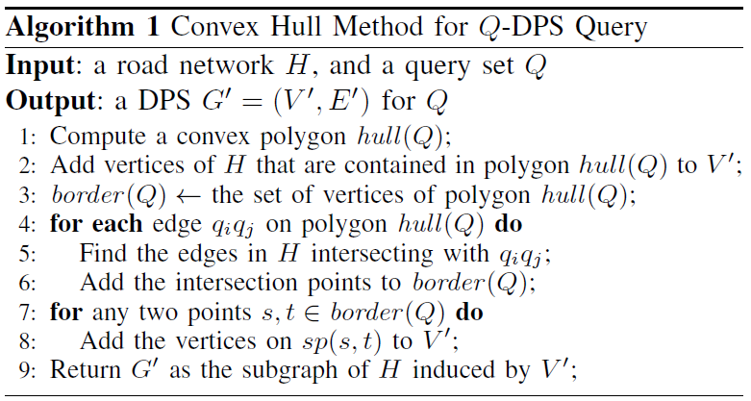
Convex Hull Method

Slide 44
Convex Hull Method

Slide 45
Convex Hull Method

Slide 46
Convex Hull Method
u₁
v₁

Slide 47
Convex Hull Method
u₁
v₁

Slide 48
Convex Hull Method
x
y
Correctness:
s
t

Slide 49
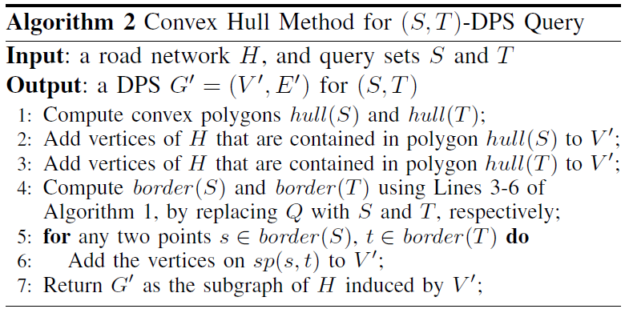
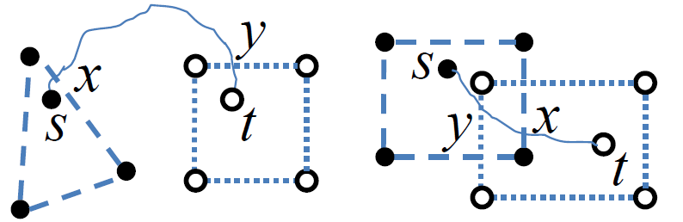
Convex Hull Method
Correctness:

Slide 50
Outline
Problem Definition
Motivation
Baseline Algorithms
RoadPart Framework
Convex Hull Method
Experiments
Conclusion

Slide 51
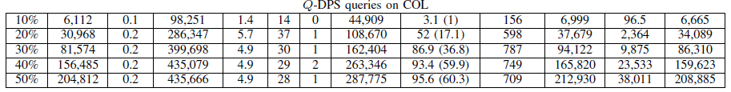
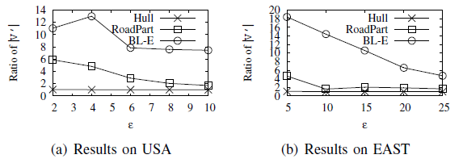
Experiments
Largest dataset:
  USA road network: |V| = 23,947,347, |E| = 28,854,312
  # of border points: 70; # of regions: 11,629

Slide 52
Outline
Problem Definition
Motivation
Baseline Algorithms
RoadPart Framework
Convex Hull Method
Experiments
Conclusion

Slide 53
Conclusion
Formalize the DPS Query in road networks
Demonstrate the applications of DPS
Propose 4 algorithms for finding DPS, with different trade-off between query efficiency and DPS quality

Slide 54
Thank you!

