Slide 1
Mining Probabilistically Frequent Sequential Patterns in Uncertain Databases
Zhou Zhao, Da Yan and Wilfred Ng
The Hong Kong University of Science and Technology

Slide 2
Outline
Background
Problem Definition
Sequential-Level U-PrefixSpan
Element-Level U-PrefixSpan
Experiments
Conclusion

Slide 3
Outline
Background
Problem Definition
Sequential-Level U-PrefixSpan
Element-Level U-PrefixSpan
Experiments
Conclusion

Slide 4
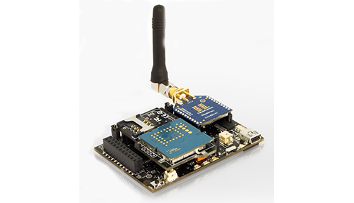
Background
Uncertain data are inherent in many real world applications
  Sensor network
  RFID tracking
Prob. = 0.9
Sensor 2: AB
Readings:
C | B | A
Prob. = 0.1
Sensor 1: BC

Slide 5

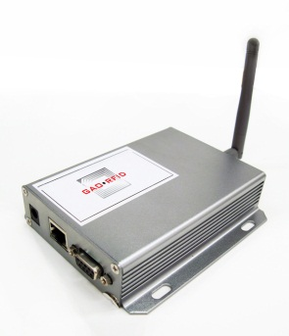
Background
Uncertain data are inherent in many real world applications
  Sensor network
  RFID tracking
t1: (A, 0.95)
Reader A
t2: (B, 0.95), (C, 0.05)
Reader B
Reader C

Slide 6
Outline
Background
Problem Definition
Sequential-Level U-PrefixSpan
Element-Level U-PrefixSpan
Experiments
Conclusion

Slide 7
Outline
Background
Problem Definition
Sequential-Level U-PrefixSpan
Element-Level U-PrefixSpan
Experiments
Conclusion

Slide 8
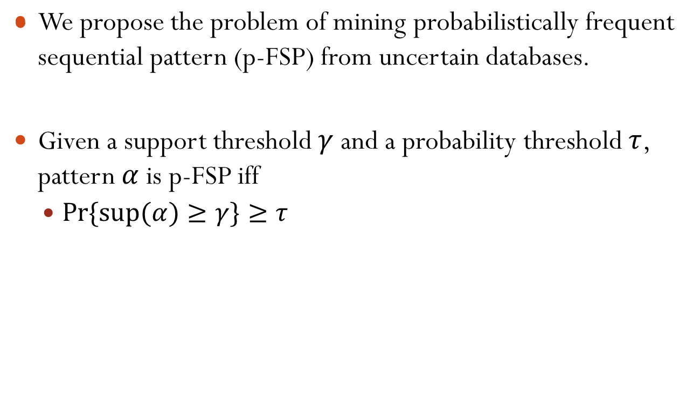
Problem Definition

Slide 9
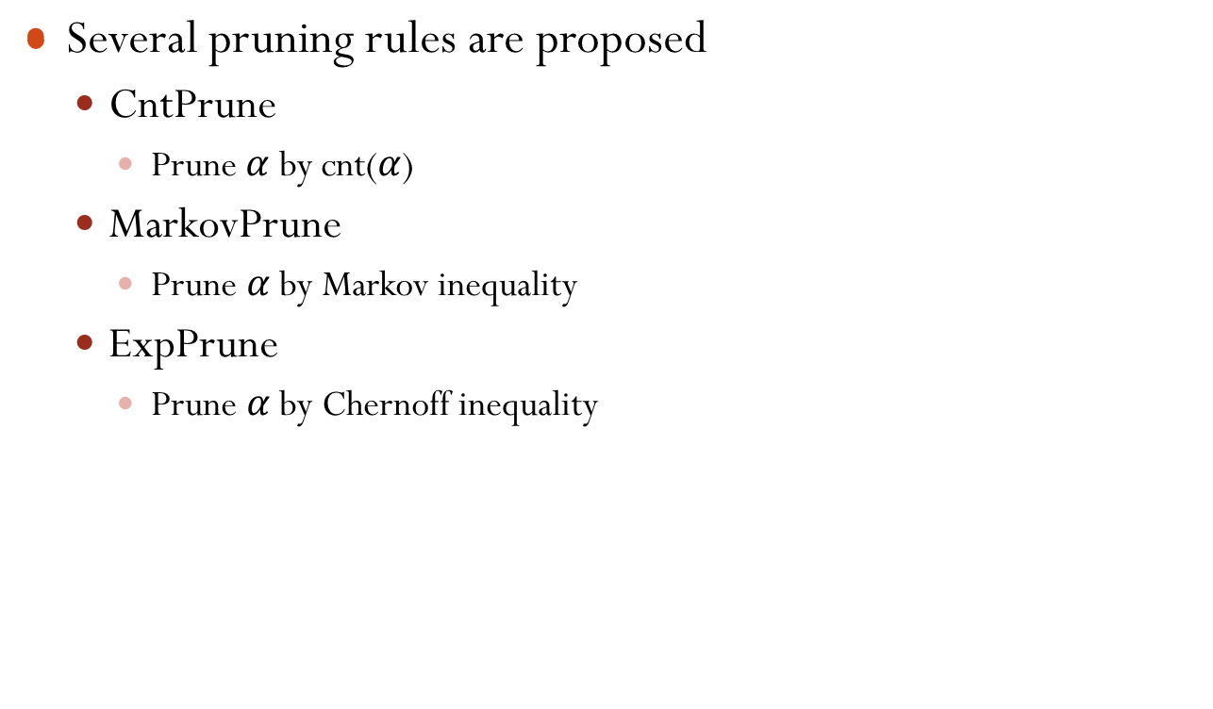
Pruning rules for p-FSP

Slide 10
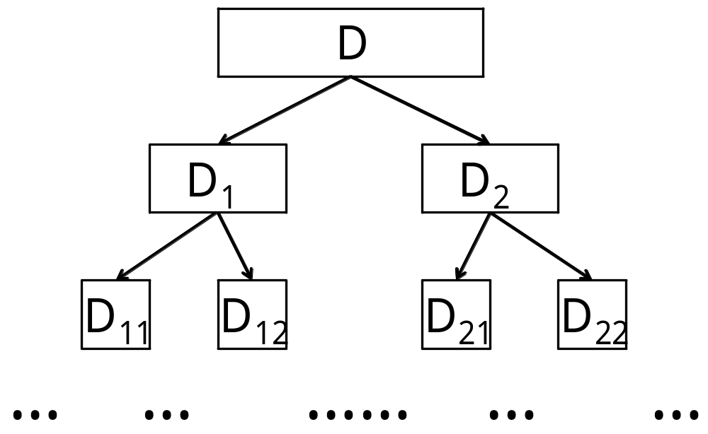
Early Validating
Suppose that pattern α is p-frequent on D’ ⊆ D, then α is also p-frequent on D
If α is p-FSP in D₁₁, then α is p-FSP in D.

Slide 11
Outline
Background
Problem Definition
Sequential-Level U-PrefixSpan
Element-Level U-PrefixSpan
Experiments
Conclusion

Slide 12
Outline
Background
Problem Definition
Sequential-Level U-PrefixSpan
Element-Level U-PrefixSpan
Experiments
Conclusion

Slide 13
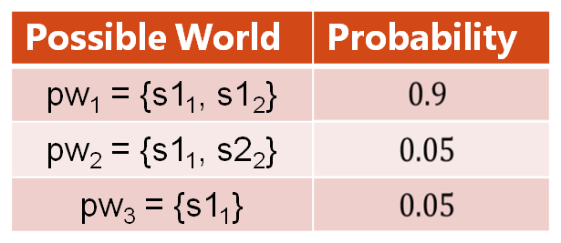
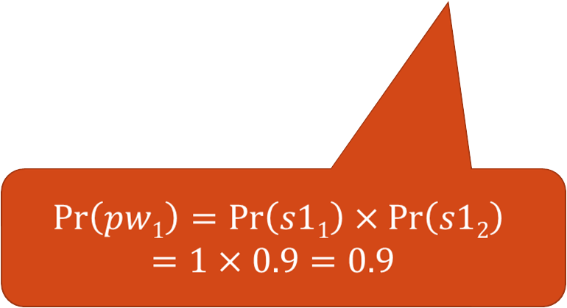
Sequence-level probabilistic model
DB:
Possible World Space:
Sequence ID | Instances | Probability
s1 | s1₁= ABC | 1
s2 | s2₁ = AB s2₂ = BC | 0.9 0.05

Slide 14
Prefix-projection of PrefixSpan
SID | Sequence
s1 | ABCBC
s2 | BABC
s3 | AB
s4 | BC
SID | Sequence
s1 | _BCBC
s2 | _BC
s3 | _B
SID | Sequence
s1 | _CBC
s2 | _C
s3 | _
A
B
D|_{A}
D|_{AB}
D

Slide 15
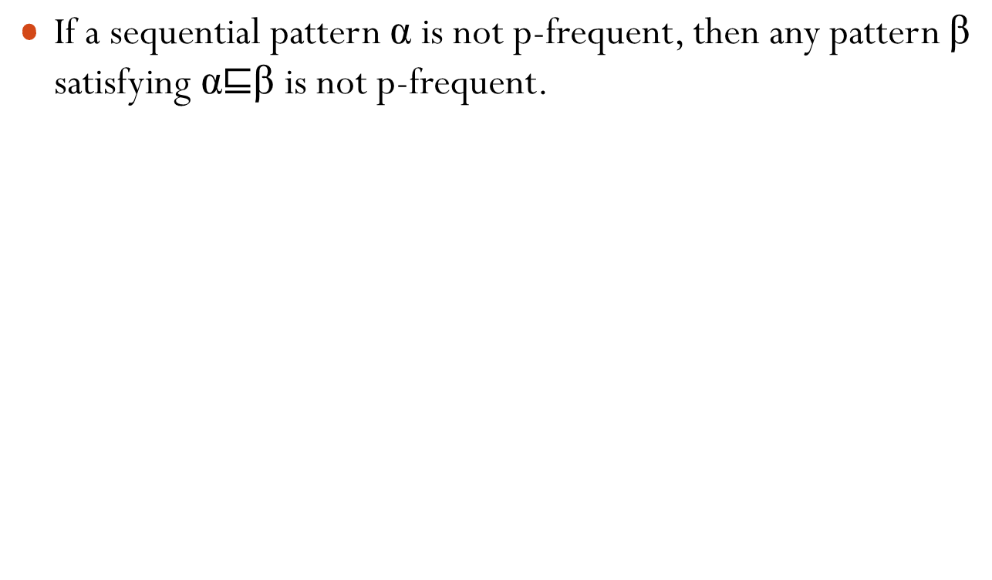
P-FSP anti-monotonicity.

Slide 16
SeqU-PrefixSpan Algorithm
SeqU-PrefixSpan recursively performs pattern-growth from the previous pattern α to the current β = αe, by appending an p-frequent element e ∈ D |_{α}
We can stop growing a pattern α for examination, once we find that α is p-infrequent

Slide 17
Sequence Projection
Seq-Instances | Prob.
si₁ = ABCBC | 0.3
si₂ = BABC | 0.2
si₃ = AB | 0.4
si₄ = BC | 0.1
si
A
Seq-Instances | Prob.
si₁ = _BCBC | 0.3
si₂ = _BC | 0.2
si₃ = _B | 0.4
B
Seq-Instances | Prob.
si₁ = _CBC | 0.3
si₂ = _BC | 0.2
si₃ = _ | 0.4
si|_{A}
si|_{B}

Slide 18

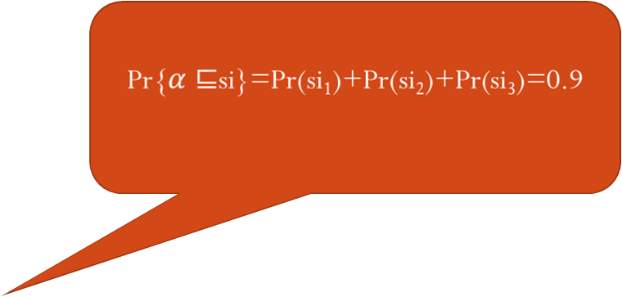
Seq-Instances | Prob.
si₁ = _BCBC | 0.3
si₂ = _BC | 0.2
si₃ = _B | 0.4

Slide 19
Outline
Background
Problem Definition
Sequential-Level U-PrefixSpan
Element-Level U-PrefixSpan
Experiments
Conclusion

Slide 20
Outline
Background
Problem Definition
Sequential-Level U-PrefixSpan
Element-Level U-PrefixSpan
Experiments
Conclusion

Slide 21
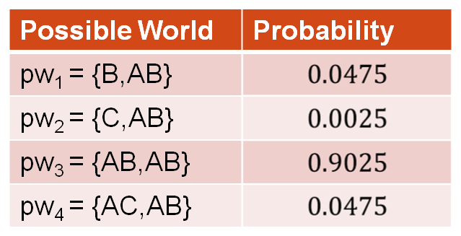
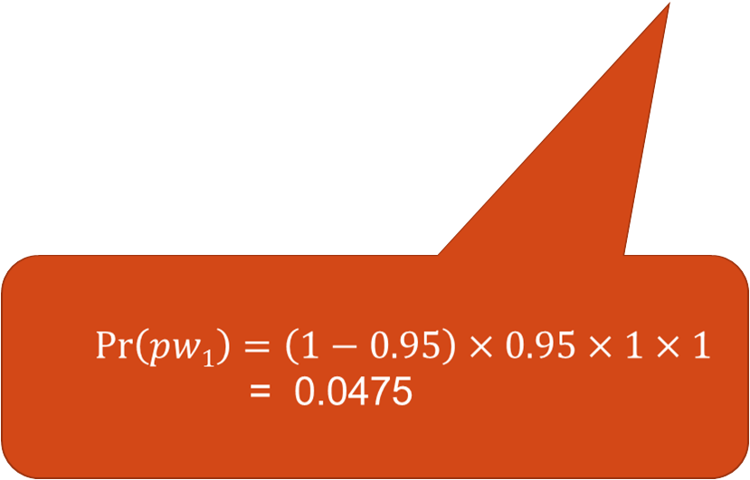
Element-level probabilistic model
DB:
Possible World Space:
Sequence ID | Probabilistic Elements
s1 | s1[1]={(A,0.95)} s1[2]={(B,0.95),(C,0.05)}
s2 | s2[1]={(A,1)}, s2[2] = {(B,1)}

Slide 22
Possible world explosion
Probabilistic Elements
si[1] = {(A,0.7), (B,0.3)} si[2] = {(B,0.2),(C,0.8)} si[3] = {(C,0.4),(A,0.6)} si[4] = {(B,0.1), (A,0.9)}
# of possible instances is exponential to sequence length
Seq-Instance | Prob. | Seq-Instance | Prob.
pw₁(si)=ABCB pw₂(si)=ABCA pw₃(si)=ABAB pw₄(si)=ABAA pw₅(si)=ACCB pw₆(si)=ACCA pw₇(si)=ACAB pw₈(si)=ACAA | 0.0056 0.0504 0.0084 0.0756 0.0224 0.2016 0.0336 0.3024 | pw₉(si)=BBCB pw₁₀(si)=BBCA pw₁₁(si)=BBAB pw₁₂(si)=BBAA pw₁₃(si)=BCCB pw₁₄(si)=BCCA pw₁₅(si)=BCAB pw₁₆(si)=BCAA | 0.0024 0.0216 0.0036 0.0324 0.0096 0.0864 0.0144 0.1296

Slide 23
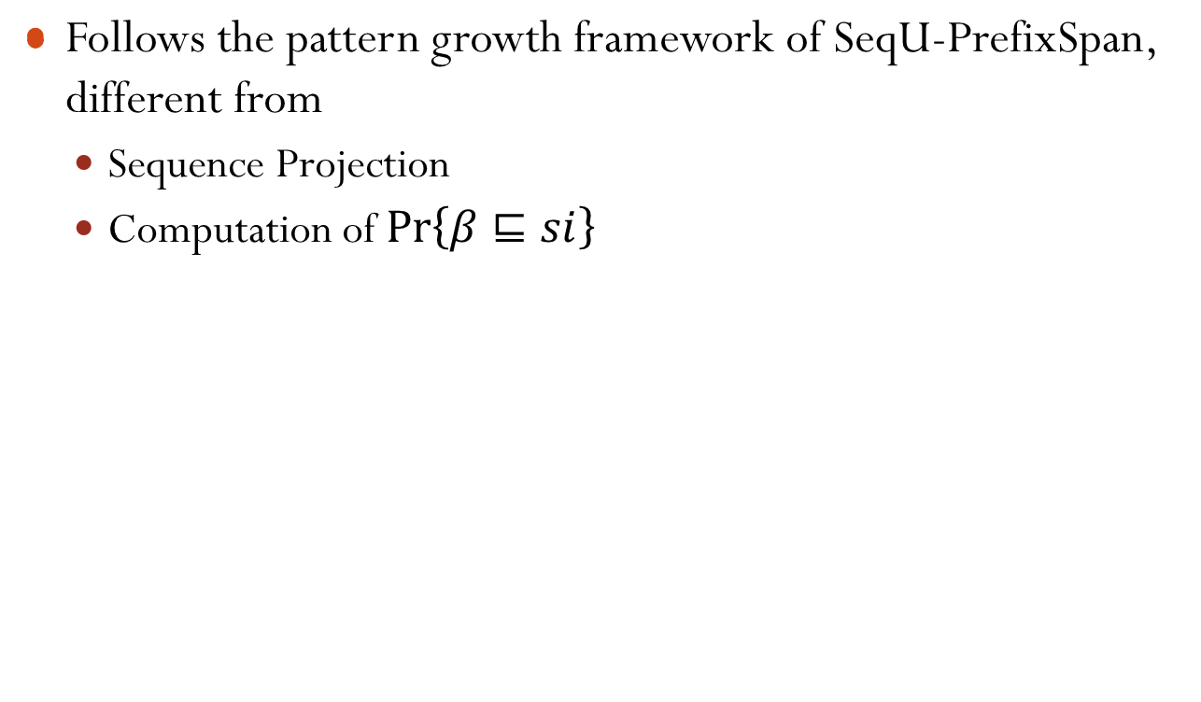
ElemU-PrefixSpan Algorithm

Slide 24

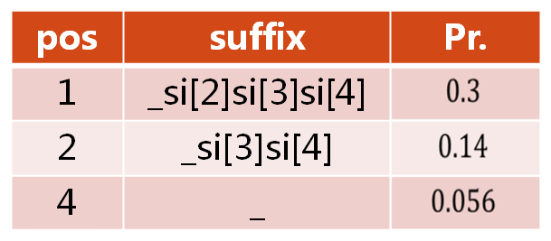


Sequence Projection
Probabilistic Elements
si[1] = {(A,0.7), (B,0.3)} si[2] = {(B,0.2),(C,0.8)} si[3] = {(C,0.4),(A,0.6)} si[4] = {(B,0.1), (A,0.9)}
pos | suffix | Pr.
0 | _si[1]si[2]si[3]si[4] | 1
B

Slide 25
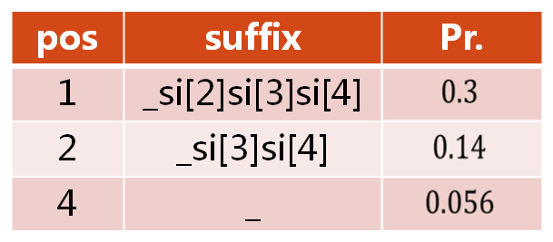

Sequence Projection
Probabilistic Elements
si[1] = {(A,0.7), (B,0.3)} si[2] = {(B,0.2),(C,0.8)} si[3] = {(C,0.4),(A,0.6)} si[4] = {(B,0.1), (A,0.9)}

Slide 26

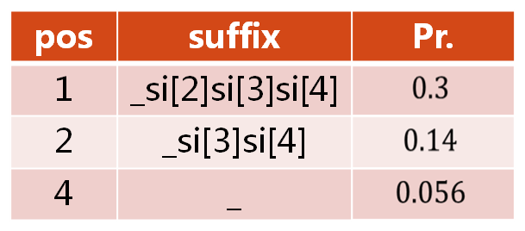
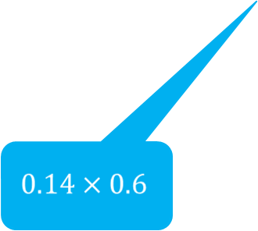


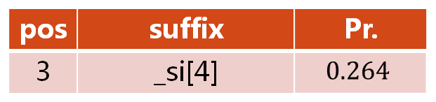

Sequence Projection
Probabilistic Elements
si[1] = {(A,0.7), (B,0.3)} si[2] = {(B,0.2),(C,0.8)} si[3] = {(C,0.4),(A,0.6)} si[4] = {(B,0.1), (A,0.9)}
A

Slide 27
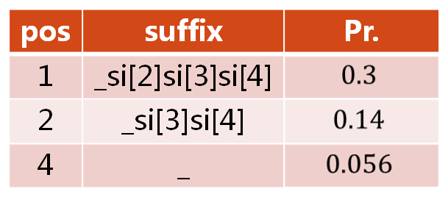
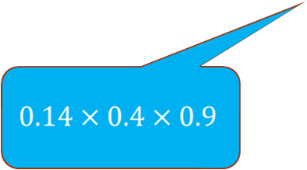

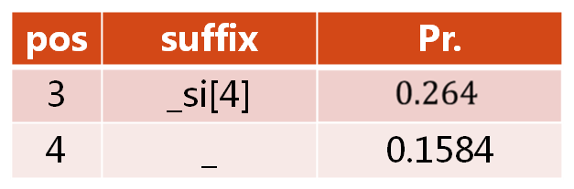

Sequence Projection
Probabilistic Elements
si[1] = {(A,0.7), (B,0.3)} si[2] = {(B,0.2),(C,0.8)} si[3] = {(C,0.4),(A,0.6)} si[4] = {(B,0.1), (A,0.9)}
A

Slide 28

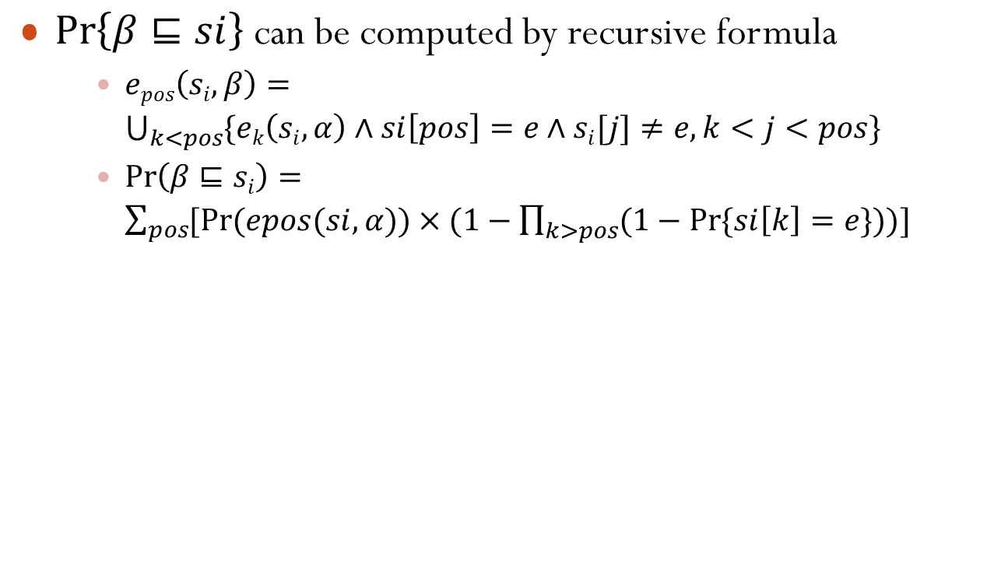

Slide 29
Outline
Background
Problem Definition
Sequential-Level U-PrefixSpan
Element-Level U-PrefixSpan
Experiments
Conclusion

Slide 30
Outline
Background
Problem Definition
Sequential-Level U-PrefixSpan
Element-Level U-PrefixSpan
Experiments
Conclusion

Slide 31
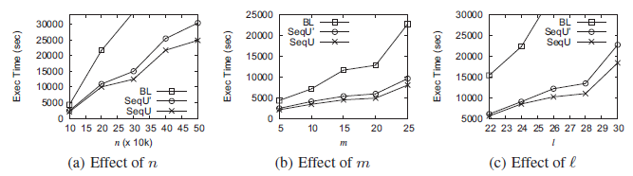
Efficiency of SeqU-PrefixSpan
Efficiency on the effects of
  size of database
  number of seq-instances
  length of sequence

Slide 32
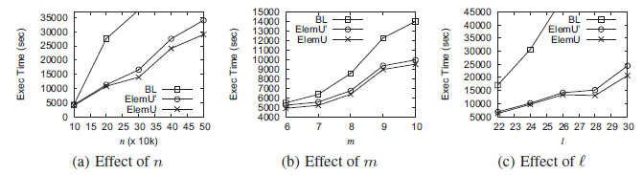
Efficiency of ElemU-PrefixSpan
Efficiency on the effects of
  size of database
  number of element-instances
  length of sequence

Slide 33
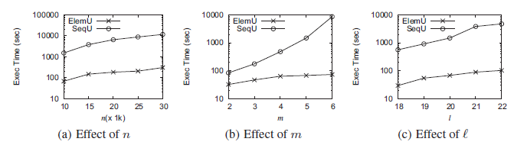
ElemU-PrefixSpan v.s. Full Expansion
Efficiency on the effects of
  size of database
  number of element-instances
  length of sequence

Slide 34
Outline
Background
Problem Definition
Sequential-Level U-PrefixSpan
Element-Level U-PrefixSpan
Experiments
Conclusion

Slide 35
Outline
Background
Problem Definition
Sequential-Level U-PrefixSpan
Element-Level U-PrefixSpan
Experiments
Conclusion

Slide 36
Conclusion
We formulate the problem of mining p-SFP in uncertain databases.
We propose two new U-PrefixSpan algorithms to mine p-FSPs from data that conform to our probabilistic models.
Experiments show that our algorithms effectively avoid the problem of “possible world explosion”.

Slide 37
Thank you!

