Slide 1

Da Yan, Zhou Zhao and Wilfred Ng
The Hong Kong University of Science and Technology

Slide 2
Outline
Motivation
Tight & Loose Cells
Object NN Queries
SRNN Query Processing
Experiments
Conclusion

Slide 3
Motivation
MRNN & BRNN Queries
  Given a data point set O and a query point q, a monochromatic reverse nearest neighbor (MRNN) query finds all the data points o ∈ O that have q as their nearest neighbor (NN)
o₁
MRNN(q) = {o₁, o₂}
q
o₃
o₂
o₄

Slide 4
Motivation
MRNN & BRNN Queries
  Given a site point set S, a data point set O and a query point q ∈ S, a bichromatic reverse nearest neighbor (BRNN) query finds all the data points o ∈ O that are closer to q than any other point in S
o₁
o₃
s₁
BRNN(s₁) = {o₁, o₂}
o₂
o₄
BRNN(s₂) = {o₃, o₄, o₅}
o₅
s₂

Slide 5
Motivation
Existing work studies RNN queries in Euclidean space and road networks
Practical applications of RNN queries involve terrain surfaces that constrain object movements
Recent technological advances in remote sensing have made available high resolution terrain data of the entire Earth surface

Slide 6
Motivation
Application of Surface BRNN Queries
  Disaster rescue
    Which rescue team is nearest to a victim?
  Supply distribution during military operations
  Wild animal rescue in nature reserves

Slide 7
Motivation
Application of Surface MRNN Queries
  Mountaineering
    Each member keeps track of his/her RNNs among all the other mountaineers
    If a member encounters a landslide, he/she can get help from his/her nearest neighbor who tracks him/her
  Military operations
    A troop would reinforce one of its reverse nearest neighbor troop if that troop suffers severe casualty

Slide 8
Motivation
Challenges
  Huge size of the surface model data
    Triangulated Irregular Network (TIN) model
    Delaunay triangulation over the elevation data on a mesh
    High resolution: 10m sampling interval

Slide 9
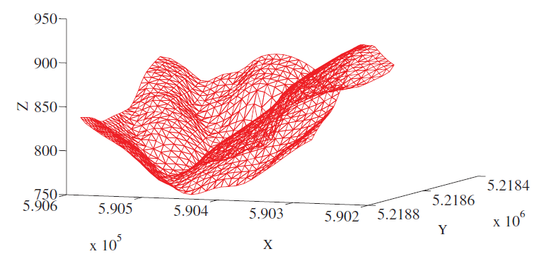
Motivation
Challenges
  Huge size of the surface model data

Slide 10
Motivation
Challenges
  Shortest surface path is expensive to compute
    Chen and Han’s algorithm takes O(n²) time on a terrain data with n triangular faces
    Poor scalability
Avoid path computation
Compute paths over a small fraction of surface

Slide 11
Motivation
Roadmap
  Voronoi cell approximation structures
    tight/loose cells
  Cell-point properties
  Cell-cell properties & object NN queries
  Per-point cell construction

Slide 12
Outline
Motivation
Tight & Loose Cells
Object NN Queries
SRNN Query Processing
Experiments
Conclusion

Slide 13
Tight & Loose Cells
Bounds of Surface Distance
  Surface distance d_{S}(p₁, p₂)
    Shortest path along the surface
  Euclidean distance d_{E}(p₁, p₂)
    Length of the connecting straight line
  Network distance d_{N}(p₁, p₂)
    Shortest path along the model network
  d_{E}(p₁, p₂) ≤ d_{S}(p₁, p₂) ≤ d_{N}(p₁, p₂)

Slide 14
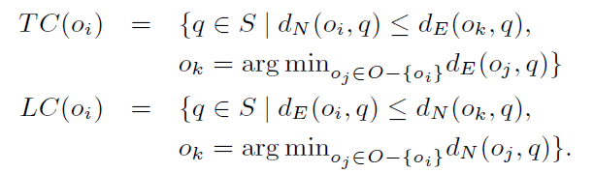
Tight & Loose Cells
Tight & Loose Cells
  Object set O = {o₁, o₂, …, o_{n}}
  S represents the whole surface

Slide 15
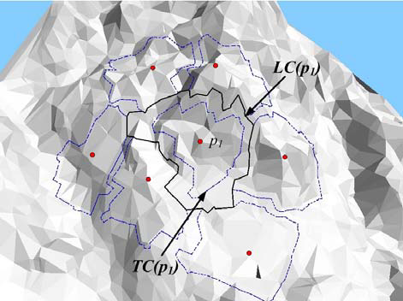
Tight & Loose Cells

Slide 16
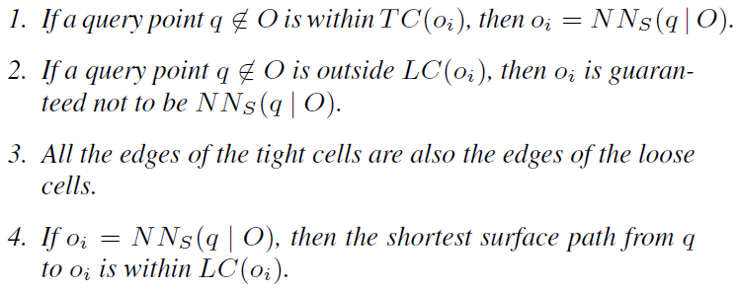
Tight & Loose Cells
Cell-Point Properties
  NN_{S}(q | O): the surface NN of q among O

Slide 17
Tight & Loose Cells
Cell Index
  All loose cells are indexed using an R-tree
NN_{S} (q) computation
  Find the loose cells containing q, by a point intersection query over the R-tree index
  If only one such loose cell LC(o) is found, then NN_{S} (q) = o
  Otherwise, for each such LC(o), compute d_{S}(o, q) on LC(o); NN_{S} (q) is the object o with smallest d_{S}(o, q)

Slide 18
Outline
Motivation
Tight & Loose Cells
Object NN Queries
SRNN Query Processing
Experiments
Conclusion

Slide 19
Object NN Queries
Object NN Queries
  Given an object o∈O, find its nearest neighbor in O on the surface: NN_{S}(o | O – {o})
  Fundamental to surface MRNN query processing
  Based on cell-cell properties

Slide 20

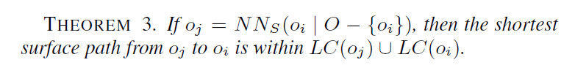
Object NN Queries
Cell-Cell Properties

Slide 21
Object NN Queries
NN_{S} (o) computation
  Find the loose cells of O – {o} that overlaps with LC(o), by an intersection query over the R-tree
  For each such LC(o’), compute d_{S}(o, o’) on LC(o)∪ LC(o’)
  NN_{S} (o) is the object o’ with smallest d_{S}(o, o’)

Slide 22
Outline
Motivation
Tight & Loose Cells
Object NN Queries
SRNN Query Processing
Experiments
Conclusion

Slide 23
SRNN Query Processing
Per-Point Cell Construction
  Breadth-first face checking
  Starts with the faces adjacent to o_{i} in Q
  If at least one vertex of the current face is on o_{i}’s side, add the non-visited neighboring faces to Q
  Collect the cell edges during the face checking
b
c
f
o_{k}
X
s
X
X
X
o_{i}
a
d
e

Slide 24
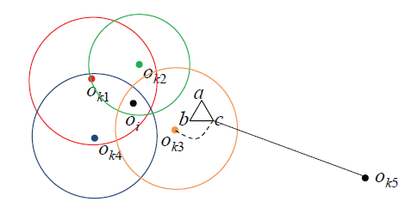


SRNN Query Processing
Per-Point Cell Construction
  Maintain a pool of partial results obtained from Dijkstra’s algorithm for different source vertices o_{k} ∈ O − {o_{i}}
  Pay-as-you-go: if d_{N}(v, o_{k}) needed but not computed yet, run Dijkstra’s algorithm until it is computed
Pool size is kept small
Prune
Use NN(o_{i}) for pruning

Slide 25
SRNN Query Processing
Special Processing of Boundary Cells
o
o
o
o
(a)
(b)
(c)
o'
(d)

Slide 26
SRNN Query Processing
Surface MRNN Processing
  Object o ∈ O is an MSRNN of q, iff d_{S}(o, NN_{S}(o)) ≥ d_{S} (o, q)
  To obtain MSRNN candidates, compute LC(q) among O∪{q} using breadth-first cell construction
  Whenever a cell vertex s on edge (u, v) is computed, collect o into the candidate set C

Slide 27
SRNN Query Processing
Surface MRNN Processing
  For each o ∈ C, if LC(o) ∩ LC(q) ≠ ∅, we compute d_{S}(o, q) on LC(o) ∪ LC(q)
  If d_{S}(o, NN_{S}(o | O − {o})) ≥ d_{S} (o, q), add o to the MSRNN set

Slide 28
SRNN Query Processing
Surface BRNN Processing
  Put all objects o ∈ O that is within LC(q) into the candidate set C
  For each o ∈ C,
    If o is within TC(q), add o to the BSRNN set
    Otherwise, if NN_{S}(o | S) = q, add o to the BSRNN set

Slide 29
Outline
Motivation
Tight & Loose Cells
Object NN Queries
SRNN Query Processing
Experiments
Conclusion

Slide 30
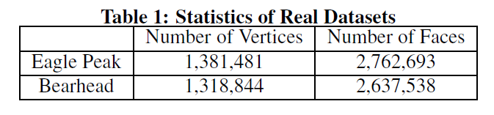
Experiments
Datasets
Objects are randomly generated with different density

Slide 31
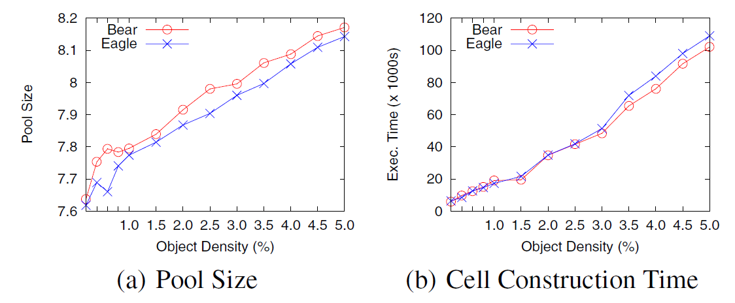
Experiments
Results of Cell Construction

Slide 32
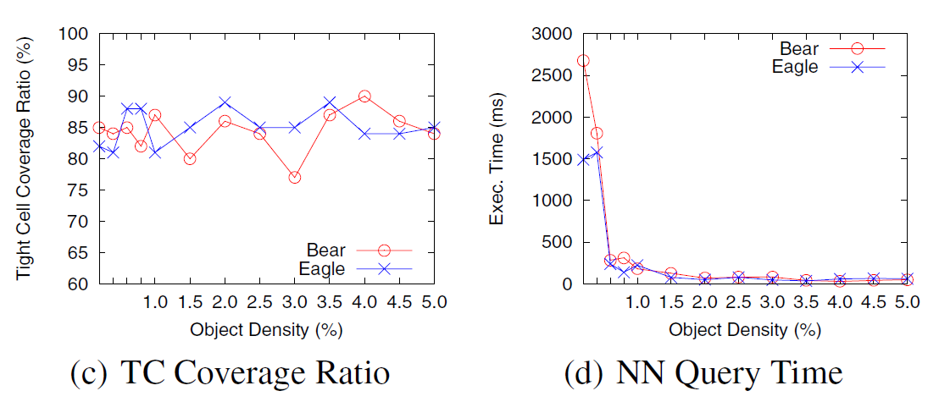
Experiments
Results of NN Queries

Slide 33
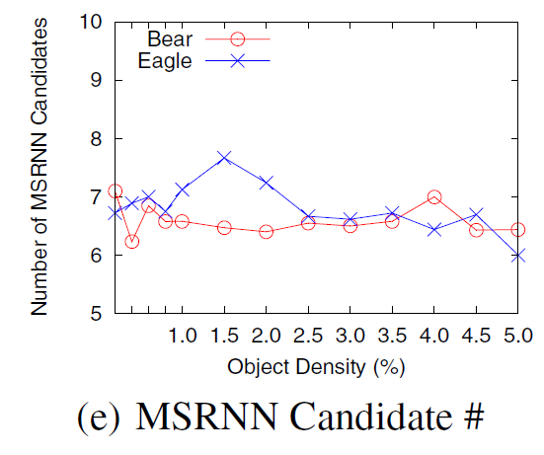
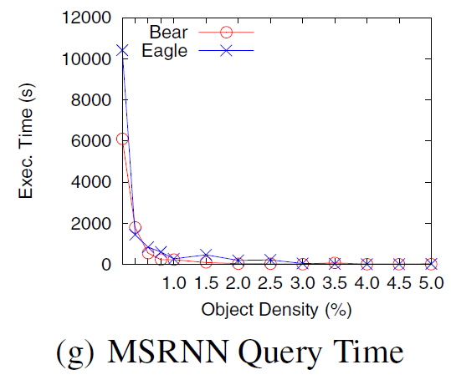
Experiments
Results of MSRNN Queries

Slide 34
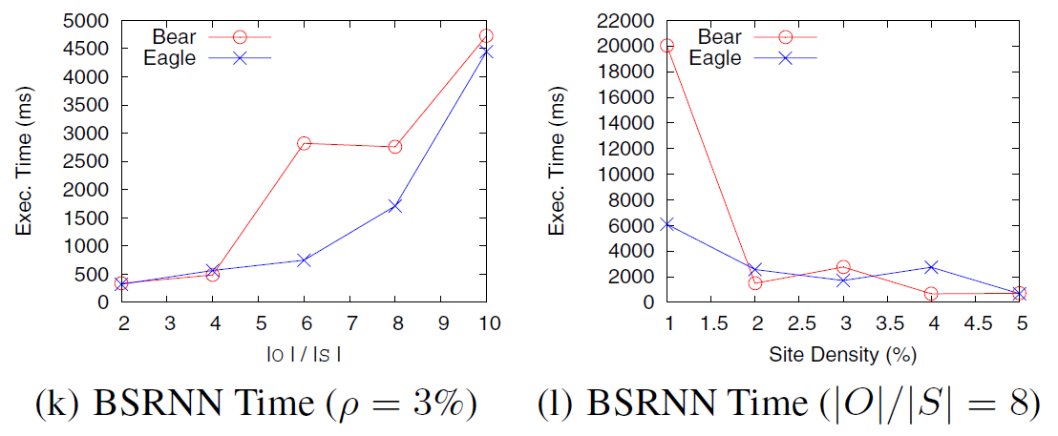
Experiments
Results of BSRNN Queries

Slide 35
Outline
Motivation
Tight & Loose Cells
Object NN Queries
SRNN Query Processing
Experiments
Conclusion

Slide 36
Conclusion
New cell-cell properties
New per-point cell construction algorithm
Algorithms for computing MSRNN & BSRNN
Efficient when object density is reasonably large (not too sparse)

Slide 37
Thank you!

