Slide 1

Da Yan and Wilfred Ng
The Hong Kong University of Science and Technology

Slide 2
Outline
Background
Probabilistic Data Model
Related Work
U-Popk Semantics
U-Popk Algorithm
Experiments
Conclusion

Slide 3
Background
Uncertain data are inherent in many real world applications
  e.g. sensor or RFID readings
Top-k queries return k most promising probabilistic tuples in terms of some user-specified ranking function
Top-k queries are a useful for analyzing uncertain data, but cannot be answered by traditional methods on deterministic data

Slide 4
Background
Challenges of defining top-k queries on uncertain data: interplay between score and probability
  Score: value of ranking function on tuple attributes
  Occurrence probability: the probability that a tuple occurs
Challenges of processing top-k queries on uncertain data: exponential # of possible worlds

Slide 5
Outline
Background
Probabilistic Data Model
Related Work
U-Popk Semantics
U-Popk Algorithm
Experiments
Conclusion

Slide 6
Probabilistic Data Model
Tuple-level probabilistic model:
  Each tuple is associated with its occurrence probability
Attribute-level probabilistic model:
  Each tuple has one uncertain attribute whose value is described by a probability density function (pdf).
Our focus: tuple-level probabilistic model

Slide 7
Probabilistic Data Model
Running example:
  A speeding detection system needs to determine the top-2 fastest cars, given the following car speed readings detected by different radars in a sampling moment:
Ranking function
Tuple occurrence probability
Radar Location | Car Make | Plate No. | Speed | Confidence
L₁ | Honda | X-123 | 130 | 0.4
L₂ | Toyota | Y-245 | 120 | 0.7
L₃ | Mazda | W-541 | 110 | 0.6
L₄ | Nissan | L-105 | 105 | 1.0
L₅ | Mazda | W-541 | 90 | 0.4
L₆ | Toyota | Y-245 | 80 | 0.3
t₁
t₂
t₃
t₄
t₅
t₆

Slide 8
Probabilistic Data Model
Running example:
  A speeding detection system needs to determine the top-2 fastest cars, given the following car speed readings detected by different radars in a sampling moment:
t₁ occurs with probability Pr(t₁)=0.4
t₁ does not occur with probability 1-Pr(t₁)=0.6
Radar Location | Car Make | Plate No. | Speed | Confidence
L₁ | Honda | X-123 | 130 | 0.4
L₂ | Toyota | Y-245 | 120 | 0.7
L₃ | Mazda | W-541 | 110 | 0.6
L₄ | Nissan | L-105 | 105 | 1.0
L₅ | Mazda | W-541 | 90 | 0.4
L₆ | Toyota | Y-245 | 80 | 0.3
t₁
t₂
t₃
t₄
t₅
t₆

Slide 9
Probabilistic Data Model
t₂ and t₆ describes the same car
t₂ and t₆ cannot co-occur
  Two different speeds in a sampling moment
Exclusion Rules: (t₂⊕t₆), (t₃⊕t₅)
Radar Location | Car Make | Plate No. | Speed | Confidence
L₁ | Honda | X-123 | 130 | 0.4
L₂ | Toyota | Y-245 | 120 | 0.7
L₃ | Mazda | W-541 | 110 | 0.6
L₄ | Nissan | L-105 | 105 | 1.0
L₅ | Mazda | W-541 | 90 | 0.4
L₆ | Toyota | Y-245 | 80 | 0.3
t₁
t₂
t₃
t₄
t₅
t₆

Slide 10
Probabilistic Data Model
Possible World Semantics
  Pr(PW¹) = Pr(t₁) × Pr(t₂) × Pr(t₄) × Pr(t₅)
  Pr(PW⁵) = [1 - Pr(t₁)] × Pr(t₂) × Pr(t₄) × Pr(t₅)
Radar Loc. | Car Make | Plate No. | Speed | Conf.
L₁ | Honda | X-123 | 130 | 0.4
L₂ | Toyota | Y-245 | 120 | 0.7
L₃ | Mazda | W-541 | 110 | 0.6
L₄ | Nissan | L-105 | 105 | 1.0
L₅ | Mazda | W-541 | 90 | 0.4
L₆ | Toyota | Y-245 | 80 | 0.3
Possible World | Prob.
PW¹={t₁, t₂, t₄, t₅} | 0.112
PW²={t₁, t₂, t₃, t₄} | 0.168
PW³={t₁, t₄, t₅, t₆} | 0.048
PW⁴={t₁, t₃, t₄, t₆} | 0.072
PW⁵={t₂, t₄, t₅} | 0.168
PW⁶={t₂, t₃, t₄} | 0.252
PW⁷={t₄, t₅, t₆} | 0.072
PW⁸={t₃, t₄, t₆} | 0.108
t₁
t₂
t₃
t₄
t₅
t₆
(t₂⊕t₆), (t₃⊕t₅)

Slide 11
Outline
Background
Probabilistic Data Model
Related Work
U-Popk Semantics
U-Popk Algorithm
Experiments
Conclusion

Slide 12
Related Work
U-Topk, U-kRanks [Soliman et al. ICDE 07]
Global-Topk [Zhang et al. DBRank 08]
PT-k [Hua et al. SIGMOD 08]
ExpectedRank [Cormode et al. ICDE 09]
Parameterized Ranking Functions (PRF) [VLDB 09]
Other Semantics:
  Typical answers [Ge et al. SIGMOD 09]
  Sliding window [Jin et al. VLDB 08]
  Distributed ExpectedRank [Li et al. SIGMOD 09]
  Top-(k, l), p-Rank Topk, Top-(p, l) [Hua et al. VLDBJ 11]

Slide 13
Related Work
Let us focus on ExpectedRank
Consider top-2 queries
ExpectedRank
  returns k tuples whose expected ranks across all possible worlds are the highest
  If a tuple does not appear in a possible world with m tuples, it is defined to be ranked in the (m+1)^{th} position
No justification

Slide 14
Related Work
ExpectedRank
  Consider the rank of t₅
Radar Loc. | Car Make | Plate No. | Speed | Conf.
L₁ | Honda | X-123 | 130 | 0.4
L₂ | Toyota | Y-245 | 120 | 0.7
L₃ | Mazda | W-541 | 110 | 0.6
L₄ | Nissan | L-105 | 105 | 1.0
L₅ | Mazda | W-541 | 90 | 0.4
L₆ | Toyota | Y-245 | 80 | 0.3
Possible World | Prob.
PW¹={t₁, t₂, t₄, t₅} | 0.112
PW²={t₁, t₂, t₃, t₄} | 0.168
PW³={t₁, t₄, t₅, t₆} | 0.048
PW⁴={t₁, t₃, t₄, t₆} | 0.072
PW⁵={t₂, t₄, t₅} | 0.168
PW⁶={t₂, t₃, t₄} | 0.252
PW⁷={t₄, t₅, t₆} | 0.072
PW⁸={t₃, t₄, t₆} | 0.108
4
t₁
5
t₂
3
t₃
5
t₄
3
t₅
4
t₆
2
(t₂⊕t₆), (t₃⊕t₅)
4

Slide 15
Related Work
ExpectedRank
  Consider the rank of t₅
Possible World | Prob.
PW¹={t₁, t₂, t₄, t₅} | 0.112
PW²={t₁, t₂, t₃, t₄} | 0.168
PW³={t₁, t₄, t₅, t₆} | 0.048
PW⁴={t₁, t₃, t₄, t₆} | 0.072
PW⁵={t₂, t₄, t₅} | 0.168
PW⁶={t₂, t₃, t₄} | 0.252
PW⁷={t₄, t₅, t₆} | 0.072
PW⁸={t₃, t₄, t₆} | 0.108
×
4
×
5
×
3
×
∑ = 3.88
5
×
3
×
4
×
2
×
4

Slide 16
Related Work
Computed in a similar mannar
ExpectedRank
  Exp-Rank(t₁) = 2.8
  Exp-Rank(t₂) = 2.3
  Exp-Rank(t₃) = 3.02
  Exp-Rank(t₄) = 2.7
  Exp-Rank(t₅) = 3.88
  Exp-Rank(t₆) = 4.1

Slide 17
Related Work
ExpectedRank
  Exp-Rank(t₁) = 2.8
  Exp-Rank(t₂) = 2.3
  Exp-Rank(t₃) = 3.02
  Exp-Rank(t₄) = 2.7
  Exp-Rank(t₅) = 3.88
  Exp-Rank(t₆) = 4.1
Highest 2 ranks

Slide 18
Related Work
High processing cost
  U-Topk, U-kRanks, PT-k, Global-Topk
Ranking Quality
  ExpectedRank promotes low-score tuples to the top
  ExpectedRank assigns rank (m+1) to an absent tuple t in a possible world having m tuples
Extra user efforts
  PRF: parameters other than k
  Typical answers: choice among the answers

Slide 19
Outline
Background
Probabilistic Data Model
Related Work
U-Popk Semantics
U-Popk Algorithm
Experiments
Conclusion

Slide 20
U-Popk Semantics
We propose a new semantics: U-Popk
  Short response time
  High ranking quality
  No extra user effort (except for parameter k)

Slide 21
U-Popk Semantics
Top-1 Robustness:
  Any top-k query semantics for probabilistic tuples should return the tuple with maximum probability to be ranked top-1 (denoted Pr¹) when k = 1
Top-1 robustness holds for U-Topk, U-kRanks, PT-k, and Global-Topk, etc.
ExpectedRank violates top-1 robustness

Slide 22
U-Popk Semantics
Top-stability:
  The top-(i+1)^{th} tuple should be the top-1st after the removal of the top-i tuples.
U-Popk:
  Tuples are picked in order from a relation according to “top-stability” until k tuples are picked
  The top-1 tuple is defined according to “Top-1 Robustness”

Slide 23
U-Popk Semantics
U-Popk
  Pr¹(t₁) = p₁= 0.4
  Pr¹(t₂) = (1- p₁) p₂ = 0.42
  Stop since (1- p₁) (1- p₂) = 0.18 < Pr¹(t₂)
Radar Location | Car Make | Plate No. | Speed | Confidence
L₁ | Honda | X-123 | 130 | 0.4
L₂ | Toyota | Y-245 | 120 | 0.7
L₃ | Mazda | W-541 | 110 | 0.6
L₄ | Nissan | L-105 | 105 | 1.0
L₅ | Mazda | W-541 | 90 | 0.4
L₆ | Toyota | Y-245 | 80 | 0.3
t₁
t₂
t₃
t₄
t₅
t₆

Slide 24
U-Popk Semantics
U-Popk
  Pr¹(t₁) = p₁= 0.4
  Pr¹(t₃) = (1- p₁) p₃ = 0.36
  Stop since (1- p₁) (1- p₃) = 0.24 < Pr¹(t₁)
Radar Location | Car Make | Plate No. | Speed | Confidence
L₁ | Honda | X-123 | 130 | 0.4
L₂ | Toyota | Y-245 | 120 | 0.7
L₃ | Mazda | W-541 | 110 | 0.6
L₄ | Nissan | L-105 | 105 | 1.0
L₅ | Mazda | W-541 | 90 | 0.4
L₆ | Toyota | Y-245 | 80 | 0.3
t₁
t₂
t₃
t₄
t₅
t₆

Slide 25
Outline
Background
Probabilistic Data Model
Related Work
U-Popk Semantics
U-Popk Algorithm
Experiments
Conclusion

Slide 26
U-Popk Algorithm
Algorithm for Independent Tuples
  Tuples are sorted in descending order of score
  Pr¹(t_{i}) = (1- p₁) (1- p₂) … (1- p_{i-1}) p_{i}
  Define accum_{i} = (1- p₁) (1- p₂) … (1- p_{i-1})
  accum₁ = 1, accum_{i+1} = accum_{i} · (1- p_{i})
  Pr¹(t_{i}) = accum_{i} · p_{i}

Slide 27
U-Popk Algorithm
Algorithm for Independent Tuples
  Find top-1 tuple by scanning the sorted tuples
  Maintain accum, and the maximum Pr¹ currently found
  Stopping criterion: accum ≤ maximum current Pr¹
  This is because for any succeeding tuple t_{j} (j>i):
Pr¹(t_{j}) = (1- p₁) (1- p₂) … (1- p_{i}) … (1- p_{j-1}) p_{j}
≤ (1- p₁) (1- p₂) … (1- p_{i})
= accum
≤ maximum current Pr¹

Slide 28
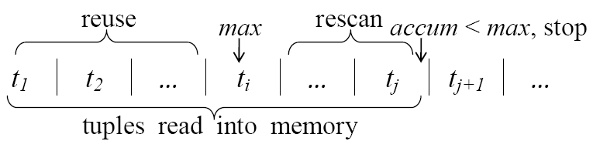
U-Popk Algorithm
Algorithm for Independent Tuples
  During the scan, before processing each tuple t_{i}, record the tuple with maximum current Pr¹ as t_{i}.max
  After top-1 tuple is found and removed, adjust tuple prob.
    Reuse the probability of t₁ to t_{i-1}
    Divide the probability of t_{i+1} to t_{j} by (1-p_{i})
    Choose tuple with maximum current Pr¹ from {t_{i}.max, t_{i+1}, …, t_{j} }

Slide 29
U-Popk Algorithm
Algorithm for Tuples with Exclusion Rules
  Each tuple is involved in an exclusion rule t_{i1}⊕t_{i2}⊕…⊕t_{im}
  t_{i1}, t_{i2}, …, t_{im} are in descending order of score
  Let t_{j1}, t_{j2}, …, t_{jl} be the tuples before t_{i} and in the same exclusion rule of t_{i}
  accum_{i+1} = accum_{i} · (1- p_{j1}- p_{j2}-…- p_{jl} - p_{i}) / (1- p_{j1}- p_{j2}-…- p_{jl})
  Pr¹(t_{i}) = accum_{i} · p_{i} / (1- p_{j1}- p_{j2}-…- p_{jl})

Slide 30
U-Popk Algorithm
Algorithm for Tuples with Exclusion Rules
  Stopping criterion:
    As scan goes on, a rule’s factor in accum can only go down
    Keep track of the current factors for the rules
    Organize rule factors by MinHeap, so that the factor with minimum value (factor_{min}) can be retrieved in O(1) time
    A rule is inserted into MinHeap when its first tuple is scanned
    The position of a rule in MinHeap is adjusted if a new tuple in it is scanned (because its factor changes)

Slide 31
U-Popk Algorithm
Algorithm for Tuples with Exclusion Rules
  Stopping criterion:
    UpperBound(Pr¹) = accum / factor_{min}
    This is because for any succeeding tuple t_{j} (j>i):
Pr¹(t_{j}) = accum_{j} · p_{j} / {factor of t_{j}’s rule}
≤ accum_{i} · p_{j} / {factor of t_{j}’s rule}
≤ accum_{i} · p_{j} / factor_{min}
≤ accum_{i} / factor_{min}

Slide 32
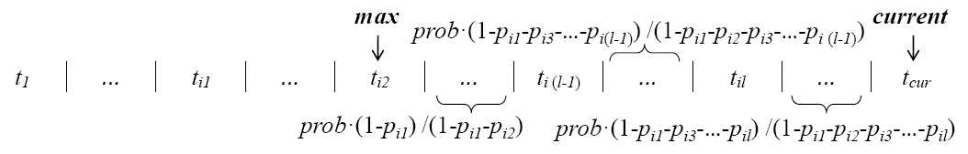
U-Popk Algorithm
Algorithm for Tuples with Exclusion Rules
  Tuple Pr¹ adjustment (after the removal of top-1 tuple):
    t_{i1}, t_{i2}, …, t_{il} are in t_{i2}’s rule
    Segment-by-segment adjustment
    Delete t_{i2} from its rule (factor increases, adjust it in MinHeap)
    Delete the rule from MinHeap if no tuple remains

Slide 33
Outline
Background
Probabilistic Data Model
Related Work
U-Popk Semantics
U-Popk Algorithm
Experiments
Conclusion

Slide 34
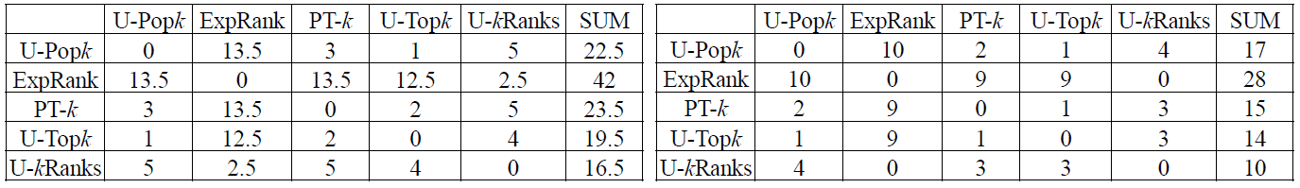
Experiments
Comparison of Ranking Results
  International Ice Patrol (IIP) Iceberg Sightings Database
Score: # of drifted days
Occurrence Probability: confidence level according to source of sighting
Neutral Approach (p = 0.5)
Optimistic Approach (p = 0)

Slide 35
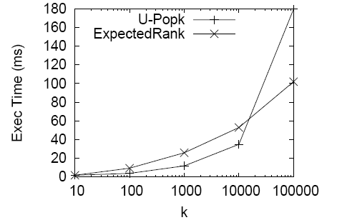
Experiments
Efficiency of Query Processing
  On synthetic datasets (|D|=100,000)
  ExpectedRank is orders of magnitudes faster than others

Slide 36
Outline
Background
Probabilistic Data Model
Related Work
U-Popk Semantics
U-Popk Algorithm
Experiments
Conclusion

Slide 37
Conclusion
We propose U-Popk, a new semantics for top-k queries on uncertain data, based on top-1 robustness and top-stability
U-Popk has the following strengths:
  Short response time, good scalability
  High ranking quality
  Easy to use, no extra user effort

Slide 38
Thank you!

